Slide 1



Year 10
Key to Success evening
Today’s aim is to provide information to allow you to best support your child through their GCSE years.

Slide 2
Outstanding academic achievement
72% grade 4+ in English and Maths (compared with 61.3% Swindon average and 65% nationally)
48% grade 5+ in English and Maths (compared with 45% nationally)
Exceptionally strong Science outcomes 80% grade 4+.
A8 (achievement across 8 best subjects) of 46.95, nearly a point higher than national averages (46)
These results reflect the hard work, ambition and resilience of our students, supported by dedicated staff and families.

Slide 3
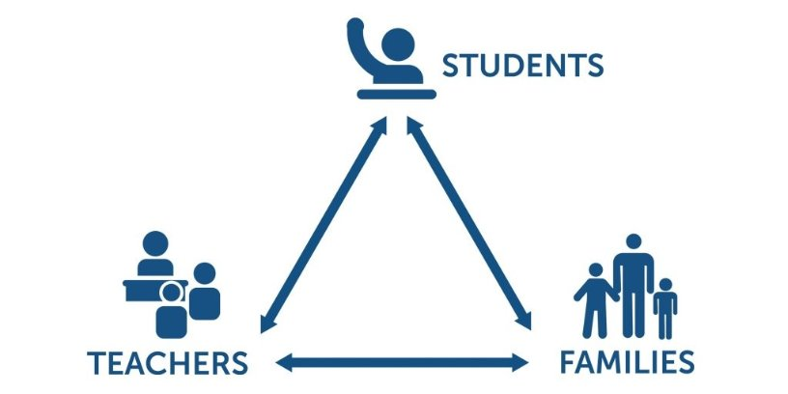
KS4 – prepare for a Three Way Effort ​
​
​
​
​
Departing Year 11 pupils within the TPAT schools rated support from home the top factor in their success at KS4

Slide 4
KS4 – Curriculum Time
 | Key Stage 4 - Hours per fortnight.
 | Year 10
English | 8
Maths | 8
Science | 10
RE | 5
PE | 3
ViP | 1
Option 1 | 5
Option 2 | 5
Option 3 | 5
Homework
Most GCSE subjects will set homework on a weekly or fortnightly basis. Students should be prepared to complete two hours of homework a night at KS4.

Slide 5
Subject Information
All students will sit examinations in Maths, English, Science and RE. They will also sit all their relevant exams for options subjects.
Grade 4 is considered a 'standard pass' and grade 5 is considered a 'good pass’.
Students who fail to achieve a grade 4 in Maths and English will be required to resit the qualifications next year.
Make sure to check entry requirements for post 16 courses with providers.
Students will not be able to switch GCSE option subjects.

Slide 6
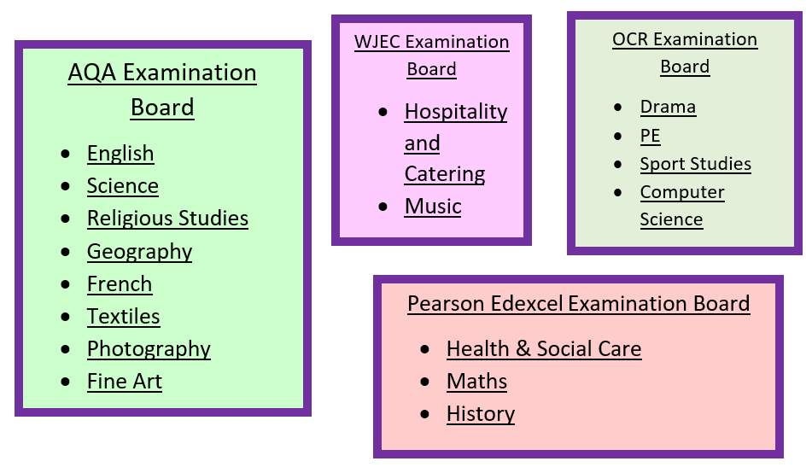
KS4 – Examination Boards

Slide 7
Important dates
September 2026 | Begin new Key Stage option subjects
December 2026 | Reports Home
25th February 2027 | Subject Consultation Evening
March 2027 | Reports Home
June / July | Mock Exams & Final Reports Home

Slide 8

Core Subject Information - Maths

Slide 9
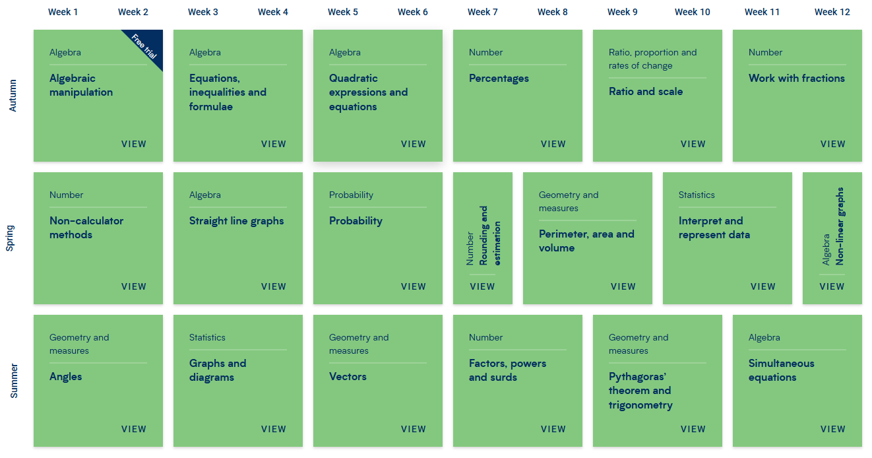
Core Subject Information – Yr10 Maths

Slide 10
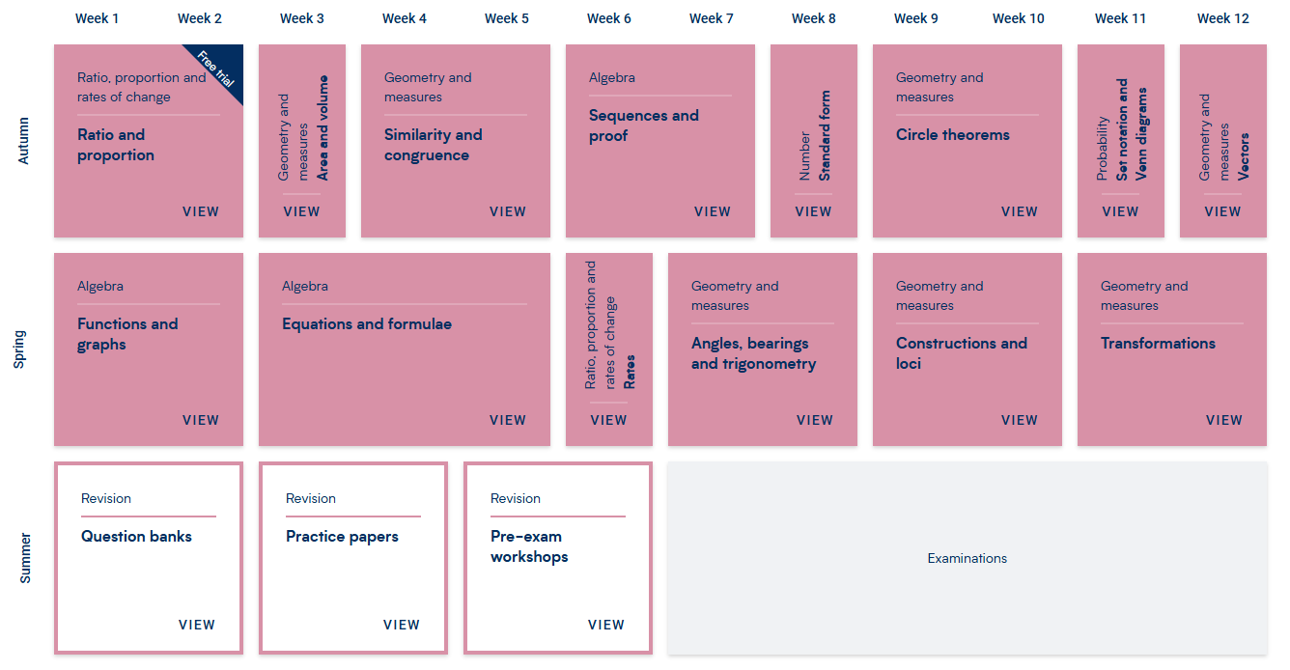
Core Subject Information – Yr 11 Maths

Slide 11
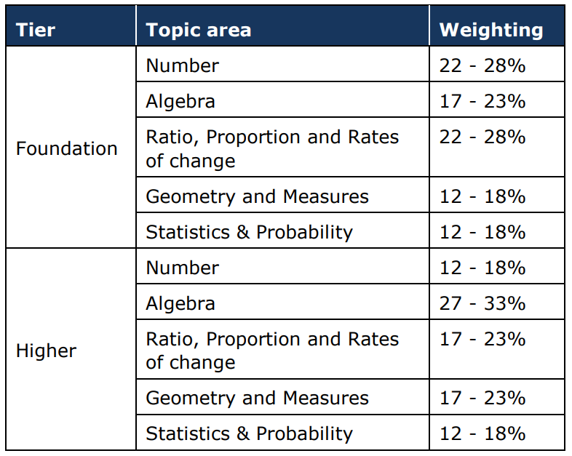
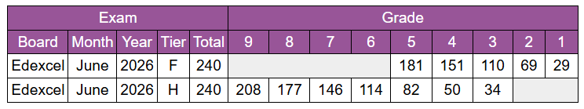
Core Subject Information - Maths
Based on 2026 results, subject to change slightly

Slide 12

Core Subject Information – Maths Homework
Weekly homework (Wednesday to Wednesday)
Personalised retrieval based on completion
All levels to challenge and support
Following the SOW taught in lesson
Scaffold videos to support each question
In Year 11 – Past paper club (Jan-May) & revision sessions throughout the year.

Slide 13
Revision – Independent Work at Home
Getting prepared early.
Amazon Prices
Complete revision & practice £10
Targeted exam practice £5

Slide 14


Enrichment – Further Maths GCSE
AQA Level 2 GCSE Maths
An extra GCSE
Available to pupils targeting a grade 7+
Starts in July for year 10 by invite

Slide 15
Year 10 Maths – Tips and Advice
Get organised early! Ask the questions and make revision cards from now!
Year 10 and year 11 are schemes that follow on, retrieval is key the teaching may not be seen again!
Take mocks and unit assessments seriously
Ask for how to improve on assessments
Experiment with revision techniques (be ready for year 11)
To learn and revise maths, is to do maths!
Enjoy the subject, when you enjoy your lesson and learning, you have better outcomes and higher confidence.
Support from parents – academic and mindset

Slide 16

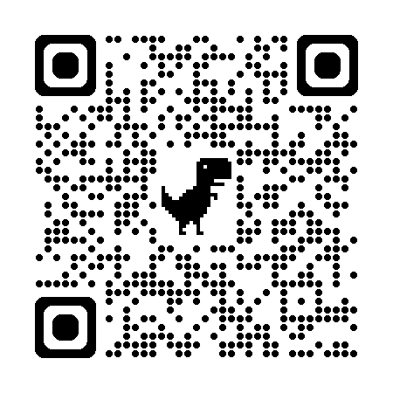

Core Subject Information – English
English Language
Paper 1: Reading & Writing (1hour 45 mins)
Paper 2: Reading & Writing (1hour 45 mins)
Spoken Language: students required to present a talk to their class (filmed and moderated by AQA)
English Literature
Paper 1: (‘old’ texts) 1 hour 45 mins
- Shakespeare’s ‘Macbeth’
- Charles Dickens’ ‘A Christmas Carol’
Paper 2: (modern texts) 2 hour 15 mins
- J.B.Priestley’s ‘An Inspector Calls’
- 15x Power & Conflict Poetry anthology poems
2x unseen poems to analyse & then compare
Resources to use at home
English section of school website: Knowledge Organisers, key quotations to learn, past papers, links to external revision websites https://www.dcea.org.uk/parent-information/our-curriculum/subjects/english/
Tassomai online homework – 45mins of weekly quizzing
School-based revision resources:
DNA interleaved knowledge retrieval
Chanting/reciting quotations at end of lessons
Knowledge Organizers: key words, sentence stems & sentence starters, model examples (Standard vs. Excellent), essay structures/writing frames/structure strips
Please encourage your child to read at home- worth 50% of GCSE Language and is THE most important thing your child can do in year 10 to prepare for GCSEs

Slide 17

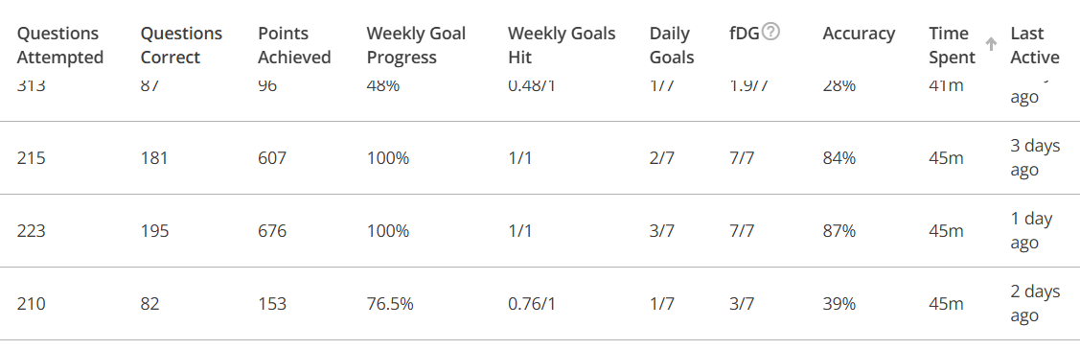
Core Subject Information – Yr10 English
Term 1 = Macbeth
Term 2 = A Christmas Carol
Term 3 = Language Paper 1: Reading
Term 4 = Language Paper 1: Writing
Term 5 = An Inspector Calls
Term 6 = Revision/Mock exams/Spoken Word presentations

Slide 18
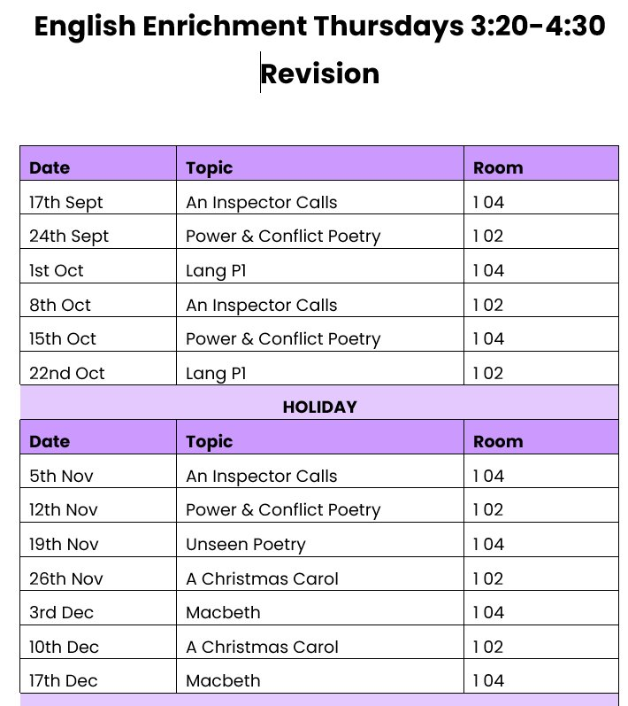


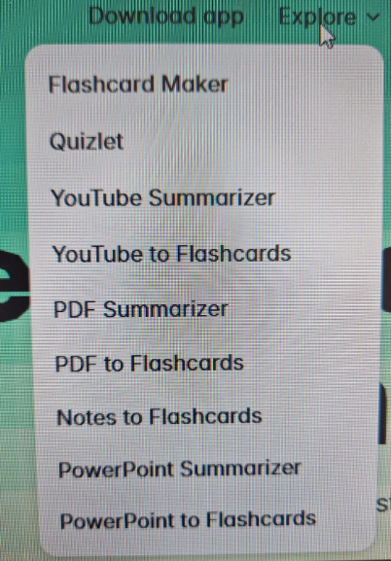
Core Subject Information – English
Please encourage your child to read at home- worth 50% of GCSE Language and is THE most important thing your child can do to prepare for GCSE English Language

Slide 19




Core Subject Information – English
What can you do to help?
Ask them about the text they're currently studying
Remind them about our weekly Tassomai homework
Test them using their flashcards
Purchase revision guides/workbooks for them to use
Encourage them to continue reading
Talk to them about current affairs/topical issues
Talk to us
Please encourage your child to read at home- worth 50% of GCSE Language and is THE most important thing your child can do to prepare for GCSE English Language

Slide 20
Core Subject Information – English
Please encourage your child to read at home- worth 50% of GCSE Language and is THE most important thing your child can do to prepare for GCSE English Language

Slide 21

Coming to this theatre... 2nd November
£10 per student

Slide 22

Core Subject Information : Science
2 Routes – No Decision until Year 11
Key Facts
Qualification Name: GCSE Combined Science - Trilogy
Assessment: 100% Examination
Examination Board: AQA
Key Facts
Qualification Name: GCSE Biology, Chemistry & Physics
Assessment: 100% Examination
Examination Board: AQA

Slide 23

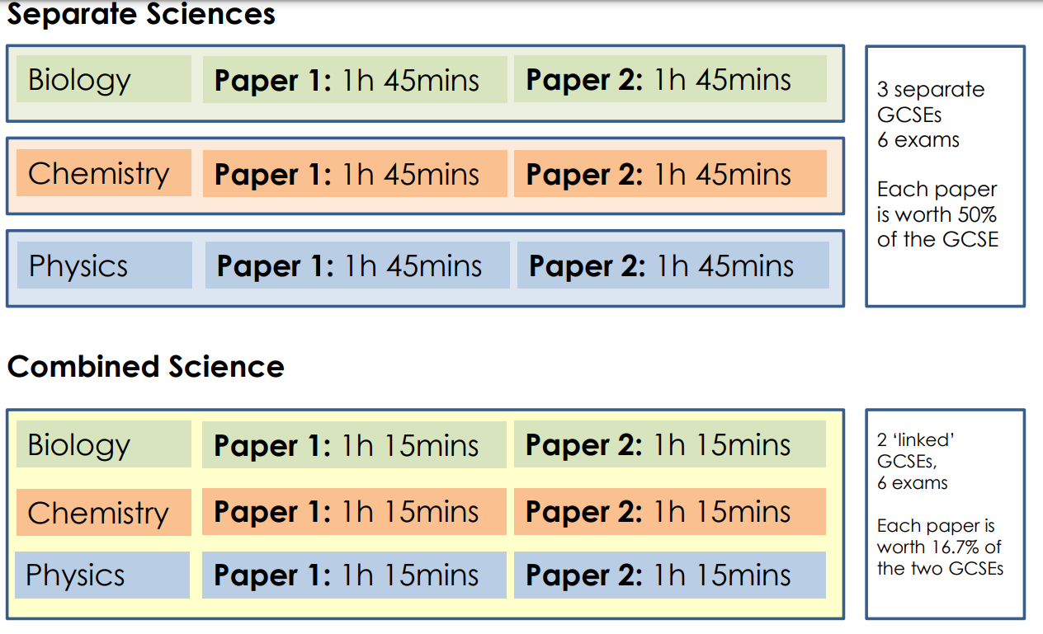
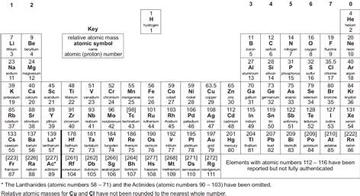
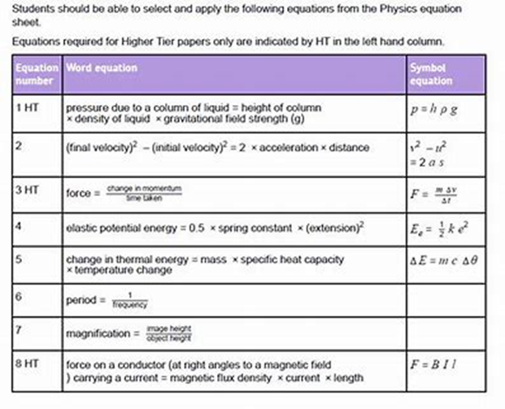
Science Exam Information

Slide 24

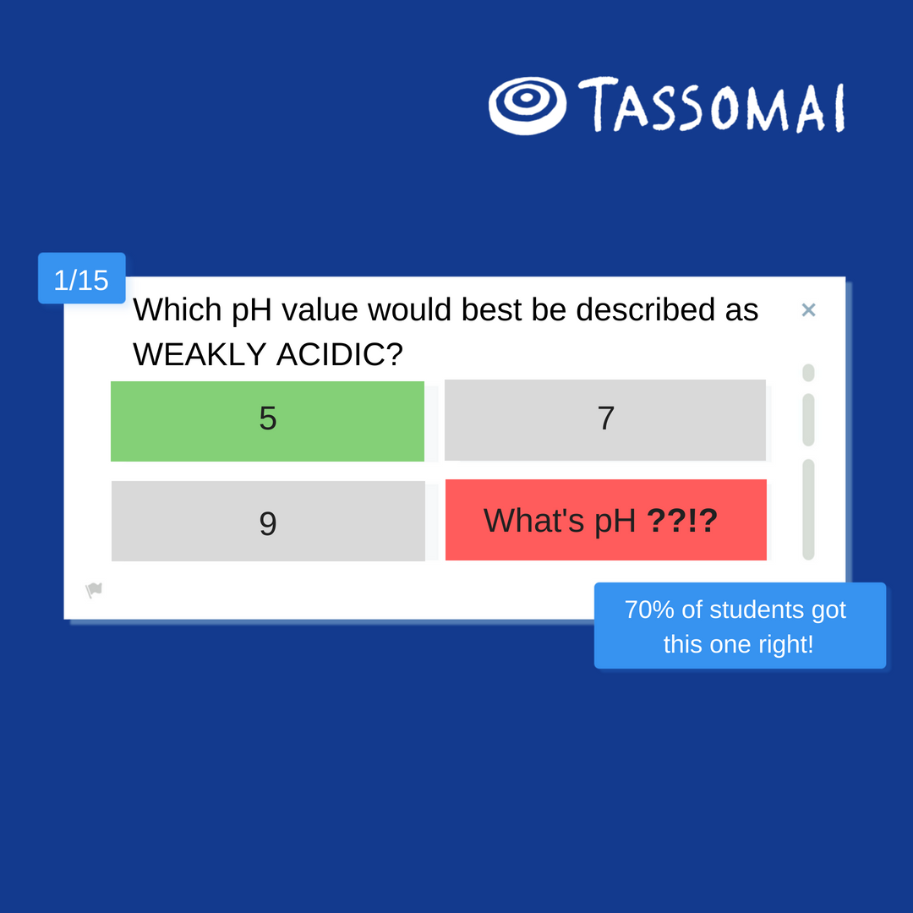
Homework Platform: Tassomai
Students learn through quizzes and short videos, using our mobile app or other online devices.
Monday to Sunday - 5pm

Slide 25
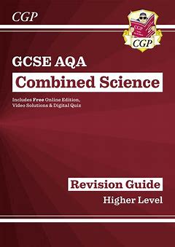
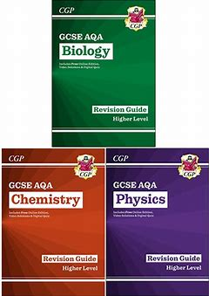


Science Revision
Revision Letter

Slide 26
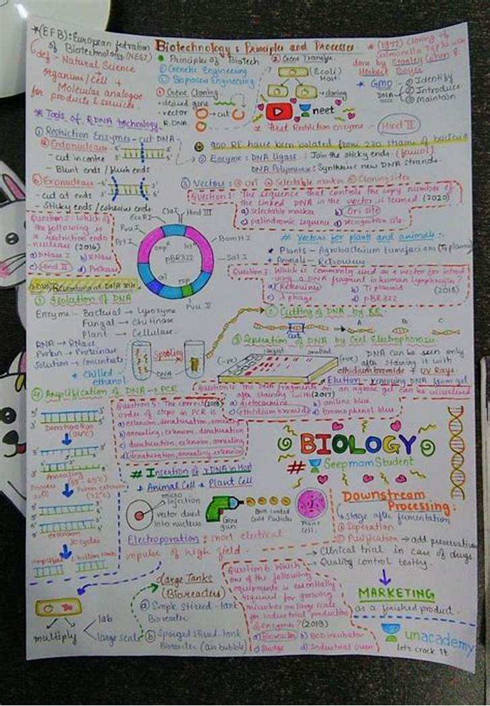
Success in Science
Science Priorities for this Term
● Settling in – 3 Science Teachers
● Building relationships with teachers
● Consistency
Term 2 to 6
● Structured questions/walking talking mock style revision style
● Use of Revision Guide
● Use of Revision Resources - The Science Table

Slide 27

Head Of Year – Welcome
Heather Penny-Larter
38th Year as a teacher
Taught in many areas but my areas of specialism are English language and literature
Mostly taught in UK but had a brief sojourn abroad
Choral Singer
Bread Baker
Reader
Sports Enthusiast
Penny-larterh@deanerycofeacademy.org.uk

Slide 28
Year Team
Mrs Mobey – AHOY
10.1 Mrs Waldron (formerly Miss Showler)
10.2 Ms Shanahan
10.3 Mrs Blondrage and Miss Komolafe
10.4 Mr Jackaman
10.5 Mrs Wright (mrs Thota)
10.6 Mrs Young/Mrs Pegado
Mrs Scotford KS4 Raising Standards Assistant Principal

Slide 29
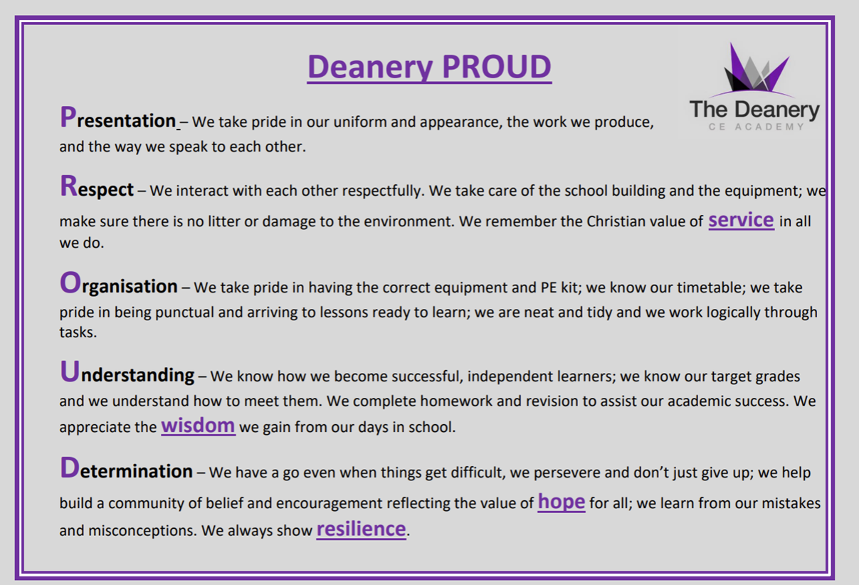
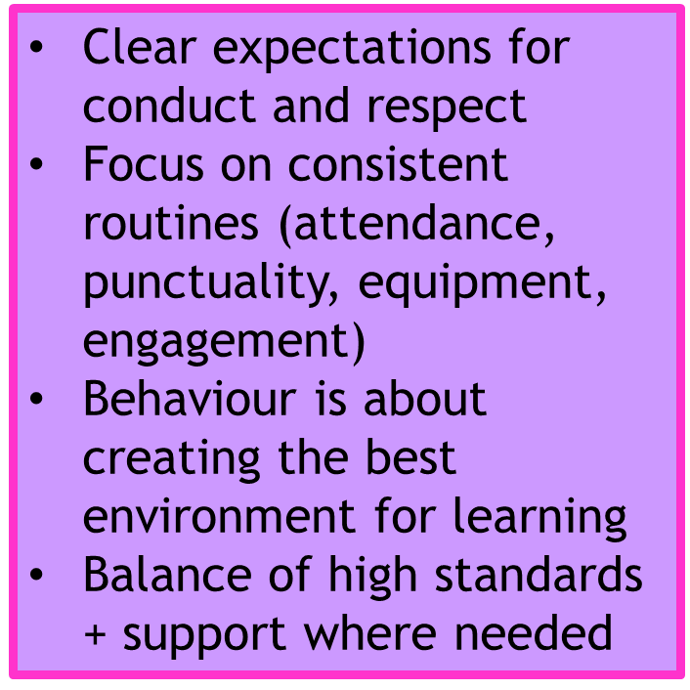
Behaviour for Learning

Slide 30


Focus on Mental Health & Wellbeing

Slide 31








Slide 32
What did last year's Yr11 say?
What helped you the most:
Top Answer = Family support
2nd = The pre-exam revision and morning booster sessions
3rd = Teachers
Most common improvement suggestions:
42% wanted revision to start earlier
38% wanted more revision sessions
20% wanted better food

Slide 33


How Parents Can Help

Slide 34
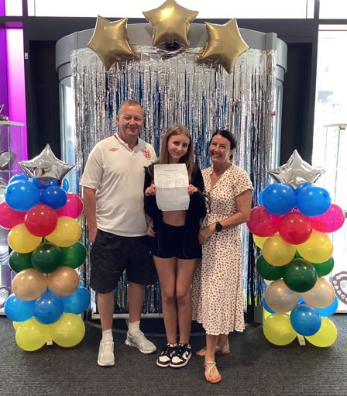
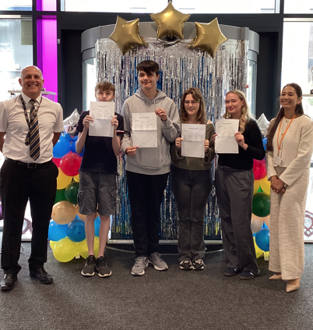
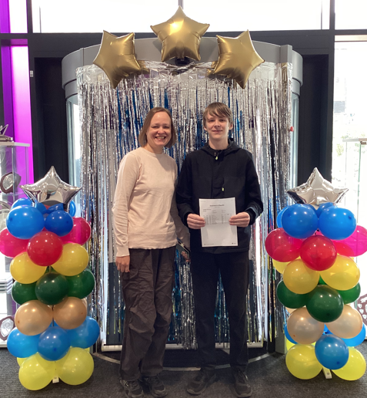
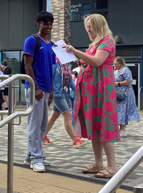
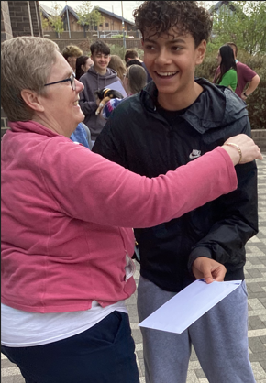
August 2028
We will see success together!
There is a booklet to take with you covering all the information given this evening. Information will also be shared on the school website.

