Slide 1

“Muhammad is not the father of any of your men, but he is the Messenger of Allah and the seal of the Prophets”
Qur’an 33:40
EVIDENCE
Add this to your notes
https://www.youtube.com/watch?v=PDxKxnVZtgo
To explain Muhammad’s significance in the development of Islam
Notes:
Explicitly refer to evidence and the importance of evidence in our writing
We cannot make fully justified, rational, logical arguments without it
Students should copy this quote into their books, highlight it or box it so it stands out
Students should refer to this evidence in their writing later in the lesson

Slide 2

Muhammad is thought to have had a personality that enabled him to convert people by clearly delivering his message from God. Muslims also believe that Muhammad had the qualities to be a strong leader and so they trust his leadership in spiritual and earthly matters. Therefore, Muslims today still hold the Hadith as an authority as it contains the prophet’s words and teachings.
Muhammad was a leader with charisma, a great teacher and the perfect example for Muslims of how best to serve Allah. He saw the family (husband, wife, children and extended family) as a basic unit for a caring society in which morals are learned and faith can be upheld. Muhammad continued to lead his community both spiritually and in earthly matters until his death in AD632.
Hadith = the teachings of Muhammad
Charisma = charm that can inspire devotion in others
Analyse the reasons why he was a good leader
Notes:
Read through the information
Students should make notes of the key elements

Slide 3

Add this to your notes
Essential information:
Muhammad is the most important prophet in Islam because he is ‘God’s messenger’ (Qur’an 33:40).
He received the Qur’an from God, which all Muslims use as the basis of their faith.
He is also remembered for helping to fully establish the religion by conquering Mecca, and for having travelled to Heaven where he was in the presence of God.
Exam question:
Give two reasons why Muhammad is important to Muslims (2)
To Analyse the reasons why he was a good leader
Notes:
Go through the ‘essential information’
Students need to add this to their notes
2 mark question: applying the knowledge and asking students to condense it into two points

Slide 4

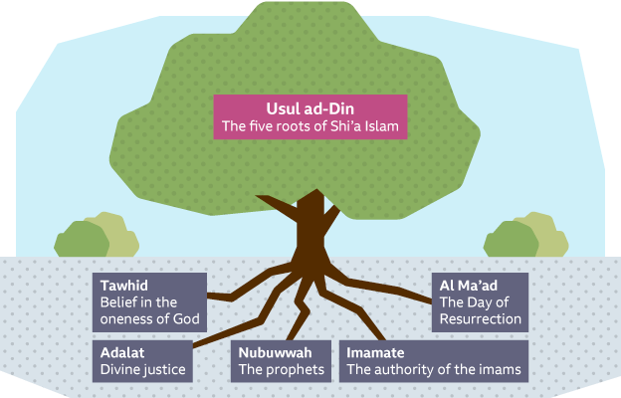
Can you remember the five roots of Usul ad-Din in Shi’a Islam?
Imamate = leadership
Notes:
What can students remember about the 5 roots of Usul ad-Din?
Click to reveal the 5 roots 1 by 1
The imamate is important when we are discussing the legacy and importance of Muhammad to Muslims
Students should as imamate into their key word glossaries

Slide 5
Although the final version of God’s law was received by Muhammad, the Imams are important for helping to preserve and explain the law.
The leader of Shi’a Muslims is called an imam. The leadership of the imams is called the imamate
Shi’as believe the imam should be a descendent of Muhammad and chosen by God.
Add this to your notes
Shi’as believe the Imams are necessary because people need divine guidance on how to live correctly.
To explain Muhammad’s significance in the development of Islam
Notes:
Briefly refer to the diagram at the top. Students will already have this in their exercise books from the start of the year
Go through the flow chart, explaining the shi’a beliefs about the imamate and why they are important
Students should add this to their notes

Slide 6
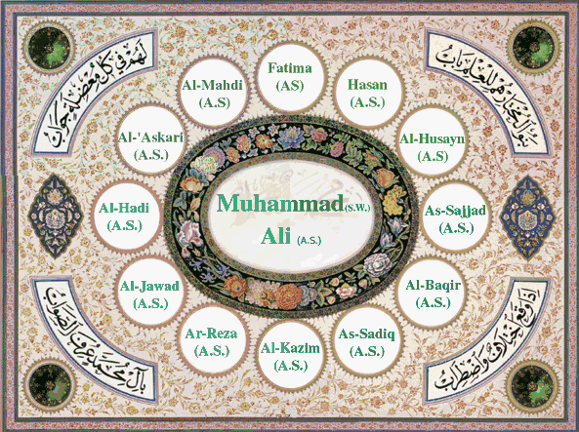
The Twelver branch of Shi’a Islam teaches that there have been 12 imams in total.
Each has been related to Muhammad in some way. The twelfth Imam has been kept alive by God and hidden away somewhere on earth.
He will return in the future and bring justice and equality to all.
Notes:
- The twelver branch (denomination) of Islam information

Slide 7

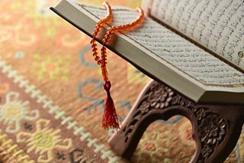
The word Qur’an means ‘recitation’ and Muslims believe that the Qur’an is the direct word of Allah revealed to Muhammad by the Angel Jibril.
Muhammad was called to be a prophet in 610-11CE. This event is known as Laylat-ul-Qadr (the Night of Power) which many Muslims now celebrate on night 27 of Ramadan.
The Prophet Muhammad became the messenger of Allah and continued to have Allah’s word revealed to him for the next 23 years. The revealed teachings were written down by the Prophet Muhammad's close friends and followers.
https://www.bbc.co.uk/programmes/p02mwjsw
Notes:
Go through the information on the slide
Students should copy the meaning of Qur’an into their key word glossaries
Click the link at the bottom of the slide to watch a video about the Qur’an and how it is used in everyday life

Slide 8
After the Night of Power, the messages from continued for the rest of Muhammad’s life. Allah gave Muhammad the words and the prophet them. When Muhammad , his friends wrote down these messages and they became the Muslim holy : The . The night the Angel Jibril visited Muhammad in a cave is called ‘The of ‘. Muhammad’s messages of mono and did not go down well with the ruling families in .
fairness
book
Night
Mecca
recited
died
theism
Qur’an
power
Allah
1. What challenges did Muhammad face in Mecca? Try to list at least 3
2. How did Muhammad find strength and resilience, do you think?
Recap…
https://www.youtube.com/watch?v=PDxKxnVZtgo
Notes:
Recap and build upon the last lesson.
Click the link at the bottom of the slide
After watching the video, allow some time for students to copy and complete the text on the slide
There are two further questions for those who finish sooner
Allah; recited; died; book; Qur’an; Night; Power; theism; fairness; Mecca

Slide 9
The Qur’an is made up of 114 SURAH (chapters), which contain 6,237 AYAHS (verses).
Once Muhammad received the revelations from Allah, he instructed one of his scribes to write them down.
Each Surah begins with “In the name of Allah, The Most Merciful, The Most Compassionate”.
49 scholars recorded the Qur’an in written form, though it was only later that this was as one book.
Muhammad could not read or write. What struggles do you think he faced?
Notes:
Information about the Qur’an
Again, students should add Surah and Ayah into their key word glossaries
Discuss the question: Muhammad could not read or write. What struggles do you think he faced?

Slide 10
Why is the Qur’an the superior authority in Islam?
The Qur’an is the direct word of Allah and therefore it has His authority.
It is infallible (without error) and remains in its original form.
The Qur’an was revealed to the Seal of the Prophets and because no man would be capable of writing such a book, it made Him even more important.
Muhammad was illiterate, making the Qur’an the first great miracle.
A written book was needed to formalise the religion.
Notes:
Why is the Qur’an the superior authority in Islam?
Go through the reasons, explaining and clarifying where necessary
There will be questions on this later in the lesson

Slide 11
What’s in The Qur’an?
The basics of worship, which Muhammad developed
The legal and social systems
Personal and spiritual guidance for all life’s situations and challenges
It explains creation and other ultimate questions, like why are we here
Notes:
What’s in the Quran?
You may want to frame this with a comparison to another holy text. For example, what is in the Bible? What do Christians gain from reading it?
Then, go through the list of what is in the Qur’an
What is the same and/or different with what’s in the Bible?

Slide 12
The second most important source of authority for Muslims is the Sunnah.
These give the perfect examples for Muslims to follow.
The Sunnah are found in the Hadith.
Reading Hadiths help Muslims learn how Muhammad explained the teachings of the Qur’an
Sunnah = the practices, customs and traditions of the Prophet Muhammad
Hadith = the sayings of the Prophet Muhammad
What Muhammad DID
Sunnah
What Muhammad SAID
Hadith
Notes:
Go through the Sunnah and the Hadith
Add the key words into key word glossaries
Students will need to be able to articulate why these sources of authority may also be important and compare them with the importance of the Qur’an

Slide 13

Risalah: holy books
Without looking in your exercise books, define the following terms:
Hadith
Sunnah
Qur’an
Seal of the prophets
Illiterate
Sayings of the Prophet
Practices of the Prophet
Recitation
The final Prophet – no more prophets are needed
Cannot read or write
To recap key features of the Qur’an
Notes:
DNA: students are to define the key terms on the slide without looking back through their notes
Purple pen the answers

Slide 14
As well as the Qur’an…
…Muslims believe there are other holy books that have been revealed by God. Allah revealed these to other prophets before Muhammad.These holy books are mentioned in the Qur’an.
Some Muslims think these books have been completely lost and no longer exist today.
Others think they can still be found to some extent in the Bible. However, the original text has been corrupted or distorted, so it does not have the same authority as the Qur’an.
To explore other holy books in Islam
Notes:
Introduce the background to the other four holy books in Islam
Make links to other Abrahamic religions, Christianity and Judaism

Slide 15
So… what about the authority of these four books?
https://www.youtube.com/watch?v=jc-UNTAPA8s
All four books are referred to in the Qur’an, so they are important
Muhammad learned from them and referred to them, therefore giving them authority
They were associated with key prophets and their revelations which give them importance
However…
Some are lost and no one knows what they said
It is alleged they have been changed, so do they still hold authority?
If they were that important, why were they not preserved like the Qur’an?
Having been so changed, Muslims cannot use them, so they have no authority today
To explore other holy books in Islam
To compare the importance of these holy books to the importance of the Qur’an in Islam
Notes:
Come back together as a class and go through the significance and importance of these holy books as authority in Islam
Compare to the Qur’an: what is different about them? And does this make a difference to their superiority as authority in Islam?
Click the link on the slide to play a 5 minute recap video
Ask students to add in any further information onto their tables

Slide 16
Overview…
Copy this into your notes
Name of the book | Who it was revealed to | Its authority in Islam
The Torah | Moses (Musa) | Some Muslims think that the Torah is the first 5 books of the Bible, but altered from the original text.
The Psalms | David | Many Muslims accept that the Psalms mentioned in the Qur’an are similar to the ones in the Bible.
The Gospel | Jesus (Isa) | Muslims believe the Gospel has been lost but some of its message is still found in the Bible.
The scrolls of Ibrahim | Ibrahim | These are considered to be one of the earliest scriptures in Islam, and no longer exist.
To compare the importance of these holy books to the importance of the Qur’an in Islam
Notes:
Go through this brief overview of the four books, which summarises the authority
Students need to copy this diagram into their exercise books

