Slide 1
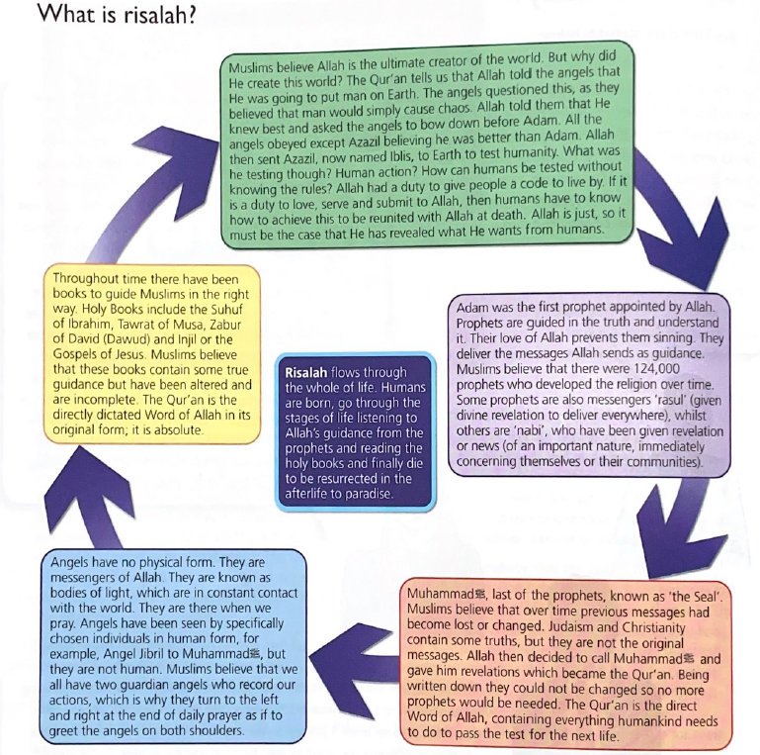

What is risalah?
Risalah means prophethood or messengership and represents the various ways Allah communicates with humanity.
Islamic belief teaches that Allah wants to help people live good lives and so he sends messages about how to do this. Many of these messages are found in the Qur’an. Muslims believe that messages from Allah are communicated through prophets, or nubuwwah.

Slide 2
The prophets are the connection between Allah and humanity.
There are 25 named prophets in the Qur’an, although many believe there may have been as many as 124,000.
All of the prophets are considered to be equal: We make no distinction between any of them(Qur’an 2:136).
Allah chose the prophets to reveal his truth. They are responsible for the revelation of God’s word.
Messages from Allah were sent to the prophets using angels (malaikah).
These messages are recorded in the holy books.
The prophets performed miracles, which proved they really were prophets.
IMPORTANT POINT
The prophets are not worshipped, because Allah is the one true God. Instead they are respected.
https://www.youtube.com/watch?v=-gxw0WWrpJo
“We believe in Allah, and the revelation given to us, and to Abraham, Ismail, Isaac, Jacob and the tribes, and that given to Moses and Jesus, and that given to (all) prophets from their Lord: we make no difference between one and another of them: and we bow to Allah”
~ Qur’an 2:136

Slide 3
The Abrahamic faiths (Judaism, Christianity and Islam) all share a focus on key figures, including many prophets. The Qur’an says ‘Of some messengers we have already told you the story; of others we have not; – and to Moses God spoke direct’ (Qur’an 4:164).
There were six key prophets before Muhammad:
Adam was created as the first human and given the role of khalifah. Muslims learn about their role on Earth from the example of Adam. Adam was forgiven for his sin and some believe he built the first Ka’aba. He was given knowledge to pass on to the rest of the human race.
Ibrahim is seen as the father of the Arab people. He refused to worship idols (people other than Allah who might be greatly admired) and he rebuilt the Ka’aba following the great flood. Ibrahim had his faith tested, which teaches Muslims that they must be prepared to submit to Allah in the same way. He is known as Abraham in Judaism and Christianity.
Isma’il was one of Ibrahim’s sons and is associated with Makkah and the construction of the Ka’aba. He is known as Ishmael in Judaism and Christianity.
Musa taught Muslims that there is one God. He is thought to be the only prophet that Allah spoke to directly. He is known as Moses in Judaism and Christianity.
Dawud was known for his bravery and wisdom. He is known as David in Judaism and Christianity.
In the Qur’an, Isa is referred to as the “son of Mary.” He is known as Jesus in Christianity. However, Muslims do not believe that he was crucified and resurrected (that is a Christian belief) or that he was the son of God.
Adam story: https://www.youtube.com/watch?v=FdqiEQkUTzI

Slide 4
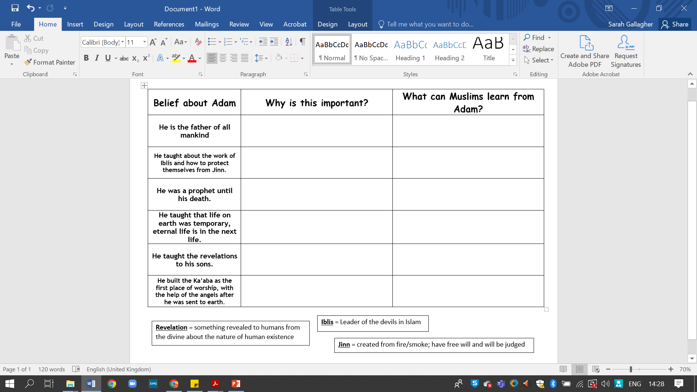
Muslims believe that we all share a common ancestor and, therefore, we are all one family
If we are all one family then we should treat others as our brothers and sisters
The story of Adam is an authority from which Muslims can learn about Iblis and Jinn
Adam is an example of how to live and how to avoid sin and temptation
Adam was chosen by Allah to be the first prophet, therefore, he is significant and important
Adam is an example of lifelong service and devotion to living as Allah wants us to. Muslims will try to be like this.
It is an authority on the afterlife, which is a foundational belief for both Sunni and Shi’a Muslims
Muslims learn how to behave in order to achieve paradise (Jannah) and avoid hell (Jahannam). They are also comforted by the belief in an afterlife.
Adam passed down the knowledge and wisdom he received from Allah. Therefore, it is important to keep this unchanged through the ages.
Muslims carry on this tradition of passing knowledge and wisdom through the generations, and will not alter the words of the Qur’an
The Ka’aba is a sacred site for Muslims, in Mecca, and is a place of pilgrimage.
Muslims make a sacred pilgrimage (Hajj) to the Ka’aba at least once in their lifetimes.

Slide 5

Write one AGREE point and one DISAGREE point
Prophet Adam can teach Muslims all they need to know

Slide 6
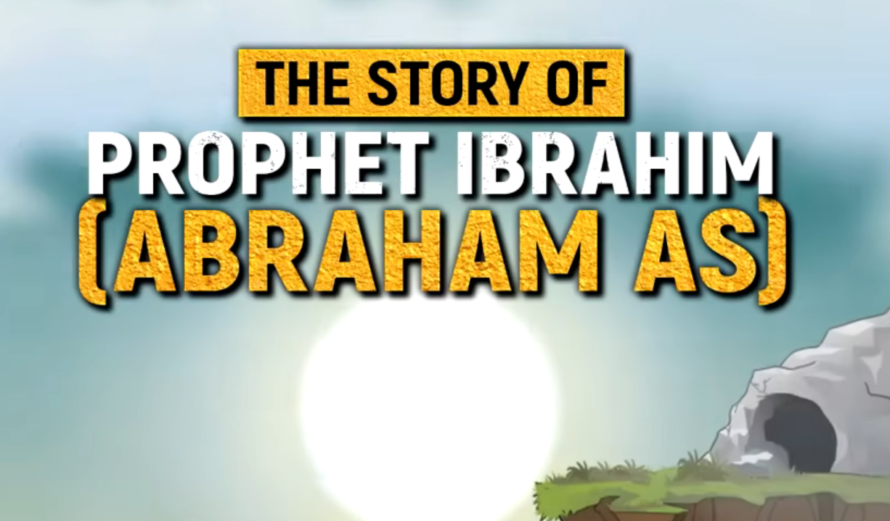
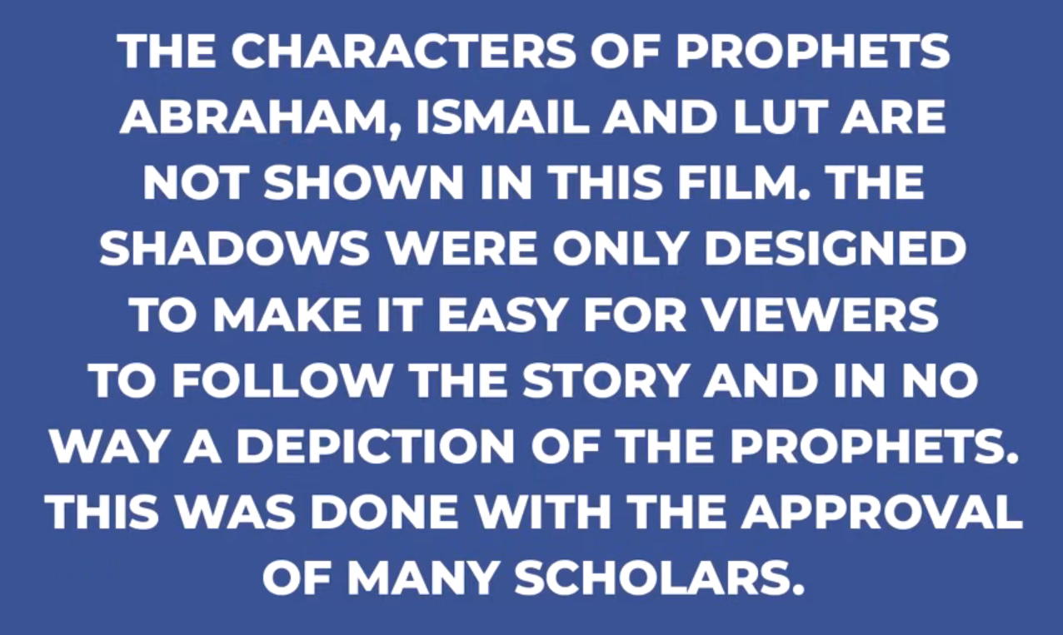
Summary:
https://www.youtube.com/watch?v=Vap4TQi4Jjw
Story:
https://www.youtube.com/watch?v=wuNAlw5kmW8
To explain the importance of the prophet Ibrahim

Slide 7
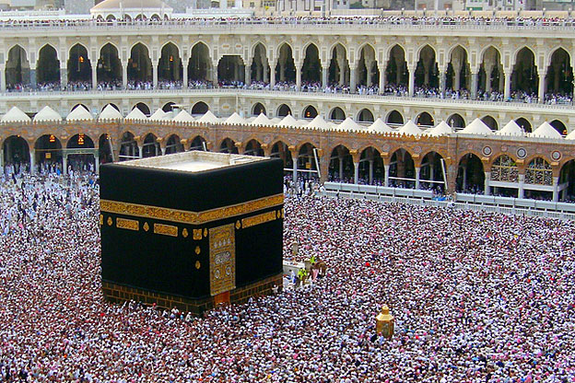
The Ka’aba
Muslims consider the Ka’aba to be the house of God and the holiest place in Islam.
Many Muslims believe the Ka’aba was built by Ibrahim with his son Ismael, on the site where Adam had prayed.
To explain how Muslims remember Ibrahim through their actions today.

Slide 8
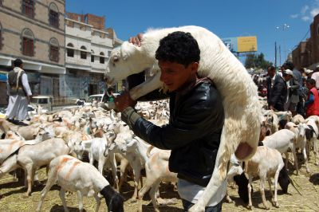
Id-ul-Adha
Id-ul-Adha is a festival which remembers when Ibrahim had a dream in which God asked him to sacrifice his son to him. God did not take the boy although Ibrahim was willing to sacrifice him. This showed that his willingness to be obedient and that he was a man of faith.
During the festival, Muslims slaughter an animal to remember Ibrahim's willingness to sacrifice his son.
To explain how Muslims remember Ibrahim through their actions today.

Slide 9
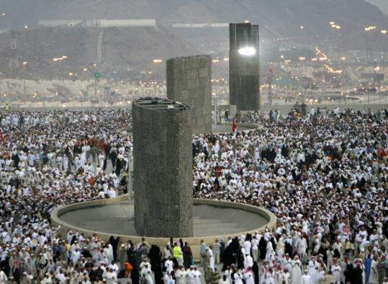
Ibrahim and Hajj
Muslims throw stones at the pillars the same way that Ibrahim threw stones at the devil that tempted him to disobey God.
When pilgrims run between the two hills and drink the water of Zamzam, they remember the story of Ibrahim’s wife Hagar (Hajaar). She searched desperately for water for her young son Ismael and God rewarded her search with the gift of a well.
To explain how Muslims remember Ibrahim through their actions today.

Slide 10
Ibrahim as a role model
Points | Further explanation
He refused to worship idols and instead preached that there is only one God | When Ibrahim was a young man, many people worshipped a number of different gods and idols Ibrahim questioned their beliefs and decided there was only one God who had created everything in the universe Ibrahim became determined to stop idol worship. One day, he took an axe and destroyed all the idols in the temple of his town People were furious and demanded that Ibrahim be burned alive. He was thrown into a huge fire, but the fire only burned his chains and he walked out of it alive This miracle prompted many people to start following Allah
He built the Ka'aba | The Ka'ba is a small, cube-shaped building in the centre of the Grand Mosque in Makkah (Mecca). lt is considered to be the house of God and the holiest place in lslam Following God's command, Ibrahim built the Ka'aba with Ishmail When Muslims take part in Hajj which starts at the Ka'aba, they remember Ibrahim and the steadfastness of his faith
He was willing to sacrifice his son to God | Ibrahim had a dream in which God asked him to sacrifice his son to him Ibrahim was willing to do this, but just before he carried out the sacrifice God stopped him, and told him he had passed the test During the festival of ld-ul-Adha each year, Muslims kill an animal to remember Ibrahim's willingness to sacrifice his own son out of obedience to God
To evaluate the impact that Ibrahim has on Muslims lives today

Slide 11
'Ibrahim is the perfect role model for Muslims.’
[12 Marks]
Exam Question
Evaluate this statement. In your answer you should:
Refer to Muslim teachings, scriptures and writings
Give 3 developed arguments to support this statement
Give 3 developed arguments to support a different point of view
Reach a justified conclusion
To explain the importance of the prophet Ibrahim
To evaluate the impact that Ibrahim has on Muslims lives today

