Slide 1

Britain has an estimated Muslim population of about 3.9 million. Of these some 5% are Shia, the rest are Sunni.
The historical split occurred 1400 years ago, following the death of Muhammad in Medina, in modern day Saudi Arabia.
SCHISM – A split because of different beliefs or opinions
Notes:
Read through the information, explaining the word ‘schism’

Slide 2

What caused the schism?
The Prophet Muhammad died in 632AD without having appointed a SUCCESSOR leading to a massive split over the future of the rapidly growing religion. Should Islam’s next leader should be chosen by a kind of democratic vote, or should only Muhammad’s blood relations reign?
SUCCESSOR– A person that comes after another
Notes:
Read through the information. Some may remember this from KS3, but it definitively needs revisiting.
Have a vote amongst the class. Who thinks Muhammad’s successor should have been a relative? And who thinks it should have been chosen through a vote?
Encourage students to justify their choices. What are the advantage and disadvantages of both systems?
How are our leaders in the UK chosen? Why?

Slide 3

CALIPH– Muslim civil and religious leader; a successor of Muhammad
The arguments are complicated but essentially boil down to the fact that Sunnis believe the Prophets’ trusted friend and advisor Abu Bakr was the first rightful leader of Muslims or “caliph”, while Shias believe that Muhammed’s cousin and son-in-law Ali was chosen by Allah to hold the title.
Abu Bakr
Ali
Notes:
Read through the information
At the heart of the split between Sunni and Shi’a is the conflict between who should have succeeded Muhammad after his death.
Sunni = Abu Bakr
Shi’a = Ali
https://www.bbc.co.uk/teach/sunnis-shias-whats-the-story/z4q8382#:~:text=Britain%20has%20an%20estimated%20Muslim,in%20modern%20day%20Saudi%20Arabia. Watch the first video on this page.

Slide 4
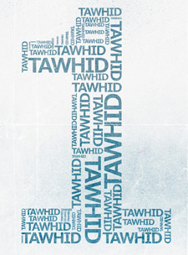
Tawhid: The oneness of God
“And your Allah is One Allah. There is no god but He, Most Gracious, Most Merciful”
Qur’an 2:163
Muslims believe that Allah:
is the one true God - all worship and praise is directed towards him
should be treated with respect as he is the supreme being
is the creator, designer and sustainer of the world
The word Tawhid is used to describe the oneness of Allah, which is the fundamental belief of Islam. It means believing in Allah, believing that he is the one and only God. It helps Muslims to think of Allah as the centre point of life.
Notes:
Go through the 6 articles of faith in Sunni Islam
Students do not need to write out each bit of information at this stage, as we will be studying each belief individually
You may choose to ask students to just summarise the information as you go through and explain each one

Slide 5
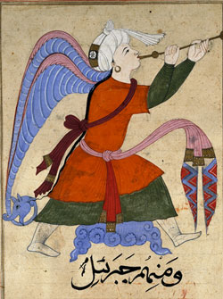
Malaikah: the belief in Angels
“They exalt him night and day and do not slacken”
Qur’an 21:20
Angels (malaikah) are important because God’s greatness means that he cannot communicate directly with humans.
He therefore passed messages (Risalah) to his prophets via the angels, who were his first creation.
Most Muslims believe that angels or malaikah were created before humans with the purpose of following the orders of Allah and communicating with humans.
Angels are immortal, are made of light and have wings. They are pure and cannot sin. They obey and serve Allah at all times.

Slide 6
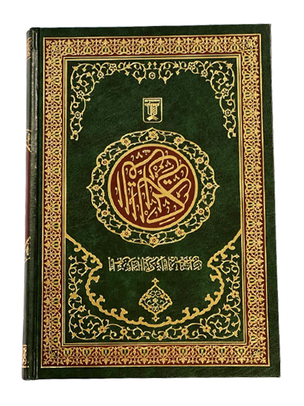
Kutub: the belief in Holy Books
“And We sent … Isa [Jesus], the son of Maryam [Mary], confirming that which came before him in the Torah; and We gave him the Gospel, in which was guidance and light and confirming that which preceded it of the Torah as guidance and instruction for the righteous.”
Surah 5:46
Muslims believe that Allah revealed holy books to other prophets who came before Muhammad. These books are called ‘revealed’ books, or kutub, meaning that Muslims believe they originally contained the same message as the Qur’an.
The holy books should be respected, especially the Qur’an, which is a direct revelation from God – it is God’s word.
The Qur’an
The Sahifah (The scrolls of Ibrahim)
The Tawrat (The Torah)
Zabur (Psalms and songs of worship)
Injil (Gospel of Jesus)

Slide 7
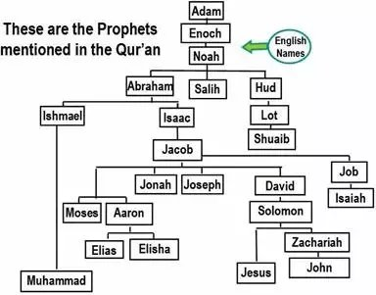
Nubuwwah: the belief in the prophets
The prophets (nubuwwah) should be respected, especially Muhammad, known as the Seal of the Prophets (the last prophet).
It is important to note that Muslims accept Isa (known by the name Jesus in Christianity) as a prophet. There are 25 prophets named in the Qur’an.

Slide 8
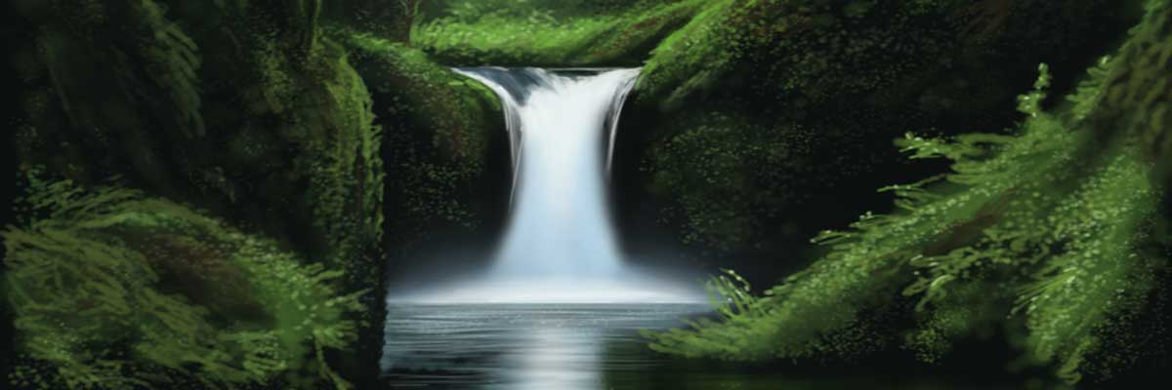
Akhirah: the belief in judgement and the afterlife
Heaven is described in the Qur’an as a beautiful garden. Jannah is Paradise, where those who have been good go. It is described in the Qur’an as “gardens of pleasure” Qur’an 31:8
Akhirah is the word Muslims use to refer to life after death. Belief in an afterlife encourages Muslims to take responsibility for their actions. They know God will hold them accountable and reward or punish them accordingly.
Akhirah explains humans’ existence on Earth, saying that life is a test from Allah. Importantly, though, Muslims believe that Allah will not test them beyond their limits.

Slide 9
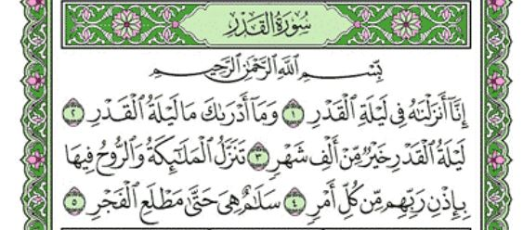
Al Qadr: the belief in predestination
“Only what God has decreed will happen to us”
Qur’an 9:51
Al-Qadr is the Muslim belief that Allah has decided everything that will happen in the world and in people’s lives, which is also called predestination. Most Muslims believe that humans cannot choose to do something if Allah has not already chosen that path for them. Some Muslims like this idea and find it reassuring that if a bad thing happens it must be part of God’s plan.
Most Sunni Muslims believe that Allah has made it impossible for them to choose anything other than what he has chosen.
Some Sunni Muslims believe that God has already determined everything that will happen in the universe.

Slide 10
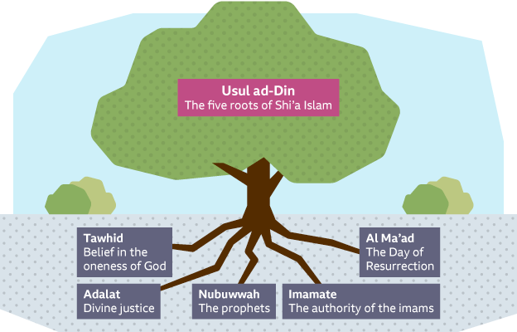
https://www.youtube.com/watch?v=QouoCo6TtqU
Why do you think this set of beliefs is referred to as ‘roots’?
Notes:
The 5 roots of Usul ad-Din
Pose the question: why do you think this set of beliefs is referred to as ‘roots’? Think about what roots do for a tree… Provide stability, nourishment, allow growth, the tree would not exist without them… etc.
Students should copy the diagram (or draw something similar) in their exercise books LEAVING SPACE FOR NOTES AS WE WATCH THE VIDEO
Once students have drawn their diagram, click the link to watch a video about the 5 roots
As we watch, students should add information to their diagrams about each of the 5 roots

Slide 11
Tawhid: The oneness of God
“And your Allah is One Allah. There is no god but He, Most Gracious, Most Merciful”
Qur’an 2:163
Muslims believe that Allah:
is the one true God - all worship and praise is directed towards him
should be treated with respect as he is the supreme being
is the creator, designer and sustainer of the world
The word Tawhid is used to describe the oneness of Allah, which is the fundamental belief of Islam. It means believing in Allah, believing that he is the one and only God. It helps Muslims to think of Allah as the centre point of life.
Notes:
Go through the 5 roots of Shi’a Islam
Students do not need to write out each bit of information on the following slides, but may choose to add to their diagrams after watching the video.

Slide 12
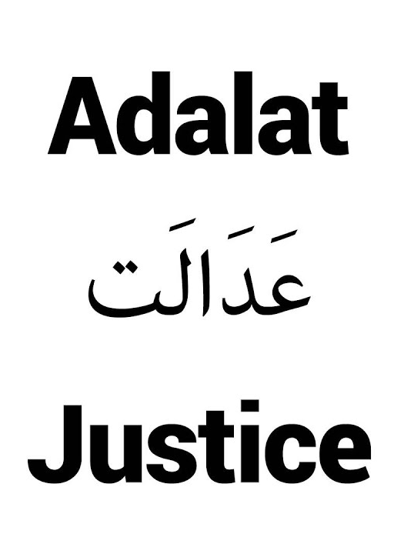
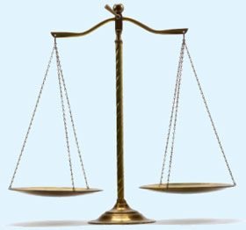
Adalat: the belief in divine justice
Shi’a Muslims believe that Allah is always right and just. Sometimes Allah may act in ways that are beyond our understanding, but ultimately the world has been created to be fair and just. All Muslims believe there will be a Day of Judgement, when they will have to account for their faith and deeds.

Slide 13
Nubuwwah: the belief in the prophets
The prophets provide guidance from God and should be respected.
This is especially so for Prophet Muhammad, as he was God’s final prophet and communicated the Qur’an to human beings. Allah’s revelations through Muhammad are true.

Slide 14
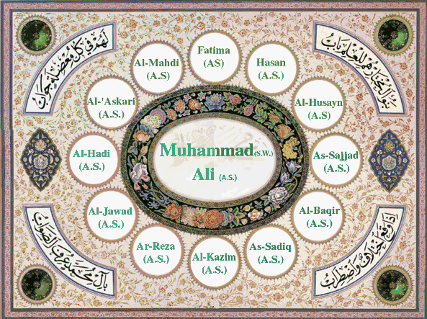
Imamate: authority of the Imams
The Twelve Imams were chosen by God to lead Islam after Muhammad. Shi’a Muslims believe that leaders such as imams protect the religion and help to guide Muslims along the right path. They guard the truth of the religion without error.

Slide 15
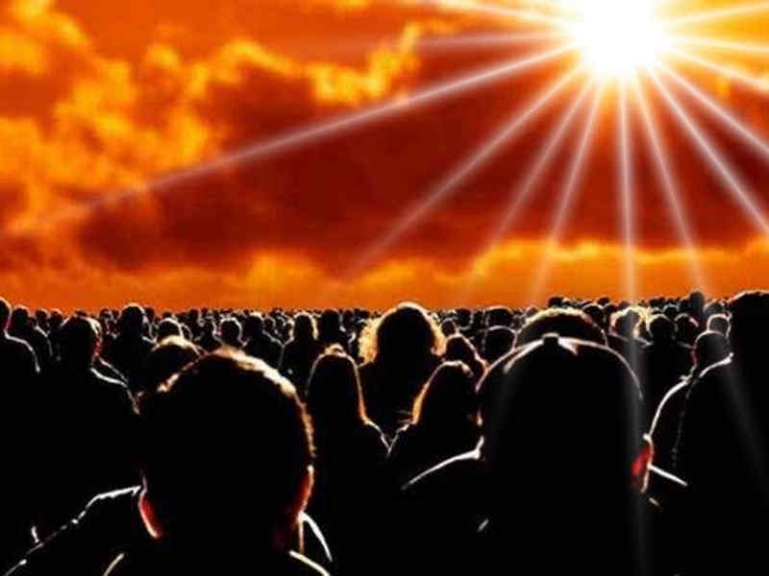
Al Ma’ad: Day of resurrection
Muslims will be resurrected and judged by God.

Slide 16
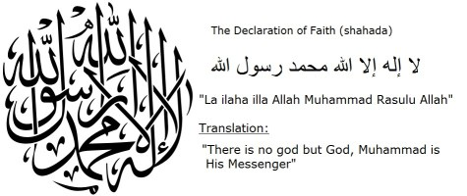
Tawhid is the belief that there is only one God and that God has no parts.
This belief is repeated daily in the Shahadah.
What is the Shahadah?
Notes:
Shahadah: First of the 5 Pillars; Declaration of Faith; say it three times with faith and you are a Muslim; it is said in the Adhan which is the first thing a new born baby hears

Slide 17
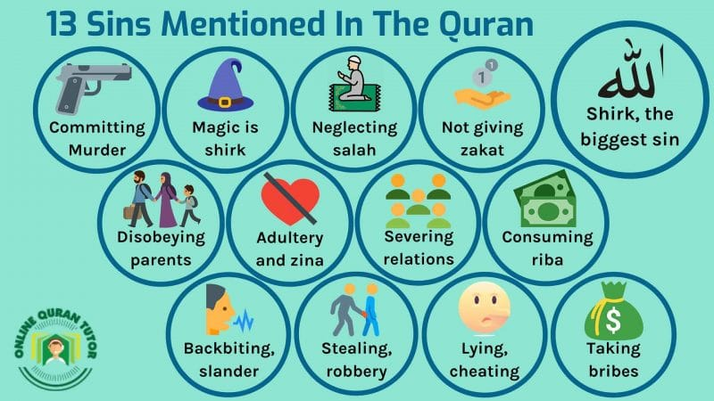
Muslims believe that the only sin that God will not forgive is the Sin of Shirk
Sin of Shirk – Attributing God-like qualities to any other being or thing
Notes:
- Ensure students have copied ‘sin of shirk’ into their key word glossaries

Slide 18
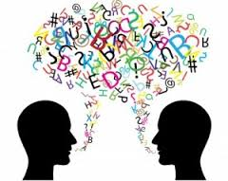
No one can picture or describe God because there is nothing with which to compare God.
Why is it SO unforgiveable to compare God with something else?
Notes:
- Think pair share: why is it so unforgivable to compare God with something else?

Slide 19
All beings are made by Him, they cannot be compared to Him.
His nature is far beyond our limited minds.
Surah 112
“Say:
He is Allah
The One and Only;
Allah, the Eternal,
Absolute;
He begot none,
Nor was
He begotten
And there is none like Him”
He is not limited by time or space
He is without beginning or end
Warns us not to think of Allah in human terms.
This verse rejcts polytheism.
Begotten = Brought into existence through the process of reproduction
Notes:
Spend some time deciphering what Surah 112 is saying about the qualities of Allah and how this links to Tawhid
Give students a copy of the Surah to stick into their exercise books, and ensure they have left space around the outside to annotate as we go through it as a class
Reveal the notes and ask students to identify where this is addressed in the Surah
Click to go though each part

Slide 20
The Supremacy of God’s Will
For Muslims, God is the one and only creator and controller of everything. Therefore nothing takes place unless God allows it to happen - no matter whether something is good or bad, Muslims believe it is God’s will and that God must have a good reason for letting it happen.
Notes:
The Six Articles of Faith for Sunni Muslims: 1. The One God (Allah); 2. The angels of God; 3. The books of God, especially the Qur’an; 4. The Prophets of God, especially Mohammed; 5. The Day of Judgement (afterlife); 6. The Supremacy of God’s will (Predestination)

Slide 21
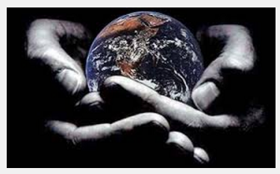
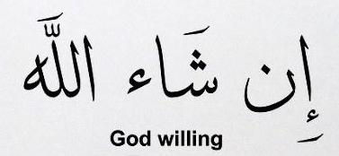
INSHALLAH
This phrase means ‘God willing’ and it is used by Muslims when they speak to show that God is supreme (completely in charge and in control of everything )
Notes:
- Inshallah

Slide 22
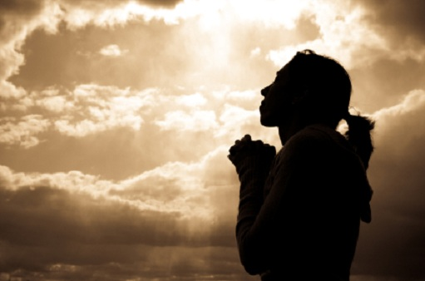
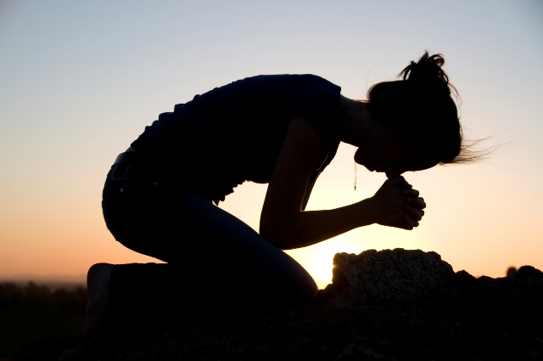
For Muslims, it is not enough just to believe in one God; they must show that belief in the way they live their lives.
Muslims must never make anything in their lives more important that God, including their family, money or jobs.
Notes:
- How does the belief in the supremacy of God’s will affect a Muslim’s daily life?

Slide 23
Tawhid: The oneness of God
“And your Allah is One Allah. There is no god but He, Most Gracious, Most Merciful”
Qur’an 2:163
Muslims believe that Allah:
is the one true God - all worship and praise is directed towards him
should be treated with respect as he is the supreme being
is the creator, designer and sustainer of the world
The word Tawhid is used to describe the oneness of Allah, which is the fundamental belief of Islam. It means believing in Allah, believing that he is the one and only God. It helps Muslims to think of Allah as the centre point of life.
BOTH Sunni and Shi’a Muslims believe this!
Notes:
Ensure students are really clear about what Tawhid is and means to Muslims
BOTH Sunni and Shi’a Muslims believe this
The oneness of God (as shown in Surah 112 last lesson) demonstrate that Islam is different to Christianity. The Christian Trinitarian belief of God as 3 persons and Jesus as God’s begotten Son would not be acceptable in Islam. This is a fundamental difference that students should be aware of.

Slide 24
“Allahu Akbar”
Allahu Akbar means “God is greatest”.
Muslims believe that God is so great He is beyond human understanding, and greater than anything humans can imagine. He is transcendent.
Where do the ideas about what God is like come from?
Transcendent – The idea that God is beyond and outside life on earth and the universe
Holy books e.g. Qur’an
The Prophet Muhammad
Notes:
- Go through the information on the slide and ask students to write down appropriate/important points

Slide 25
The names of God
Hadith – Sayings of Muhammad
There are 99 names of God in the Qur’an and Hadith, which can help Muslims to understand something of God’s nature.
Each name describes a quality that God has revealed about himself.
Allah has many different descriptions and it is hard to represent him in a few words, so the Qur’an teaches that Allah has 99 names. Each of the 99 names relates to a particular attribute of Allah, making him easier to understand and relate to.
Spend a few minutes thinking of what some of these names could be… For example: The merciful; The loving
Notes:
Read through the information and students should add ‘Hadith’ into their key word glossaries
Although the Hadith is not God’s direct word, like the Qur’an, importance is placed on the sayings of Muhammad as he was the seal of the prophets and God’s messenger on earth. He is seen as an authority to which Muslims can look for how to interpret God’s words and follow his example
Students should come up with some ideas about what some of these 99 names could be

Slide 26
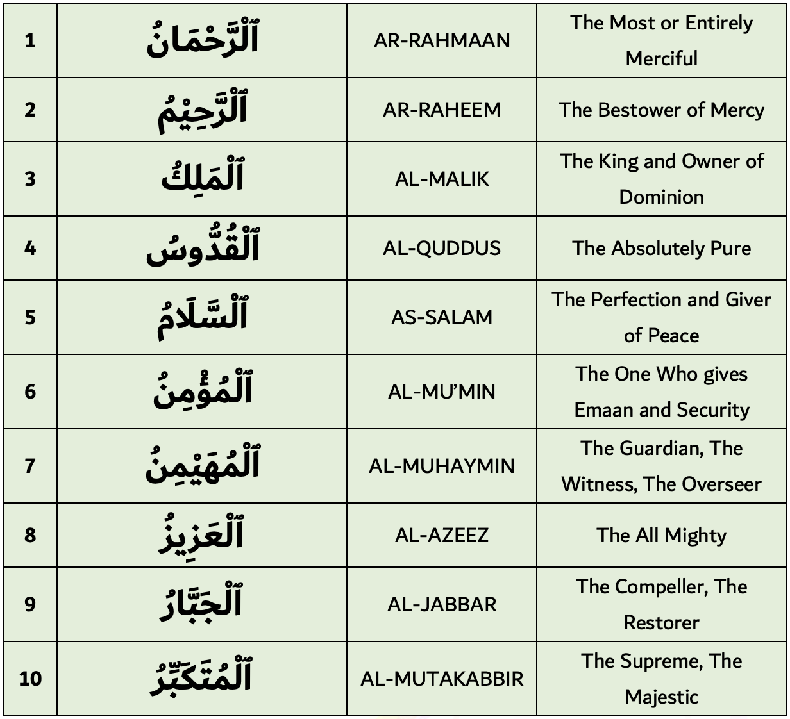
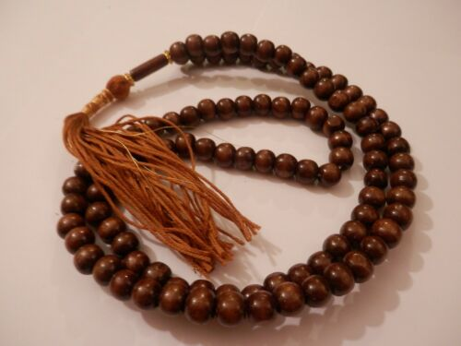
These are just some examples of Allah’s 99 names in the Qur’an.
Subhah beads are used in prayer when Muslims are remembering the 99 names of Allah.
Notes:
Emaan = faith
Read through the information
There are some prayer beads hanging on the display board of Mrs Gallagher’s room in 1-17

Slide 27

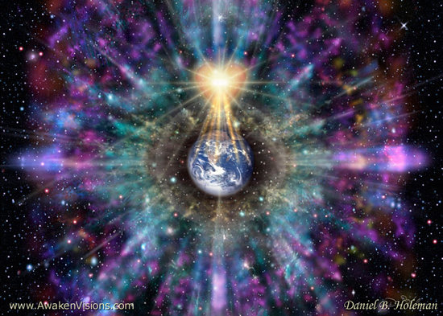
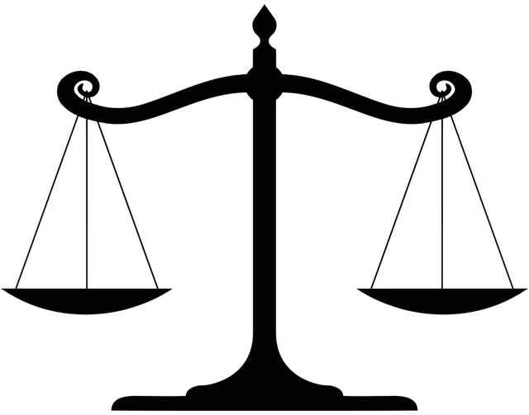


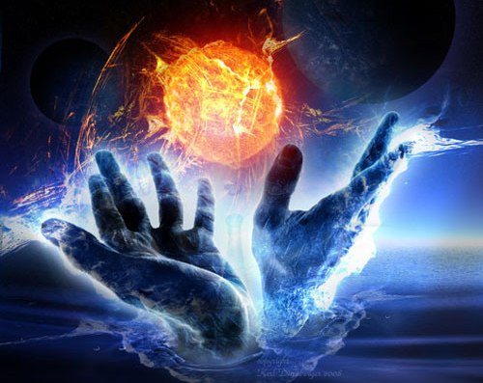
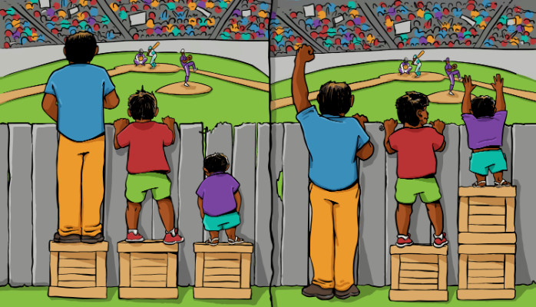

Just – God is just and fair and judges human actions, rewarding the good and punishing the bad
Immanent – God is present in and involved with life on earth and in the universe
Transcendent – God is beyond and outside life on earth and the universe
Fair – God treats people fairly and impartially, without favour or discrimination
Beneficient – Benevolent; all-loving
Omnipotent – almighty; having unlimited power
Merciful – God shows compassion or forgiveness to humans, even though he has the power to punish them
Notes:
Can students work out what attributes Muslims believe God has?
Encourage a discussion based on these pictures/symbols
Click to work though each one, in a clockwise direction
Challenge: how can God be both immanent and transcendent at the same time?? Where else have we encountered a seemingly illogical belief about God, and yet it is believed to be true?

Slide 28
Evidence of Allah’s beneficence and mercy
.
He sent prophets as guides to the right path… so He is compassionate and humans have free will to follow His path.
The mercy of Allah is reflected in the rules within the Qur’an.
Making mistakes is a part of being human, but Allah always forgives those who repent. Out of mercy Allah forgives and even repeated sin is forgiven.
Suffering clearly exists, but it is a test of faith to see how humans respond even where it seems beyond comprehension.
Allah’s mercy allows humans to exist, to live, to love and to care. Muslims are never alone. Allah’s compassion surrounds them and mercy helps them deal with being human.
Notes:
- Print this sheet off and review the information with pupils depending on ability and circumstances.

Slide 29
Immanence VS Transcendence
How is Allah both?
Immanence
‘We are closer to human than his jugular vein.’ (50:16)
‘And He is with you wherever you may be.’ (57:4)
Transcendence
‘No vision can grasp Him…He is above all comprehension.’ (6:103)
‘Nothing there is like Him.’ (42:11)
Notes:
- Students are to complete the activities in the pink box in their exercise books

Slide 30
Immanence VS Transcendence
How is Allah both?
Muslims believe Allah must be in this world to help and guide, to give people the purpose and ability to live this life.
This is what immanence means; that Allah is active in the world.
Allah is beyond human understanding, limitless and therefore He is not part of this world.
Transcendence is being separate to the world, which allows Allah to control it.
Notes:
- Read through the information and explain/clarify

