Slide 1
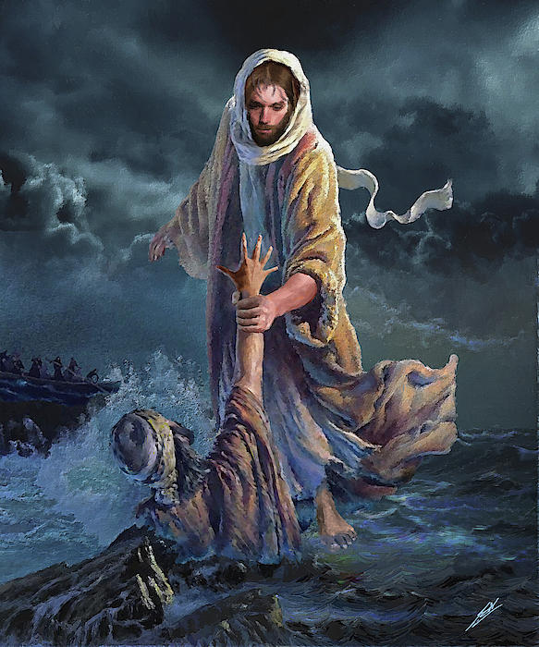

Sin and salvation
Sin: Any action or though that separates humans from God.
Original sin: Augustine’s doctrine that says everyone is born with a built in urge to do bad things and disobey God.

Slide 2

Our lesson objectives today:
IDENTIFY
DESCRIBE
EXPLAIN
ANALYSE
LINK
SYNTHESIS
To understand Christian beliefs about the origin and nature of sin.
Consider the effects that sin has on salvation.
Understand the role of Jesus crucifixion and resurrection in salvation.
Notes:
- Today’s lesson objectives

Slide 3


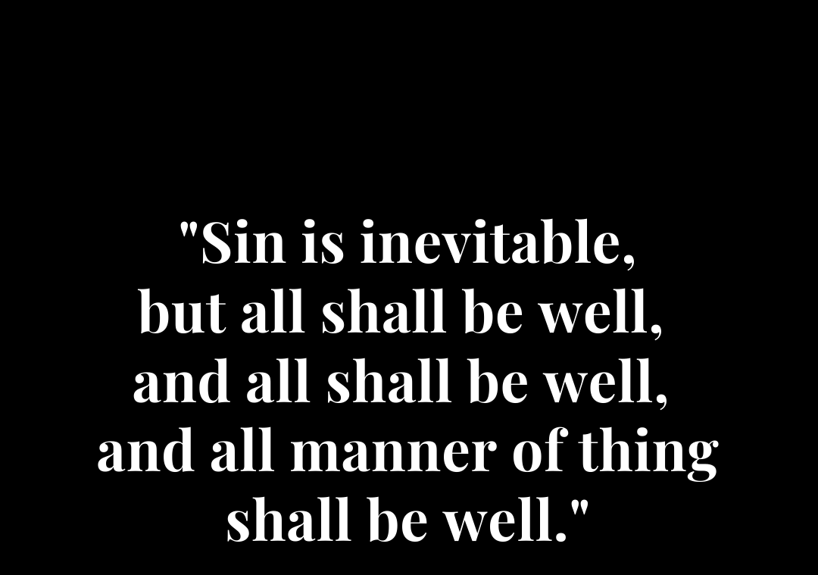
Is sin inevitable?
Christians believe that all humans commit sin, indeed as nobody is perfect; it is impossible not to sin.
To understand Christian beliefs about the origin and nature of sin.

Slide 4
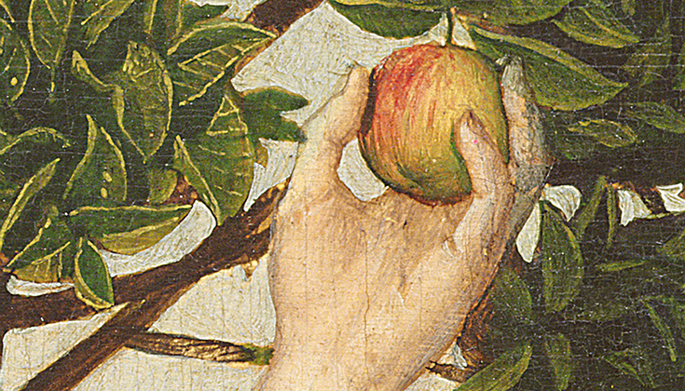
How did the fall result in the separation between God and humanity?
Discuss:
What do you think the story of Adam and Eve’s disobedience is trying to teach humans today?
the fall adam and eve - Google Search
To understand Christian beliefs about the origin and nature of sin.

Slide 5

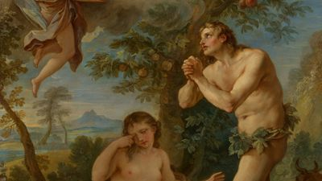
Adam & Eve
The devil
Who is responsible for humans sinning?
Humans free will
Temptations on earth
To understand Christian beliefs about the origin and nature of sin.

Slide 6

Salvation
Salvation through good work, Old Testament makes it clear that salvation can be achieved by obeying God and God’s laws.
Salvation through grace, received from God through faith in Jesus. It is not earnt or deserved but rather a gift for being faithful.
Consider the effects that sin has on salvation.

Slide 7

Role of Christ in salvation
Christians believe that Jesus’ death, his crucifixion makes up for the original sin.
Jesus knew his death was necessary to restore the relationship between God and humanity.
Jesus’ resurrection shows Christians that death has been defeated and that the goodness of Jesus as defeated the evil of sin.
Christians believe that they can receive forgiveness and receive eternal life with God in heaven if they believe in Jesus
Understand the role of Jesus crucifixion and resurrection in salvation.

Slide 8
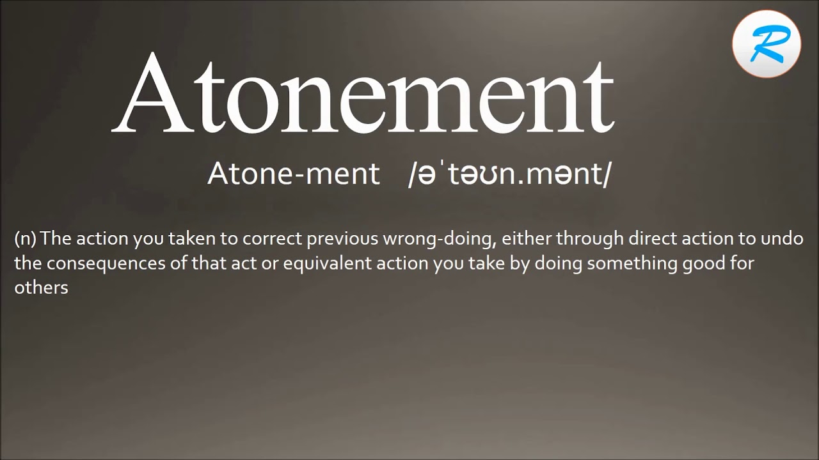
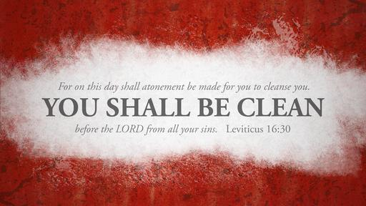
Atonement
Bible makes it clear that atonement removes the effect of sin and allows people to restore their relationship with God
How can Christians atone for sin?
Understand the role of Jesus crucifixion and resurrection in salvation.

Slide 9


Exit ticket:
‘Salvation is God’s greatest gift to humans,’ Evaluate this statement
Refer to Christian teachings
Include both sides of the argument in your answer
Understand the role of Jesus crucifixion and resurrection in salvation.

