Slide 1
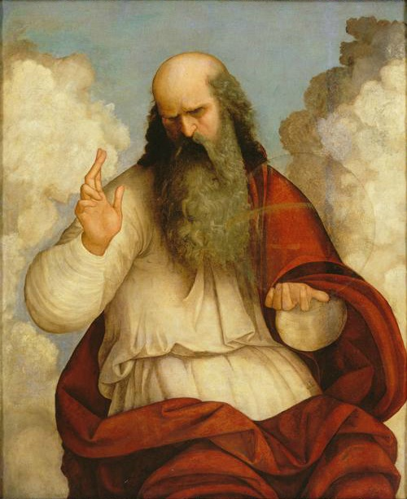
Silent starter – recap quiz!
What is a prophecy?
What is a ‘Messiah’?
Explain how Christianity started.
Write as many words as you can think of that describe the Christian god.
Notes:
Does this picture match your ideas about God?
See who got the most words. Remind them that it’s all personal.

Slide 2

Today we will learn…
What Christians believe about the nature of God
Some keywords in relation to Christianity
Notes:
Explain nature in this sense – characteristics, personality traits, abilities

Slide 3
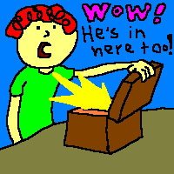
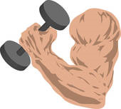
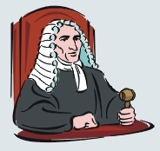

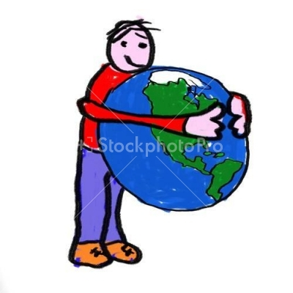
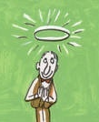

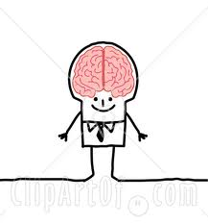
Forgive me father for I have sinned…’

Slide 4
Forgive me father for I have sinned…’
Omnipotent
A judge
Omnipresent
Forgiving
Benevolent
Holy
Eternal
Omniscient

Slide 5
The Nature of God
Holy - Pure, perfect, does no wrong.
Omnipresent - Present everywhere.
Omniscient - Knows everything.
Eternal - Has always existed and will always exist.
Benevolent - Kind and loving.
Omnipotent - All-powerful.
Forgiving - Will forgive people’s sins.
Judge - Will decide who goes to heaven or hell.

Slide 6
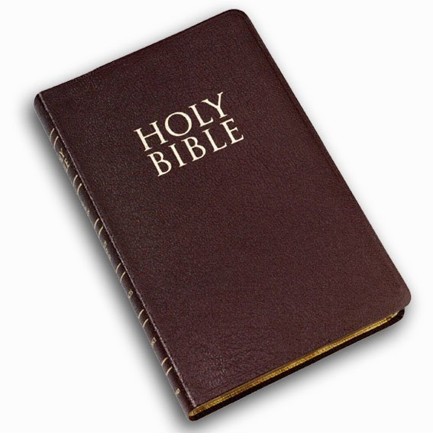
WHY do Christians believe God is like this?

Slide 7
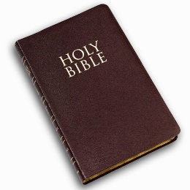
Task
On your sheet there are a selection of Biblical quotes.
Read each quote and try to work out which of God’s characteristics they are referring to – write it underneath
Cut out the quotes and stick into your exercise book

Slide 8
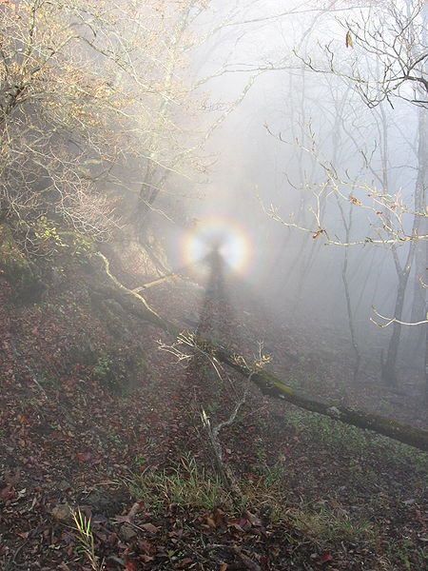
How would YOU represent God?
Notes:
Knowing what we now know, how would you present God differently to the artist at the beginning?
Think outside the box! Use symbols if you don’t feel comfortable drawing him as a person.

Slide 9
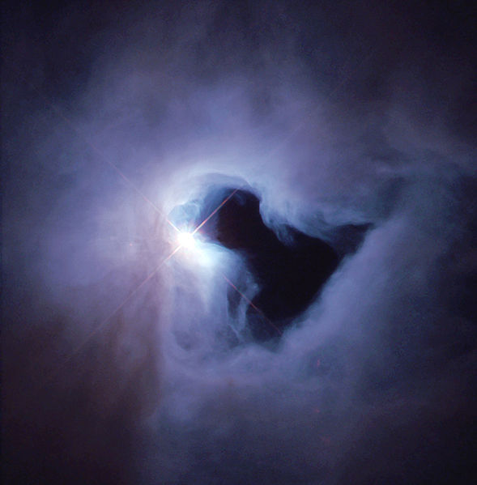
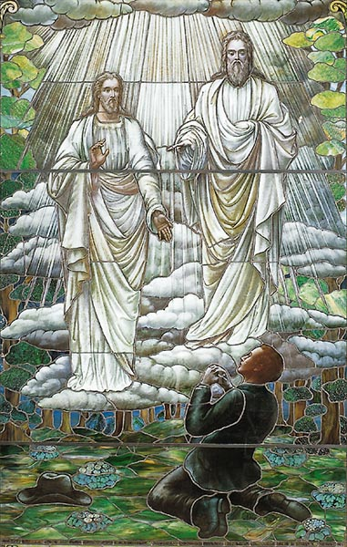
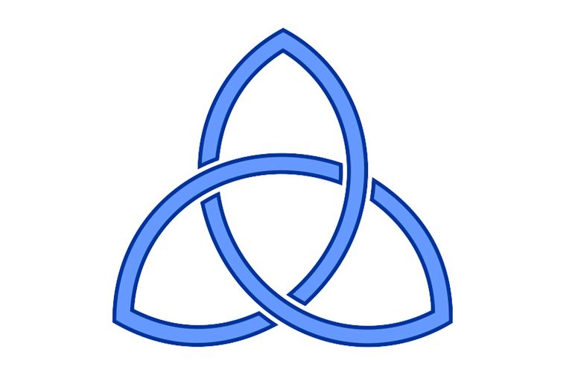
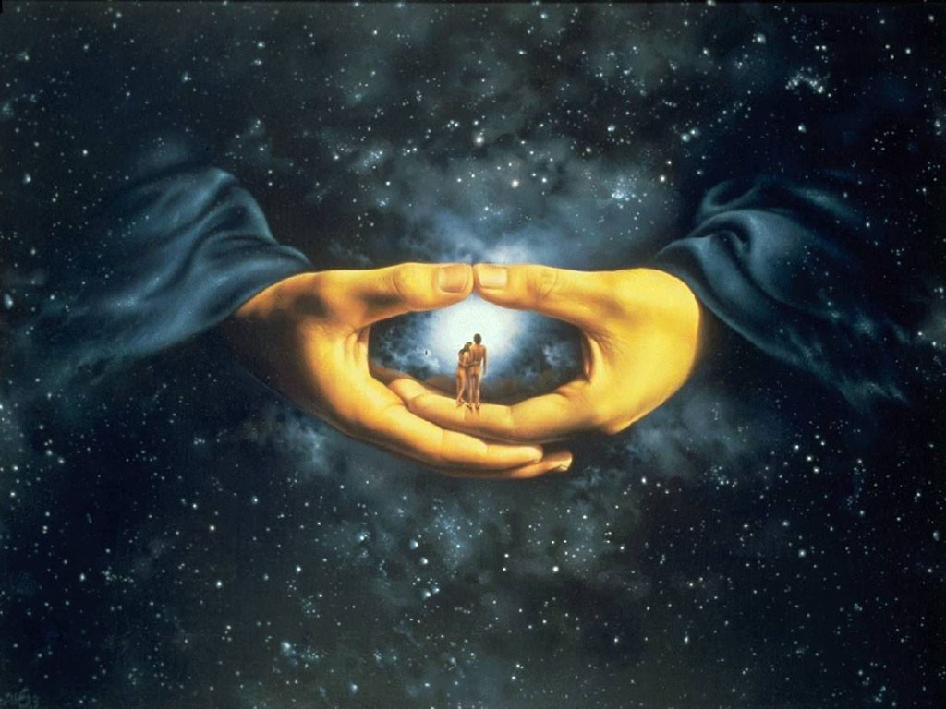
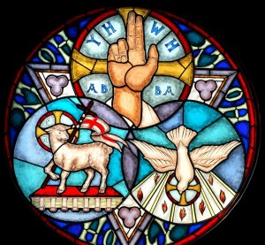
Notes:
Knowing what we now know, how would you present God differently to the artist at the beginning?
Think outside the box! Use symbols if you don’t feel comfortable drawing him as a person.

Slide 10

Now apply the knowledge!
Explain two Christian beliefs about God. You must include reference to scripture or a sacred text (5 marks)
REMEMBER:
Make two separate points!
Back up your points with evidence or examples!

Slide 11
Forgive me father for I have sinned…’

