Slide 1
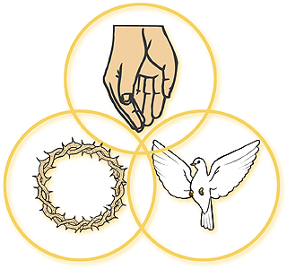

Oneness of God & The Trinity
Trinity: Belief that there are three persons in one God
Holy Spirit: Third person of the trinity
Son of God: Title used for Jesus

Slide 2

Learning Intentions:
IDENTIFY
DESCRIBE
EXPLAIN
ANALYSE
LINK
SYNTHESIS
To understand and analyse the concepts of the oneness of God and the Trinity.
To evaluate what may seem to be conflicting ideas about God.
Notes:
- Today’s lesson objectives

Slide 3


Who are you?/Who am I?
In your books, using a PENCIL draw an outline picture of a person. Put your name in the middle.
Now, around your person put all the different people you are eg. Brother, sister, uncle, aunt, student, niece, nephew etc. etc.
So are you a lot of different people or one person with different roles?
This thought will help with the next part of the lesson

Slide 4
The Trinity
Christians believe in ONE God who has THREE elements.
Father, Son and Holy Spirit.
It could be helpful to think about H₂O which can be known in different ways as Water (liquid) Ice (solid) Steam (gas). Each one still has the same chemical formula of H₂O.
To understand and analyse the concepts of the oneness of God and the Trinity.

Slide 5
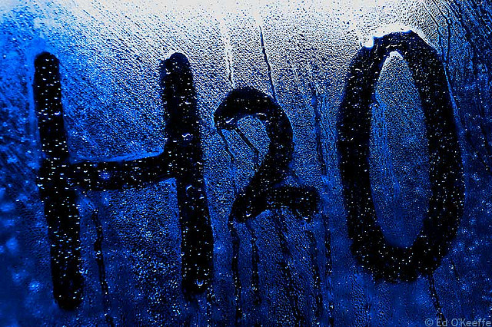
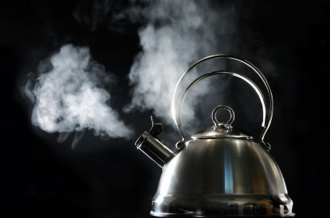
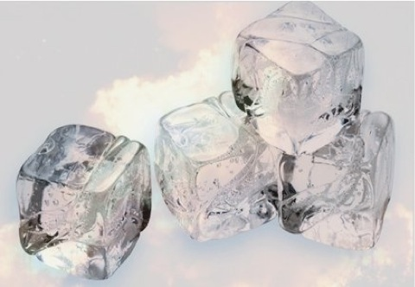
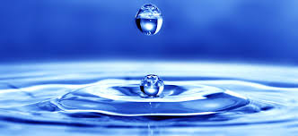

Slide 6
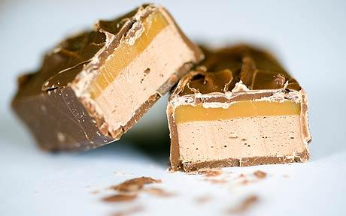

Slide 7
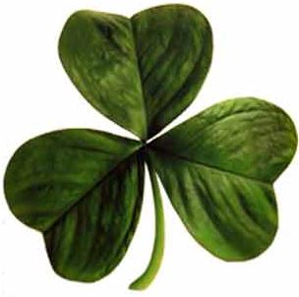
Are these shapes a good representation of the Trinity?

Slide 8
Task:
Using the pictures on your table, how would you describe each part of the Trinity? Copy and complete the sentence below
“Looking at this picture, I think God the (Son/Father/Holy Spirit) is ……………………………… because……”
To understand and analyse the concepts of the oneness of God and the Trinity.

Slide 9
The Trinity
In pairs:
Read each of the following descriptions and decide if you think it is describing the Father, Son or Holy Spirit.
To understand and analyse the concepts of the oneness of God and the Trinity.

Slide 10
God the Father | God the Son | God the Holy Spirit
Performed miracles | Helper and guider. | He rose on the third day.
Will judge. | Sustains and rules everything. | Christians believe that he created US and the WORLD.
Invisible power of God which breathes new life into people. | Part of God that works within the world. | Continues to care for us like a father.
Born of the Virgin Mary. | Redeemer, saviour. | Came to Earth in the form of Jesus.

Slide 11
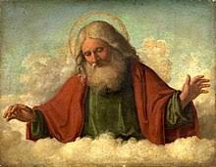
God the Father
God is referred to as a FATHER because Christians believe that he created US and the WORLD.
God the FATHER continues to care for us as a father would his own children.
God will judge.
God sustains and rules everything.

Slide 12
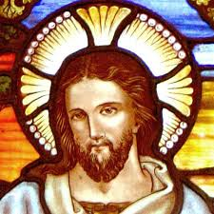
God the Son
God came to Earth in the form of his SON – Jesus. (God incarnate or God in a body)
Born of the Virgin Mary.
Performed miracles.
He was crucified
He rose on the third day.
Jesus is the redeemer of humanity, saviour of the world.

Slide 13
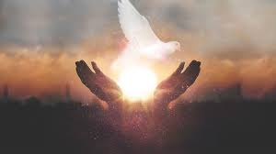
God the Holy Spirit
Part of God that is always or omnipresent
Part of God that works within the world.
Helper and guider.
Invisible power of God which breathes new life into people.

Slide 14
TASK
In books divide a page into 3 columns and head them up Father, Son, Holy Spirit
Write up the descriptions from our sorting activity into the correct columns.
When completed check with a partner.

Slide 15
God the Father is the creator of all things, he created the universe and everything in it is dependent on God. He is also seen as a loving father who cares for humanity as a father cares for his son.
God the Son refers to Jesus Christ. Christians believe Jesus is God incarnate (in human form) who was sacrificed for the sins of humankind which allows them to be reunited with God after death.
God the Holy Spirit is the unseen power of God at work on Earth who influences and guides Christians on Earth. It was also through the Holy Spirit Mary became pregnant with Jesus.

Slide 16
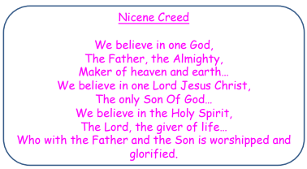
Go back to the Nicene Creed from last lesson, highlight and annotate the references made to the Trinity in three different colours for Father, Son and Holy Spirit
Does it make more references to God the Father, Son or Holy Spirit?

Slide 17
Tasks
Write a paragraph to describe the Trinity and explain what Christians believe about the Trinity. (50 – 100 words)
Design a symbol for the Christian Trinity.

Slide 18
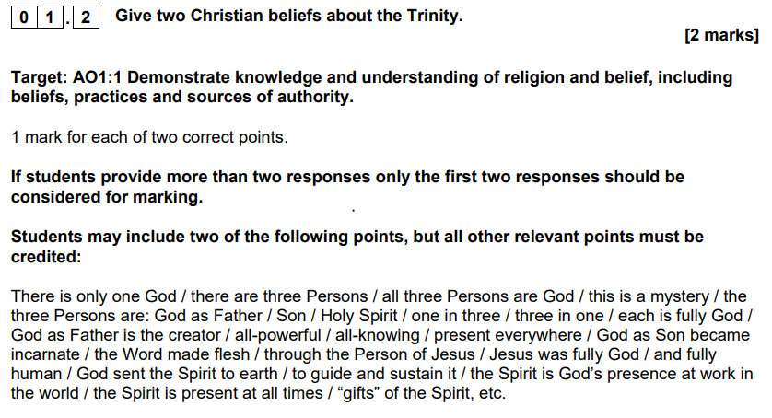
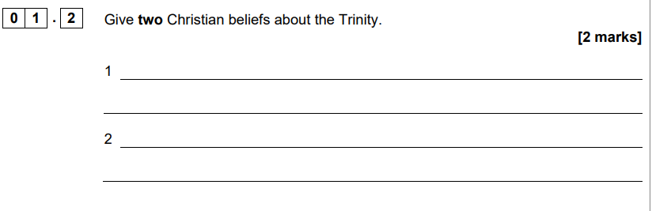
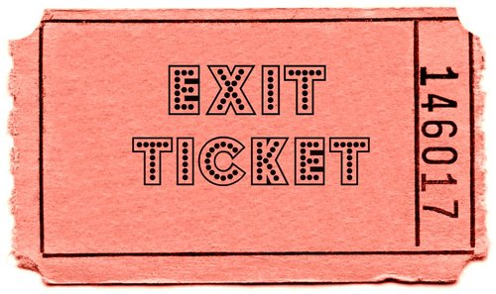
Exam practise
Design a symbol for the Christian Trinity.

