Slide 1
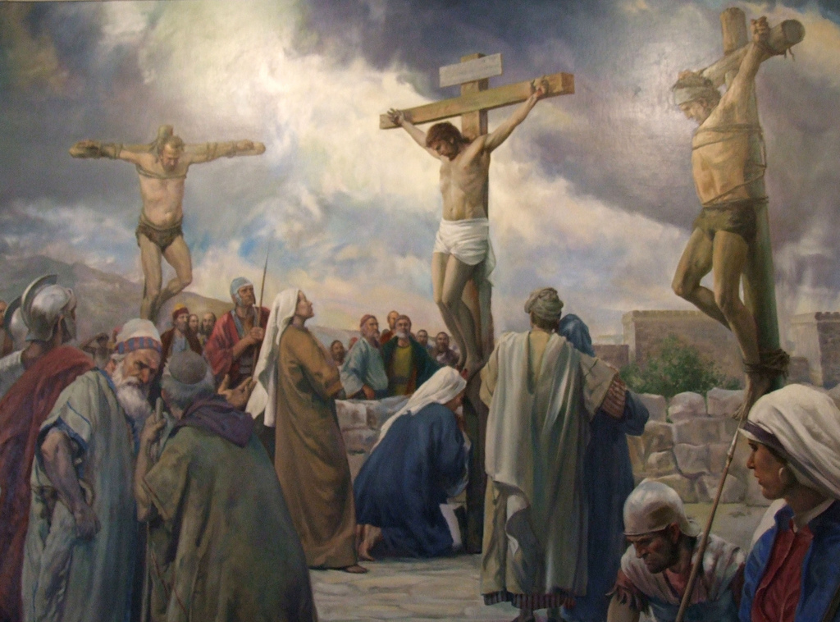
Starter
What is happening in this image?
__________________________________________
Who is being crucified in this image?
__________________________________________
What background information do you have about this?
__________________________________________
__________________________________________
How do Christians celebrate this?
__________________________________________
You each have a starter sheet with an image on.
Use your source skills to complete this starter.

Slide 2


Slide 3
Christian Festivals- Easter

Slide 4
Background
Easter is not just about eggs and bunnies. Yes, we have become used to this is society today but, for Christians, Easter is the THE MOST important festival in the Christian calendar.
This is the CATHOLIC
liturgical calendar.

Slide 5
This special time of year begins with Lent, and culminates (ends) with Easter Sunday.
This year (2017), Lent started on March 1st which was also Ash Wednesday and the day after Shrove Tuesday.
The day of Lent changes every year in accordance to the lunar calendar, similar to Easter Sunday.
Lent is a 40-day fast, so will run up until the Thursday before Easter Sunday, April 13, which is known as Holy Thursday, or Maundy Thursday.
Good Friday – March 14th
Easter Sunday – March 16th

Slide 6
What is Lent?
http://www.catholic.org/lent/
https://www.youtube.com/watch?v=UAFO61FRV9I
Fasting – Going without food
Abstinence - To ABSTAIN from something; To not do/have something
Alms giving – Giving to others

Slide 7
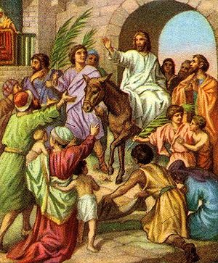
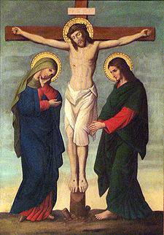
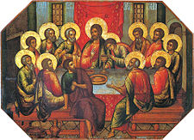
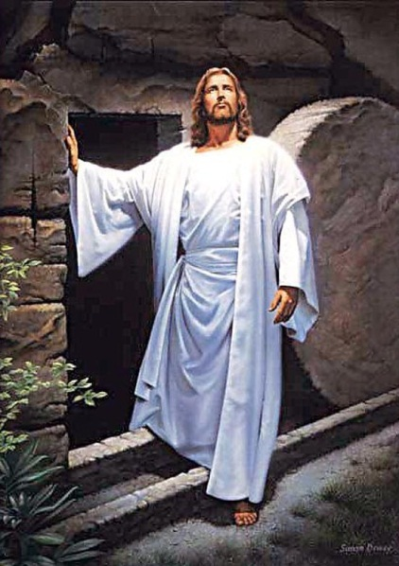
The week before Easter…
During Holy Week, Christians often attend special church services. During each service there is a remembrance for the key events in the last week of Jesus’ life.
Maundy Thursday
Easter Sunday
Palm Sunday
Good Friday

Slide 8
Palm Sunday
Palm Sunday remembers the time when Jesus went into Jerusalem riding on the back of a donkey.
The people welcomed Him like a King and threw coats and palm leaves on the ground for the donkey to walk over, just as a red carpet would be put on the ground for a King or Queen today.
This occasion is sometimes known as the Triumphal Entry to Jerusalem.

Slide 9
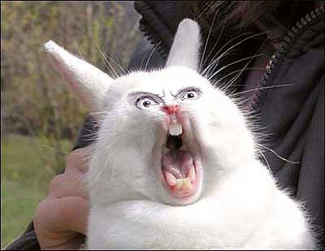
Q. Why did Jesus ride triumphantly into Jerusalem on a donkey?
"The Coming of Zion's King - See, your king comes to you, righteous and victorious, lowly and riding on a donkey, on a colt, the foal of a donkey".
He fulfilled an Old Testament prophecy in Zechariah 9:9:
“Rejoice greatly, Daughter Zion! Shout, Daughter Jerusalem! See, your king comes to you, righteous and victorious, lowly and riding on a donkey, on a colt, the foal of a donkey”
An angry rabbit

Slide 10
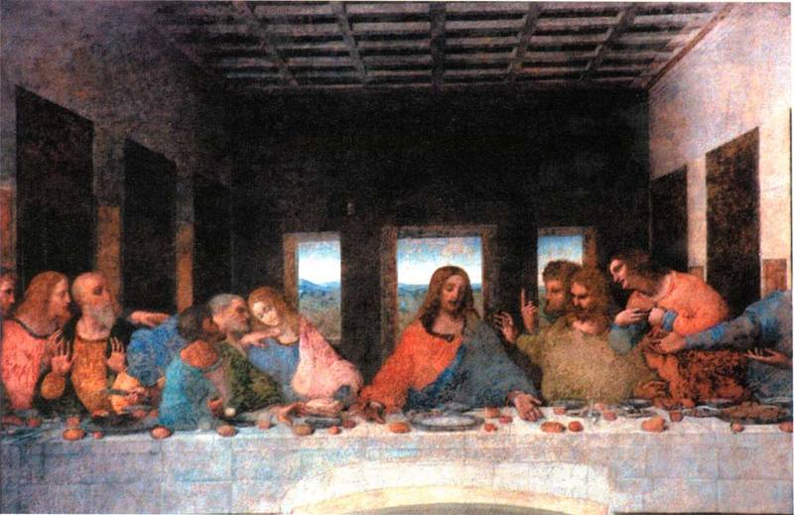
MAUNDY THURSDAY
Maundy is an old word for a commandment. Maundy Thursday remembers when Jesus met with His disciples for The Last Supper and gave them a new commandment, to love one another as He had loved them.

Slide 11
How is Maundy Thursday celebrated in the church?
Many churches will not have a celebration on Maundy Thursday. However, the Last Supper is remembered regularly, often every Sunday, in most Christian churches with a communion service.
In some churches the Ministers wash the feet of twelve members of the church, remembering that Jesus washed the feet of his twelve disciples.
In England it is traditional for the King or Queen to give out Maundy money to some of their people, often to elderly people who are in need. This is a small bag of silver coins that have been specially made for the occasion.

Slide 12
The Garden of Gethsemane
After the Last Supper, Jesus and his disciples went to the Garden of Gethsemane to pray
Jesus knew his time was coming to an end and wanted his disciples to stay awake with him and prepare for his arrest
But they did not…
https://www.youtube.com/watch?v=mMU9YVEIKZU

Slide 13
How do you think Jesus was feeling at this point? How would you have felt?
What do the events in the Garden of Gethsemane tell us about Jesus?

Slide 14
GOOD FRIDAY
Good Friday was the day when Jesus stood trial before the Priests and later a Roman Governor called Pilate. Although Pilate could not find any wrong in Jesus, He was still sentenced to death by crucifixion. Later that day after having been beaten and mocked Jesus was crucified. He died in the afternoon.
Good Friday is a day when Christians remember in a special way what Jesus did for them. It is the day that Christians remember God allowing Jesus, his perfect son, to take the world's sin onto Himself and take the punishment for it by being crucified

Slide 15
How is Good Friday Celebrated?
Good Friday is a time of sadness and thankfulness. Some Christians will fast on Good Friday. This could mean missing one or more meals or avoiding some kinds of foods.
This helps them remember the sacrifice Jesus made for them on the day of crucifixion. It is a special time of asking for forgiveness.

Slide 16
Easter Sunday
After Jesus had died on the cross, his body was anointed and buried in a tomb in the garden of Joseph of Arimathea, which was sealed by a large rock and guarded by two Roman soldiers.
When Mary Magdalene and other women went to visit the tomb on Easter Sunday, they discovered that the body was gone!
Jesus had been resurrected! And as they ran away from the tomb they saw Jesus and he said to them,
“Do not be afraid. Go and tell my brothers to go to Galilee. There they will see me”

Slide 17
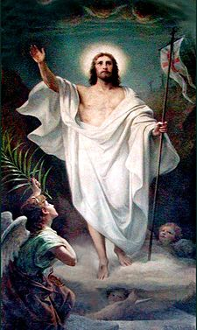

Slide 18
How is Easter Sunday celebrated in church?
Easter is a happy time. It is festival of hope and light. It celebrates new life. In churches Easter will be celebrated with special services. They will be really happy occasions remembering Jesus coming to life after his cruel death on the cross.
There will often be lots of flowers to make the church colourful and bright. There will be joyful hymns and choruses sung. Some churches will hold a service early in the morning, just as day breaks, to remember how Mary went to the tomb at daybreak and discovered the empty tomb and Jesus alive.

Slide 19
Holy week is remembered in many different ways in many different communities. How do you celebrate Holy week? OR How would you celebrate Holy week if you were a Christian?
Which event during Holy week do you think is the most important? And why?
Holy Week ends with the most important event in the history of Christianity. Why do you think this is the most important event for Christians?
God sacrificed his only son to save us from our sins. What does this tell Christians about God?

Slide 20
Task 2
Match the Bible verses to the appropriate picture!
NOTE: There may be more than one quote per picture
Stick into your exercise books

Slide 21
A Christian Easter
Palm Sunday:
Palm crosses are given out in church to worshippers
Maundy Thursday:
Priests wash the feet of the worshippers in church
Good Friday:
Christians often meditate on Jesus’ last words:
‘Father forgive them, for they do not know what they are doing’ (Luke 23:34)
In some places there may be reenactments of Jesus’ death

Slide 22
What happened after Jesus’ death?
We have looked at the week before the death of Jesus.
What do you think happened after Jesus died?

Slide 23
Ascension
Ascension | The action of Jesus rising to heaven after his resurrection
After Jesus’ death, he was taken from his cross and buried in a tomb. This was common at the time.
Three days after his death, he rose from the dead, performing his final miracle.
He then ascended (rose) into heaven.

Slide 24
Easter Sunday
This is a celebration for Christians.
Jesus came back and because of this, Christians believe in an eternal life.
Churches are decorated beautifully with gold and white colours and banners.

Slide 25
Is Easter just for Christians?
What do you associate with Easter?
Chocolate eggs
=
Eggs symbolize new life like Jesus’ resurrection. Eggs are not alive but hold life within them.
Easter bunnies
=
Symbolising new birth of animals in the spring like the rebirth of Jesus and the birth of Christianity
School holidays
=
A time for families to spend a lot of time together
Shops earning a lot of money
=
People feel pressured to buy Easter gifts

Slide 26
Question
Peer assess!
What went well?
Even better if?
‘Easter has lost all religious meaning.’ Do you agree?
Success Criteria
Describe the significance of Easter
Consider the ways in which the religious meaning has been lost.
Conclude by saying how far you agree with the statement

Slide 27
Easter has lost all religious meaning | Easter has not lost all religious meaning
Christians give up something they enjoy during lent to respect Jesus There are many important Easter services within Church where Christians are expected to attend The Church reenacts particular parts of the Holy Week events Easter has a bank holiday in England so is respected by the religion of the country. | Many people use Easter as an excuse to stay off work. People don’t understand the religious symbolism behind the Easter Egg and the Easter bunny. Many people refer to Easter as ‘the spring holidays’. People receive presents for Easter so this has become commercialised.

