Slide 1


Unscramble the anagrams and define the keywords!
fsciareic
yhorpecp
aratybel
samlpheby
EXTENSION TASK: Think of something that is really important to you. Draw a symbol to represent it.
Notes:
Sacrifice
Prophecy
Betrayal
Blasphemy

Slide 2

Unscramble the anagrams and define the keywords!
Sacrifice = to give up something for someone else; Jesus’ sacrifice for us
Prophecy = a prediction of what will happen in the future
Betrayal = to act disloyally or to break a person’s trust
Blasphemy = the crime of speaking disrespectfully about God or claiming to be God
Add these into your key word glossaries at the back of your book
Notes:
Sacrifice
Prophecy
Betrayal
Blasphemy

Slide 3

Why is the cross so important to Christians?
Why might it comfort them to always remember the sacrifice he made?
CRUCIFIXION
The killing of Jesus upon the cross.
Crux
Cruz
Crucify
Notes:
Get them onto crucifixion – talk about origins – crux, cruz, croix. Criminals sentenced to death by hanging on a cross. Why might it comfort them to always remember the sacrifice he made? Cross v. crucifix?

Slide 4


Did Jesus deserve to die?
Yes, he was disrupting the peace! | No, he was innocent and good!
Yes, he was disrupting the peace! | No, he was innocent and good!

Slide 5
Did Jesus deserve to die?
Yes, he was disrupting the peace! | No, he was innocent and good!
Yes, he was disrupting the peace! | No, he was innocent and good!
The Sanhedrin (Council of Jewish leaders) felt that Jesus was becoming too powerful and was a risk to their own authority. | Even Pontius Pilate, the Roman Governor, couldn’t find anything that Jesus had done wrong – he tried to get the public to free him.
He was claiming to be God (blasphemy). | One of the Romans said ‘Surely this man was the Son of God!’ (Mark 15.39) when he realised that Jesus had done nothing wrong.
He was causing upheaval in society. | He had made a lot of positive changes in the community.
Notes:
Fist vid – 0.45-2.08. explain that it’s a bit of a stereotype! Second video, up to 3.21ish

Slide 6

Pretend you are a lawyer either defending or trying to persecute Jesus… what would be your closing speech?
You might want to think about…
The crime he was accused of (blasphemy)
The good he had done in the community
The fact that key Roman officials didn’t think he’d done anything wrong
The upheaval he had caused in society
The threat to Jewish authority
Notes:
Write definition of blasphemy on the board

Slide 7
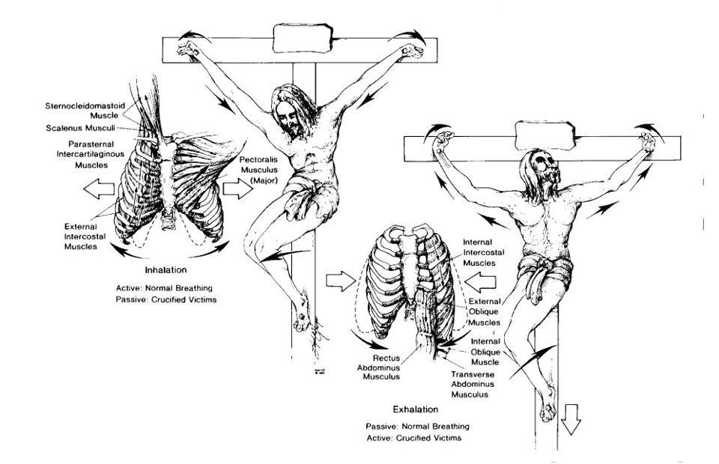
Notes:
Usually died from asphyxiation – some hours, some days.

Slide 8
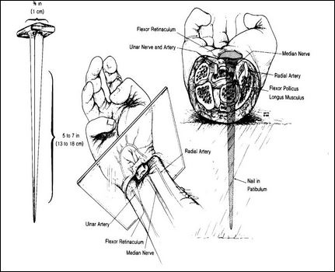
Notes:
Also spear in his side, whipped repeatedly, crown of thorns. Died after six hours. Watched by people like Mary Magdalene and his mother.

Slide 9

Describe the scene…
If you were at the crucifixion, what would you see, hear and feel?
You might want to mention…
Jesus’s injuries
The anger of the crowd
The fear of his followers
His final words – ‘Father, into your hands, commit my spirit’ – Luke 23:46
The fact that Jesus was a good man right until the end – he forgave the guards and comforted one of the criminals beside him.
Notes:
Forgave guards – they didn’t know what they were doing. Comforted criminal – said he’d go to heaven after he defended Jesus when the other one insulted him.

Slide 10
If God is so powerful, why did his son suffer so much?
Notes:
Felt all the pain and suffering of the crucifixion. Lead on to god making up for it by bringing him back

Slide 11
As the Sabbath was approaching, there was no time to bury the body.
They spread the word, and Jesus appeared to many people, such as his disciples.
After 40 days, Jesus left the Earth physically and returned to heaven.
The body was therefore placed in a cave, with a stone rolled in front.
Angels appeared and told the women that Jesus had been resurrected – he had risen from the dead.
This event is called the ascension – he ascended (went up) to heaven.
Two days later, Mary Magdalene and some other women went to anoint the body.
The body was not there.
What happens next?
Notes:
Get key words in glossaries!

Slide 12

Question
REMEMBER:
Make two separate points.
Explain them both or back them up with examples.
Talk about the CRUCIFIXION, not RESURRECTION!
‘Explain two ways in which learning about the crucifixion may influence Christians today’
(4 marks)

Slide 13
‘Explain two ways in which learning about the crucifixion may influence Christians today’ (4 marks)
One way in which learning about the crucifixion may influence Christians today is that it will bring them strength. By learning that Jesus physically suffered in the most horrific way, it might encourage them to know that God knows how we feel when we suffer in our lives. For example, when we are poorly., and give them the strength to face challenges they face.
Another way learning about the crucifixion may influence Christians today is they may no longer fear what happens when we die. Through the resurrection, Jesus atoned (paid the price for) our sins and opened the way into Heaven. Christians may feel comforted by this and not longer fear death.
One way in which learning about the crucifixion may influence Christians today is that it will bring them strength. By learning that Jesus physically suffered in the most horrific way, it might encourage them to know that God knows how we feel when we suffer in our lives. For example, when we are poorly, and give them the strength to face challenges they face.
Another way learning about the crucifixion may influence Christians today is they may no longer fear what happens when we die. Through the resurrection, Jesus atoned (paid the price for) our sins and opened the way into Heaven. Christians may feel comforted by this and no longer fear death.

Slide 14
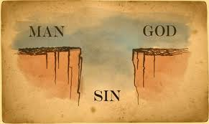
Can you explain this image might mean for Christians?

Slide 15


The Christian narrative
People of God & prophets e.g. Moses
Try to sort the problem
Jesus is born & teaches people. Dies for our sins
The Fall (separation between God & humanity)
Unexpected hero
Incident & disruption
The Bible is a ‘narrative’. It is telling a ‘big story’ of God’s dealings with humanity
Humanity & God back together. The Kingdom of God.
God creates the world
Salvation
Setting
Salvation = To be ‘saved’ from a bad situation

Slide 16
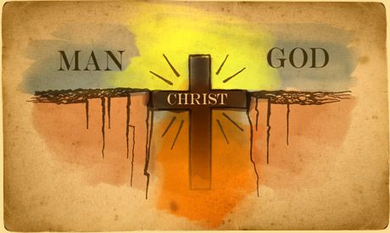

Slide 17
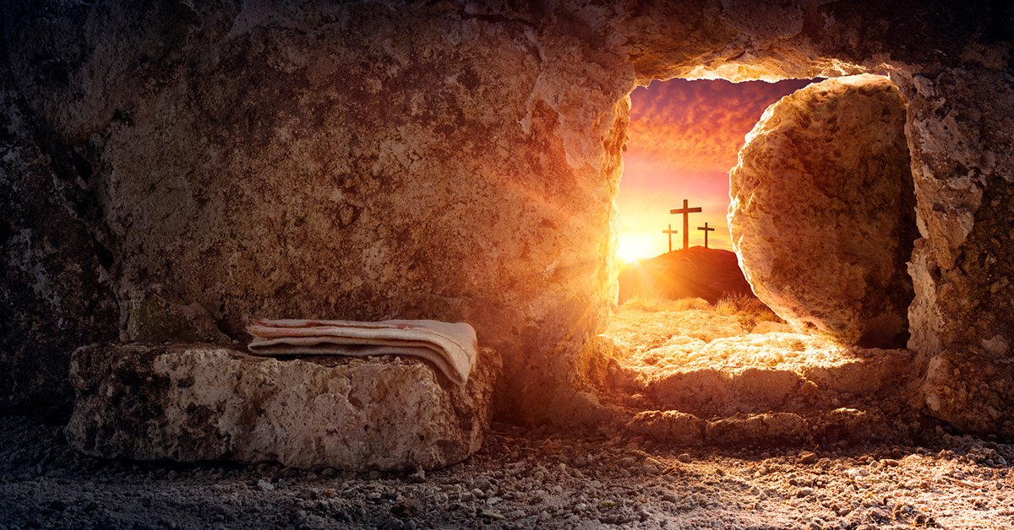
Resurrection = To ‘rise’ from the dead; come back to life
https://www.youtube.com/watch?v=qmQGzbVH-sA

Slide 18
LUKE 24 On the first day of the week, very early in the morning, the women took the spices they had prepared and went to the tomb. ² They found the stone rolled away from the tomb, ³ but when they entered, they did not find the body of the Lord Jesus. ⁴ While they were wondering about this, suddenly two men in clothes that gleamed like lightning stood beside them. ⁵ In their fright the women bowed down with their faces to the ground, but the men said to them, “Why do you look for the living among the dead? ⁶ He is not here; he has risen! Remember how he told you, while he was still with you in Galilee: ⁷ ‘The Son of Man must be delivered over to the hands of sinners, be crucified and on the third day be raised again.’ ” ⁸ Then they remembered his words.
⁹ When they came back from the tomb, they told all these things to the Eleven and to all the others. ¹⁰ It was Mary Magdalene, Joanna, Mary the mother of James, and the others with them who told this to the apostles. ¹¹ But they did not believe the women, because their words seemed to them like nonsense. ¹² Peter, however, got up and ran to the tomb. Bending over, he saw the strips of linen lying by themselves, and he went away, wondering to himself what had happened.

Slide 19
MATTHEW 28 After the Sabbath, at dawn on the first day of the week, Mary Magdalene and the other Mary went to look at the tomb.
² There was a violent earthquake, for an angel of the Lord came down from heaven and, going to the tomb, rolled back the stone and sat on it. ³ His appearance was like lightning, and his clothes were white as snow. ⁴ The guards were so afraid of him that they shook and became like dead men.
⁵ The angel said to the women, “Do not be afraid, for I know that you are looking for Jesus, who was crucified. ⁶ He is not here; he has risen, just as he said. Come and see the place where he lay. ⁷ Then go quickly and tell his disciples: ‘He has risen from the dead and is going ahead of you into Galilee. There you will see him.’ Now I have told you.”
⁸ So the women hurried away from the tomb, afraid yet filled with joy, and ran to tell his disciples. ⁹ Suddenly Jesus met them. “Greetings,” he said. They came to him, clasped his feet and worshiped him. ¹⁰ Then Jesus said to them, “Do not be afraid. Go and tell my brothers to go to Galilee; there they will see me.”

Slide 20
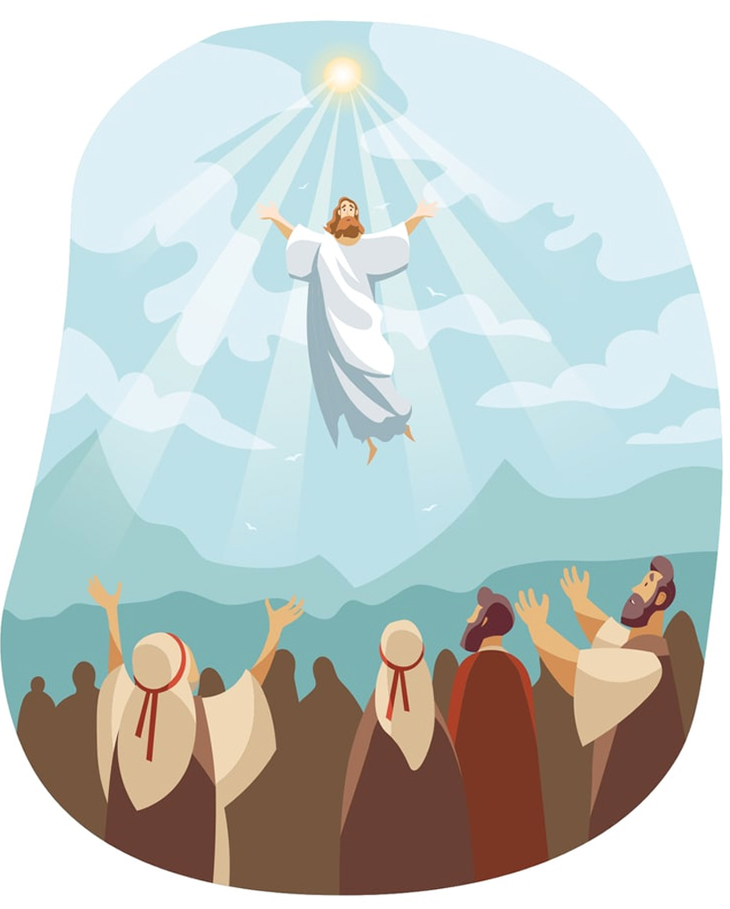
⁷ He said to them: “It is not for you to know the times or dates the Father has set by his own authority. ⁸ But you will receive power when the Holy Spirit comes on you; and you will be my witnesses in Jerusalem, and in all Judea and Samaria, and to the ends of the earth.”
⁹ After he said this, he was taken up before their very eyes, and a cloud hid him from their sight.
¹⁰ They were looking intently up into the sky as he was going, when suddenly two men dressed in white stood beside them. ¹¹ “Men of Galilee,” they said, “why do you stand here looking into the sky? This same Jesus, who has been taken from you into heaven, will come back in the same way you have seen him go into heaven.”
Ascension = the event, 40 days after the resurrection, when Jesus returned to God, the Father, in Heaven

Slide 21
Christians believe the crucifixion was when Jesus took the punishment for our sins. They have been atoned for.
The resurrection shows that good triumphs over evil.
The resurrection proves that Jesus is the son of God – as no human has this power.
The crucifixion shows that suffering is part of life, and that Jesus/God suffers along with us. They understand what we are going through.
But why does it all matter?
Without the resurrection there would be no Christian faith.
The resurrection shows that death is not the end. So there is no need to fear death.
The resurrection and crucifixion influences culture – people now ask God for forgiveness around Easter time.
Atone = pay the price for/make amends for/make up for. Our sins were buried with Jesus.
Notes:
Atone = pay the price for/make amends for/make up for. Our sins were buried with Jesus.
Easter – festival of hope and change

Slide 22
Interpretations of ‘resurrection’
There are different beliefs about what happens when a person who has died is resurrected.
Others believe that some time in the future, when Jesus returns to judge, the dead will be raised.
The Catholic and some Orthodox Churches are clear that this resurrection will be a bodily one and will once again receive their old body but transformed into a glorified state in which suffering will not exist.
Some believe that a person’s soul is resurrected very soon after death occurs.

Slide 23
‘The crucifixion is more important to Christians than the resurrection’
Evaluate this statement, in your answer you should:
Refer to Christian teaching
Give detailed judgements to support this statement
Give detailed arguments to support a different view
Reach a justified conclusion

