Slide 1
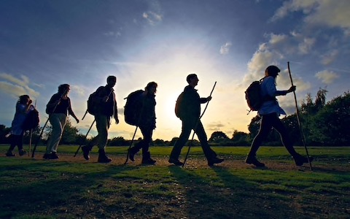


Christian practices Pilgrimage: Lourdes & Iona
Complete your knowledge review on worship and prayer

Slide 2
What do I need to know?
Liturgical and non-liturgical worship (How do different Christian churches worship?)
Formal and informal worship (What is the difference?)
The Bible in worship (How is the Bible used in Christian worship?)
Private worship (What are the benefits of private worship?)
Prayer, and the Lord’s Prayer (Why is the Lord’s Prayer significant? Why pray at all?)
The meaning of sacraments (What is a sacrament?)
Baptism – infant and believer’s (Why do Christians have different beliefs about when a person should be baptised?)
Eucharist in Catholicism (What is the sacrament of Holy Communion, and why is it important?)
Eucharist in the Church of England (How do C of E beliefs about the Eucharist differ from Catholic beliefs?)
Lourdes (Why is Lourdes a place of pilgrimage for Christians today?)
The role of the Church in the local community, including food banks and street pastors (Why does the Church provide these things?)
The importance of the ‘worldwide Church’ in working for reconciliation
How Christian Churches respond to persecution (How do they help?)
The work of one Christian charity (Tearfund, Christian Aid, CAFOD)

Slide 3
What is a pilgrimage?
A pilgrimage is a journey made for a religious reason to a place that is holy or sacred
People who go on pilgrimage are called pilgrims
Can you name any places of pilgrimage?

Slide 4
Every year, pilgrims from many different religions make these special religious journeys
Though a pilgrimage is a physical journey, it is also a spiritual journey towards God.

Slide 5
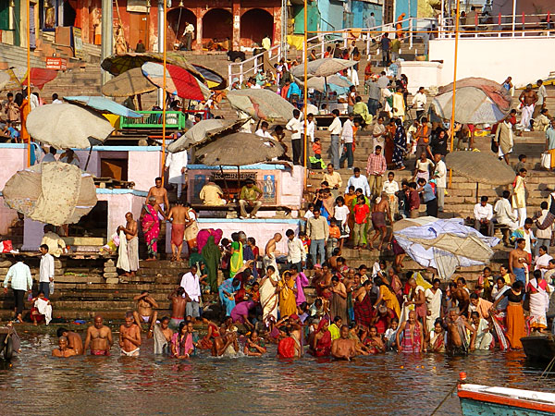
Here are some places which are special to many religious believers…
River Ganges in Varanasi, India.

Slide 6
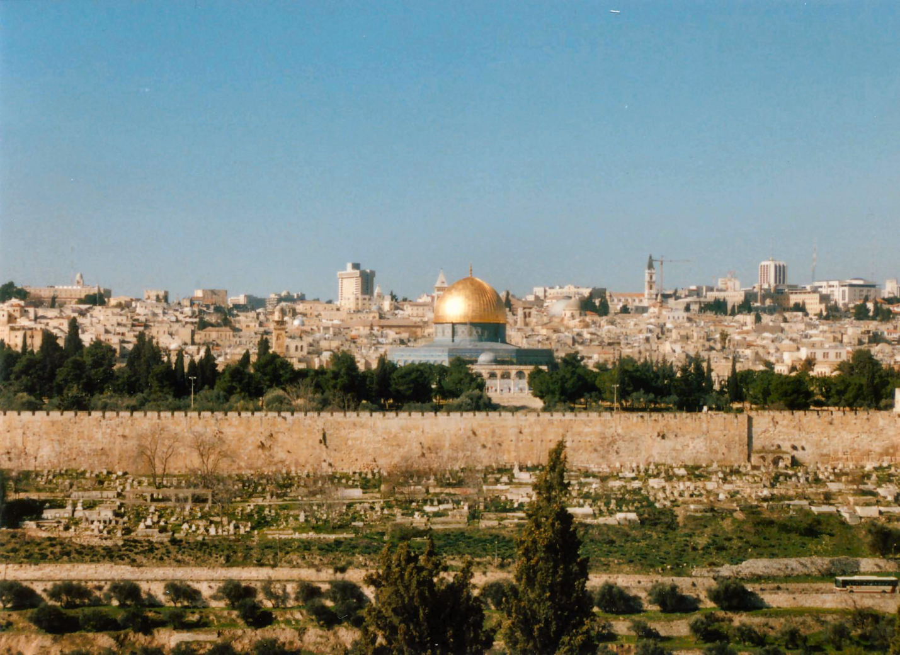
The Holy Land, Jerusalem

Slide 7
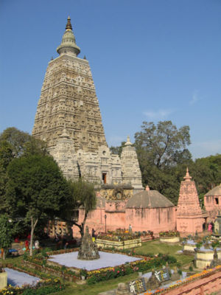
Bodh Gaya , India

Slide 8
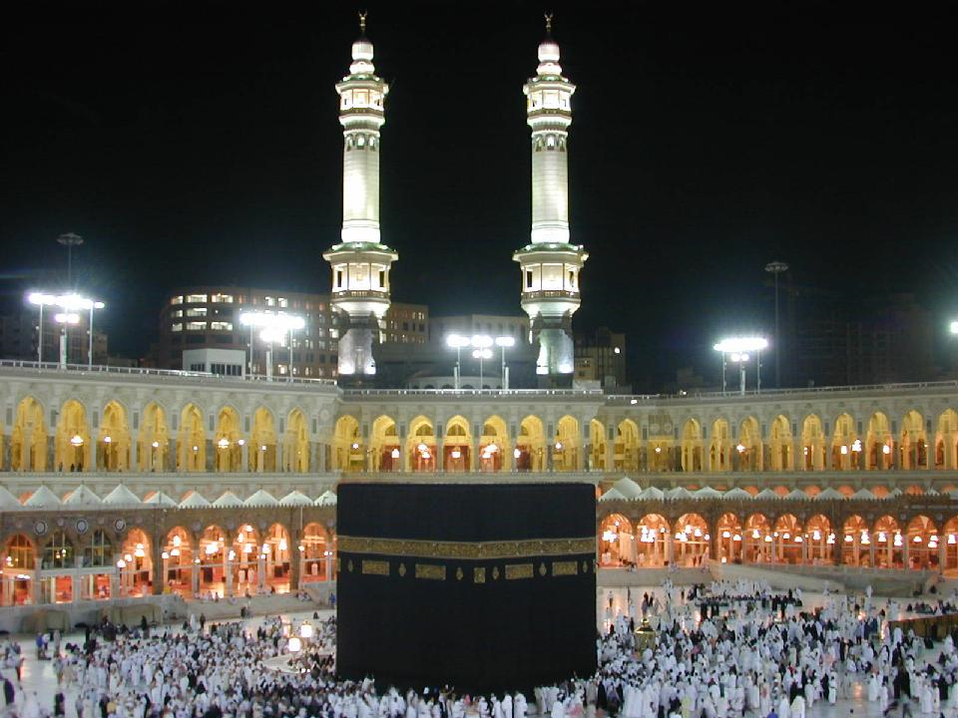
Ka’aba, Holy City of Mecca Saudi Arabia

Slide 9
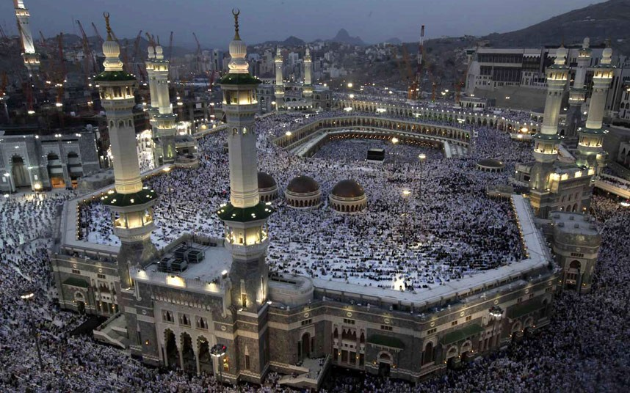
Mecca

Slide 10
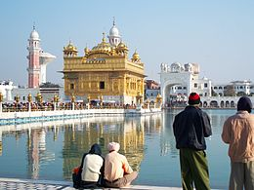
Golden Temple, Amritsar
India

Slide 11
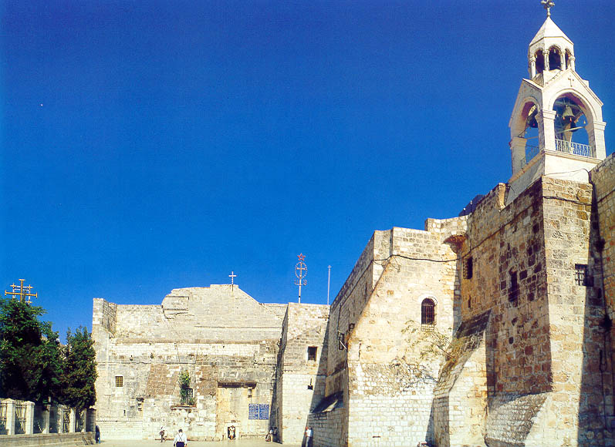
The Church of the Nativity, Bethlehem

Slide 12
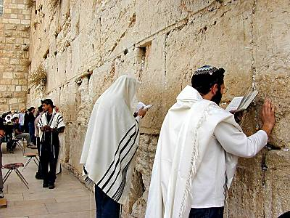
Western Wall, Jerusalem

Slide 13
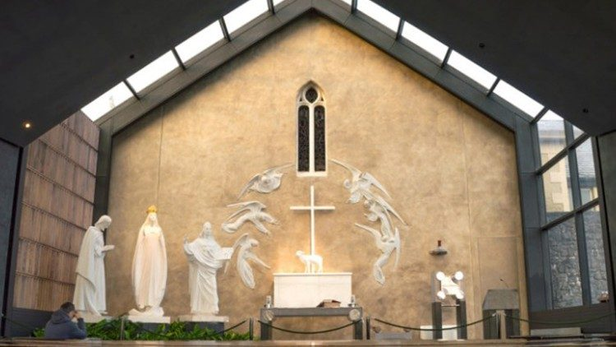
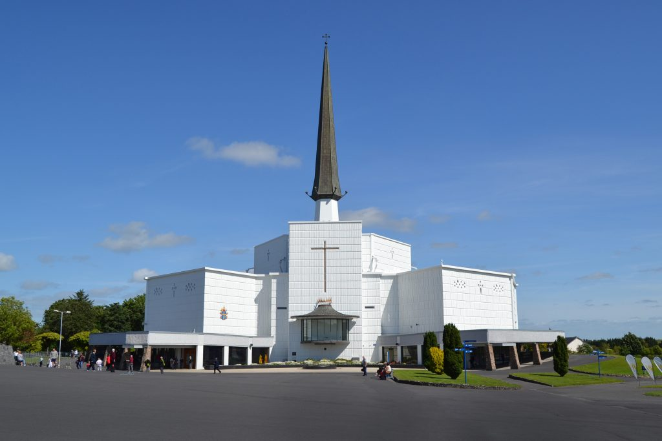
Knock Shrine, Ireland

Slide 14
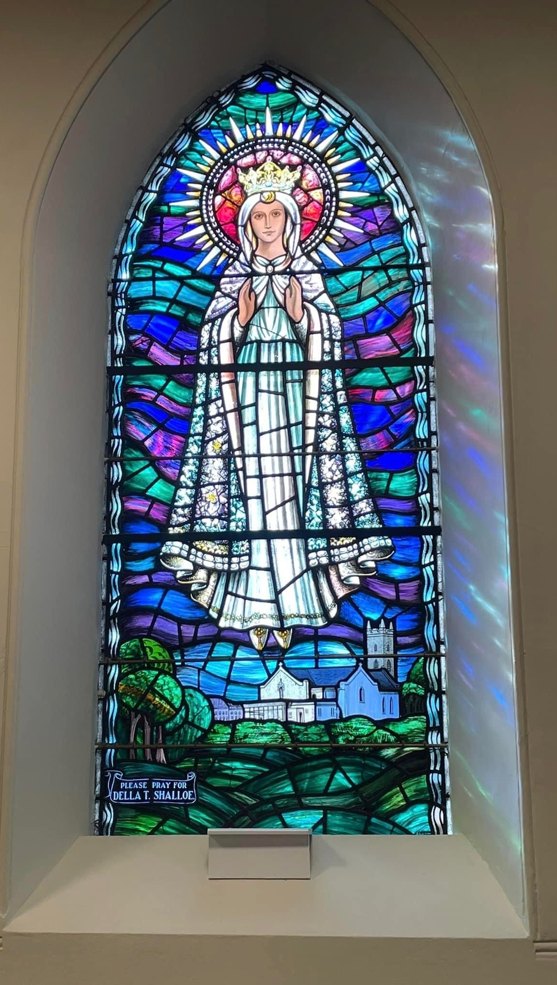
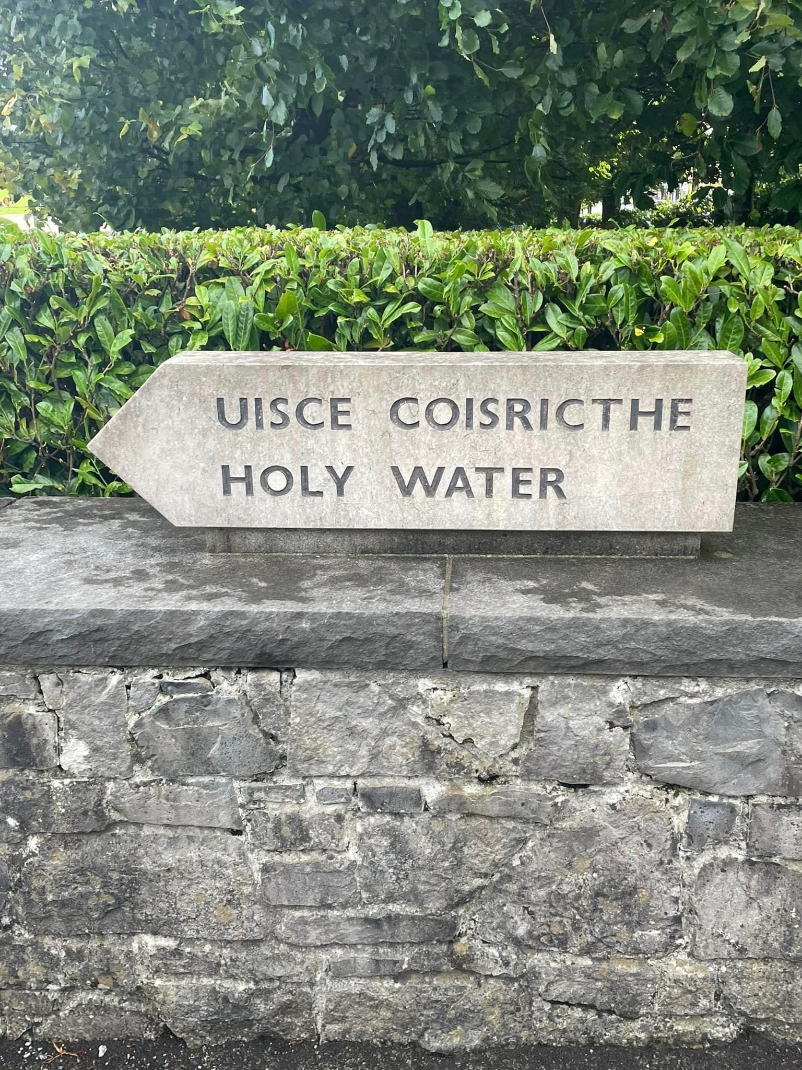
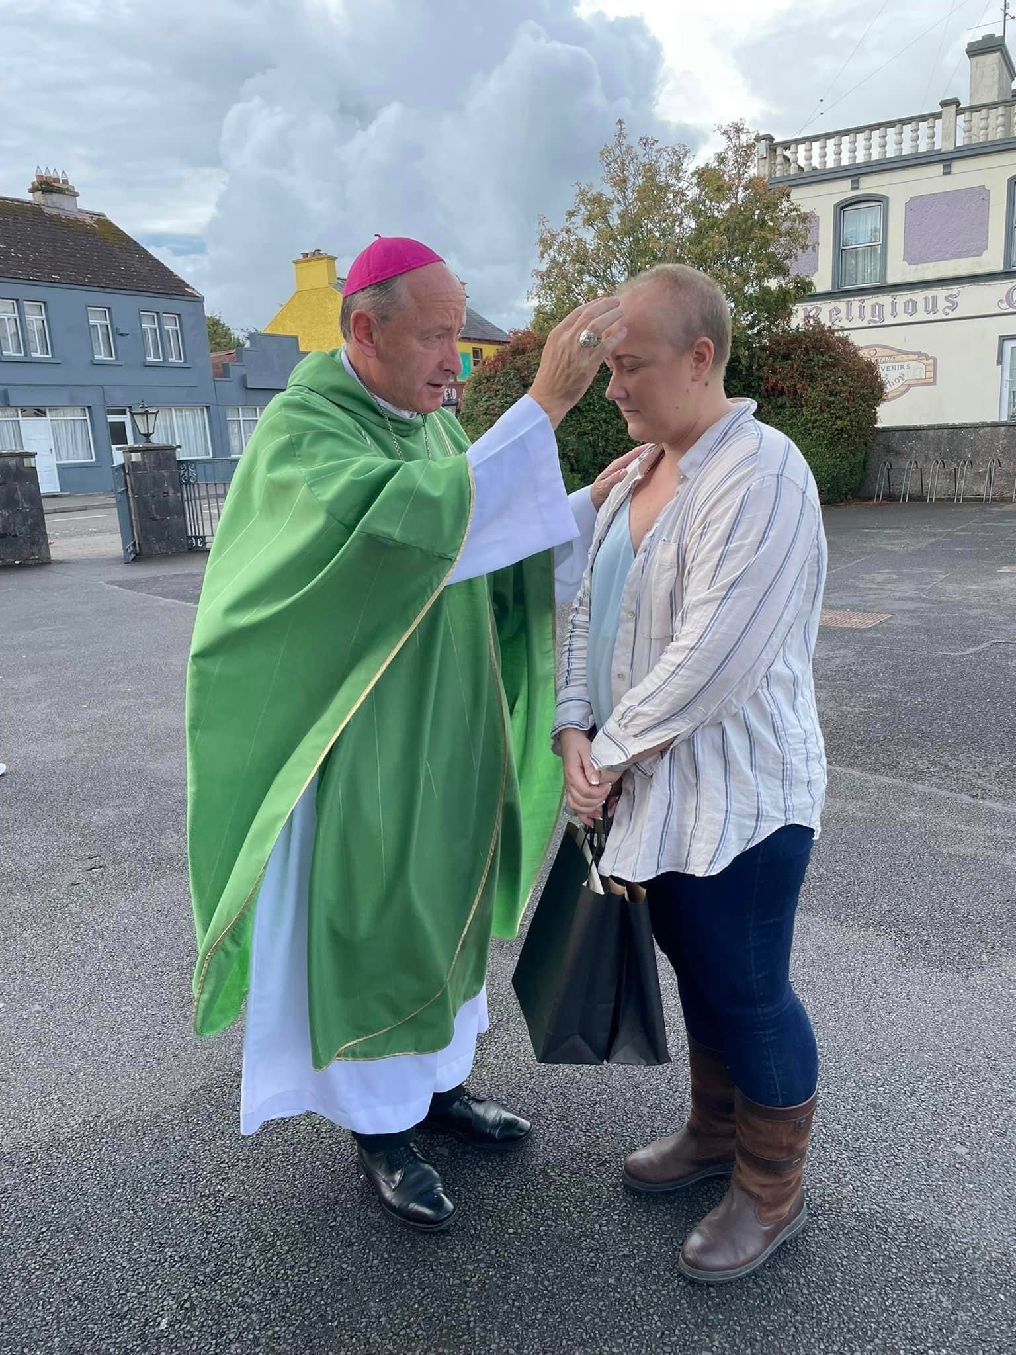
Knock Shrine, Ireland July ‘22

Slide 15
In the Middle Ages, pilgrimages were long and dangerous journeys undertaken as an act of penance and religious devotion. One famous pilgrimage site is Santiago de Compostela (Spain). The pilgrimage started at the pilgrim’s home and continued by foot until they reached Santiago. Once they returned home, either by foot, horseback or boat, pilgrims presented the scallop shell as proof they completed the pilgrimage, since the shells are indigenous to the Galician coast. By the 12th Century, scallop shells were being sold by hundreds of licensed vendors around the Cathedral of Santiago cementing their symbolic status.

Slide 16
The role and importance of pilgrimage
Christians go on pilgrimage to:
Grow closer to God and strengthen their faith
Express sorrow and be forgiven
Reflect on their lives, particularly in difficult times
Pray for something special or thank God for a blessing
Seek a cure for an illness
Help other pilgrim who are disabled or ill
Experience a holy place
Meet others who share a faith

Slide 17
It is not compulsory for Christians to go on a pilgrimage but it can play an important part in their spiritual lives.
However, in Islam, there is a duty for all Muslims to take part in Hajj at least once in their lifetime.

Slide 18
How does going on a pilgrimage INFLUENCE a Christian’s life?
Taking part in a pilgrimage gives many opportunities for prayer and worship, and is itself an act of worship as believers show devotion to God by choosing to go
Often, believers will come back with a better understanding of their faith and a renewed enthusiasm for living a Christian life.
Believers may have received advice from priests or monks that has helped them see their problems in a new light.
Believers may also feel cleansed from sin.

Slide 19
Answer these questions in your exercise book
What is a pilgrimage?
What are people who go on a pilgrimage called?
Name 3 places of pilgrimage and who goes there
Why do people go on a pilgrimage? Give one reason
How does going on a pilgrimage influence those who go? Give 3 ways

Slide 20
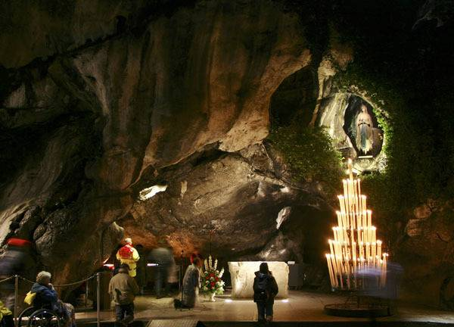
Lourdes
https://www.youtube.com/watch?v=7xNUkYL1_Po
https://www.bbc.co.uk/programmes/p08bf7kz

Slide 21
“As I raised my head to look at the grotto, I saw a Lady dressed in white, wearing a white dress, a blue girdle and a yellow rose on each foot, the same colour as the chain of her rosary; the beads of the rosary were white”
- Bernadette describing her first vision of the Virgin Mary

Slide 22
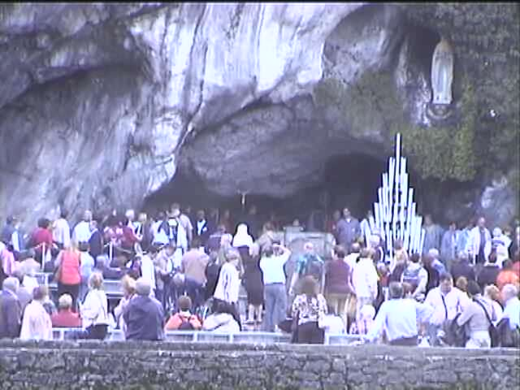
Lourdes Today
Around five million pilgrims and visitors travel to Lourdes each year, including many who are seriously ill or handicapped.
They visit the site where Mary appeared to Bernadette, attend mass and pray the rosary.
http://www.lourdes-radio.com/player_live/player_live_en/player-token_en.php

Slide 23
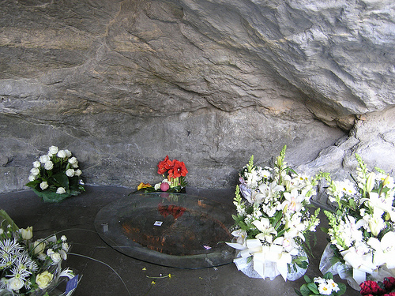
The Healing Water
Pilgrims visit the pools of holy water and immerse themselves.
As many as 6,000 unexplained healings have been recorded.
However only 67 have been authenticated by the Catholic Church.

Slide 24
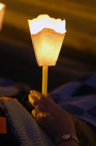
Candlelight Procession
Pilgrims also take part in the torch-light procession, which begins at dusk and ends in the dark. There is a beautiful image from outside the old basilica as the thousands of candles create a sea of light.
At the head of the procession a statue of Our Lady is carried.
The rosary is recited along the way, interspersed with the Lourdes hymn ‘Ave Maria’.

Slide 25
Iona
https://www.youtube.com/watch?v=ocBl16Mw8mE
https://www.youtube.com/watch?v=IUZAIfwn52I
Iona is an island off the west coast of Scotland. In the 6th century AD, ST Columba established a small monastery there. It is now the home to the the ecumenical Iona Community and a place of Christian pilgrimage dedicated to the Virgin Mary.

Slide 26

What happens?
The Iona community holds daily services in the abbey church
Lead a seven mile hike to the island’s holy and historic spots
Conduct workshops on Christian themes
Pilgrims are asked to help out with daily chores and meals while staying there
There is time for silence, for reflection and meditation and reading the Bible or holy books
Some people think Iona is a ‘thin place’, where the veil between the spiritual world and the physical world is thin. Iona is remote and windswept, so for many pilgrims it feels like a place where nature reveals God’s infinite power and presence.

Slide 27
“There is no difference between a pilgrimage and a holiday”
For (agree)​
Against (disagree)​
Religious view​
My opinion​
​
Have I also:​
Evaluated? (e.g. this is a strong argument because…)​
Referred back to the statement?​
Scripture included?
Level​ | Mark​ | Comment​
1​ | 1-3​ | A point of view (ID) with some basic reasons to support it (DV)​
2​ | 4-6​ | A recognition of various points of view (ID) with developed reasons to support them (DV)​ Some evidence (EV) used to support points of view​ Maximum of level 2 if there is no reference to religion or the argument is one-sided​
3​ | 7-9​ | Clear reference to religion (R)​ A recognition of various points of view (ID) with well explained reasons to support them (DV)​ Evidence (EV) used to support points of view ​ Points are clearly linked (L) to the original statement​
4​ | 10-12​ | Clear reference to religion (R) which is applied to the issue​ A recognition of various points of view (ID) with well explained reasons to support them (DV)​ Evidence (EV) used to support points of view ​ Points are clearly linked (L) to the original statement​ There may be some evaluation (E) of individual arguments​

Slide 28
Summary
You should now be able to:
explain the role and importance of pilgrimage for Christians
describe two contrasting examples: Lourdes and Iona

