Slide 1

Christian practices The sacraments: Baptism & Eucharist
Wednesday 25th April

Slide 2
What do I need to know?
Liturgical and non-liturgical worship (How do different Christian churches worship?)
Formal and informal worship (What is the difference?)
The Bible in worship (How is the Bible used in Christian worship?)
Private worship (What are the benefits of private worship?)
Prayer, and the Lord’s Prayer (Why is the Lord’s Prayer significant? Why pray at all?)
The meaning of sacraments (What is a sacrament?)
Baptism – infant and believer’s (Why do Christians have different beliefs about when a person should be baptised?)
Eucharist in Catholicism (What is the sacrament of Holy Communion, and why is it important?)
Eucharist in the Church of England (How do C of E beliefs about the Eucharist differ from Catholic beliefs?)
Lourdes (Why is Lourdes a place of pilgrimage for Christians today?)
The role of the Church in the local community, including food banks and street pastors (Why does the Church provide these things?)
The importance of the ‘worldwide Church’ in working for reconciliation
How Christian Churches respond to persecution (How do they help?)
The work of one Christian charity (Tearfund, Christian Aid, CAFOD)

Slide 3
Our outward facial expressions usually represent how we are feeling on the inside, which we cannot see. They are outward, visible signs of something which we cannot see, but it is real.

Slide 4
What is a sacrament?
Sacraments come from the word ‘sacred’ and bring people closer to God.
It is an outward and visible sign of an inward and spiritual blessing (Grace from God).
Grace = The unwavering love, peace and mercy of God, even if we do not deserve it.

Slide 5
RC Church | Protestant
7 | 2
Baptism Reconciliation Holy Communion Confirmation Marriage Holy Orders Sacrament of the sick | Baptism Holy Communion
Most Christian churches recognise two sacraments as set out in the gospels. The Roman Catholic Church recognise another five.

Slide 6
What is a sacrament?
Baptism
Water
Oil
candle
Sacrament of the sick
Oil
Prayers
Holy orders
Confirmation
Flames
Dove
Marriage
Rings
Communion
Bread
Wine
Chalice
Host
Reconciliation
Cross
Forgiven

Slide 7
Baptism
Initiation = to introduce or begin something; to be initiated
https://www.youtube.com/watch?v=WPAi7h_sP9w

Slide 8

What is baptism?
Baptism is a ceremony in which a baby (or an adult) is welcomed into the Church
Why?

Slide 9
“Therefore, go and make disciples of all nations, baptising them in the name of the Father and of the Son and Holy Spirit” ~ Matthew 28:19
Jesus’ baptism set an example for his followers to be baptised in order to receive the Holy Spirit and begin a new life in the Christian community
https://www.youtube.com/watch?v=9_dr9njVzKM

Slide 10
Being in the Family
Christians believe that we are ALL a part of God’s family.
Some Christians celebrate being a part of this family from birth and other Christian denominations mark this moment much later.
Whenever Christians are initiated in to this family they are being WELCOMED

Slide 11
Baptism usually takes place as part of the mass or service, and is performed by the priest.
The child’s parents, and sometimes special friends called ‘Godparents’, are called to make promises to God
These promises are to God that they will raise their child as a Christian and to believe in Jesus and follow his teachings

Slide 12
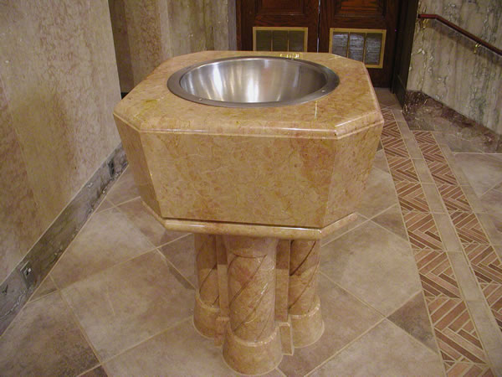
What happens?
In some Churches, the parents and godparents stand near the font. The font is a special basin which contains holy water.

Slide 13
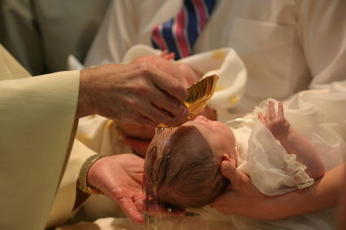
The priest will use the water from the font to pour onto the baby’s forehead. As they do this, they say “I baptise you in the name of the Father, and of the Son and of the Holy Spirit.”

Slide 14
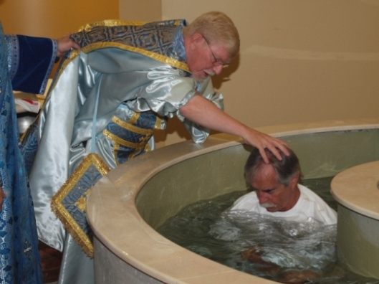
Other Churches prefer to perform adult (or believer’s) baptisms
Why do you think some Churches prefer to baptise adults, rather than children?

Slide 15
Why water?
The water is used to symbolise the washing away of our original sin. If an adult is baptised it is used to symbolise the washing away of our old life, and mark the beginning of our new life as a Christian

Slide 16

Candle
In some Christian churches, newly baptised babies or adults will be given a special baptism candle.
This symbolises Jesus as the light of the world, and the light of Jesus in your new life as a Christian.

Slide 17
Infant or believer’s baptism?
Infant
Catholic, Orthodox, Anglican, Methodist churches practice infant baptism
Everyone is a descendant of Adam & Eve, who committed the first sin
Infant baptism removes this ‘original sin’
The child is welcomed into the Church
The parents thank God for their new baby
Usually takes place in a font, with parents and god-parents present
Believer’s
Baptist and Pentecostal Churches practice adult baptism
Some Christians argue that a baby is too young to understand the meaning of baptism
You should wait until you are old enough to come to a mature decision about your faith
Baptism itself does not ’save’ a person (like infant baptism), it is someone’s conversion to living a life dedicated to Jesus that is important
Involves a full immersion in a pool

Slide 18
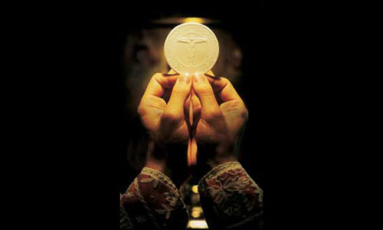
The Eucharist
From a Greek word meaning ‘thanksgiving’
What are Christians thankful for?

Slide 19
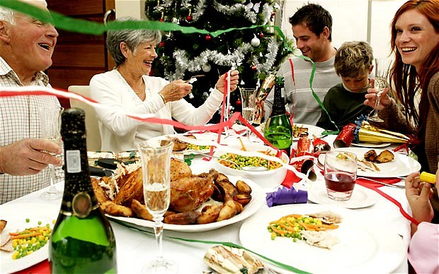
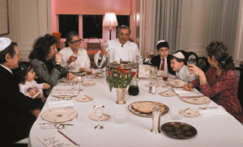
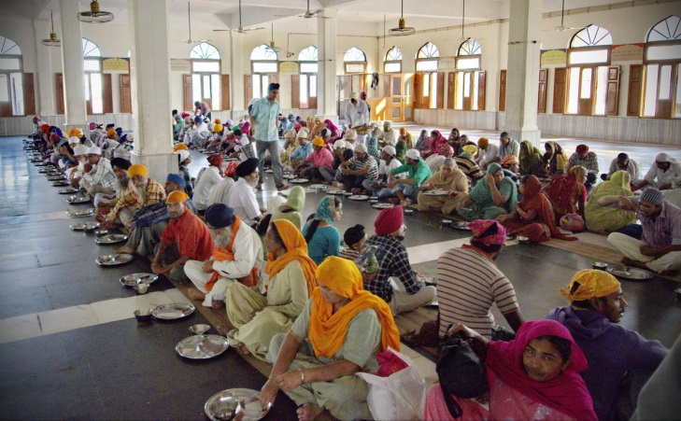
Communal : Communion
When do we share meals with others?
Why do we share meals with others?
https://www.youtube.com/watch?v=MuxWptcwqUs
Notes:
Traditional family Christmas dinner – Jewish Sedar meal (Passover) – Sikh Langar (communal meal). Emphasis on why this is important and special. Gathering together and sharing a meal brings communities/families closer and allows those involved to particpate in a communal event. Definition of key word. Bringing together in unity.

Slide 20
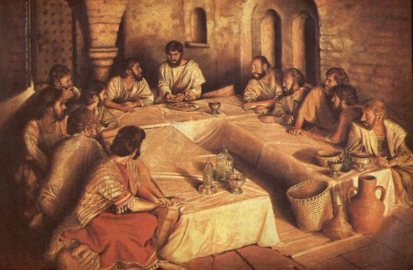
Passover
Notes:
Click the picture to watch a ‘Passover rhapsody’. Jewish Passover story – Jesus and his disciples were gathered to celebrate the Passover meal. Tradition. Why do we have a meal to commemorate past events? By remembering the freedom of the Jewish nation from slavery in Egypt, Christ frees us from the slavery of sin and the power of death.

Slide 21
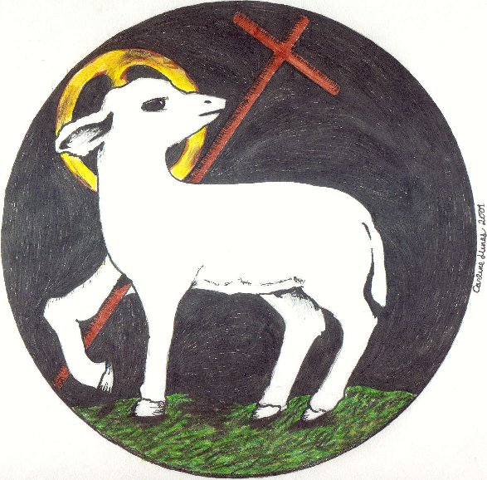
Notes:
Jesus is the sacrificial lamb – lambs were sacrificed to God as part of the Jewish tradition. By celebrating Passover, He is also revealing Himself as the one who will be sacrificed for us.

Slide 22
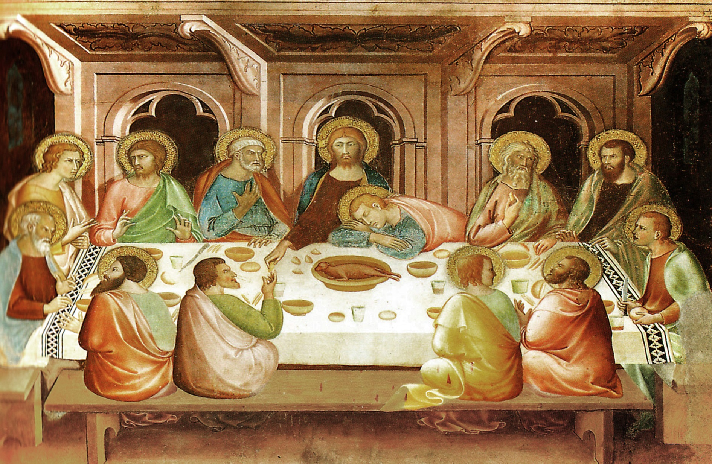
“Do this in remembrance of me” 1 Corinthians 11:24
Notes:
Click the picture to watch the clip from the film ‘The passion of the Christ’ of the last supper. Ask students to note down THREE key things/words that they think are important about the Last Supper.

Slide 23
One Christ : One Church
“Is not the cup of thanksgiving for which we give thanks a participation in the blood of Christ? And is not the bread that we break a participation in the body of Christ? Because there is one loaf, we, who are many, are one body, for we all share one loaf”
1 Corinthians 10:16-17

Slide 24
Every time Christians receive Holy Communion it unites them more deeply with Christ, making them living members of the Body of Christ. It brings the community together in unity, strengthening their commitment to their faith.

Slide 25
“I am the way, the truth and the life” John 14:16
Holy Eucharist is the sacrament in which Jesus Christ gives his Body and Blood – himself- for us, so that we too might give ourselves to him in love and be united with him in Holy Communion. In this way Christians are joined with the one Body of Christ, the Church.
The Eucharist is the “source and summit of the Christian life” – Catechism of the Catholic Church

Slide 26
The Eucharistic rite
Roman Catholic tradition
In Mass, the priest recites the words spoken by Christ at the Last Supper
The bread and the wine are blessed, and Jesus is present, at that moment, with us. The bread and wine become the body and blood of Christ.
TRANSUBSTANTIATION

