Slide 1


DNA – recap last lesson
Explain a Christian belief about judgement.
Summarise the Parable of the Sheep and the Goats in no more than 50 words.
Give two ways that beliefs about judgement may affect how a Christian lives their current life.

Slide 2

heaven: a state of eternal happiness in the presence of God; the place of eternal peace ruled over by God.
hell: the place of eternal suffering or the state of being without God.
purgatory: the intermediate state where the soul are cleansed in order to enter heaven.
Satan: name for the Devil – the power and source of evil.
Add these into your key word glossaries at the back of your book

Slide 3
What is the soul?
According to Christians, the soul is what makes us HUMAN
Christians believe that when God created the world, he made people in his own image
Why is this an important idea for Christians?

Slide 4
Body Mind Soul
What Might the Soul Be?
Wanting food
Thinking
Emotions
Doing maths
Personality
Might survive death
Feels love
Can be evil
Makes us do kind things
Can be seen
Making decisions

Slide 5
Body Mind Soul
Wanting food
Can be seen
Thinking
Making decisions
Doing maths
Feels love
Can be evil
Makes us do kind things
Emotions
Might survive death
Personality

Slide 6
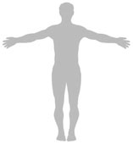
Body
Soul

Slide 7
Invisible
Body
Mortal
Animals also have one
Wants to serve God
Animals don’t have one
Wants pleasure
Soul
Cannot be destroyed
Visible
Will be destroyed
Immortal

Slide 8
Will be destroyed
Visible
Body
Animals also have one
Mortal
Wants pleasure
Invisible
Soul
Immortal
Cannot be destroyed
Animals don’t have one
Wants to serve God

Slide 9
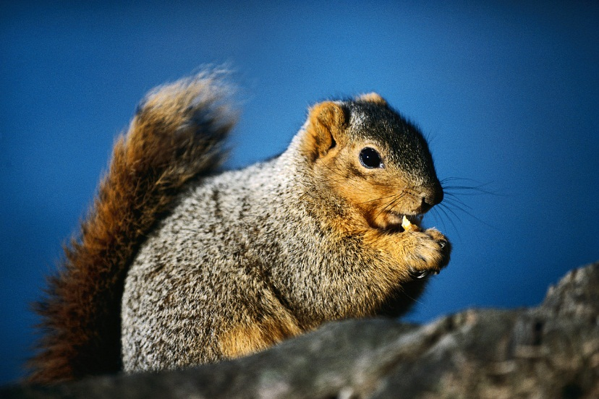
The Soul
Does not have a soul
Christians believe that God gave a special kind of life to humans, which is what makes humans different from other animals. In the Bible this is called “the breath of life” (Genesis 2:7)
Has a soul

Slide 10
Christian beliefs about the soul
‘So God created in his own image, in the image of God He created them’ (Genesis 1:27). This verse tells Christians that as they are different to all other creatures because God put a part of , the , into every person. He did this by breathing the ‘breath of ‘ into Adam’s nostrils. St taught, ‘If there is a natural body there is also a body’ (1 Corinthians 15:44)
man
humans
himself
soul
life
John
spiritual
Spiritual Paul perishable conflict physical victory John humans himself life
man Kingdom right die soul
different immortality spirit
Notes:
This is a cloze sentence exercise. Not all words are used in the text.
The completed text is provided below. You may wish to copy and paste this into a text document, and print copies for students to keep for reference. Alternatively you could delete words and students could complete the gap fill activity individually.
‘So God created man in his own image, in the image of God he created him.’ (Genesis 1:27) This verse tells Christians that as humans they are different to all other creatures because God put a part of himself, the soul, into every person. He did this by breathing the ‘breath of life’ into Adam’s nostrils. St Paul taught, ‘If there is a natural body there is also a spiritual body.’ (1 Corinthians 15:44)
Christians believe that the body and soul can often want different things. St Paul said that he often knew what was the right thing to do, but his body wanted to do something different. This conflict is something all humans experience but Christians believe that the way we respond will determine what happens when we die.
St Paul also said that our physical bodies are imperfect and will die but the spirit, or soul, will be raised with God. The body ‘is sown a natural body, it is raised a spiritual body.’ (1 Corinthians 15:44) St Paul went on to say that flesh and blood cannot inherit the Kingdom of God, instead Christians will be changed at death. ‘When the perishable has been clothed with the imperishable, and the mortal with immortality, then the saying that is written will come true: “Death has been swallowed up in victory.”’ (1 Corinthians 15:54)

Slide 11
Christian beliefs about the soul
a) What is the soul?
Where do Christians believe the soul came from?
c) Give three reasons why the soul is important to Christians.

Slide 12
Christian beliefs about the soul
The soul is the spiritual part of a human being.
God made people in his own image. Christians believe that this means he created the soul. Therefore the soul comes from God.
The soul is important to Christians because it is the closest link a human has to God. It is what makes us important and special. It is also the part of us that will go to heaven when we die.

Slide 13

Some believe that ideas about heaven and hell were invented by people as an effective way of justifying suffering in the present life: good people go to heaven as a deserved reward for a virtuous life, and bad people go to hell as a just punishment for an immoral life.
What do you think? Think of arguments for and against this viewpoint with reference to Christian beliefs.

Slide 14
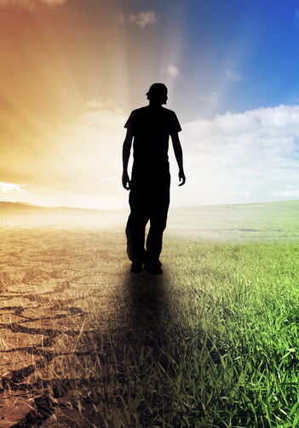
What happens when we die?
Christians believe that there is another life after this one ends. This new life lasts for eternity.
Our souls will be resurrected in a new body, at peak age, health and fitness.
Some Christians believe this happens straight away after death, others believe this only happens on Judgement Day.
These new bodies will be either rewarded or punished.
Notes:
See what kids think before we go through any answers. Maybe get them to talk to two different people and then feed back what someone else said.

Slide 15
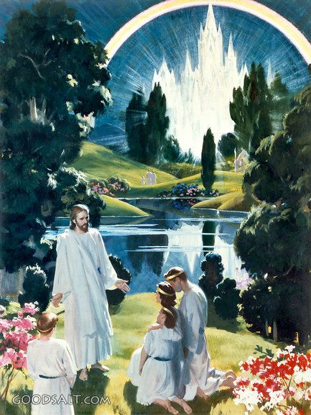
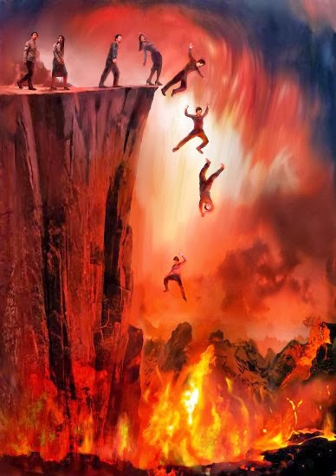

Heaven
Hell
Eternal paradise
Presence of God
Eternal suffering
Absence of God
“I am the way, the truth and the life. No one comes to the father except through me” John 14:6
Notes:
Ask first: what’s the key different between them?
14:6 – do you have to be baptised? Compare with sheep and goats story of deeds.

Slide 16
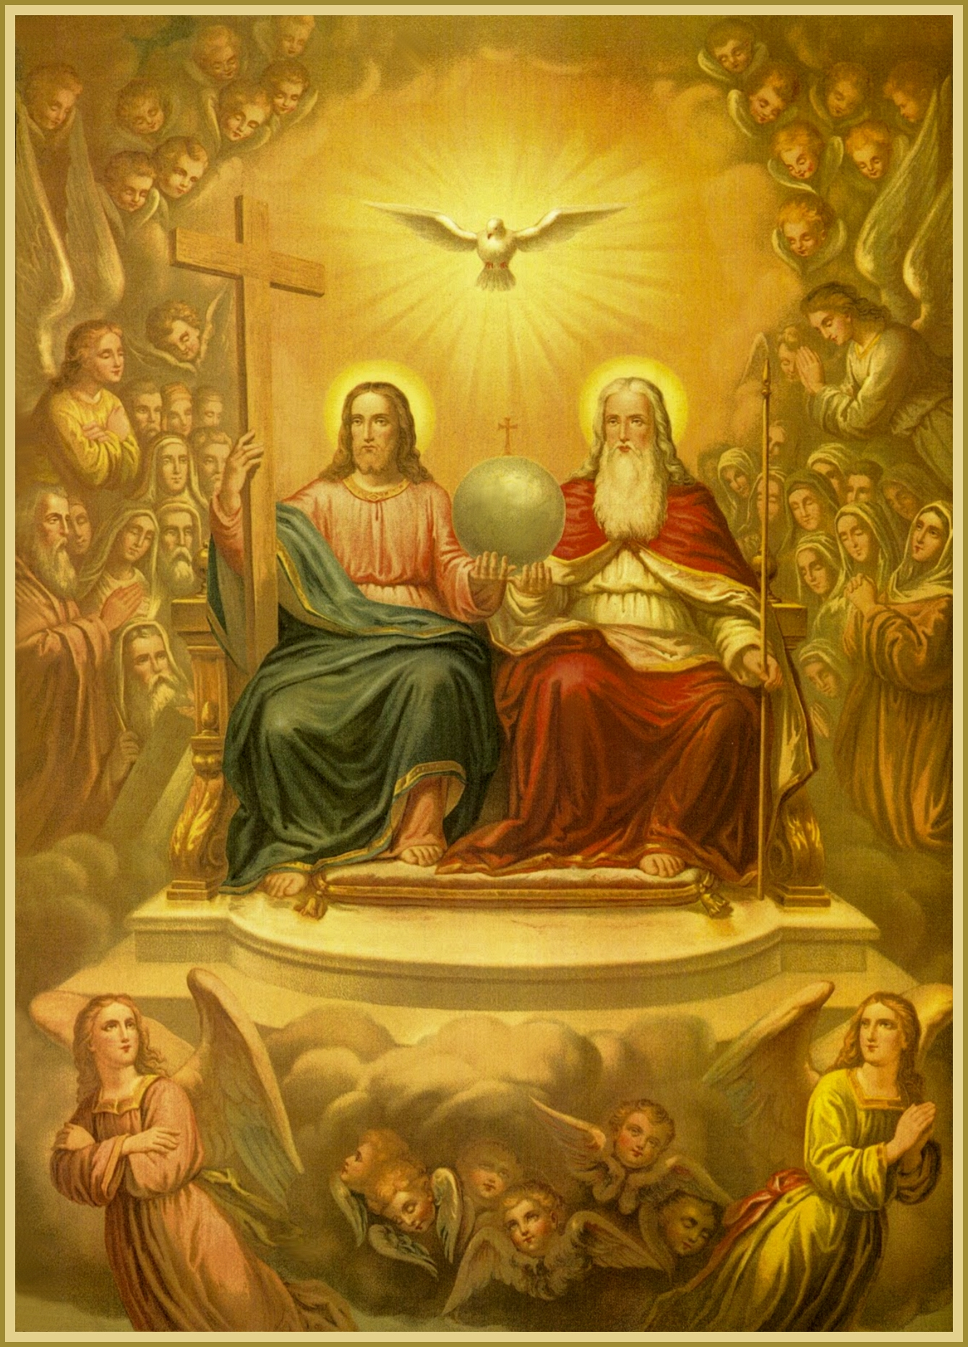
Heaven
Traditional paintings of heaven show it is beyond the clouds an where God sits on a huge throne, surveying the earth with angels flying around. It is seen as a place of peace, joy and freedom from pain, and a chance to be with friends and family who are already in heaven.
Whether this is a physical or spiritual existence is unclear.

Slide 17

Christians may have different beliefs about who will be with God eternally. Some believe that only those who believe in Jesus will be with God in heaven.
Others think that heaven is reserved for Christians and perhaps followers of other faiths who have lived good, principled lives and pleased God in doing so.
Others believe it is for all those who call themselves Christians regardless of how they live their life, and that simply the act of being baptised into the faith is almost a guarantee into heaven.
All Christians believe that God will forgive sins and this will enable people to approach God’s presence. The Parable of the Sheep and Goats does seem to indicate that it is a reward for both faith and actions – only one is insufficient.

Slide 18
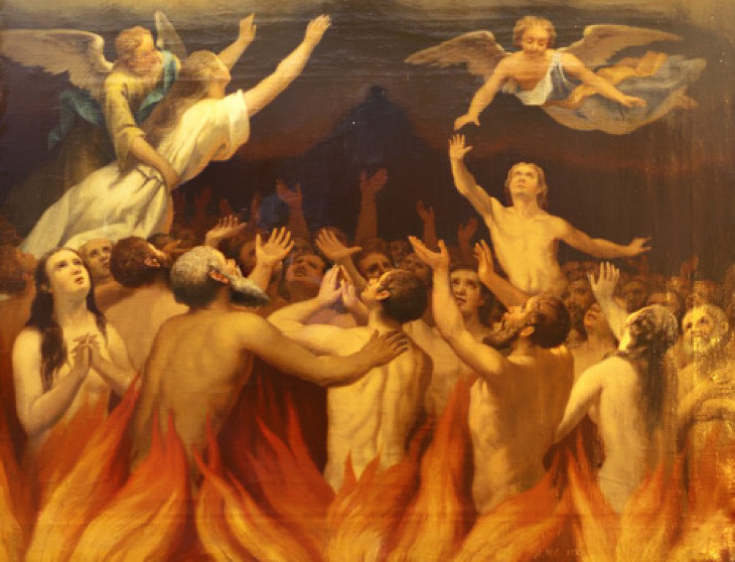
Purgatory
Purg – purge – get rid of things that are undesirable, purify
-atory – relating to, serving of, characterised by
Roman Catholics believe in purgatory - a state of temporary punishment for people whose souls are not quite ready for heaven.
It is a chance for them to be ‘purged’ of their sins, if they try to make amends for them or if people pray for them.
From purgatory, the soul can only go to heaven, not to hell.

Slide 19
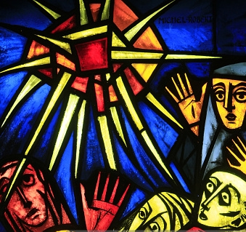
Hell
Hell is often seen as the opposite of heaven. Christians understand it to be a state of existence without God. It is often shown in paintings to be a place of eternal suffering, terror, fire and torture ruled by the Devil (Satan). It is pictured as a fiery pit somewhere beneath the earth.

Slide 20
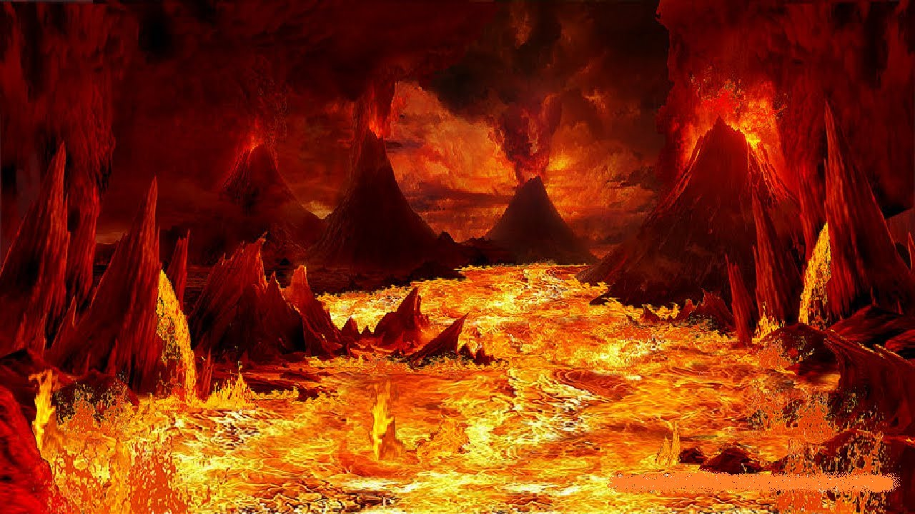
Does this mean that non-Christians go to hell if heaven is reserved for Christians?
This would appear to be very unfair and, as Christians believe God is incapable of being unfair, may believe that all those who believe in God and try to follow him will be accepted by God and be welcomed eternally into his presence.
There is great debate about whether a loving God would condemn people to eternal torment and pain. If this is not the case, perhaps a more modern interpretation is that hell is an eternal state of mind of being cut off from the possibility of God. This would be what awaits a person who throughout their life did not acknowledge God or follow his teachings.

Slide 21
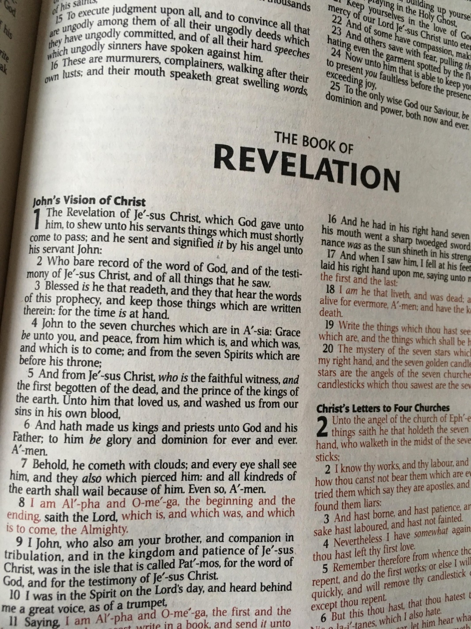
How to read the Bible…
First, look at the contents page and find the BOOK that you are looking for.
Turn to the correct page. Flick through until you find the correct CHAPTER (the big number)
Finally, skim over the chapter until you reach the VERSE that you are trying to find (the small number)
This example would be Revelation 1:8.

Slide 22
Now find out some more details about…
Heaven:
Ezekiel 28:24-26
John 14:2
Revelation 7:16-17
Revelation 21:3-4
Revelation 21:21-22
Revelation 22:5
Hell:
Matthew 13:50
2 Peter 2:4
2 Thessalonians 1:9
Revelation 9:2
Revelation 20:10
Revelation 21:8
Purgatory:
Malachi 3:3
Micah 7:9
Psalm 66:12
2 Maccabees 12:44-45
Matthew 5:26
In groups, create an image of heaven, hell or purgatory based on what you find in these Bible passages.
You might want to have two people finding the quotes, one person writing them and one person drawing.

Slide 23
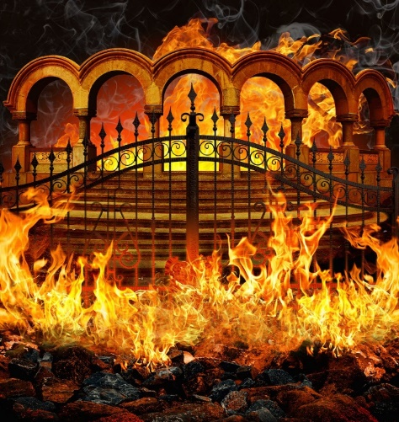

Are beliefs about heaven and hell…
Symbolic?
They are too wonderful or awful for our minds to comprehend literally
They only difference between heaven and hell is that God is present in one and not the other
A loving god wouldn’t let his people suffer eternally in hell
The Bible describes them, and as this is the word of God, we should take everything it says literally
These are beliefs that people have had for centuries – there must be some truth to them
In my opinion, beliefs about heaven and hell should be interpreted symbolically/literally, because…
Literal?
Notes:
Literal: the Bible describes them, it is the word of God, they are beliefs that have been held for centuries

Slide 24

Explain two Christian beliefs about the afterlife.
You must refer to scripture or sacred text in your answer.
(5 marks)
You get marks for:
IDENTIFYING a point. One mark!
  EXPLAINING that point or giving an EXAMPLE. One mark!
IDENTIFYING a different point. One mark!
  EXPLAINING that point or giving an EXAMPLE. One mark!
Using EVIDENCE from scripture or a sacred text. One mark!
You can refer to beliefs about resurrection, heaven, hell or purgatory.
Use a Bible quote!

