Slide 1

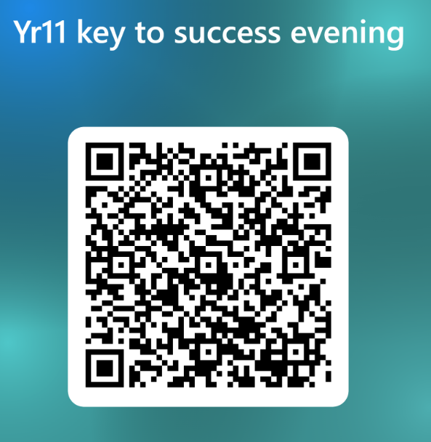

Year 11
Key to Success evening
Today’s aim is to provide information to allow you to best support your child through their final GCSE year.

Slide 2
Outstanding academic achievement
72% grade 4+ in English and Maths (compared with 61.3% Swindon average and 65% nationally)
48% grade 5+ in English and Maths (compared with 45% nationally)
Exceptionally strong Science outcomes 80% grade 4+.
A8 (achievement across 8 best subjects) of 46.95, nearly a point higher than national averages (46)
These results reflect the hard work, ambition and resilience of our students, supported by dedicated staff and families.

Slide 3
Timeline
October
SLT Interviews
November 9th
Mocks (most subjects)
December 16th
Parent Consultation Evening
February
SLT Interviews
GCSE PE / Drama Practical
March 2nd
Mocks (most subjects incl MFL speaking)
Reports
Reports
April/May
Final Exams
January
College Applications
College Applications
April
MFL Speaking exams
Music Assessments
August 19
Results Day
May 10th - June 23rd
Morning boosters & pre-exam revision schedule begins

Slide 4
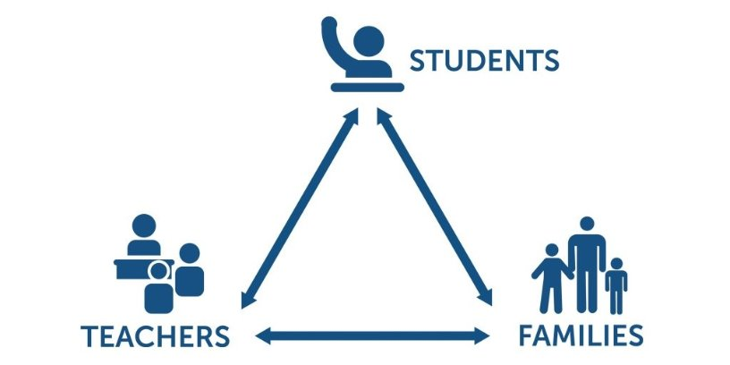
KS4 – prepare for a Three Way Effort ​
​
​
​
​
Departing Year 11 pupils within the TPAT schools rated support from home the top factor in their success at KS4

Slide 5
Core Subject Information
All students will sit examinations in Maths, English, Science and RE. They will also sit their relevant exams for options subjects.
Grade 4 is considered a 'standard pass' and grade 5 is considered a 'good pass’.
Students who fail to achieve a grade 4 in Maths and English will be required to resit the qualifications next year in their post-16 provision.
Make sure to check entry requirements for post-16 courses with providers.

Slide 6

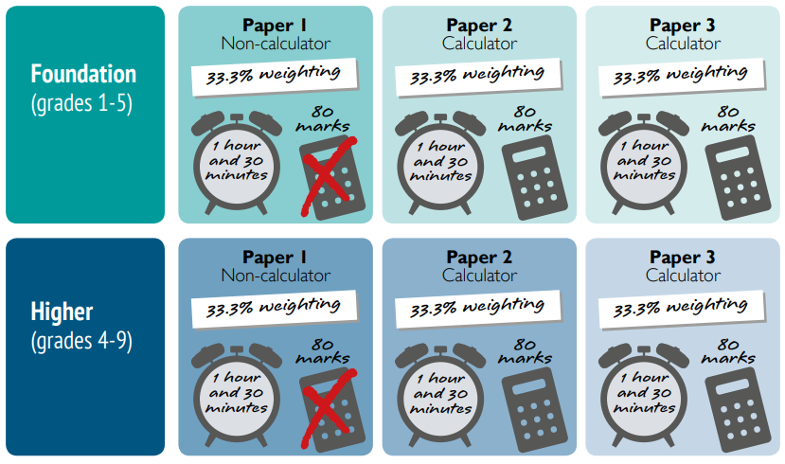
Core Subject Information - Maths
Grades 1-5
Grades 3-9

Slide 7
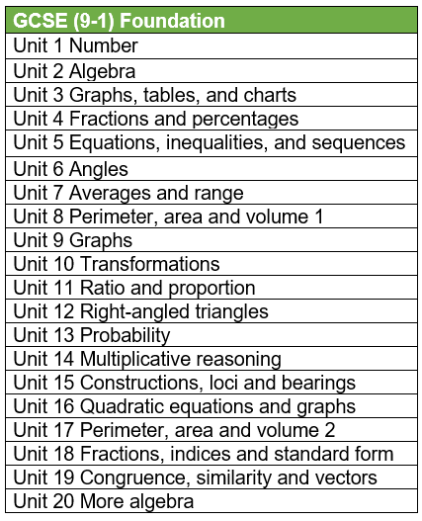
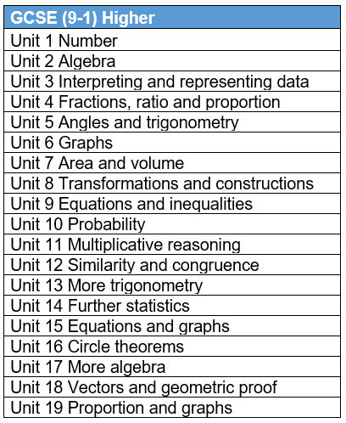
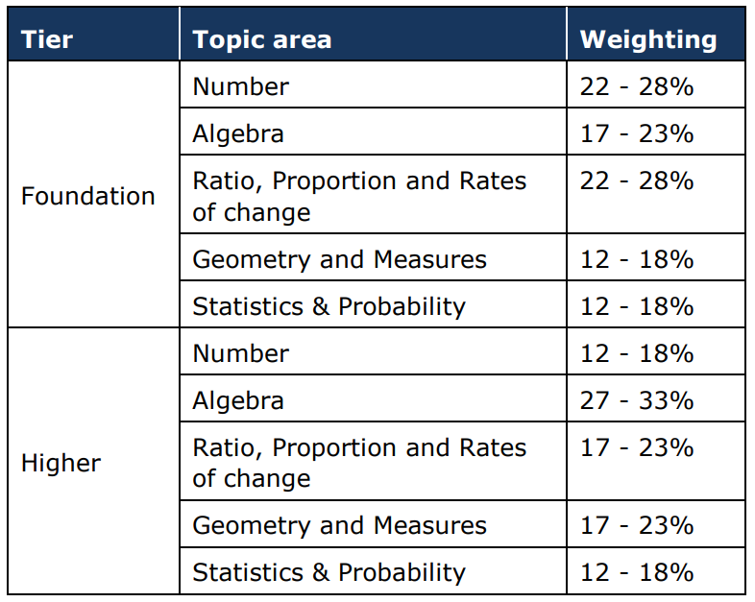
Core Subject Information - Maths

Slide 8
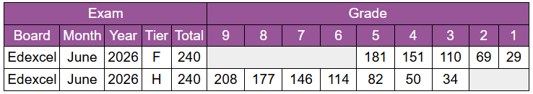
Core Subject Information - Maths
Examination code | Title | Date | Time | Duration
1MA1 1F | Paper 1 (Non-Calculator) Foundation Tier | Friday 14th May | AM | 1h 30m
1MA1 1H | Paper 1 (Non-Calculator) Higher Tier | Friday 14th May | AM | 1h 30m
1MA1 2F | Paper 2 (Calculator) Foundation Tier | Thursday 27th May | AM | 1h 30m
1MA1 2H | Paper 2 (Calculator) Higher Tier | Thursday 27th May | AM | 1h 30m
1MA1 3F | Paper 3 (Calculator) Foundation Tier | Monday 14th June | AM | 1h 30m
1MA1 3H | Paper 3 (Calculator) Higher Tier | Monday 14th June | AM | 1h 30m
GCSE Revision guides – Parent Pay £5.50

Slide 9

Core Subject Information – Maths Homework
Weekly homework (Wednesday to Wednesday)
Personalised retrieval based on completion
All levels to challenge and support
Following the SOW taught in lesson
Scaffold videos to support each question

Slide 10


Enrichment – Further Maths GCSE
Tuesday 3:25-4:25pm
AQA Level 2 GCSE Maths
An extra GCSE
Available to pupils targeting a grade 7+

Slide 11
Free Support – GCSE Maths
Old.Mathsgenie
Corbettmaths
Sparx – independent learning

Slide 12
The Final Push – PGL Revision Weekend
Liddington, Swindon
Two night residential to PGL Liddington (in Swindon)
Revision sessions taught, in correct tiers, by The Deanery staff (3 hours each day)
4 adventure activities with peers for a final secondary school residential (2 each day)
Full board (all meals included)
When launched, first come first serve for 50 students.
23rd – 25th April 2027
Exam technique
Common misconceptions identified and corrected
Key topics revisit
Key skill retrieval

Slide 13

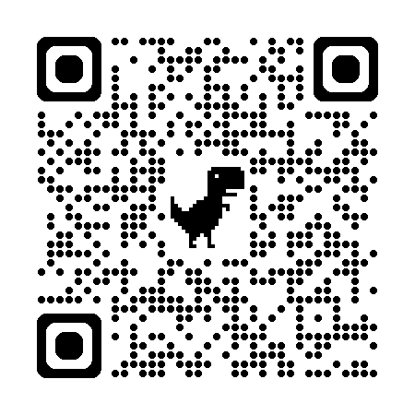

Core Subject Information – English
English Language
Paper 1: Fiction Reading & Writing (1hour 45 mins)
Paper 2: Non-Fiction Reading & Writing (1hour 45 mins)
Spoken Language: students are required to present a talk to their class (filmed and moderated by AQA)
English Literature
Paper 1: (‘old’ texts) 1 hour 45 mins
- Shakespeare’s ‘Macbeth’
- Charles Dickens’ ‘A Christmas Carol’
Paper 2: (modern texts) 2 hour 15 mins
- Priestley’s ‘An Inspector Calls’
- 15x Power & Conflict Poetry anthology poems
- 2x unseen poems to analyse & then compare
School-based revision resources:
DNA interleaved knowledge retrieval
Chanting quotations at end of lessons
Knowledge Organizers: key words, sentence stems & sentence starters, model examples (Standard vs. Excellent), essay structures/writing frames/structure strips
Enrichment GCSE Literature Revision 3:20-4:20pm Thursdays
Enrichment GCSE Language Past Paper Club (Begins in January)
Tutor Time Intervention- students identified through mock data
Resource table: Available in the English locker area. Students can help themselves
Essay drop off: Students can drop off an exam essay to be marked at any time
Resources to use at home
English section of school website: Knowledge Organisers, key quotations to learn, past papers, links to external revision websites https://www.dcea.org.uk/parent-information/our-curriculum/subjects/english/
Tassomai online homework platform 45mins weekly
Tuesday Test Day (pink homework book)
Please encourage your child to read at home- worth 50% of GCSE Language and is THE most important thing your child can do to prepare for GCSE English Language

Slide 14

Tuesday Test Day= pink homework books
Model essay provided, alongside an exam style question
Students spend over a week learning from the model, and planning the exam style question
Tues Week A – students come into class and write the essay in test conditions
Teachers mark, rank and create whole class feedback sheets
An hour feedback lesson takes place before the end of the week

Slide 15

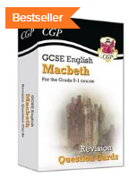


Core Subject Information – English
What can you do to help?
Ask them about the pink book essay that they're currently planning
Get them to dig out their Yr10 exercise book and booklets
Remind them about our weekly Thursday revision opportunity
Test them using their flashcards
Encourage them to continue reading
Talk to them about current affairs/topical issues
Monitor their revision schedule
Talk to us
Please encourage your child to read at home- worth 50% of GCSE Language and is THE most important thing your child can do to prepare for GCSE English Language

Slide 16
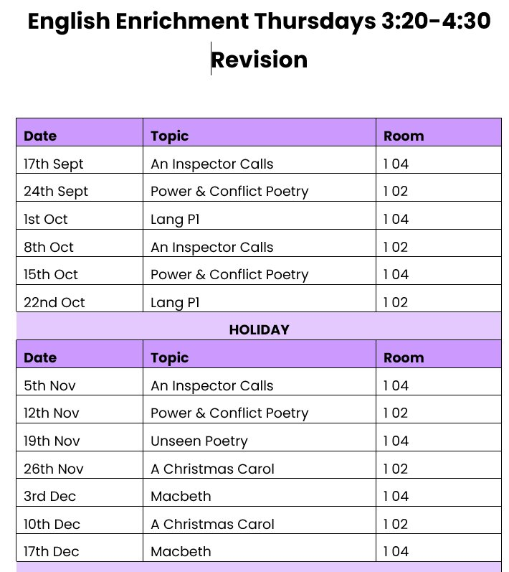
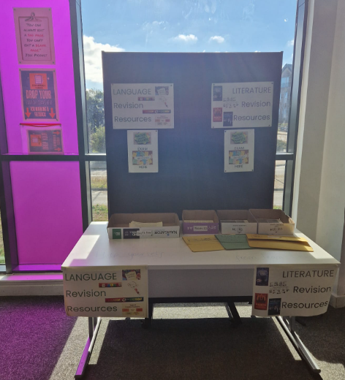

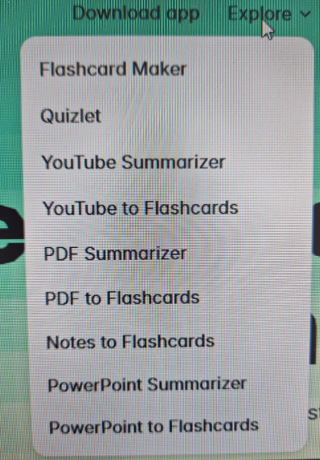
Core Subject Information – English
Please encourage your child to read at home- worth 50% of GCSE Language and is THE most important thing your child can do to prepare for GCSE English Language

Slide 17

Coming to this theatre... 2nd November
(during the school day)
£10 per student​

Slide 18

Core Subject Information : Science
2 Routes – No Decision until Year 11 Mocks
Key Facts
Qualification Name: GCSE Combined Science - Trilogy
Assessment: 100% Examination
Examination Board: AQA
11th May
To
18th June
2027
Key Facts
Qualification Name: GCSE Biology, Chemistry & Physics
Assessment: 100% Examination
Examination Board: AQA

Slide 19
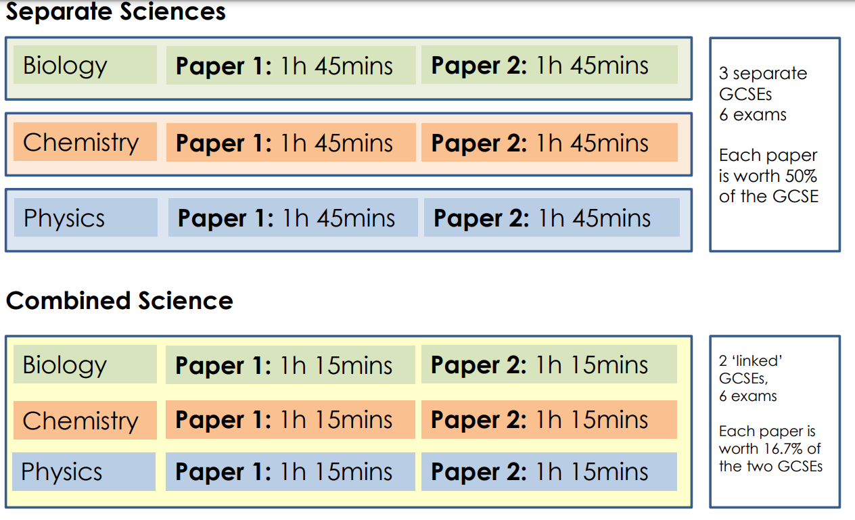
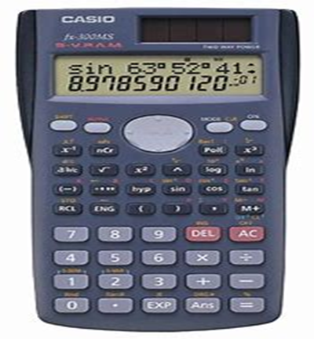
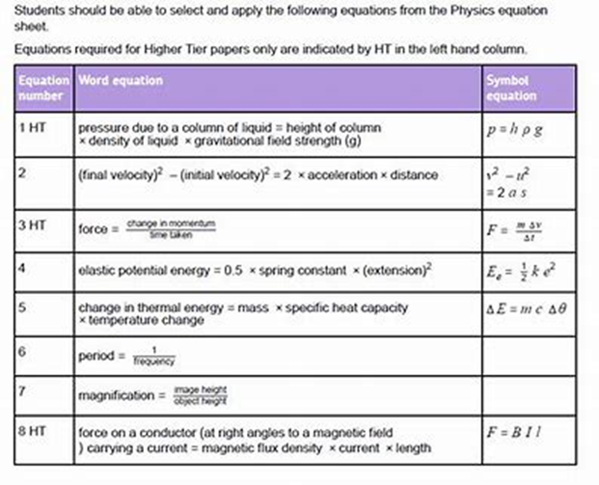
Exam Information

Slide 20
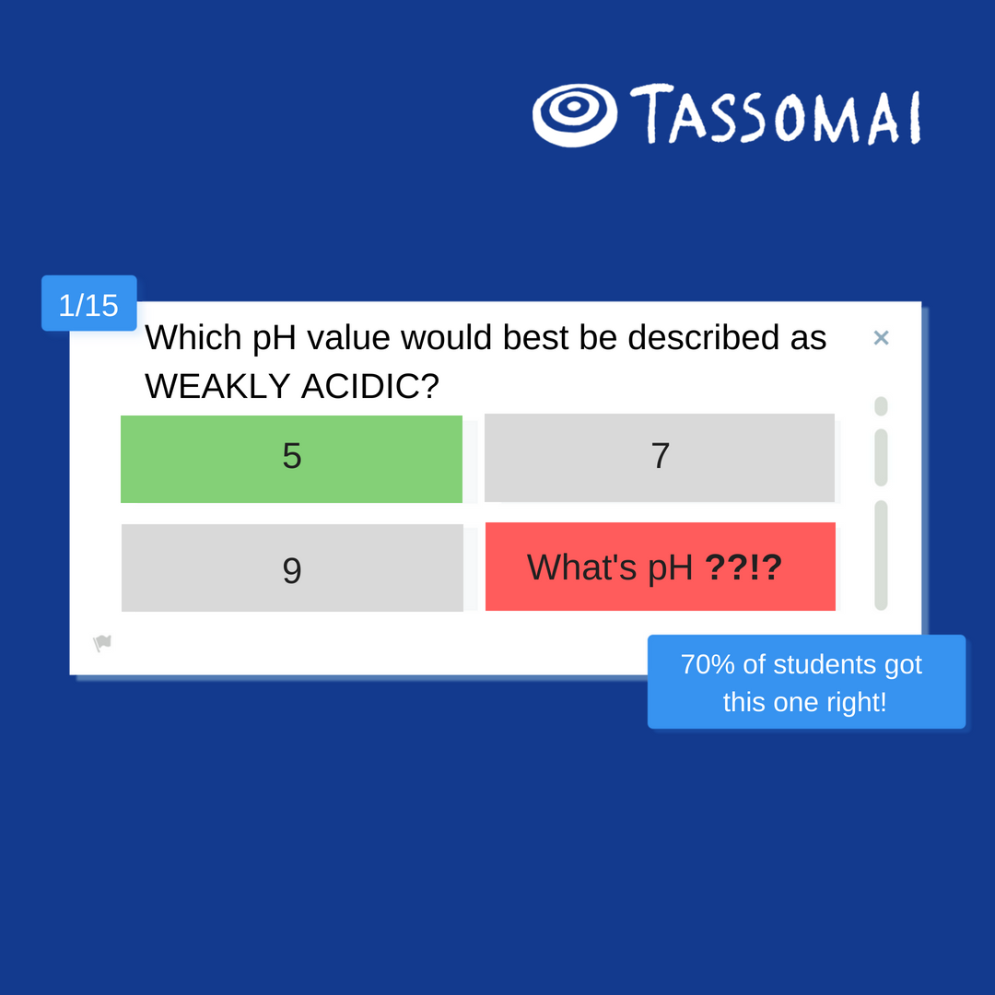
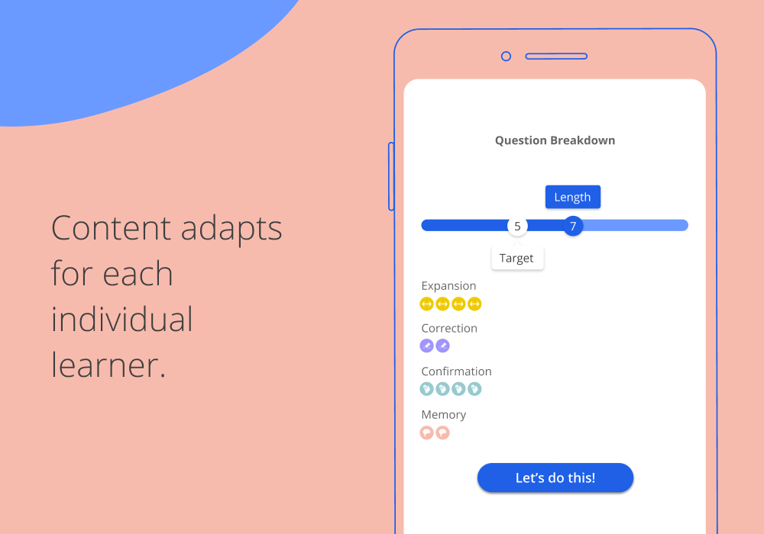
Science Homework Platform: Tassomai 45 minutes per week
Students learn through quizzes and short videos, using our mobile app or other online devices.

Slide 21
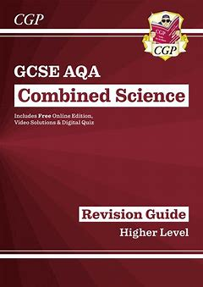
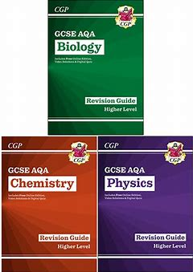


Science Revision
Tuesday 3.30pm to 4.30pm
See Mrs Hockin tonight

Slide 22

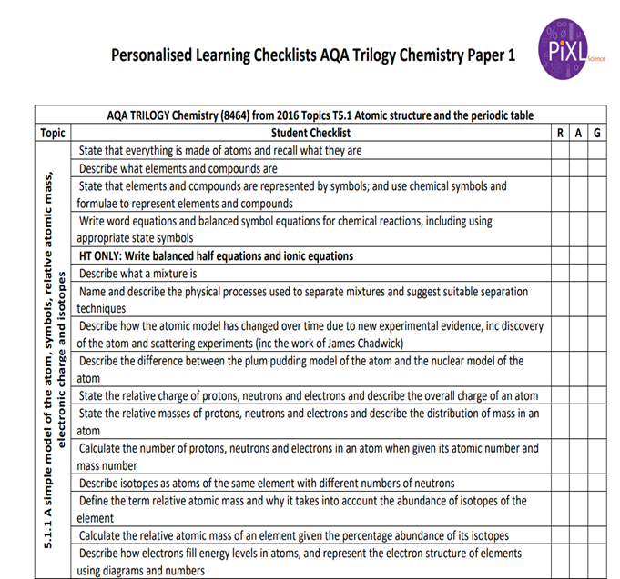
SUCCESS in SCIENCE
● Skills for managing stress
● Exam preparation technique/support – use Tassomai/Retrieval Grids
● Recognising your areas of strength and weakness in Biology, Chemistry and Physics
Revision | Details | What to bring?
Science Revision Café Tuesday 3.pm– 4.30pm | Drop-in Science support session that runs throughout the year | Pen and Paper Revision Guide Questions
Focused Science Intervention Terms 1 to 5 8.45am to 9.05am | Structured questions/walking talking mock style revision sessions that cover key areas of the specification | Pen and Paper Revision Guide Questions
Revision Materials | On the Science Table | Collect

Slide 23

Key to Success: What can I do to help my child at home?
If possible, provide a calm, quiet area that is free from distractions.
Help them plan an allocated time to revise – including breaks.
Praise them.
Encourage them.
Take an interest (not an over interest) in what they are doing.
Maybe ask if they want you to quiz them or even revise with them.
Provide revision resources such as revision guides or printed past papers (school can help).
Support them doing what they enjoy in parallel to revision such as clubs and activities.
Ensure stable routines: meal-times and bed-times.

Slide 24
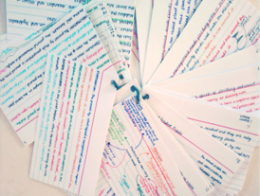
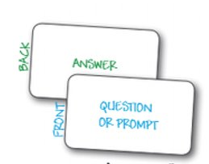
Key To Success: Revision Techniques
AO1 – Knowledge recall
1. Creating or using flash-cards
2. Reading knowledge organisers and re-creating them from memory
3. Watching You-Tube clips and making notes
4. Testing yourself with multiple choice quizzes
5. Reading revision guides or textbooks and making notes

Slide 25

Key To Success: Revision Techniques
AO2 – Applying knowledge
1. Try summary questions in revision guides or textbooks
2. Practice some past exam questions and check these with the mark scheme.
3. Try some online quizzes.
4. Ask friends and family to question you on a particular topic using key command works from the exam “describe or explain”.
5. Ask your teacher for subject specific advice.

Slide 26
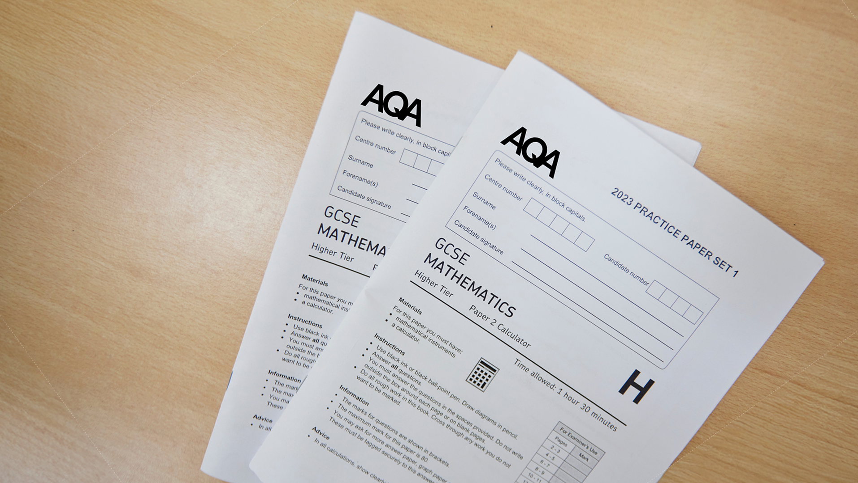
Key To Success: Revision Techniques
AO3 – Linking your knowledge
1. Try whole past exam papers.
2. Read model examples and check them against your own attempt
3. Use the mark scheme to mark your own paper.
4. Read the mark-scheme and annotate both the past paper and the mark-scheme.
5. Ask your teacher for a past paper question to take home, bring it to them and ask them to go over it with you.

Slide 27
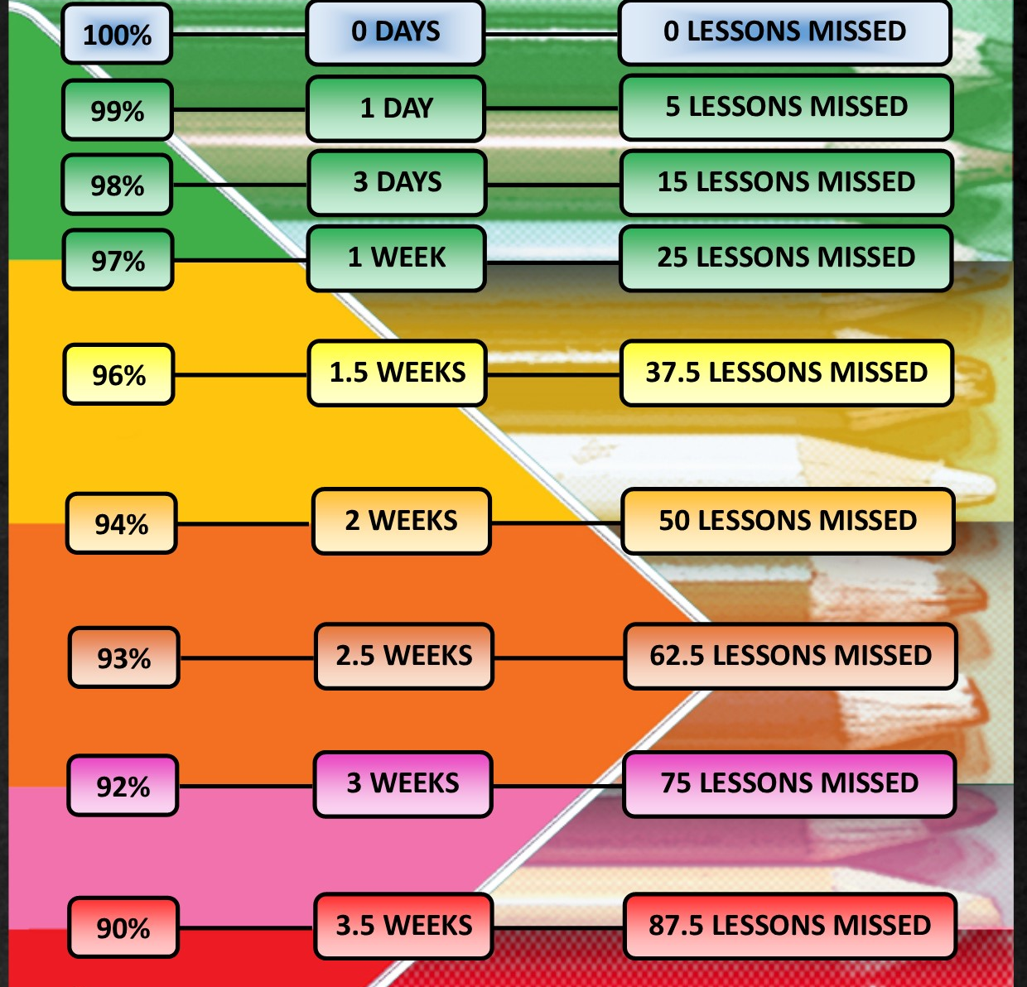
Key To Success: Attendance Matters
Maximise your potential,
attend school every day!
Attendance >95%
On average half a grade better in every subject.
Attendance <90%
On average one and a half grades worse in every subject.

Slide 28
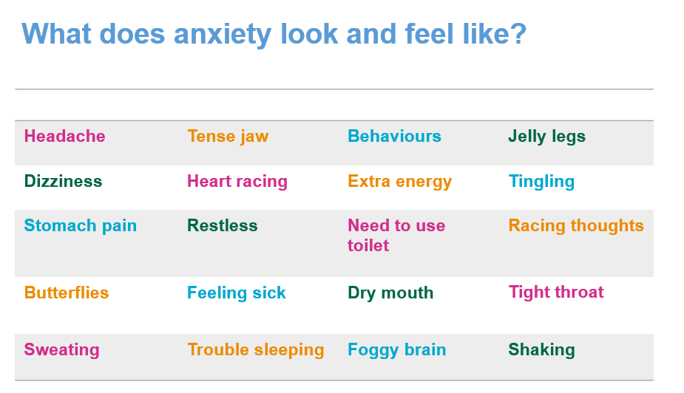
Exam Stress Management
Key To Success: Exam stress management
It's OK to feel anxious – it can be a good thing!
Anxiety isn't necessarily a bad thing. It can spur us on, help us stay alert, make us aware of risks and motivate us to solve problems.

Slide 29

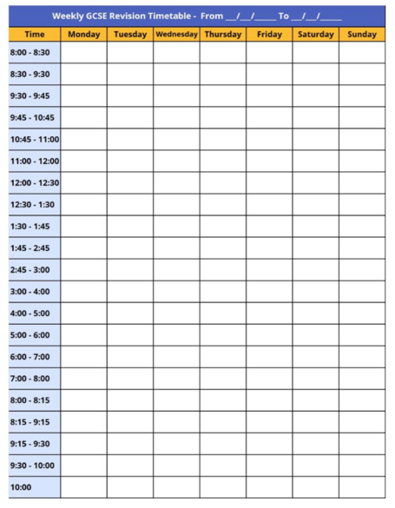

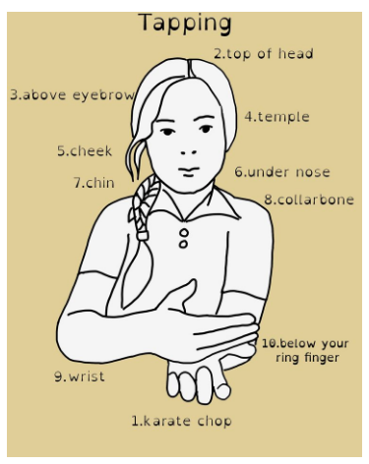

Key To Success: Exam stress management
Be prepared! A lot of the anxiety can be prevented with good preparation – early revision, looking at past papers, schoolwork etc.
Exercise
Eating healthily
Sleep
Limit time of social media/electronics.

Slide 30
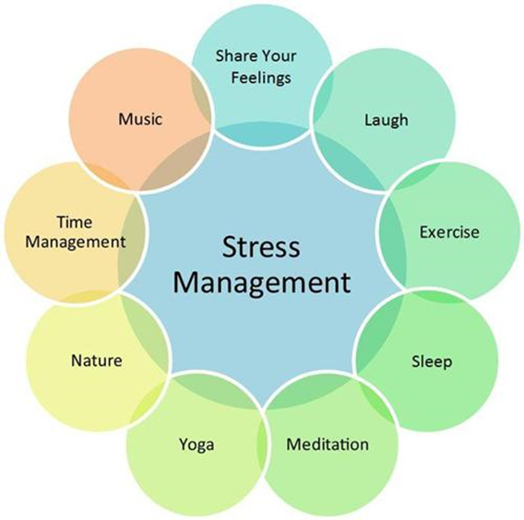
What are we doing in school?
Tutor program now includes revision skills and exam stress management on a weekly basis
More focus on exam techniques in lessons to support students feeling prepared.
Homework is all revision and recap to aid long term memory
Enrichment afterschool revision programme
Careers guidance in school to help with important decisions.
BRIYM counselling – 1:1 but also will be visiting tutor groups to offer support.
https://www.briym.co.uk/parents

Slide 31
What did last year's Yr11 say?
What helped you the most:
Top Answer = Family support
2nd = The pre-exam revision and morning booster sessions
3rd = Teachers
Most common improvement suggestions:
42% wanted revision to start earlier
38% wanted more revision sessions
20% wanted better food

Slide 32
Students, when you need support …
Feeling nervous or worried are normal emotions:​
​
Communicate with parents and teachers​
Tutor – Exam preparation and skills time ​
Head of Year – Mr. Andrew McEachrom
Assistant Head of Year – Ms Amanda Mobey
KS4 Raising Standards Lead – Mrs Scotford
SENco – Ms. Laura Connors ​- for any Access Arrangement information
Teaching Assistants ​
Post 16 and Careers
All Deanery staff are here to help you

Slide 33
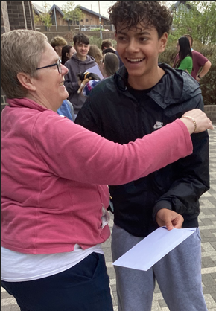
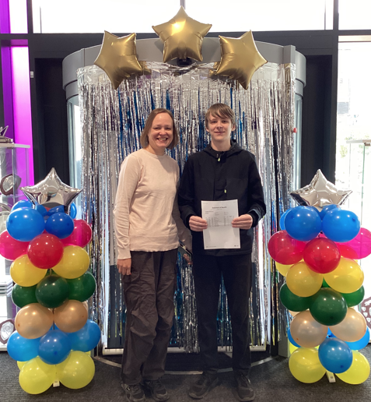
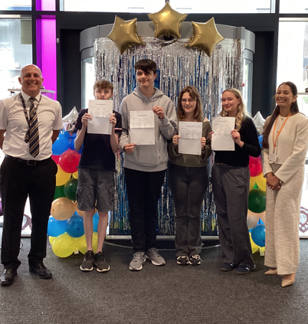
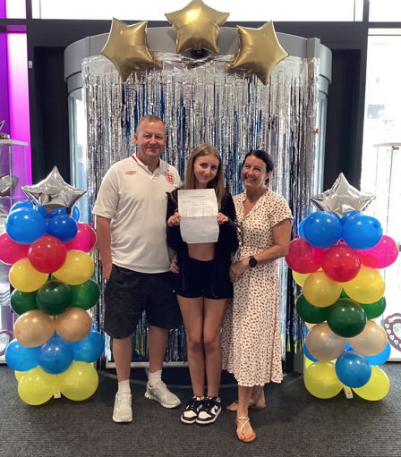
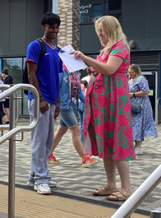
Thursday 19th August 2026
We will see success together!
There is a booklet to take with you covering all the information given this evening. Information will also be shared on the school website.

