Slide 1
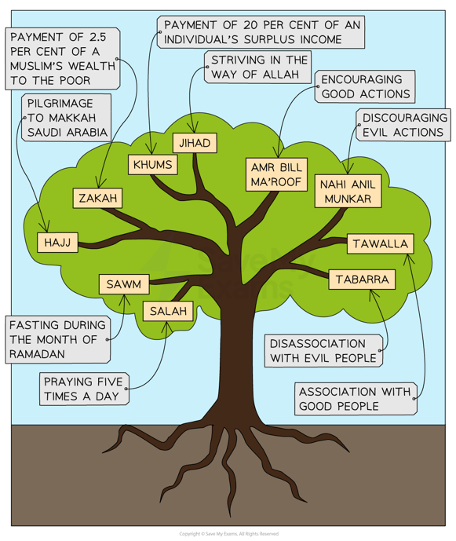

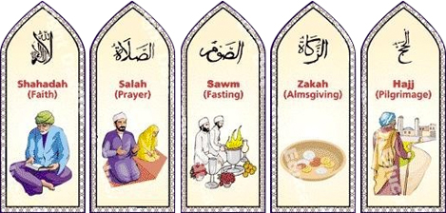
Sawm = Fasting during the month of Ramadan
Notes:
Sawm is in both the 5 pillars of Sunni Islam and the 10 obligatory acts of Shi’a Islam
Students should ensure they have all key vocabulary (shown with a key symbol) in their key word glossaries at the back of their exercise books

Slide 2
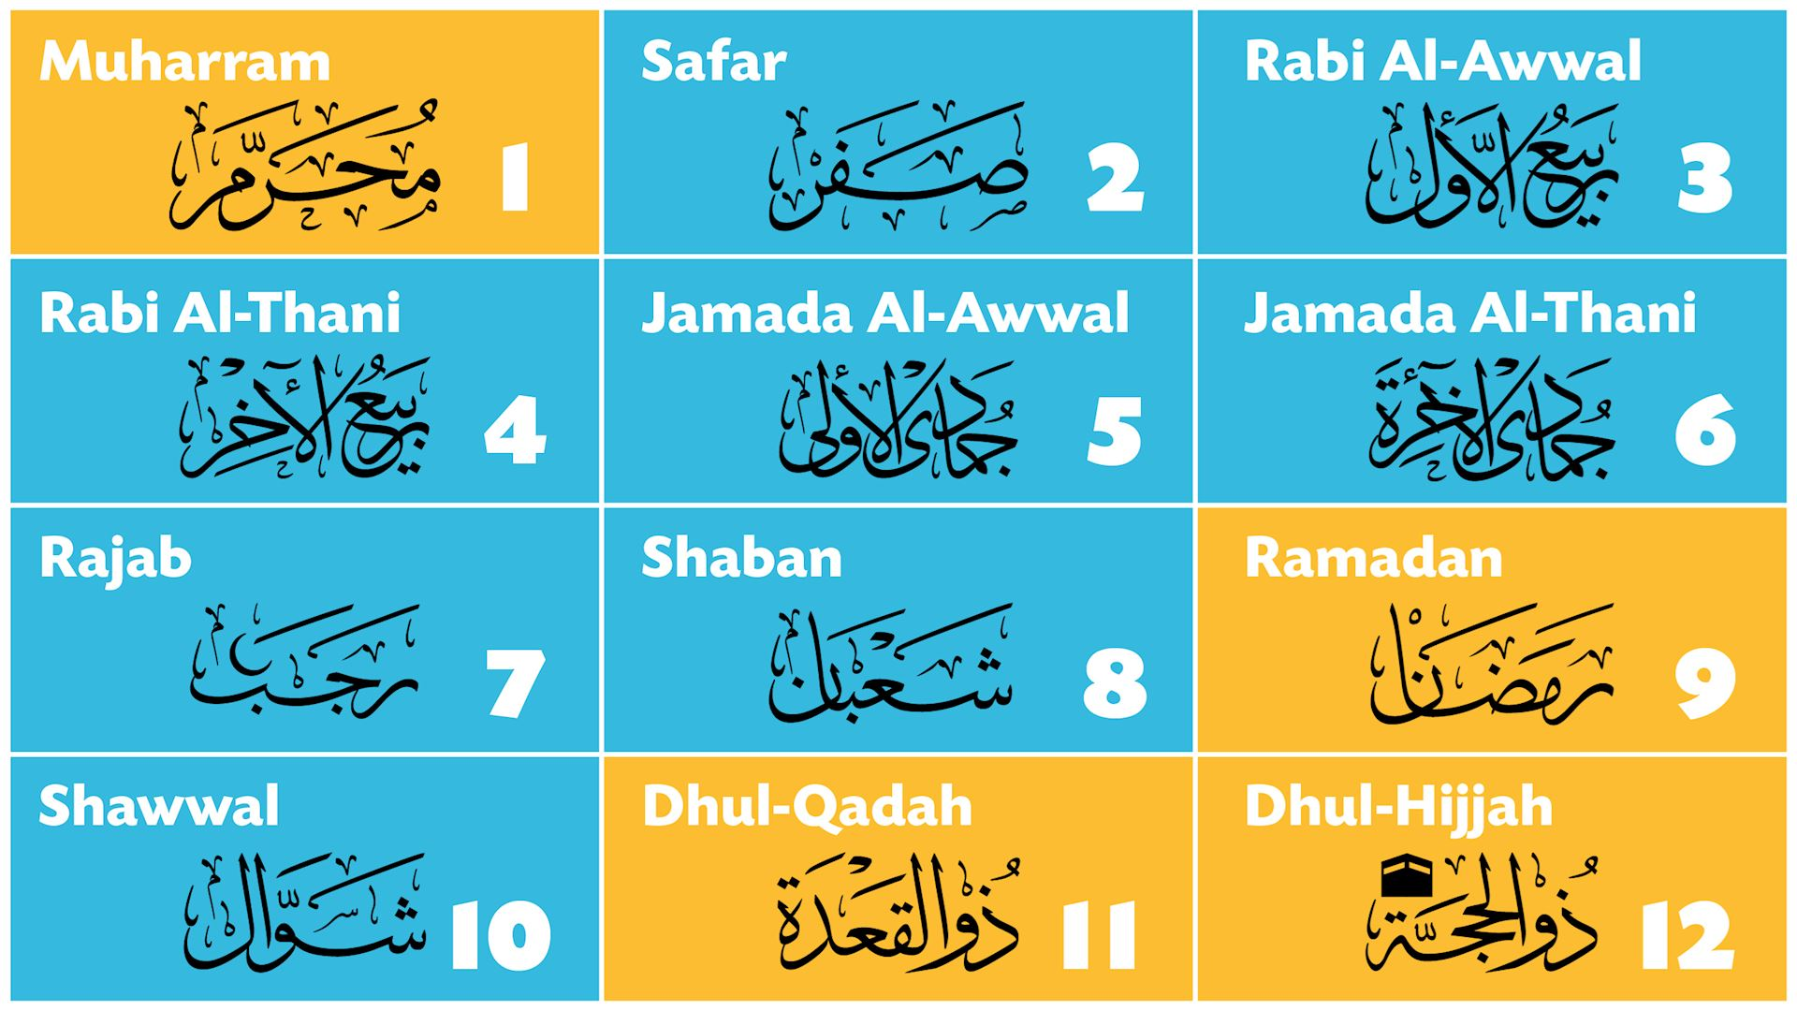
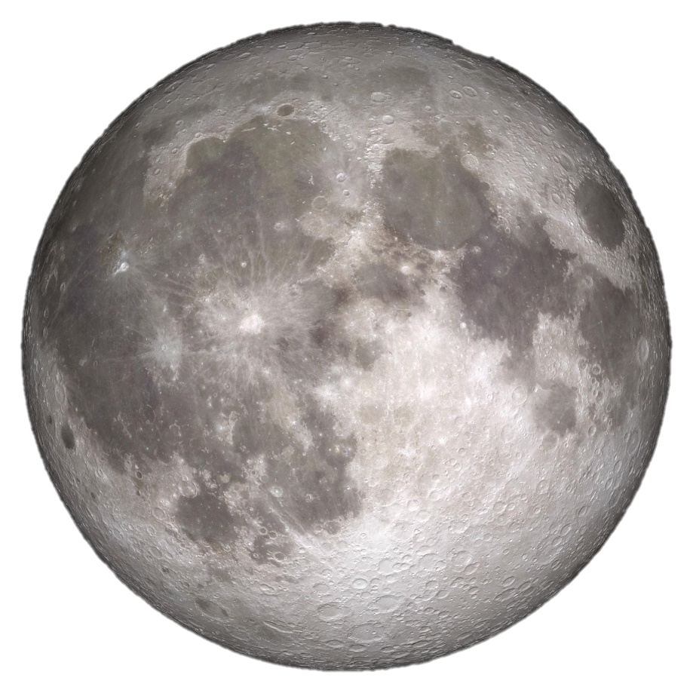
Unlike the western Gregorian calendar, the Islamic calendar has 12 lunar months of 354 or 355 days
Ramadan is the 9th month of the Islamic calendar and, for Muslims, is the most important.
It was during Ramadan that the Qur’an started to be revealed to Muhammad.

Slide 3
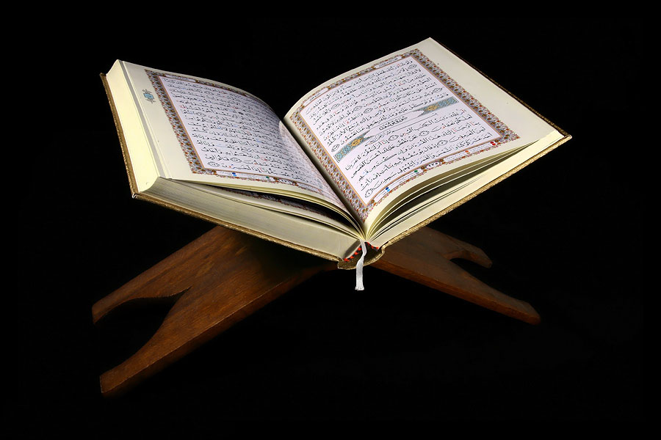
Many Muslims will recite the whole of the Qur’an, in daily sections, over the 30 days of Ramadan.
Why?
The daily readings from the Qur’an help Muslims to remember its teachings and importance in their lives.

Slide 4
Laylat Al-Qadr = The night of power
This is an important festival that marks the beginning of God’s revelation to Muhammad. The exact date is not agreed upon, but it is believed to be one of the odd-numbered days in the second half of Ramadan.
“What will explain what the Night of Glory is? The Night of Glory is better than a thousand months!”
~ Qur’an 97:2-3
This means that observing the Night of Power gives Muslims the benefits of worshipping for a thousand months. Therefore, Muslims will try to stay awake throughout the night on each of the possible dates, devoting themselves to prayer and studying the Qur’an.
https://youtu.be/Jvs00f_Hvqk?si=d5f6rQN7T-X8XX0K

Slide 5

“It was in the month of Ramadan that the Qur’an was revealed as guidance for mankind… so any of you who is present that month should fast, and anyone who is ill or on a journey should make up the lost days by fasting on other days later” ~ Qur’an 2:18
Everyday from before sunrise until sunset, Muslims abstain (stay away from) from:
Food
Drink
Sexual activity
Smoking
Lying, cheating and swearing.
Muslims are allowed to eat when the sun goes down and often Muslims will break the fast by eating a few dates and drinking water before they have a large family meal together.
Who has to fast?
All adult and healthy Muslims have to fast.
Who doesn’t have to fast?
The elderly, the young (younger than 12yrs old)
The pregnant, the breast feeding mother, the traveller (someone travelling over 45/50 miles) and the sick.
Fasting = not eating or drinking for a certain length of time, usually for religious reasons
As we watch the video, write down any reasons you see and hear about why Muslims fast during Ramadan
https://youtu.be/qFU9Cb0D6lo?si=IiGEloiYGSC2gTcH

Slide 6
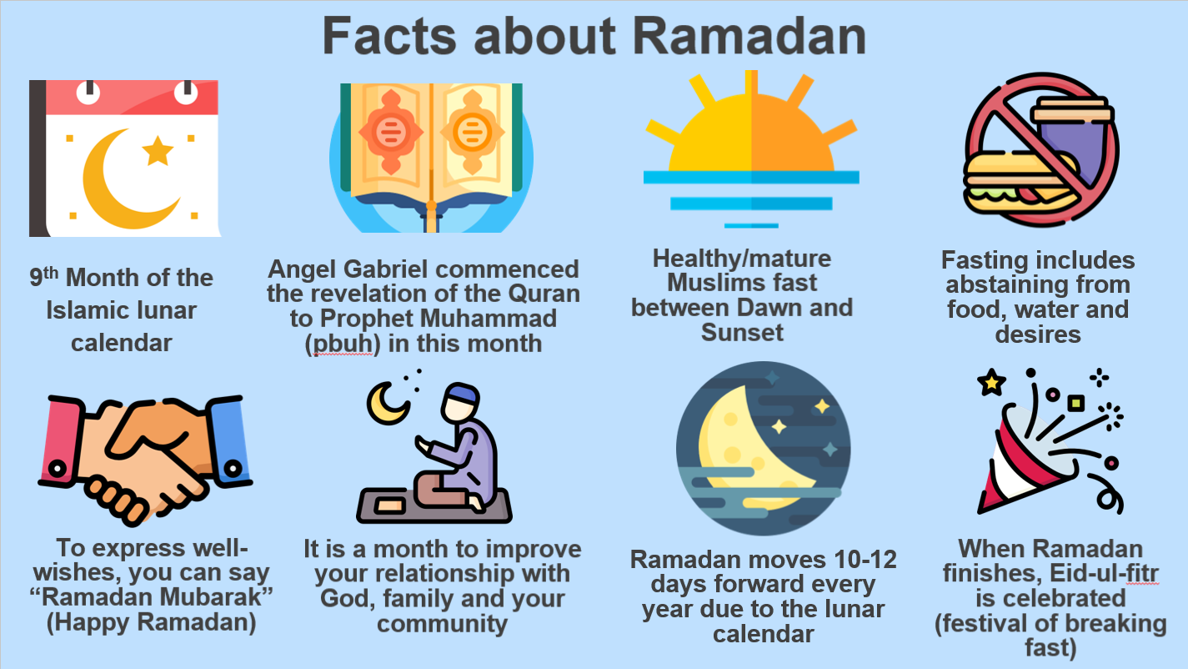
Why do Muslims fast?
To show obedience to God by following his command.
What are the benefits of fasting?
So they may acquire self-control and discipline.
Obedience and submission to God
Improve health
More awareness of the suffering of the sick, poor and hungry.
Following the example of the Prophet Muhammad.
Muslims believe:
It might be tempting to hide somewhere and have a quick snack and drink. But Muslims know that this cheating may fool people, but it won’t fool God. God can see everyone all the time.
And to cheat like this is a great SIN.

Slide 7
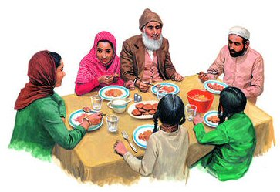
When Ramadan ends it is celebrated for three days in a holiday called Eid–Ul-Fitr (the Feast of Fast Breaking).
Food is donated to the poor, this is called Zakat which is the third pillar of Islam. Friends and family gather to pray together, to have a large meal and exchange gifts.

Slide 8
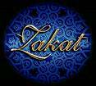
Zakat is giving 2.5% of one’s wealth to a good cause
Zakat is an act of worship.
It is not charity – because charity is voluntary.
It is a duty.
People who pay it should not feel proud and good about themselves
Zakat helps to make a fairer society.
What is a ‘duty’?
“They ask you [Prophet] what they should give. Say, ‘Whatever you give should be for parents, close relatives, orphans, needy and travelers. God is well aware of whatever good you do”
~ Qur’an 2:215

Slide 9

In Arabic zakat literally means “purification”, because zakat is considered to purify one’s heart of greed. Love of wealth is natural and it takes firm belief in God for a person to part with some of his wealth.

Slide 10
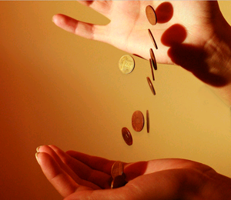
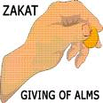
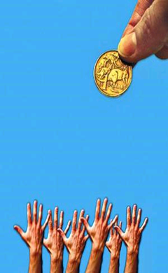
Muslims believe:
Everything that they own has been given to them by God.
They are simply looking after what God has given them.
The money they have should be used wisely and in a way which God will like. This means giving things to those who need them.
The poor have a right to share the wealth that belongs to the rich people.
Zakat makes sure this happens and that no one is left really poor in the society.

Slide 11
What are the benefits of giving Zakah?
Obeying God-being a true Muslim.
Freeing oneself from the love of possessions and greed
Protecting society – so that the poor don’t feel that they need to turn to crime such as stealing.
Acknowledging that whether we are rich or poor is God's choice so we should help those he has chosen to make poor.
Zakat makes a fairer society, so that the poor don’t get poorer and the rich don’t get richer.
“And establish prayer and give Zakat, and whatever good you put forward for yourselves – you will find it with Allah.” ~ Qur’an 2:110

Slide 12




Muslims believe it is a sin to let people in the society suffer from hunger and disease.
Hanging and holding on to the wealth which God has given you is also a sin as it is being greedy, and being greedy is a sin.
In Muslim countries – the government will collect the money and distribute it amongst the poor.
In non-Muslim countries such as the UK – Islamic organisations will collect the money and send it to the poor Muslim countries.
https://youtu.be/dio21smcqQE?si=bUM4p9uvt9HucIx3

Slide 13
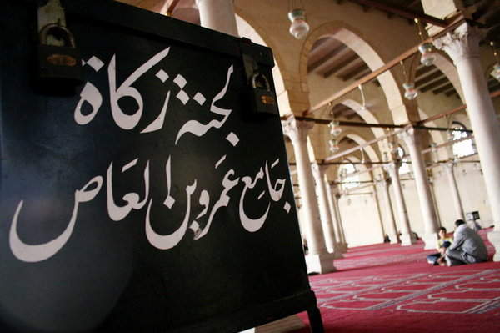
Most Muslims in the West disperse zakat through Islamic charities, mosques, or directly giving to the poor. Money is not collected during religious services or via collection plates, but some mosques keep a drop box for those who wish it to distribute zakat on their behalf.

Slide 14
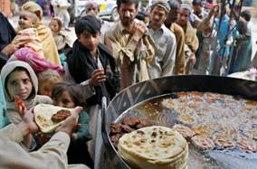


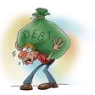

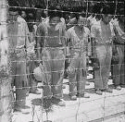
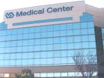

Who receives Zakat money?
Muslims studying Islam
The poor and the needy
Travellers who need money
Zakat goes to:
People in debt
New Muslims
Schools, Hospitals, Libraries, Mosques
Prisoners of war

Slide 15

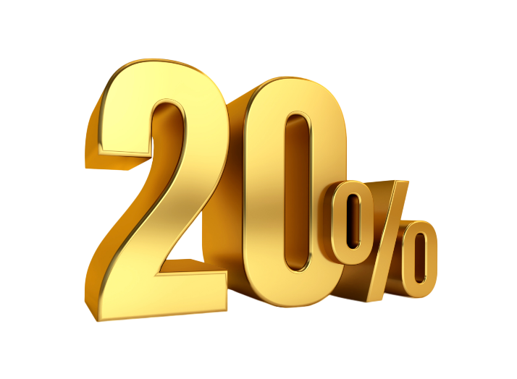

Khums
Good actions or voluntary payments that are undertaken for charitable reasons
Sadaqah
Literally means ‘fifth’
Originally it referred to a requirement for Muslims to donate 20% of the spoils of war to the leader representing the state of Islam.
In addition to giving Zakat, Muslims are encouraged to voluntarily give their money and time to charity at any point in the year. This is called sadaqah.
Nowadays it refers to the excess in come or earnings a Shi’a Muslim makes, and is still set at 20%.
“Alms are meant only for the poor, the needy, those who administer them, those whose hearts need winning over, to free slaves and to help those in debt, for God’s cause, and for travelers in need” ~ Qur’an 9:60
Half of money collected as Khums goes to Shi’a religious leaders, to be spent on behalf of God on things considered necessary for religious matters, while the rest is given to charity or the poor.

Slide 16
Hajj = annual pilgrimage to Mecca that every Muslim should make at least once in their lifetime
Notes:
Sawm is in both the 5 pillars of Sunni Islam and the 10 obligatory acts of Shi’a Islam
Students should ensure they have all key vocabulary (shown with a key symbol) in their key word glossaries at the back of their exercise books

Slide 17
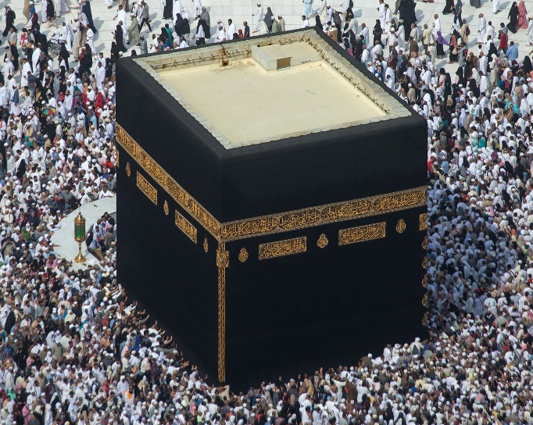
What is Hajj?
“Pilgrimage to the house is a duty owed to God by people who are able to undertake it”
- Qur’an 3:97
Pilgrimage = a journey by a religious believer to a holy site for religious reasons; an act of worship and devotion
Hajj is an obligation of all Muslims. This special pilgrimage should be made at least once during a Muslim’s lifetime, provided they are healthy and wealthy enough to do so.
https://youtu.be/Ok7-mB62xeE?si=H2te5ayOqQ8kkTx4

Slide 18
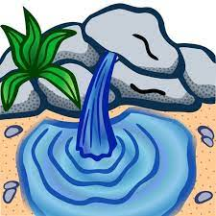
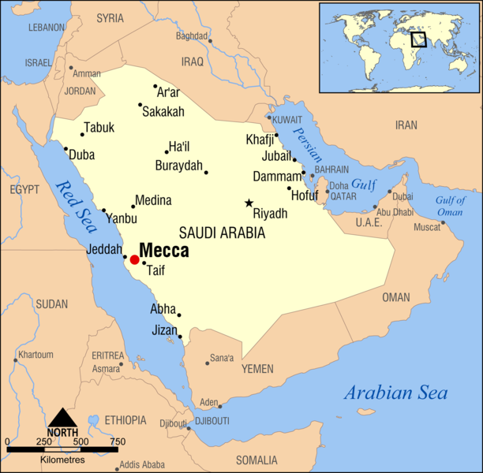
The story of Hajj
Think back to the story of Ibrahim…
What happened to Hajira (Hagar) and Ishmael?
Can you remember anything about their story?
Muslims believe that around 4000 years ago Allah told Ibrahim to take his wife Hajira and his son, Ishmael, to Arabia. He was then told to leave Hajira and their son on their own in the desert with limited supplies of food and water.
Looking for help, Hajira ran between two hills called Safa and Marwah. Exhausted, she prayed to Allah for help. Ishmael struck his foot on the ground, which caused water to gush from the earth. They then traded this water for food.
When Ibrahim returned he was told by Allah to build a shrine dedicated to him. This became the Ka’aba.
Centuries later, the city of Mecca was established nearby using water from Ishmael’s well (the well of Zamzam).
What happened next?
Notes:
What happened next? Recap the story of Muhammad

Slide 19
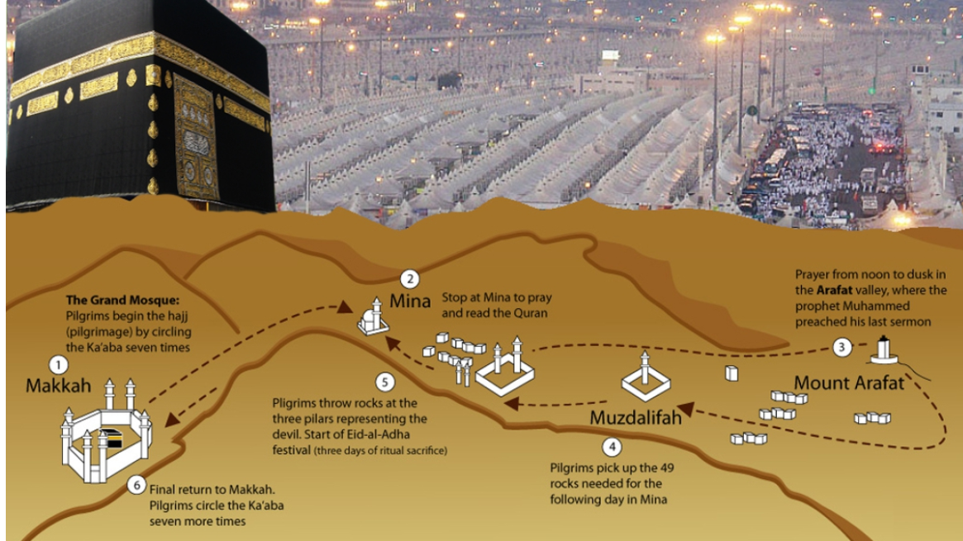

Slide 20

How does the Hajj pilgrimage mirror the story of Ibrahim?

