Slide 1
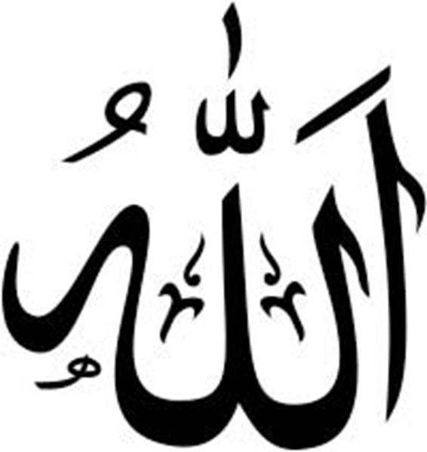
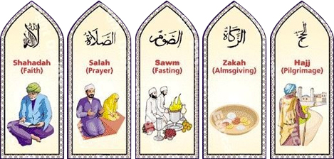
Sunni = the 5 pillars

Slide 2
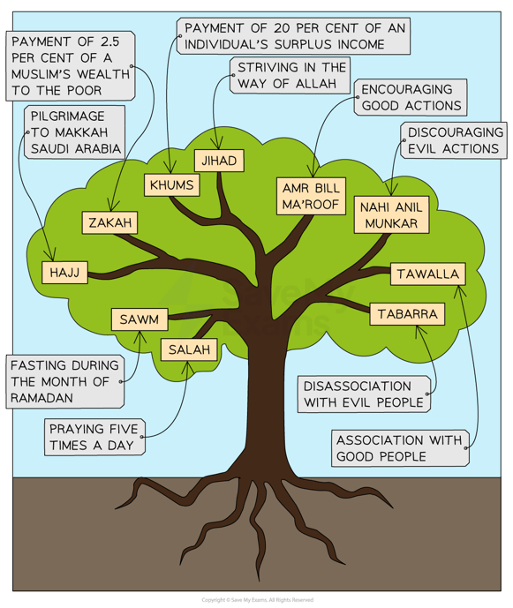
Shi’a = the 10 obligatory acts
Which of these acts are the same as the 5 pillars of Sunni Islam?
https://youtu.be/c5c9-1zxPeA?si=ebZifxJs2ZrZGS2a

Slide 3

Shahadah
Shahadah is the Muslim declaration about belief in Allah (God)
It is the first of the five pillars of Islam
It can be found on the flag of Saudi Arabia.
Muslims say it to show that they believe there is only one God.
The word means ‘to witness or testify’.
They also state that the Prophet Muhammad (PBUH) is the last prophet of Allah.
To become a Muslim you have to say this statement and really mean it.

Slide 4
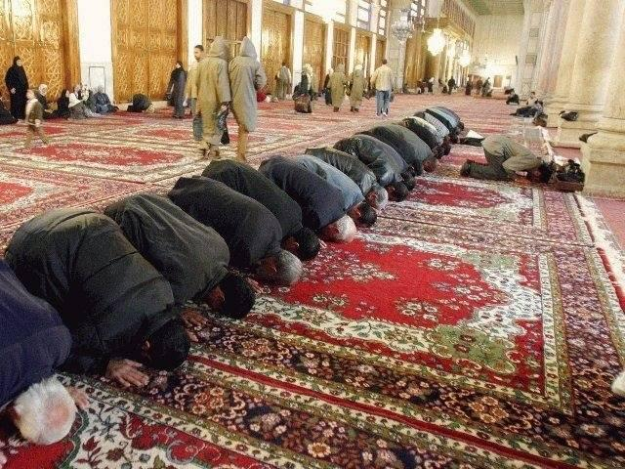
Muslims must clean themselves before prayer to show respect to Allah.
Salah is the act of formal prayer in Islam.
Muslims are required to pray five times a day – EVERY DAY.
Salah
Muslims must pray on a clean surface.
Prayer is at set times during the day and is these times are set by the movement of the sun.
There are various positions involved with prayer and Muslims should follow this routine each time they pray.
The first prayer is called Fajr and the final prayer is called Isha.

Slide 5

Zakat
Banks across the world have special Muslim bank accounts to help Muslims calculate the Zakat value of their interest rates.
It requires Muslims to give 2.5% of their earnings to charities.
Zakat means to purify or give alms.
Various people can receive Zakat such as those living in poverty and homeless children.
Zakat is only payable on assets if they have been owned for over one lunar year (using the moon).
Zakat is more than charity, which is voluntary. It is seen as essential for a Muslim to give Zakat in order to please Allah.

Slide 6

Sawm is the practice of fasting during the month of Ramadan.
Fasting also reminds Muslims that there are less fortunate people in the world.
Sawm
The word sawm means to not eat, drink or have sex.
Muslims fast so that they can feel closer to Allah. If you can control basic desires, you can concentrate on Allah.
Muslims observe Sawm from sunrise to sunset during the 9th month of the Islamic calendar.
Muslims are also encouraged to avoid swearing and thinking evil thoughts during a period of sawm.
Ramadan ends with a festival called Eid-Ul-Fitr

Slide 7
HAJJ
Hajj takes place during the 12th month of the Islamic calendar. (this is not the same as the calendar that we use)
Hajj is the name of a pilgrimage.
Muslims must go on a holy journey to Mecca, Saudi Arabia.
All Muslims must go on this journey at least once in their lives. However, if they are ill and unable, someone may take their place.
Although they have to go at some point in their lives, Muslims are not allowed to get into debt to go on Hajj.
All Muslims must wear the same as each other on Hajj to show equality.

Slide 8

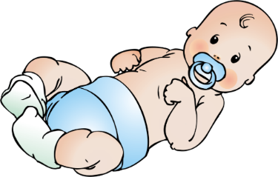
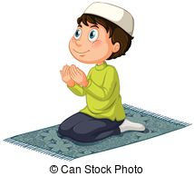
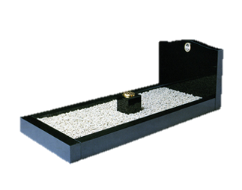
Shahadah
Testimony; Declaration of faith
https://youtu.be/Z1uYIpD_SyE?si=Q1-7TwzjPtFXAgL3
It is said when a baby is born, so the first thing that they hear is this basic belief of the faith they are born into.
The basic belief in Islam is expressed in the Shahadah. In Arabic it is:
‘La ilaha illa Allah wa, Muhammad rasul Allah’
‘There is no God but Allah and Muhammad is the Prophet of Allah’
It is also included in the daily prayers
If possible, it becomes the last words of a Muslim before they die.
Reciting this statement in front of Muslim witnesses is the only requirement for joining the Muslim community.

Slide 9
Shahadah in Shi’a Islam
In Shi’a Islam, Muslim’s add an extra phrase to the Shahadah:
‘and Ali is the friend of God’.
This demonstrates their belief that Ali, Muhammad’s cousin and son-in-law, was the true successor of Muhammad, and that only he and his descendants know the true meaning of the revelation given to Muhammad.
Abu Bakr
Ali

Slide 10
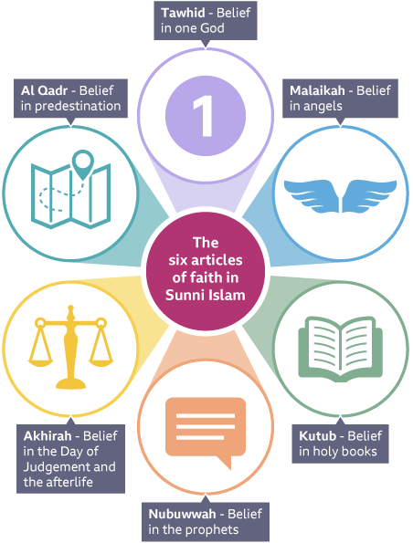
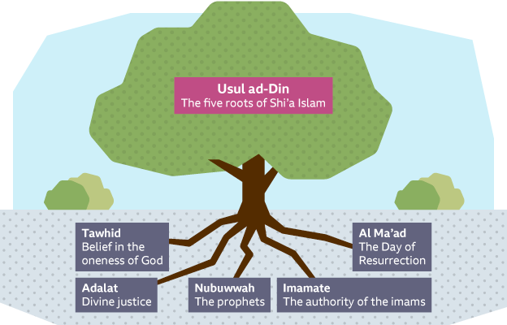

Slide 11
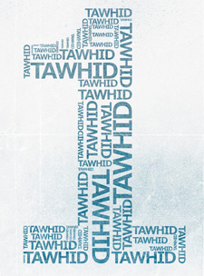
Tawhid: The oneness of God
“And your Allah is One Allah. There is no god but He, Most Gracious, Most Merciful”
Qur’an 2:163
Muslims believe that Allah:
is the one true God - all worship and praise is directed towards him
should be treated with respect as he is the supreme being
is the creator, designer and sustainer of the world
The word Tawhid is used to describe the oneness of Allah, which is the fundamental belief of Islam. It means believing in Allah, believing that he is the one and only God. It helps Muslims to think of Allah as the centre point of life.

Slide 12
“The Shahadah is the most important of the 5 pillars”
Do you agree? Write a brief response to this statement in your exercise book

Slide 13

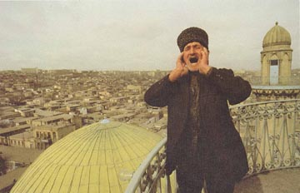
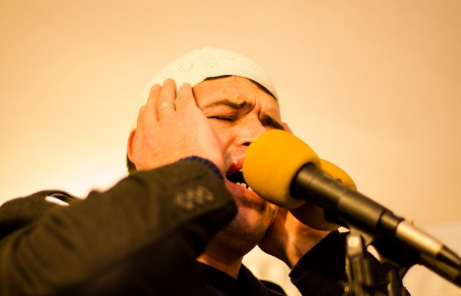
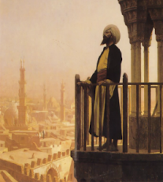
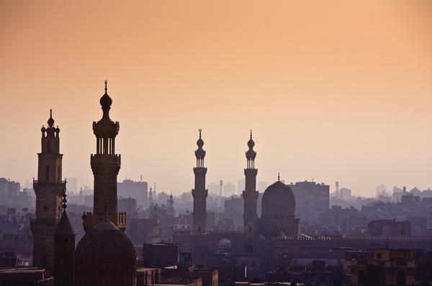
Where can we hear the first of the 5 pillars in the Adhan?
Where can we hear the belief in Tawhid in the Adhan?
The Adhan is the Islamic call to prayer. It is sung by a muezzin.
Allahu Akbar
God is Great x2
Ashhadu an la ilaha illa Allah
I bear witness that there is no god except the One God. X2
Ashadu anna Muhammadan Rasool Allah
I bear witness that Muhammad is the messenger of God. X2
Hayya 'ala-s-Salah
Hurry to the prayer (Rise up for prayer) x2
Hayya 'ala-l-Falah
Hurry to success (Rise up for Salvation) x2
Allahu Akbar
God is Great x2
La ilaha illa Allah
There is no god except the One God
https://www.youtube.com/watch?v=ADLO-Hm_nCQ
Notes:
https://www.youtube.com/watch?v=ADLO-Hm_nCQ

Slide 14

Salah = Prayer

Slide 15
Key vocabulary
Compulsory - necessary.
Humility – to show that you are not proud and not arrogant; To believe that you are not better than other people.
Discipline – training to act in accordance with rules.
Dependent – to rely on someone or something else.

Slide 16


We all need peace and privacy at times.
It helps to relieve stress and anger that we bottle up inside ourselves.

Slide 17
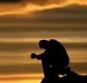
Prayer, for a Muslim, is partly about this sense of space and peace. By turning to God five times a day, Muslims unload their worries, ask forgiveness, and seek peace of mind.

Slide 18
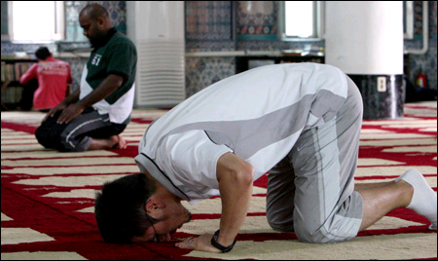
Muslims believe that God created human beings to worship him, so the second pillar of Islam is prayer.
Sunni Muslims must pray 5 times a day.
Each time takes about 10 minutes.

Slide 19

Prayer reminds Muslims that they are dependent upon their creator. They did not make themselves and have no power of the gift of life.
“Your Lord says, ‘Call on me and I will answer you’”
~ Qur’an 40:60

Slide 20
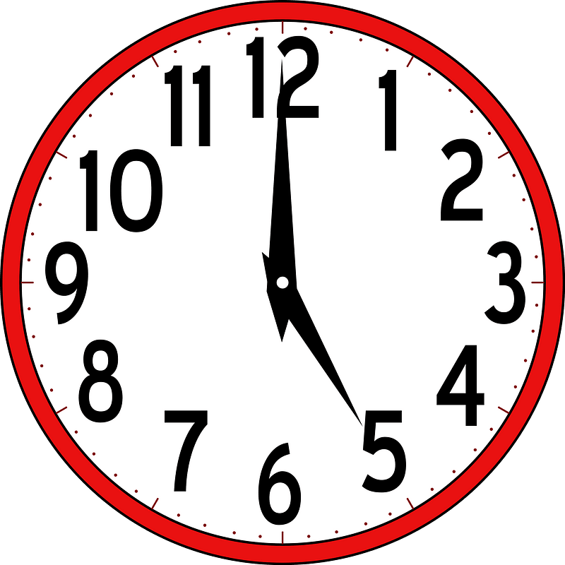
Timings of the 5 daily prayers
The morning prayer (Fajr) is prayed an hour and half before sunrise until sunrise.
The noon prayer (Zuhr) is when the sun is at its highest peak.
Afternoon/early evening prayer (Asr) is between noon prayer and evening prayer.
Evening prayer (Maghrib) is when the sun sets.
Night prayer (Isha) is an hour and half after sunset.

Slide 21
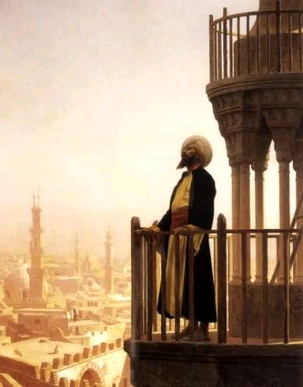
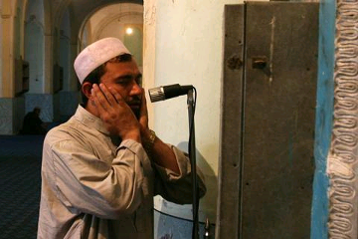
The Adhan (call to prayer) marks the beginning of the time slot for the prayer.
In Muslim countries this can be heard loudly in the streets and marketplace.
In Western countries you hear it inside
the mosque.

Slide 22
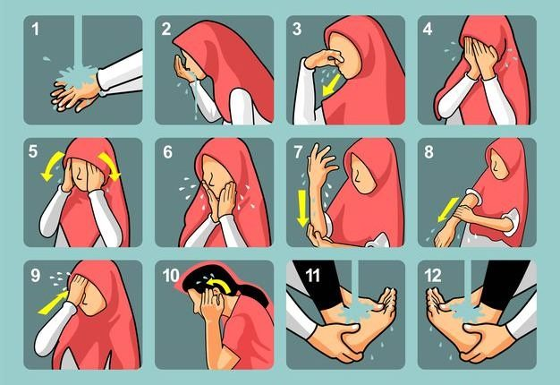

Muslims MUST perform Wudu in order to pray their Salah, otherwise it will not be accepted by God.
Wudu = ritual washing before prayer
“You who believe, when you are about to pray, wash your faces and your hands up to the elbows, wipe your heads, wash your feet up to the ankles and, if required, wash your whole body”
~ Qur’an 5:6
Why do Muslims believe it is important to perform wudu?
https://youtu.be/iV_nZJMLhmo?si=Xbq5PYHPbyHVLFYY

Slide 23
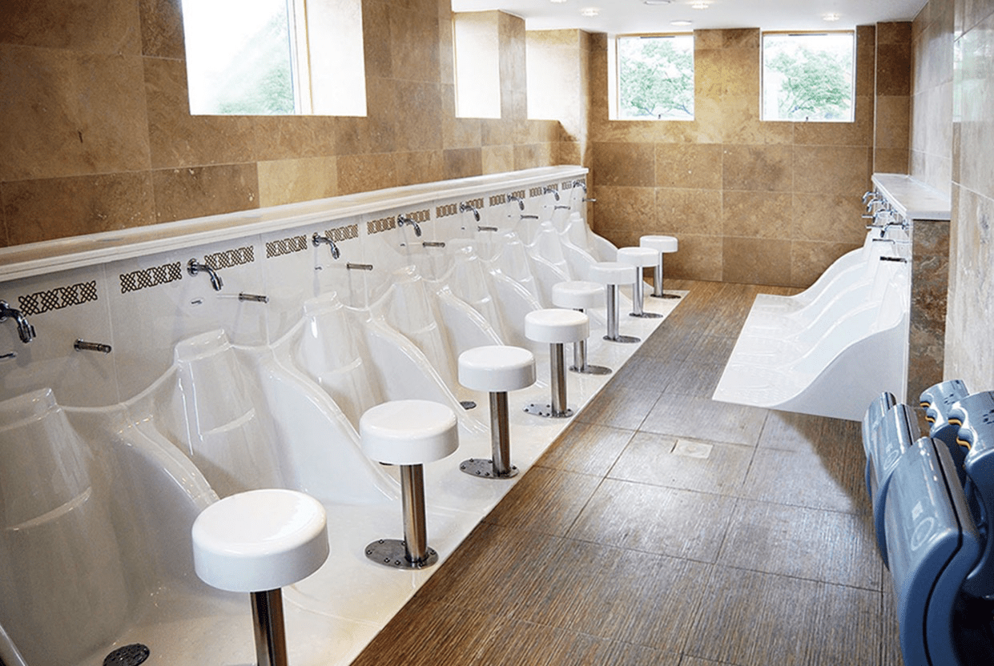
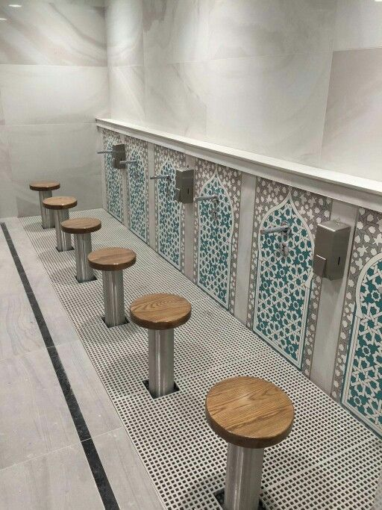
Mosques have two special rooms set aside for washing, one for men and one for women. Washing is done under running water, rather than using a basin.
If water is not available, for example in a desert, a dry form of washing is allowed using sand or dust. This illustrates that it is not the physical cleanliness that is required, but the spiritual cleanliness, and wudu is a form of spiritual preparation or purification to allow Muslims to focus fully on God in their prayers.

Slide 24
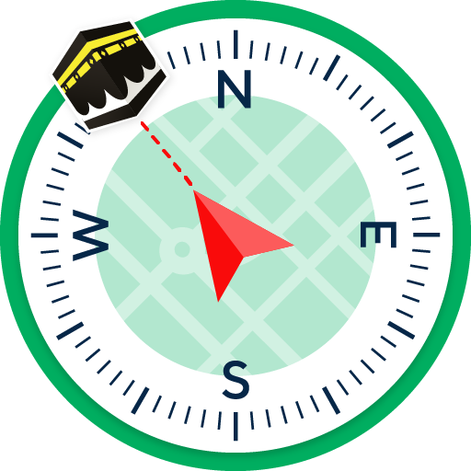
All Muslims face the Ka’bah in Makkah when they pray.
This means that all Muslims are physically and mentally focusing on one place associated with God
In a mosque, this is easy to achieve as all the mats will be facing the mihrab. This is a semi-circular niche in the qibla wall.
Many prayer mats have a compass on it showing the direction of Mecca.
Mihrab = niche in the wall of a mosque indicating the direction of Mecca
Qibla = the direction of Mecca

Slide 25
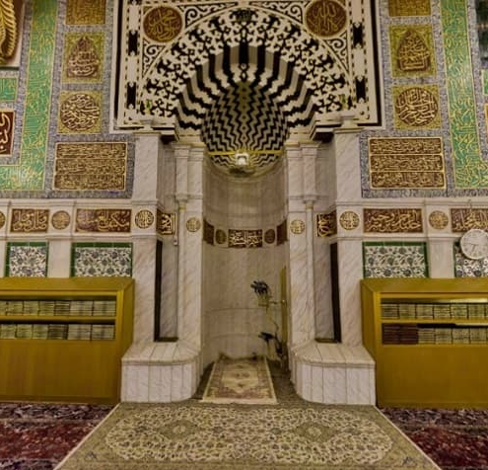
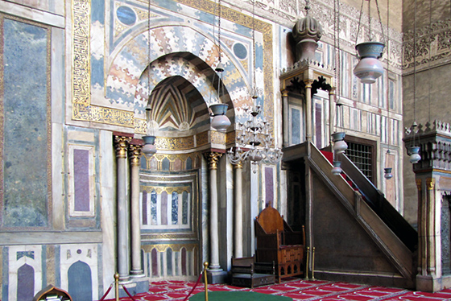

Slide 26

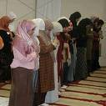
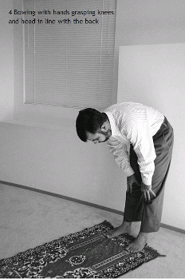

These 5 daily prayers are compulsory.
They involve a series of standing up, bowing and prostrating.
Why prostrate and bow?
Bowing and prostrating remind Muslims that God is greater and more important than them.

Slide 27
Rak’ah = sequence of movements and recitations used in salah
O Allah, glory and praise are for you, and blessed is your name, and exalted is your majesty: there is no god but you. I seek shelter in Allah from the rejected Satan. In the name of Allah, the most merciful, the most kind
Allahu Akkbar
Glory to my God the great
Allah hears those who praise Him. Our Lord praise be to you
Allahu Akbar
Glory to my God the highest
After salah is completed personal prayers – du’a – may be recited
https://youtu.be/q_WEa9IobmI?si=zhYwsqGnVeaJOpKb

Slide 28
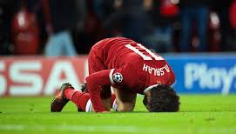
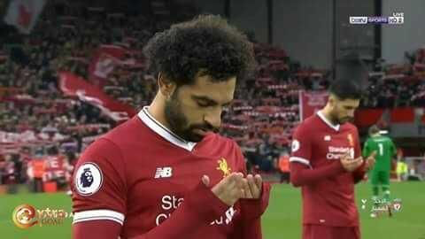
Why did Mo Salah do this after scoring a goal?
https://youtu.be/5OIr4WHMA-M?si=oZjuq1p7VcOoFwMp

Slide 29
What does the bowing and prostration
express?
It shows humility in front of their creator.
It shows respect for their creator.
It reminds Muslims that they are dependent upon God.
This helps a Muslim be obedient to God.

Slide 30
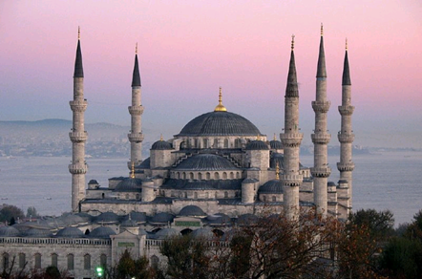

Men should pray at mosques whenever possible.
Ladies do not have to go to mosques – they are encouraged pray in their homes, especially if they have children to look after.
Once a Muslim reaches 10 years of age – they must start to pray.
The midday prayer on a Friday is considered to be the most special, and is called the Jummah prayer. All male Muslims are expected to attend mosque for this prayer and women may do so if they wish. Once the prayer is complete, the imam will deliver a sermon that reminds Muslims of their obligations and duties to God.
“Believers! When the call to prayer is made on the day of congregation, hurry towards the reminder of God and leave off your trading”
~ Qur’an 5:6

Slide 31


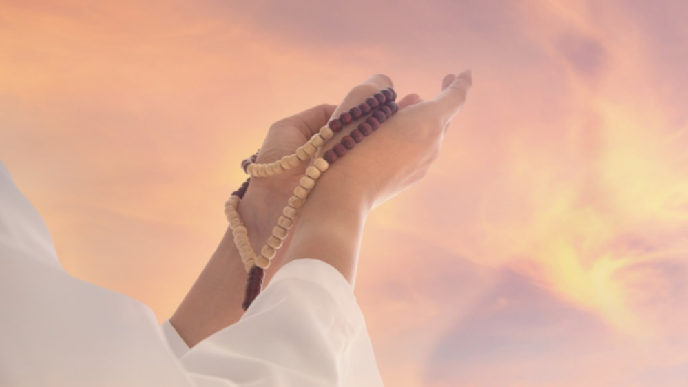
Muslims can also make a small personal prayer asking God for whatever they wish anytime of the day.
This is called Du’a.

Slide 32
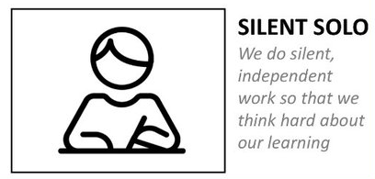

Answer the following questions…
Why do Muslims perform wudu before praying?
Explain what Muslims do when they pray
Do you think having a set sequence for prayer is a good idea? Explain your opinion
Why do you think Muslims pray in Arabic rather than their native language?
If Muslims are allowed to pray at home, why do you think many go to a mosque to pray?
Explain how a Muslim might answer this question: Why do you pray?

Slide 33
EXT: What do Sunni and Shi’a Muslims have in common in their daily prayer?
Similarities | Differences
May recite the all/some of the 99 beautiful names or the Qur’an during prayer.
Shi’as have a piece of clay (mohr) on their prayer mat when they prayer as they believe this is what Muhammad (PBUH) did.
The Shahadah said during Wudu – Shi’a Muslims may include an extra line with reference to Ali.
The wudu routine is slightly different – all of the same parts are washed.
Men pray separately from Muslim women
Muslims believe they are part of the Ummah
Pray in a Mosque OR at home/on a prayer mat
Believe in 1 God – Allah and only pray to him
Pray 5 times a day
Some prayers are combined
Du’a prayers may include words from Imams (Imammate)
Muslims gain spiritual, personal, physical and mental benefits from prayer
Called to prayer with an Adhan

Slide 34
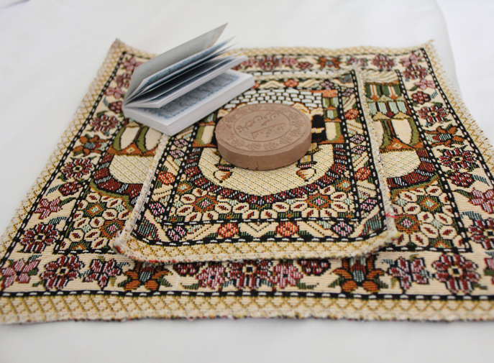
EXT: What do Sunni and Shi’a Muslims have in common in their daily prayer?
Similarities | Differences
All Muslims are called to prayer with an Adnan
All Muslims can pray in a Mosque OR at home/on a prayer mat
All Muslims believe they are part of the Ummah
All Muslims pray 5 times a day
All Muslims believe in 1 God – Allah and only pray to him
All Muslim men pray separately from Muslim women
All Muslims gain spiritual, personal, physical and mental benefits from prayer
All Muslims may recite the all/some of the 99 beautiful names or the Qur’an during prayer.
The wudu routine is slightly different – all of the same parts are washed.
Shi’as have a piece of clay (mohr) on their prayer mat when they prayer as they believe this is what Muhammad (PBUH) did.
The Shahadah said during Wudu – Shi’a Muslims may include an extra line with reference to Ali.
Their Du’a prayers may include words from Imams (Imammate).
Some prayers are combined.

Slide 35
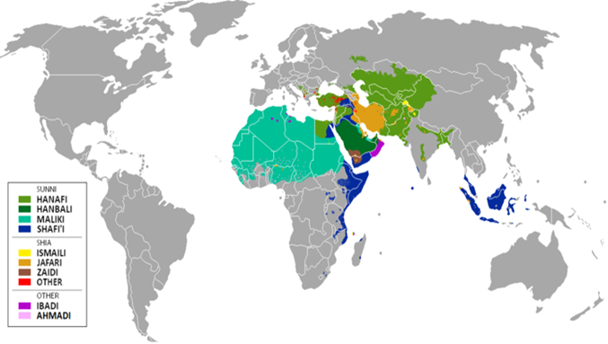
But remember there have also been differences between Sunnis and Sunnis, Shi’a and Shi’as due to the different Muslim schools and locations.
More unites them than divides them.

Slide 36
