Slide 1
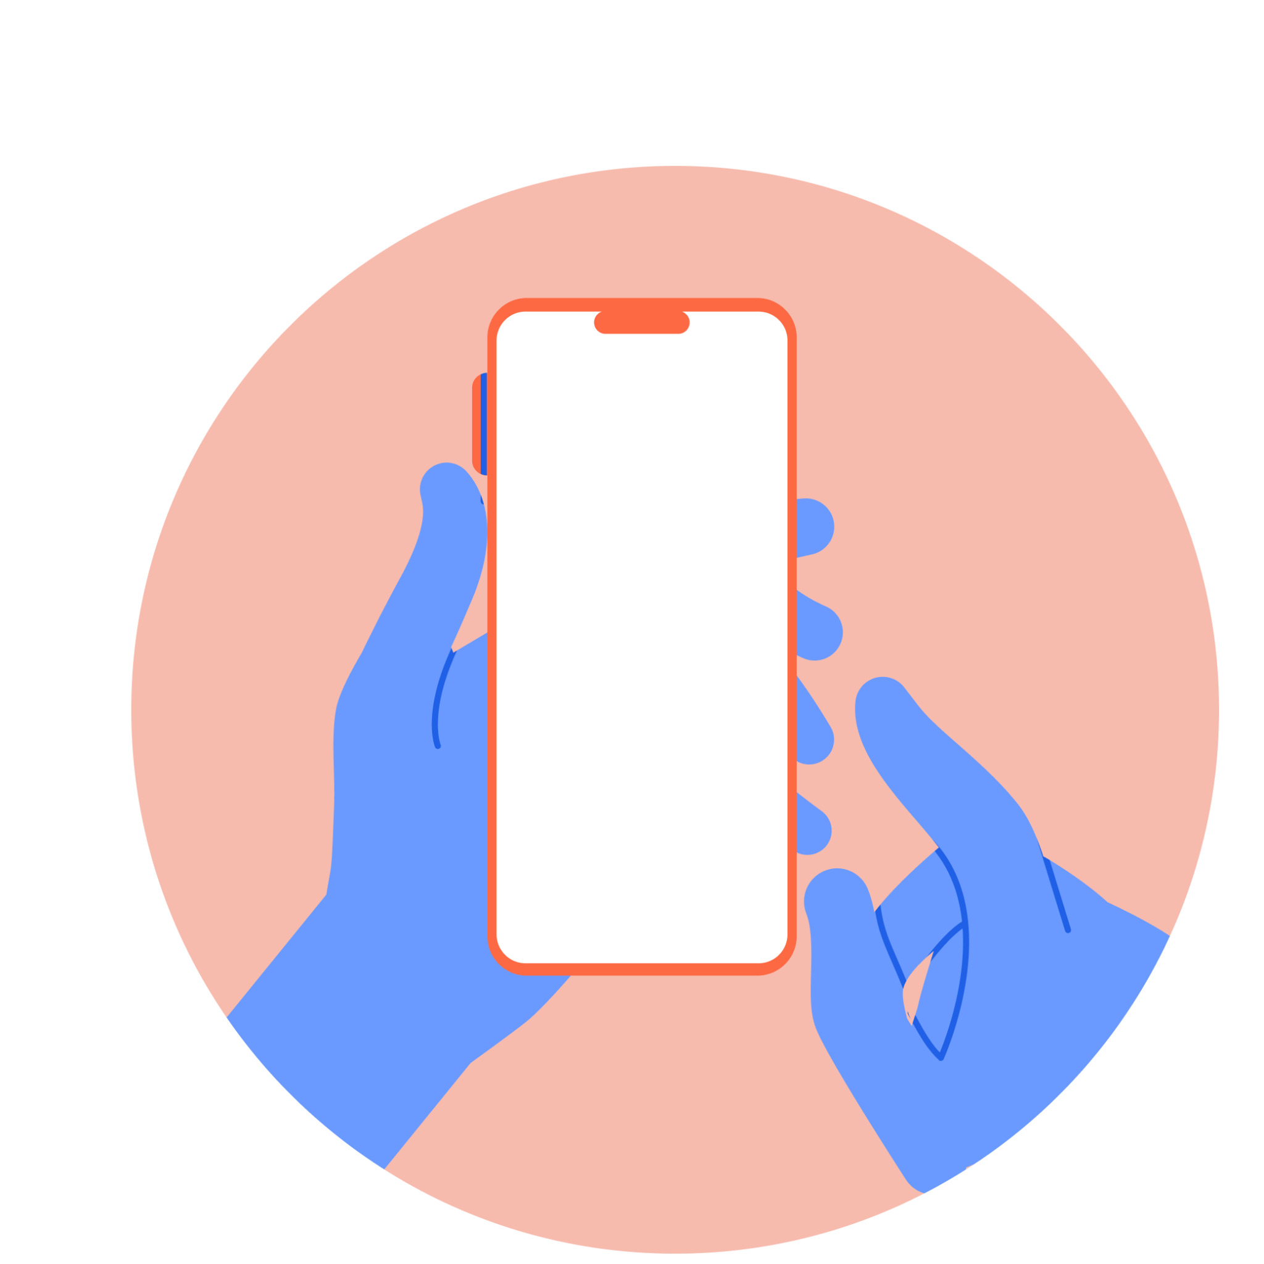
Launch Presentation
A quick note: the blue slides in this presentation are designed to support students primarily.
The purple slides provide information about the parent platform.

Slide 2
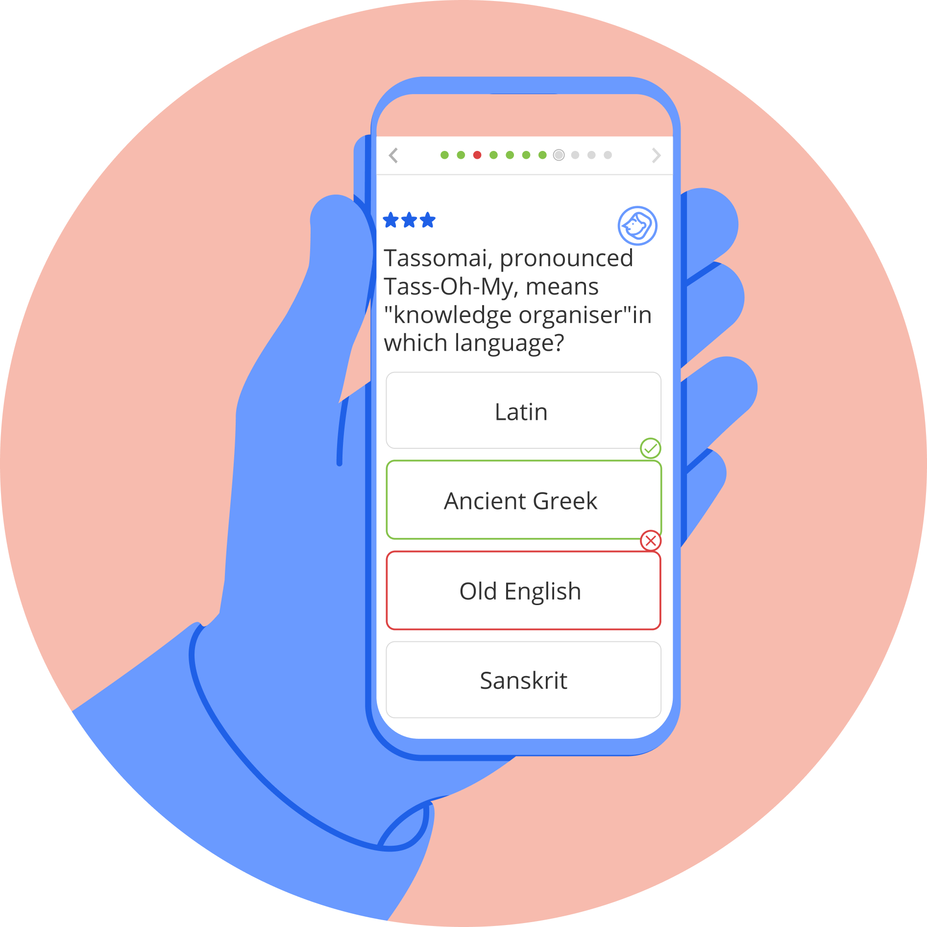
Welcome to Tassomai!
Let’s get you started…

Slide 3
What is Tassomai?
Tassomai is an online multiple-choice quizzing tool that helps you learn and revise. Content is personalised to you by an algorithm that also…
Selects the right content at the right time for you;
Unlocks more challenging topics when you’re doing well;
Gives more support to weaker areas;
Provides other helpful tools to help you learn!
Watch this short video to see how Tassomai works in more detail.

Slide 4
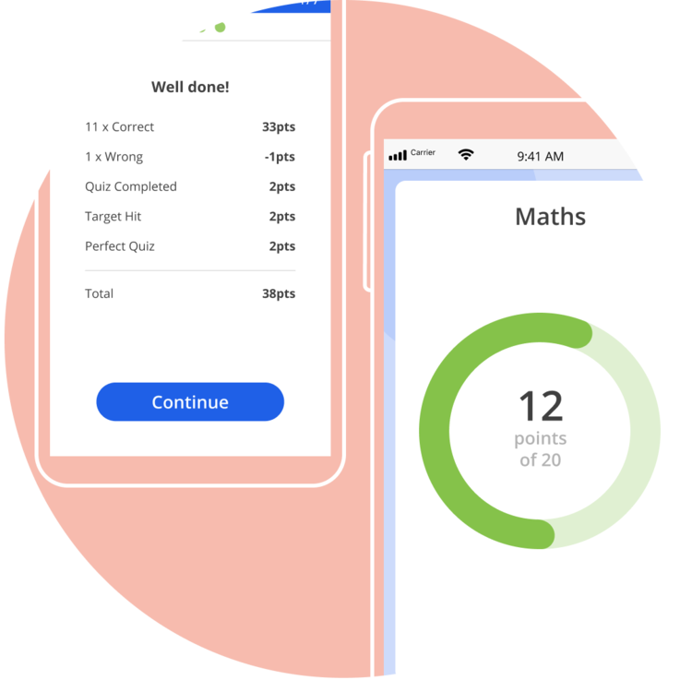
How does Tassomai work?
Each day, Tassomai gives you a set amount of work to complete. This is known as your Daily Goal (DG), and you will have a DG for every subject.
Every correct answer in a quiz earns you 3 points towards your DG. If you hit the target score of a quiz, you receive 4 bonus points!
There are other ways to earn points…but you can lose points with incorrect answers, so answer carefully!
Quizzes do not have a time limit, so you can (and should) take as long as you need to complete each one.
When you get enough points, you will complete your DG.

Slide 5
Why does Tassomai work?
Research into revision and learning techniques has found that the best way to study, and get knowledge to stick in your memory is to:
Work for short, concentrated periods of time;
Frequently switch between topics;
Regularly test yourself.
Tassomai is designed to help you do all of these things!

Slide 6
What’s the best way to work through Tassomai?
Your English teacher will check every Thursday that you have completed 45 minutes of Tassomai questions in the previous week. You can do all 45 mins in one go- but we recommend that you complete your Daily Goals (DGs) at least 4 times per week to space out your 45 mins.

Slide 7
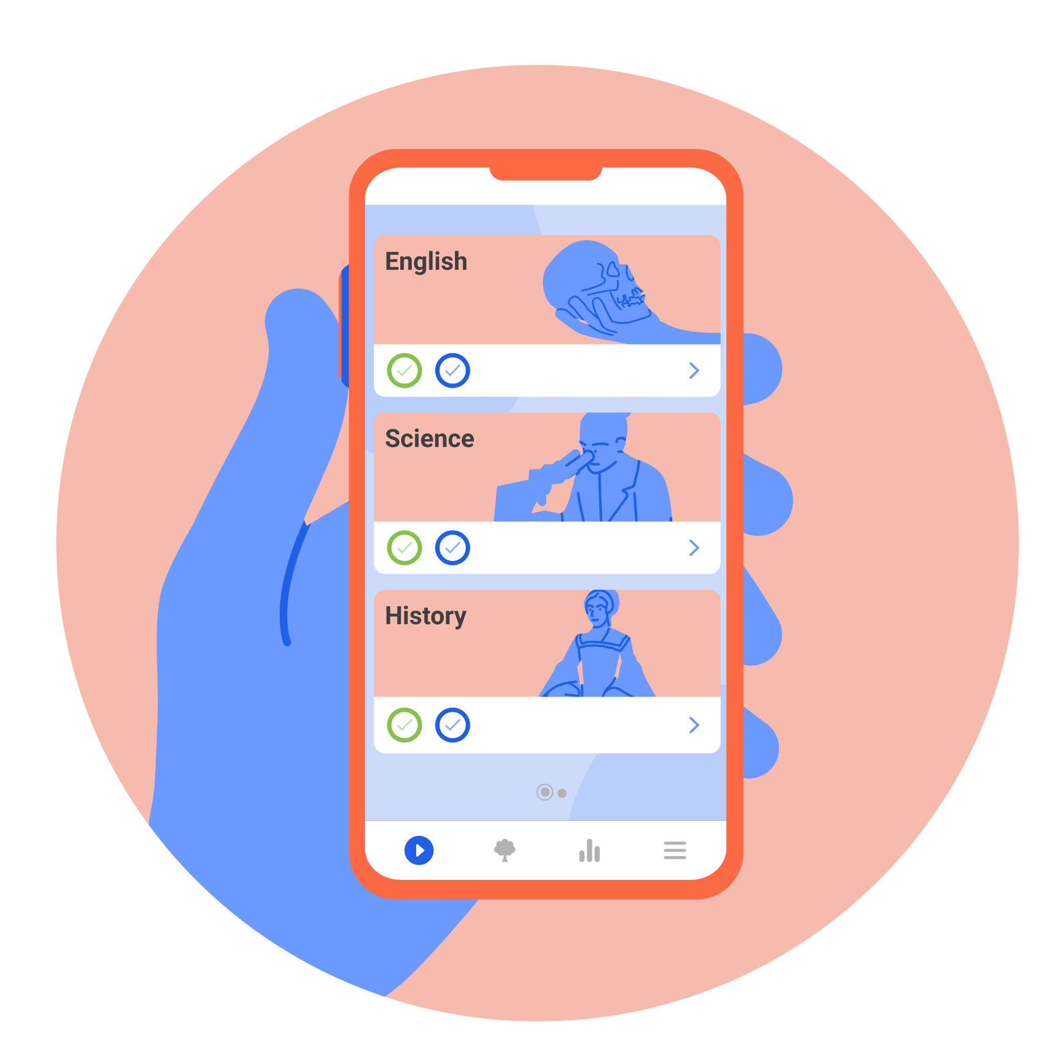
When & where can I work on Tassomai?
You can log in to your account on a computer or laptop, or you can download our free mobile app and use that instead!
You will need to be connected to the internet in order to take quizzes and access your data.
If you are halfway through a quiz and the internet drops out, don’t worry - Tassomai will store your completed answers until you’re reconnected.
Your DGs can be completed throughout the day, so you don’t need to do all your work in one go. However, they will reset at midnight*, so be aware of that.
You don’t need to worry about your mobile data - Tassomai is designed to use very little! See this blog post for more information.
* 12am U.K time.

Slide 8
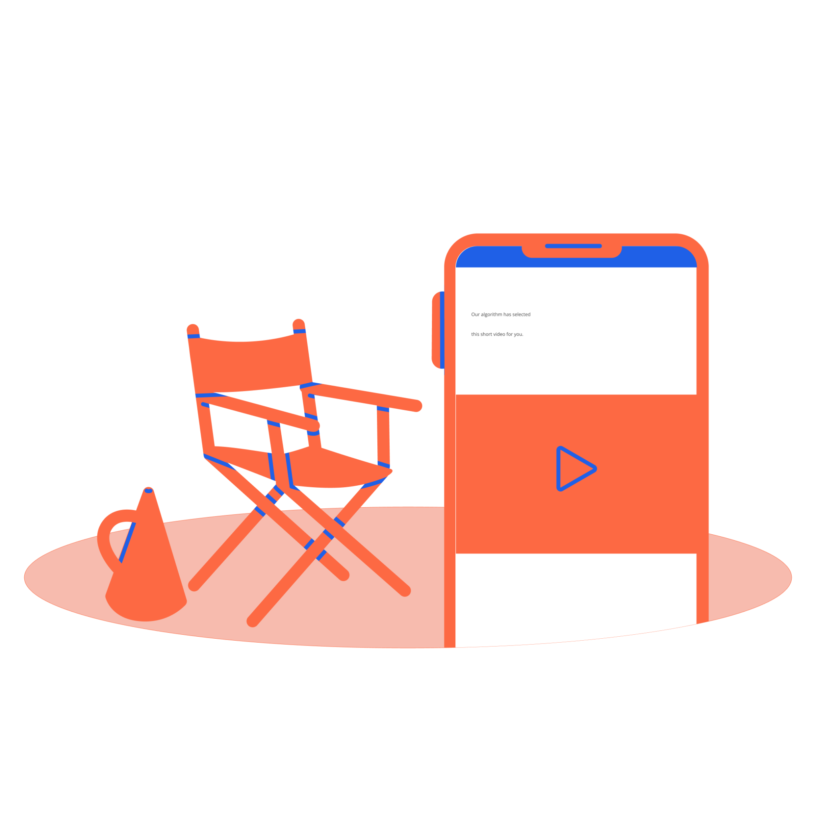
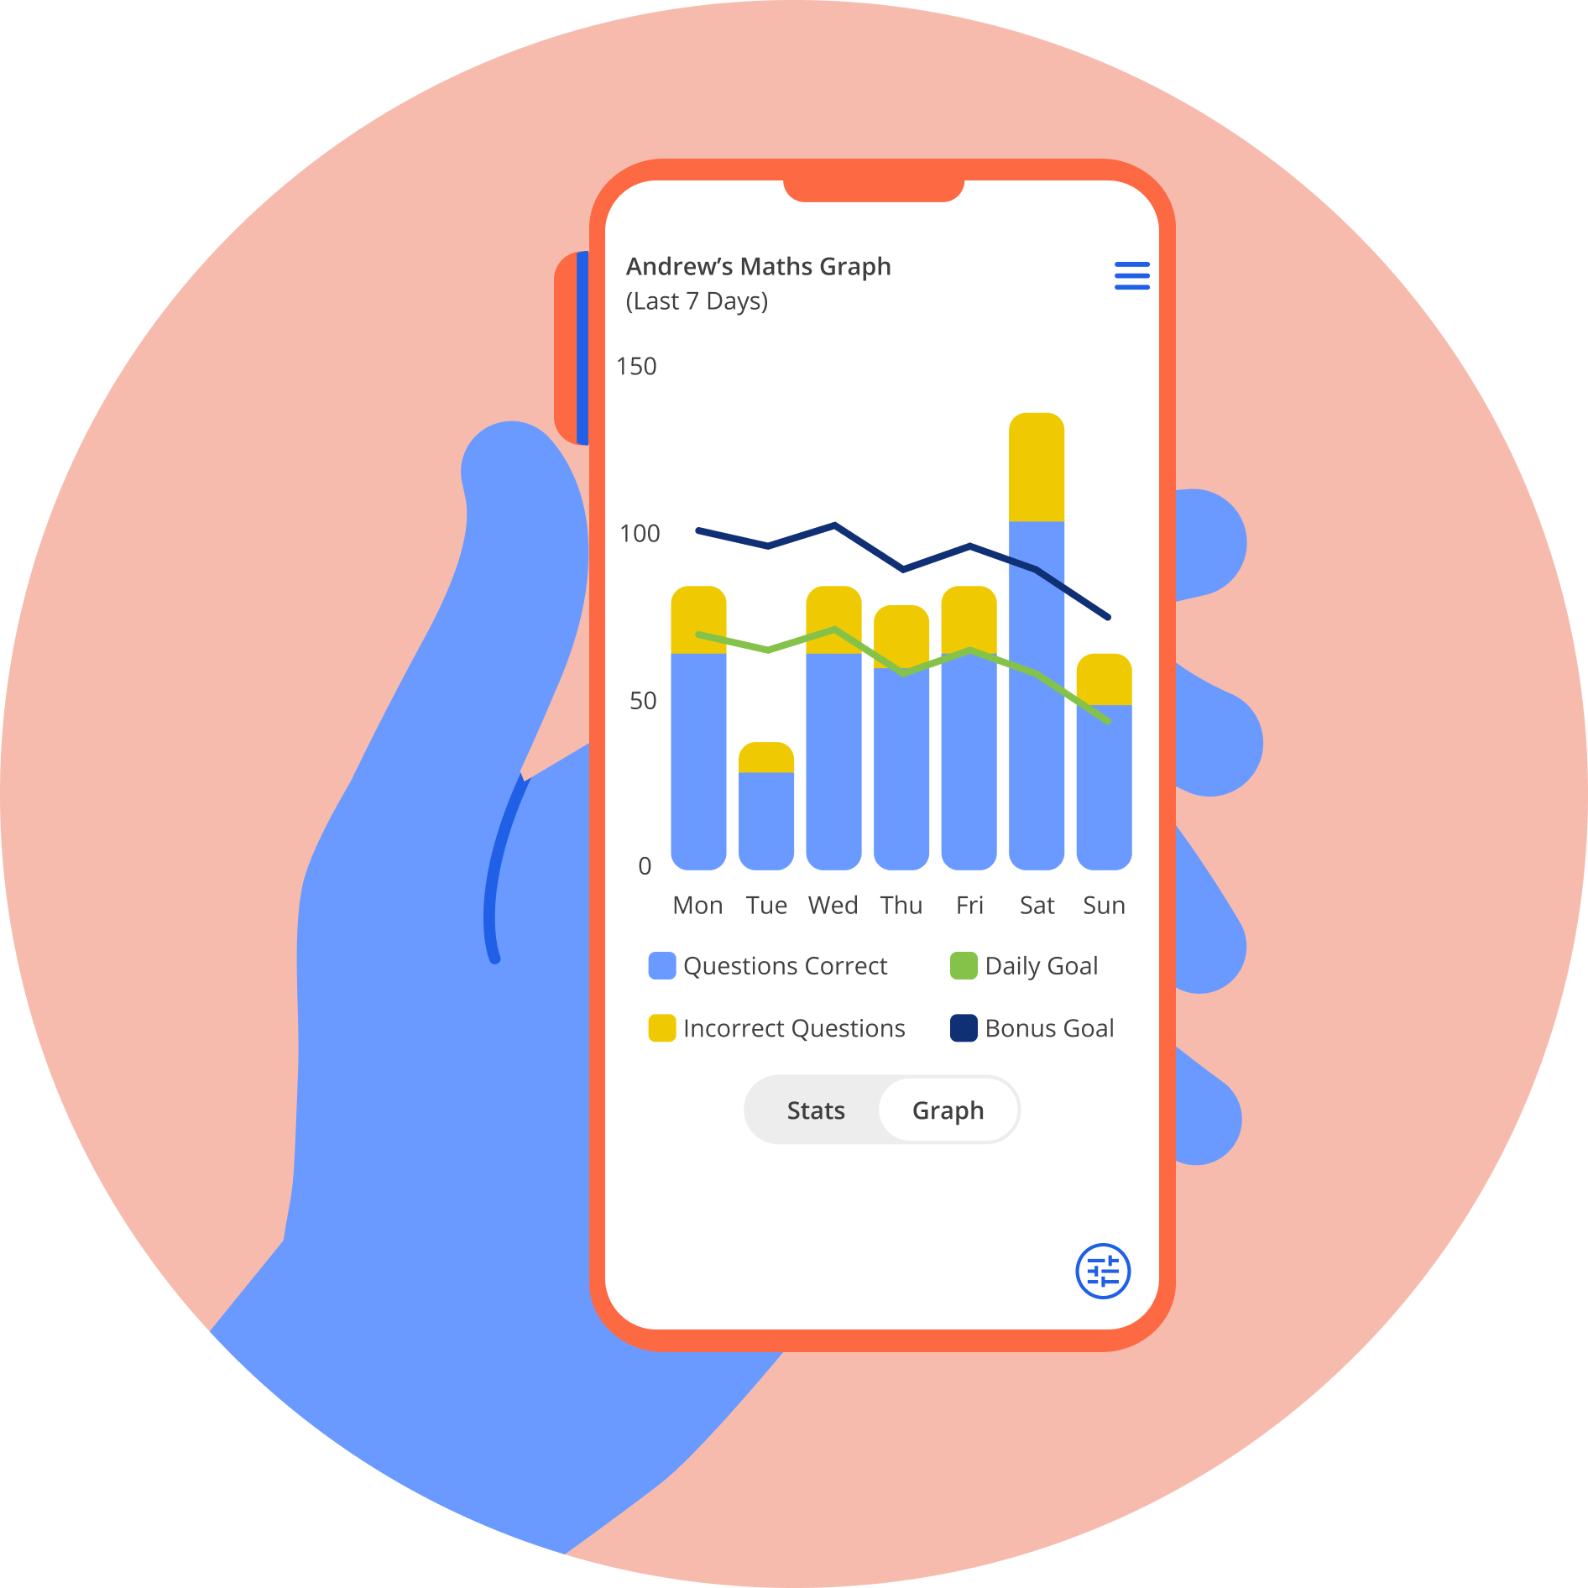
What else does Tassomai offer?
There’s loads more on Tassomai to help you master your learning and confidence!
Let’s explore some of these other tools…

Slide 9
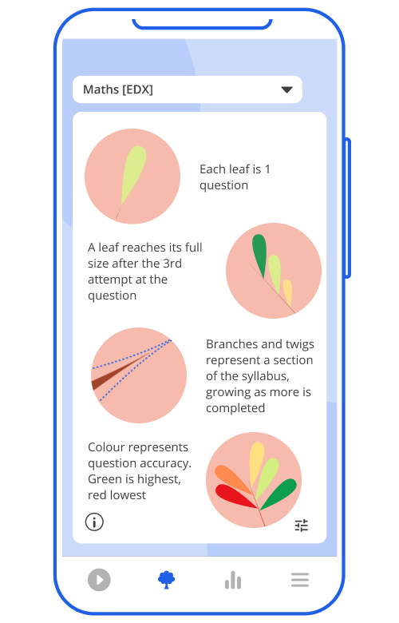
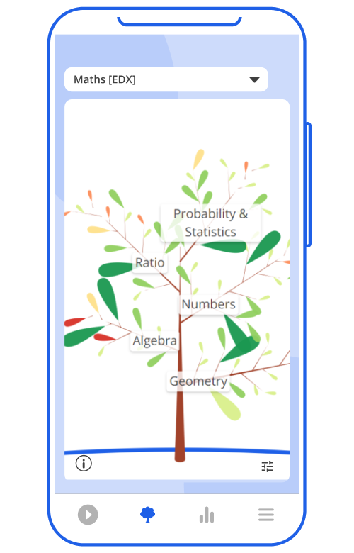
The Tassomai Tree
You will have a tree for each subject you’re studying, and it will grow in size and colour as you work through the quizzes in that subject.
Branches on a tree are topics within that subject, and the leaves on branches are questions within that topic.
You can click on a leaf to read that question and see your data relating to it.

Slide 10
Your Data
Tapping on Usage will show you lots of information about your recent Tassomai use.
You can view different types of data and change the time frame.
If you’re using Tassomai for more than one subject, you can separate your data between those subjects, or view them altogether.
Your Review tab will show you your ten most recently taken quizzes, and you can reflect on any mistakes you may have made.

Slide 11
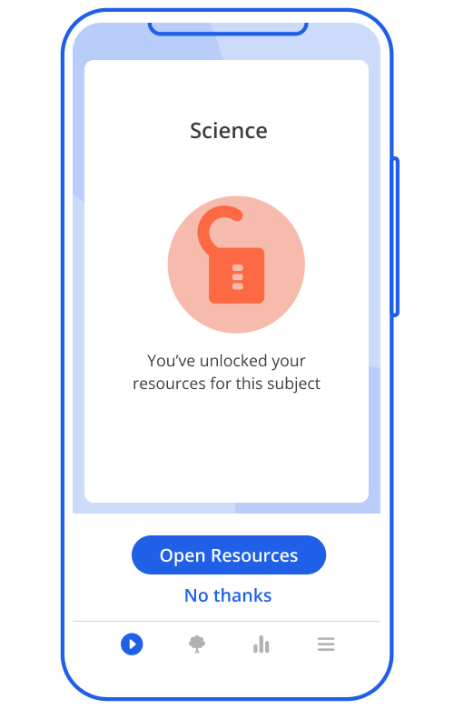
Resources
Once you’ve completed a Daily Goal in a subject, you can select Resources and get 3 supportive materials on areas you’ve struggled with.
You’ll either get an online article, or a video to watch.
Speaking of videos… sometimes you'll be offered a short video to watch before you take a quiz. Watching these videos in full has a useful bonus…but you’ll need to discover this for yourself!
If you like our videos, you can find ALL of them on our YouTube channel “TassomaiTV”.

Slide 12
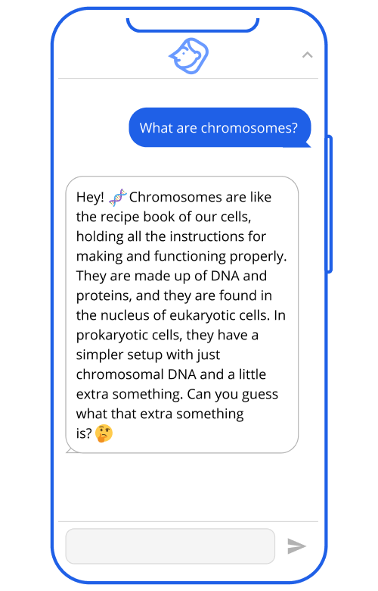
Introducing Mai!
Tassomai has an AI-powered tutor named Mai, to support you with your quizzing.
Before you choose an answer to a question, click the Mai Help icon in the top right corner and a dialogue box will appear - start typing to have a conversation with Mai!
If you choose a wrong answer on a quiz, the Mai Help icon becomes Mai Explain. Click the icon and Mai will explain why the answer you selected is wrong, which answer is correct and why.
You can use Mai Help and Mai Explain a few times each week, so choose wisely! Every Monday, your interactions with Mai will refresh.
Learn more and see examples at tassomai.com/mai

Slide 13
I’m new - how do I get started?
Good news - your account is ready to go!
You can log in to your account (either from the mobile app or Tassomai’s website: www.tassomai.com) using your new school email address.
Your school’s default password: SmartWayToStudy
The first thing you will be asked to do is change that password to something more personal.
Your teacher will have assigned you to your class(es), so you can then start taking quizzes!
Want to learn more?
Visit www.tassomai.com/students for tips and support.

Slide 14
Tassomai for parents - how can we help?
Once your students are up and running, Tassomai sends a weekly progress report to all parents for each child using the platform, sent via email on Mondays.
We also create a free login for parents, allowing them to log in via our web & mobile apps, and access their own personal Parent Dashboard to monitor their child’s progress.

Slide 15
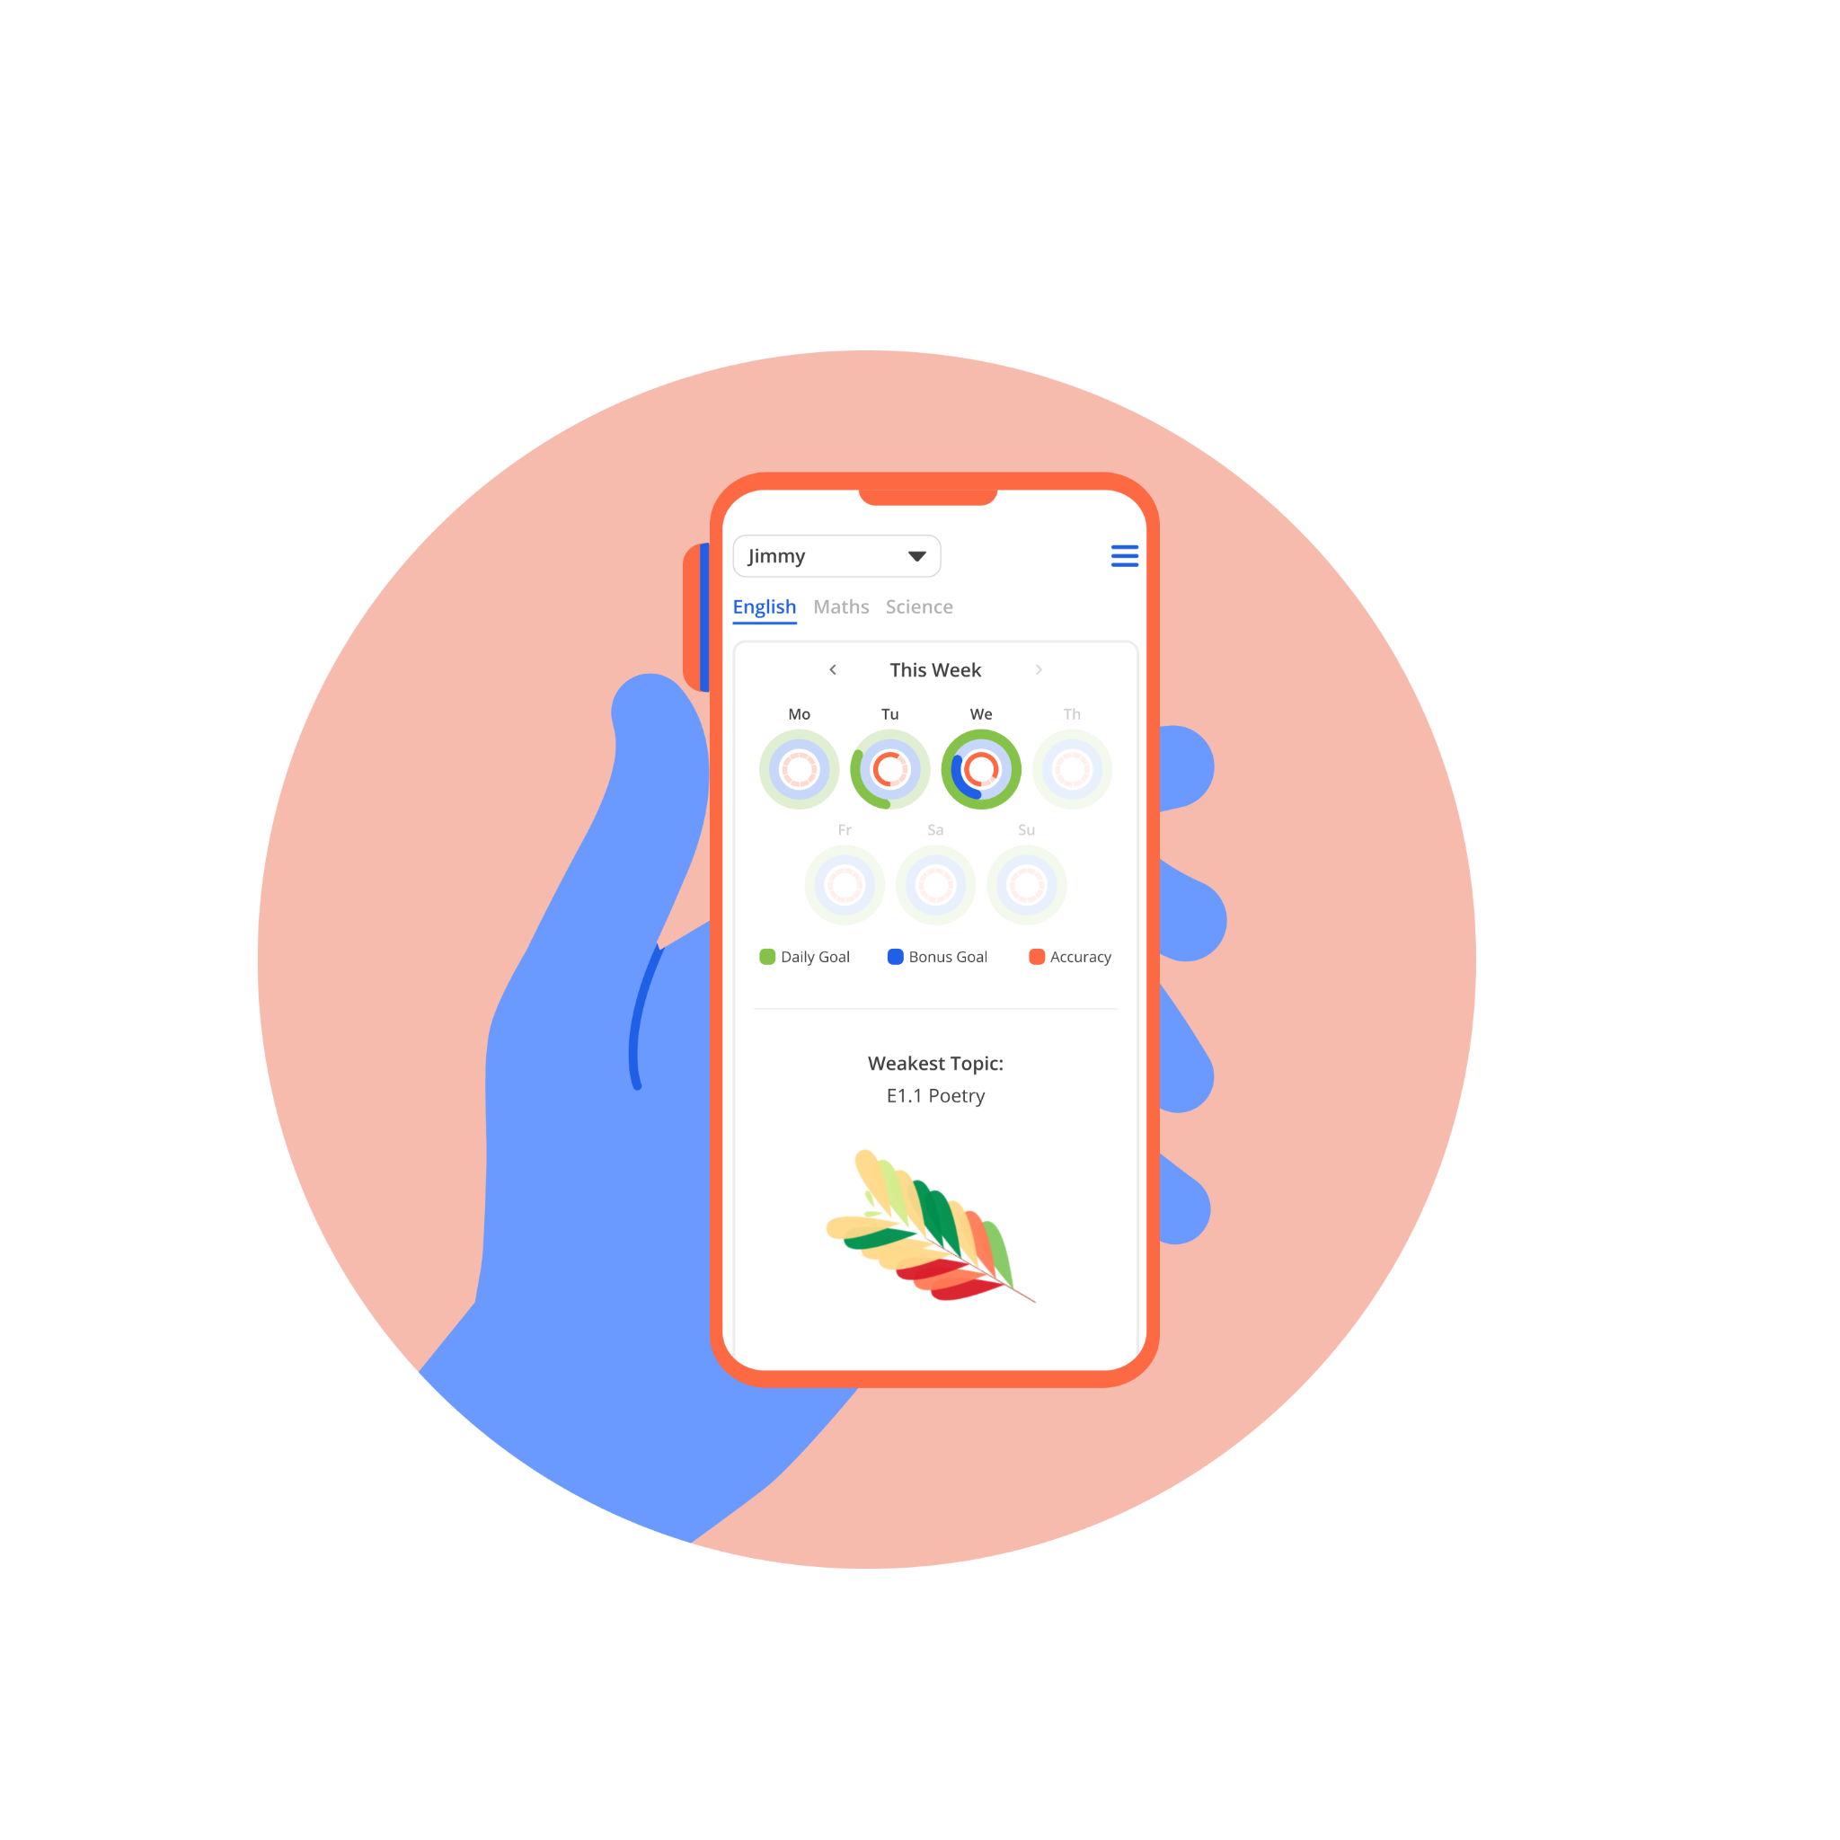
What does the parent dashboard offer?
Parents can monitor their children’s Daily Goal completion across the week (and go back by up to 3 weeks’ worth of activity). They can also control their account settings, and opt into our Parent Club giving them a range of benefits!
It will also highlight the weakest areas for their child across their subjects, and provide resources to help support learning which they can review together.

Slide 16
Tassomai’s Parent Club
Parents who opt in via their dashboards to receive offers and updates from Tassomai become members of our Parent Club.
All Parent Club members can access free webinars, downloadable PDF guides and recordings of Live Lessons.
They also have the option of paying a small monthly fee to:
Add Extra Subjects (not covered by the school’s subscription)
Add weekly Leapfrog Sessions
Add unlimited access to Mai, our AI tutor
Learn more on our website at: tassomai.com/school-parents

