Slide 1

Welcome to Year 9

Slide 2

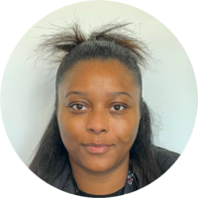

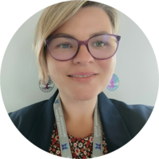

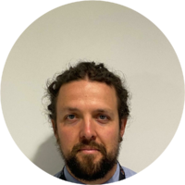
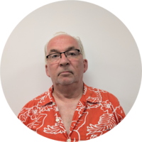
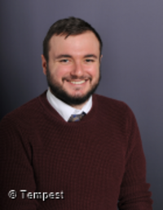
Meet The Team
Mr Halpin
Head of Year
Miss Byrne
Assistant Head of Year
9.1 – Mrs Ashley/Mrs Stanea
9.2 – Mr Marshall
9.3 – Miss Pickles/Mr North
9.2 – Mr Oldroyd

Slide 3

Attendance: Every Day Counts!
Regular school attendance is the key to success. Every day in school is an opportunity to learn, grow and achieve.
Lesson time is learning time!

Slide 4


Our school calendar is jam packed with fun events and rewards to work towards.
Key dates for Year 9:
Subject Consultation Evening – Thursday 21st January
Options Evening – Thursday 28th January

Slide 5

Thank you for your support
We look forward to working with you
Let's make Year 9 the best yet.

