Slide 1

Welcome to Year 8
Notes:
Welcome to Year 8 – The Deanery
Slide 1 – Welcome
Good evening, everyone, and a very warm welcome to our Year 8 parents and carers.
Thank you for taking the time to join us this evening. I am incredibly excited to be leading Year 8 this year, and I am really looking forward to working with you all to support your children throughout this important stage of their education.
Slide 2 – Our Year 8 Journey
This is my third KS3 year group at The Deanery, and I am really excited to see this group continue to grow, develop and make progress, both academically and personally.
Year 8 is a fantastic opportunity for students to build on the foundations they have already developed, grow in confidence and become more independent learners as they prepare for the next stage of their school journey.
My aim is to ensure that every student feels supported, challenged and encouraged to achieve their very best.
Slide 3 – Your Year 8 Team
Alongside me, I will be working closely with Miss Jasmine Byrne, our AHOY for Year 8, to ensure that students receive the support and guidance they need.
Each student also has their own form tutor: Mr Gavin, Mrs McMullen, Mrs Gregory and Mr McK[n]un.
Our tutors play a really important role in students' daily school lives and are often the first point of contact for parents and carers.
If you ever have any questions or concerns, or feel that your child needs additional support, please do not hesitate to get in touch. We want to work together with you to ensure that every student has a positive and successful year.
Slide 4 – Attendance Matters
One of our biggest priorities this year will be attendance.
I would absolutely love for Year 8 to become one of the best year groups in the school for attendance, and I want our students to take real pride in achieving this.
We will be recognising and rewarding students who attend school every day, as well as those who make significant improvements in their attendance.
Every day in school matters. It provides students with the opportunity to learn, make progress and build positive relationships, and we want to celebrate those who make the effort to be here consistently.
I am really keen for us to work together to make attendance a real strength for Year 8 this year.
Slide 5 – Rewards and Positive Behaviour
Alongside attendance, we will continue to celebrate positive behaviour and recognise students who consistently make the right choices.
Students will have opportunities to earn house points and access additional rewards for their effort, attitude, behaviour and contribution to school life.
We are also working towards some exciting incentives, including the potential for an end-of-year trip.
I want students to understand that positive choices make a difference, and I would love to see Year 8 working together to earn as many points and rewards as possible.
Of course, our expectations remain high. Detentions will continue to be issued for punctuality issues, disruptive behaviour and incorrect uniform.
However, I must say that the group has settled in fantastically well this year, and I am really pleased with the positive start they have made.
I am hopeful that we can build on this, continue to celebrate success and make Year 8 a year group that we can all be proud of.
Slide 6 – Homework and Preparing for KS4
Another key focus this year will be homework.
We want our students to develop strong independent learning habits and take greater responsibility for their education as they prepare for the transition into KS4.
Completing homework regularly will help students consolidate their learning, build confidence and prepare for the increased expectations they will face as they move towards their GCSE years.
We understand that some students may occasionally find homework challenging, and we want to make sure that support is available.
Homework club takes place daily and is open to all students. We encourage anyone who needs extra help, additional time or a quiet space to complete their work to make the most of this opportunity.
Our aim is to help every student develop the skills, routines and confidence they need to succeed.
Slide 7 – Working Together
Finally, I want to emphasise how important the partnership between home and school is.
We all want the same thing: for our students to be happy, safe, successful and proud of what they achieve.
By working together, maintaining high expectations and celebrating progress along the way, we can help every student make the most of their time at The Deanery.
I am genuinely excited to be working with this year group, and I cannot wait to see what they achieve over the coming months.
Thank you for your time this evening, for your continued support and for trusting us with your children's education.
I look forward to working with you all and making this a fantastic year for Year 8.
Thank you, and welcome to Year 8!

Slide 2
Growing Together
My third KS3 year group at The Deanery
Building confidence and independence
Celebrating progress and achievement
Preparing for the future

Slide 3
Your Year 8 Team
Head of Year: Miss Katia Esposito
AHOY: Miss Jasmine Byrne
Form Tutors: Mr Niel Gavin, Mrs Jenny McMullen, Mrs Natasha Gregory and Mrs Jenny Maknun
  8.1 - McMullenJ@deanerycofeacademy.org.uk
  8.2 - GregoryN@deanerycofeacademy.org.uk
  8.3 - MaknunN@deanerycofeacademy.org.uk
  8.4 - GavinN@deanerycofeacademy.org.uk
We're here to help — please get in touch!

Slide 4

Attendance: Every Day Counts!
Aim high. Be here. Be successful.
Celebrating excellent attendance
Rewarding personal improvements
Working together to reduce absence

Slide 5



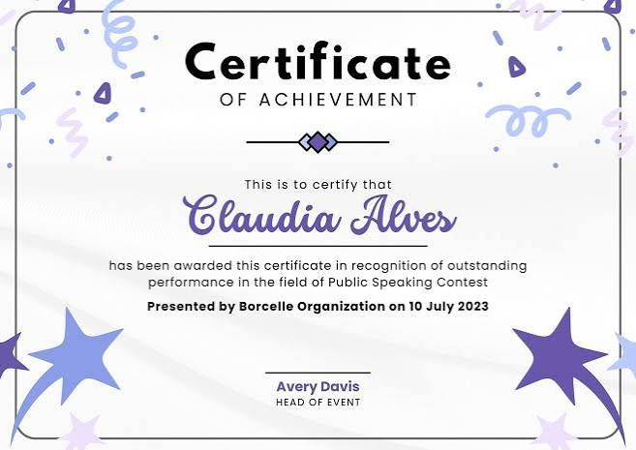
Rewards and Expectations
House points and positive recognition
Celebrating effort and achievement
Potential end-of-year trip
Punctuality matters
Excellent behaviour and correct uniform

Slide 6




Homework and Future Success
Building independent learners
Taking responsibility for homework
Getting ready for KS4
Daily homework club — open to everyone!
Extra help whenever it's needed

Slide 7
Working in partnership
Open communication
High expectations
Celebrating every success
Supporting every student
Together, we can make a difference

Slide 8

Thank You!
Thank you for your support
We look forward to working with you
Let's make Year 8 fantastic!

