Slide 1
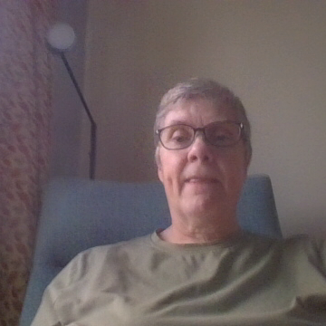
Welcome to Year 10

Slide 2

Growing Together
Teaching for nearly 40 years
Experience of state and Independent schools
Worked mostly in the UK but also a few years teaching abroad
Lots of experience at GCSE including years as a senior marker for AQA English

Slide 3
Your Year 10 Team
Head of Year: penny-larterh@deanerycofeacademy.org.uk
AHOY: mobeya@deanerycofeacademy.org.uk
Form Tutors:
  10.1 waldronj@deanerycofeacademy.org.uk
  10.2 shanahanc@deanerycofeacademy.org.uk
  10.3 blondragek@deanerycofeacademy.org.uk
  10.4 jackamano@deanerycofeacademy.org.uk
  10.5 wrightr@deanerycofeacademy.org.uk
  10.6 youngr@deanerycofeacademy.org.uk

Slide 4

Attendance: Every Day Counts!
We are striving for 96% attendance
Absence might make the heart grown fonder but it has a serious negative affect on attainment
If there is a reason for absence please inform the school

Slide 5


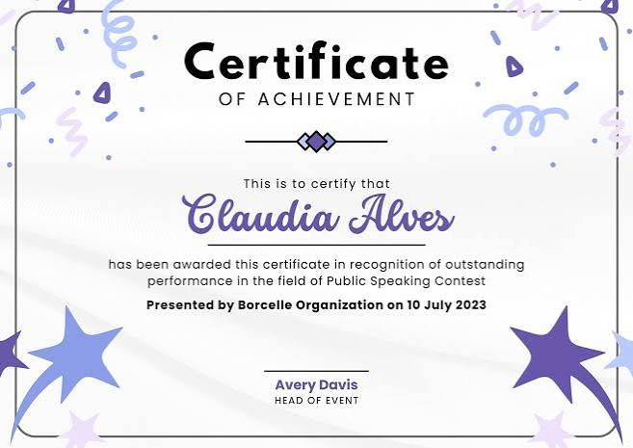
Rewards and Expectations
House points and positive recognition
Celebrating effort and achievement but also improvement
Punctuality matters
Excellent behaviour and correct uniform

Slide 6


Homework and Future Success
Building independent learners
Taking responsibility for homework
Daily homework club — open to everyone!
Extra help whenever it's needed

Slide 7
Working in partnership
Together, we can make a difference
Supporting each other
Demonstrating Christian values

Slide 8

Thank You!
We appreciate your support
Building strong foundations

