Slide 1


Welcome to
The Deanery CE Academy
Tutor Evening 2026

Slide 2

School Culture

Slide 3
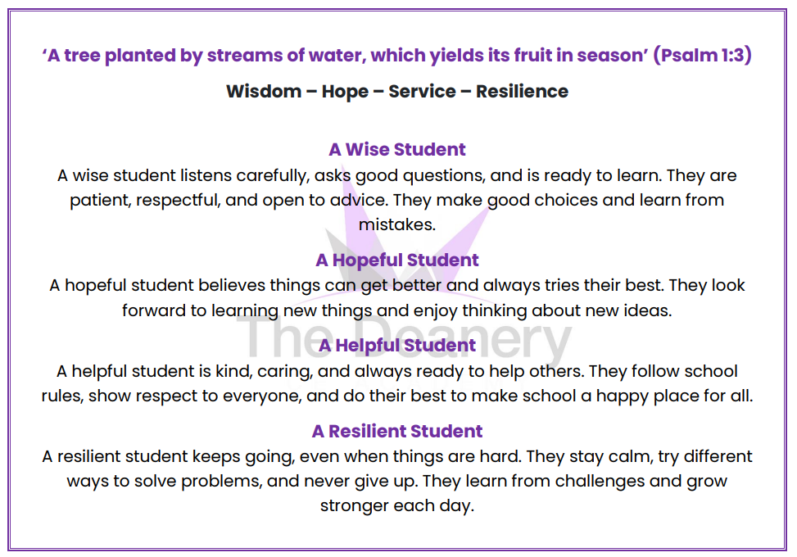

Slide 4
Ethos
There is an emphasis on building a strong academic ethos.
All pupils will be expected to work hard and behave respectfully in order to fulfil their potential.
Pupils will be expected to take pride in both the content and presentation of their work and the positive attributes we want to develop in our learners will be made clear from the outset.
Pupils’ academic performance will be supported by the pastoral system which will deal with any issues that might otherwise be a barrier to effective learning.

Slide 5
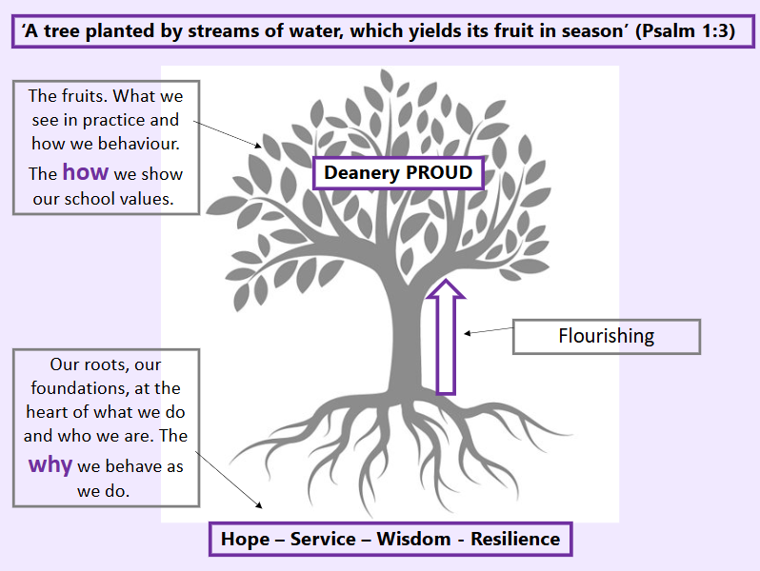

Slide 6


Slide 7
Uniform
The Deanery uniform supports the ethos and the academic values of the school. There is a high expectation that pupils will be dressed appropriately in the uniform. Any pupil not following the uniform rules will be challenged. Please ensure uniform is labelled with your child’s full name.
The uniform consists of:
Blazer
Grey straight legged trousers (no skinny trousers or leggings) or Grey tailored shorts
School skirt (worn at a suitable length)
White shirt (tucked in)
School tie
Purple jumper (optional)
Black shoes – not trainers. No logos.
One pair of stud earrings
No nose stud (or clear or covered)
Subtle make-up, no nail varnish or false nails. No false eyelashes.
No white/grey socks over tights

Slide 8
Equipment
It is important that students come to school ready to learn. This includes having the correct equipment with them every day
Black or blue Pen
Purple pen
Pencil
Ruler
Rubber
Sharpener
Calculator
Compass
Protractor
Whiteboard pen
Glue stick
Colouring pencils
Reading books

Slide 9

Tutor Programme
There is a tutor programme which indicates what must be covered during each tutor time. The programme will include:
Uniform checks
Equipment checks
Rewards and Consequences checks
Collective worship
Assembly
Reading program

Slide 10


