Slide 1

Year 11
Parent Information Evening
Today’s aim is to provide information to allow you to best support your child through their final GCSE year.

Slide 2
Important dates
College/sixth form applications in December and January (check the Newsletter for updates).
Year 11 Mock Examinations 15th January to 26th January
Year 11 Parents Evening – 29th February
Reports home in February and May.
Key Stage 4 exams - 9th May to 26th June 2024
Prom 5th July 2024

Slide 3
Core Subject Information
All students will sit examinations in Maths, English, Science and RE. They will also sit all their relevant exams for options subjects.
Grades 4 is considered a 'standard pass' and grade 5 is considered a 'good pass'.
Students who fail to achieve a grade 4 in Maths and English will be required to resit the qualifications next year.
Make sure to check entry requirements for post 16 courses with providers.

Slide 4

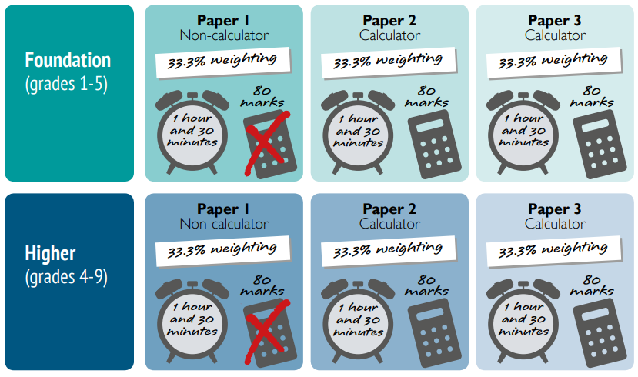
Core Subject Information - Maths

Slide 5
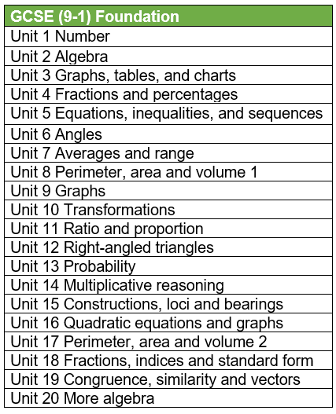
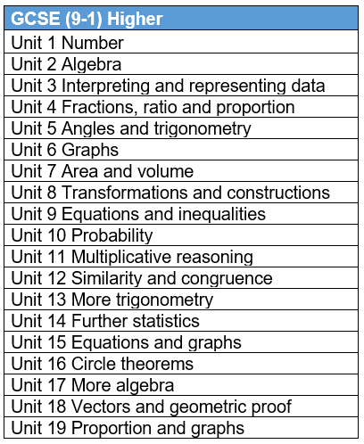
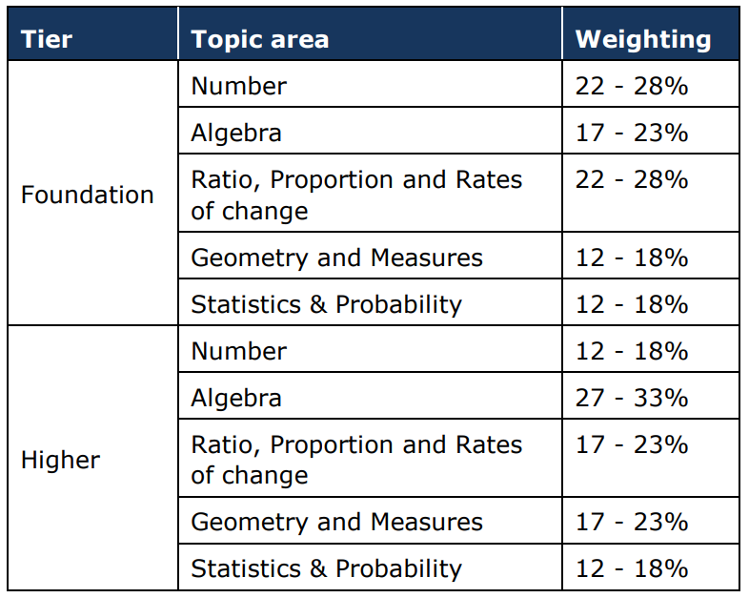
Core Subject Information - Maths

Slide 6
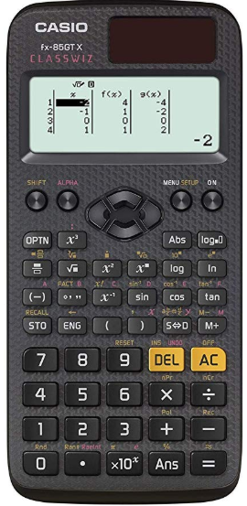
Core Subject Information - Maths
Examination code | Title | Date | Time | Duration
1MA1 1F | Paper 1 (Non-Calculator) Foundation Tier | Thursday 16 May | Morning | 1h 30m
1MA1 1H | Paper 1 (Non-Calculator) Higher Tier | Thursday 16 May | Morning | 1h 30m
1MA1 2F | Paper 2 (Calculator) Foundation Tier | Monday 03 June | Morning | 1h 30m
1MA1 2H | Paper 2 (Calculator) Higher Tier | Monday 03 June | Morning | 1h 30m
1MA1 3F | Paper 3 (Calculator) Foundation Tier | Monday 10 June | Morning | 1h 30m
1MA1 3H | Paper 3 (Calculator) Higher Tier | Monday 10 June | Morning | 1h 30m
FOUNDATION
HIGHER

Slide 7
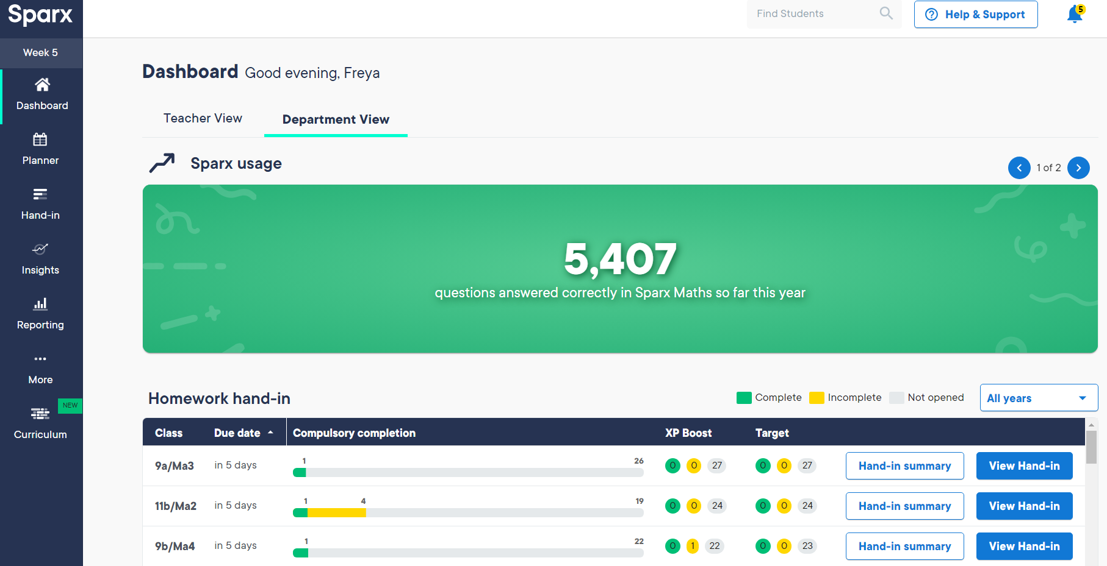
Core Subject Information - Maths

Slide 8

Core Subject Information – English
English Language has 2 exams: each 1hr45mins long
English Language has a Spoken element – students will be required to complete a presentation to their class. This is recorded and sent to AQA.
English Literature has 2 exams: one 1hr45mins and one 2hr15mins
Thursdays = revision sessions afterschool
For the remainder of the year, we will study:
Term 2: Language Paper 1
Term 3: Mock exams and Poetry
Term 4: Language Paper 2
Term 5: Revision
For the January Mocks, students will complete:
Language Paper 1
Literature Paper 1
Literature Paper 2
Speaking Presentations

Slide 9
Core Subject Information - English
The top 3 ways to revise for English:
Learn quotes from each Literature text
  Look, cover, write, check, repeat
  Turn them into flashcards, with questions on one side and the quotation on the other
  Draw images to go with each quote
  Put all the quotes you can remember onto mindmaps and draw links to each character/theme
Read model essays/answers
Complete practice papers
15x Macbeth
15x AIC
15x ACC
3x15 poems
= 90 quotes
minimum
Homeworks – build to Friday Test Days

Slide 10

Core Subject Information
Combined Science and Separate Sciences
AQA
100% Exam

Slide 11
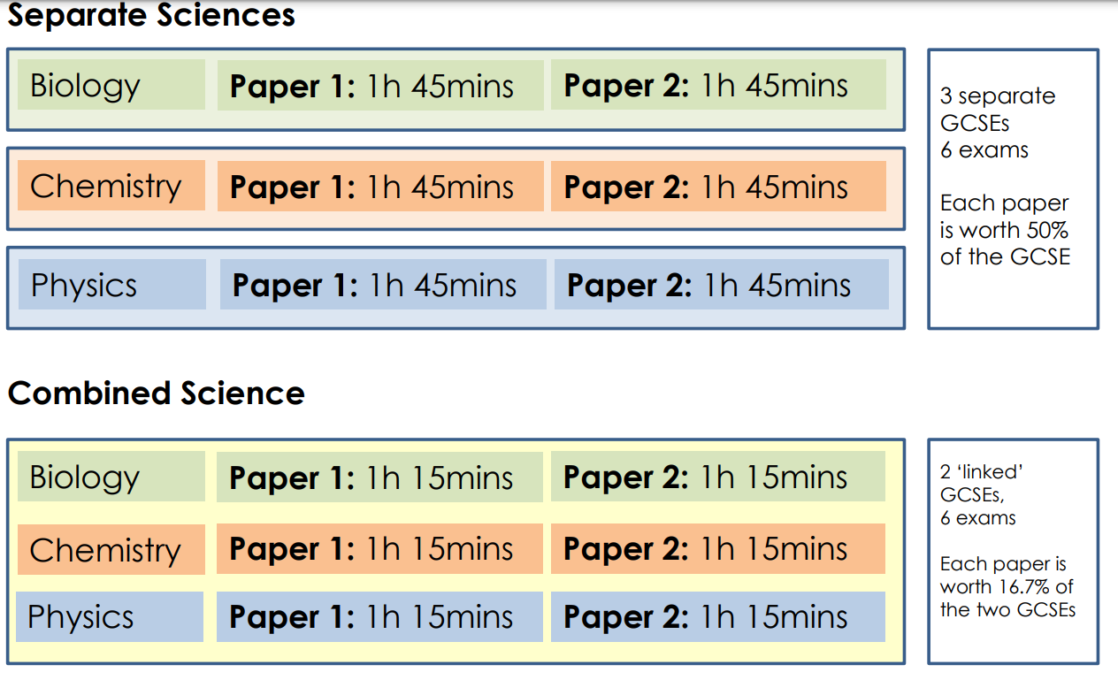
Exam Information

Slide 12
Exam Information
Course in Science​​ | Tier​​ | Grading​​
Separate -Biology, Chemistry, Physics​​ | Higher (4-9)​​ | One grade for each subject between 4 to 9​​ Below 4, graded as U​​
​​ | Foundation (1-5)​​ | One grade for each subject between 1 to 5​​ Below 1, graded as U​​
Combined Science​​ | Higher (4-9)​​ | Two grades between 4-3 and 9-9​​ Below 3, graded as U​​
​​ | Foundation (1-5)​​ | Two grades between 1-1 and 5-5​​ Below 1-1, graded as U​​

Slide 13
Diary Dates
Exam​ | Paper​ | Date​
Biology​ F/H | Paper 1​ | Friday 10th May​
​ | Paper 2​ | Friday 7th June​
Chemistry​ F/H | Paper 1​ | Friday 17th May​
​ | Paper 2​ | Tuesday 11th June​
Physics​ F/H | Paper 1 ​ | Wednesday 22nd May​
​ | Paper 2​ | Friday 14th June​
​ | ​ | ​
Combined Science​ F/H | ​ | Same dates as above​
​ | ​ | ​

Slide 14
SUCCESS in SCIENCE
Revision | Details | What to bring?
Science Revision Café Tuesday 3.30 – 4.30pm | Drop-in Science support session that runs throughout the year | Pen and Paper Revision Guide Questions
Focused Science Revision Terms 3 to 5 Details to follow | Structured lecture/walking talking mock style revision sessions that cover key areas of the specification | Pen and Paper Revision Guide Questions

Slide 15
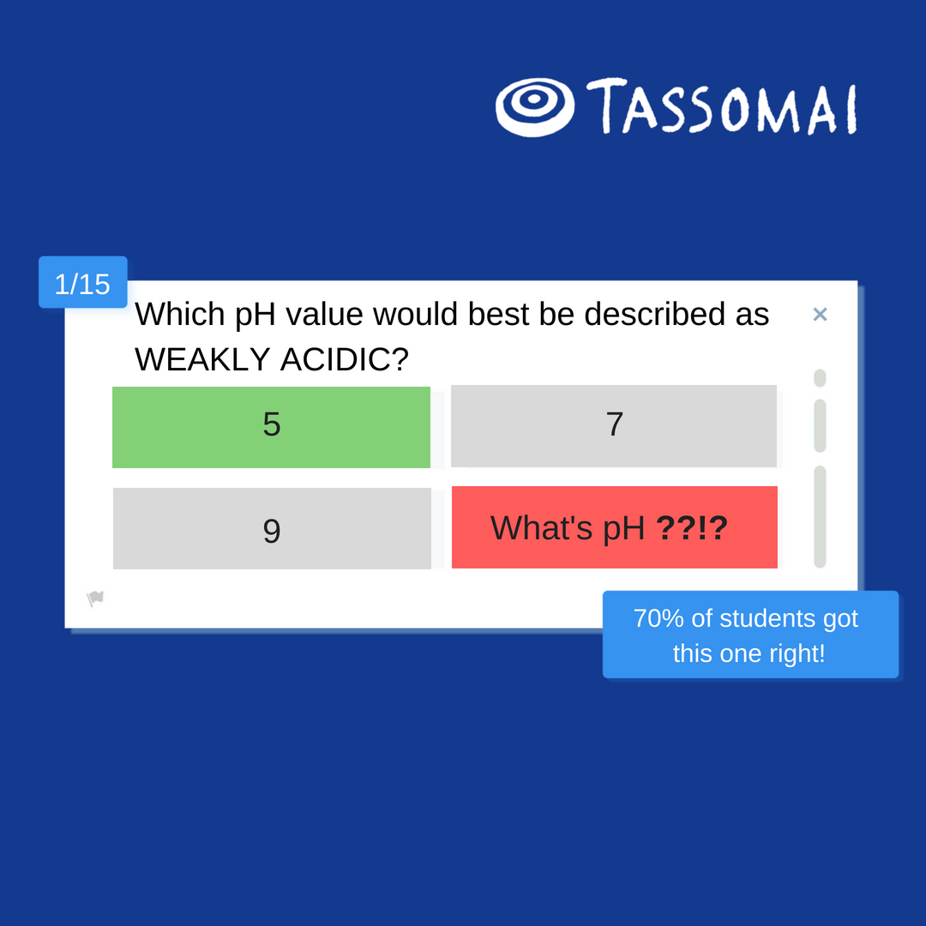

New Homework Platform: Tassomai
Students learn through quizzes and short videos, using our mobile app or other online devices.

Slide 16

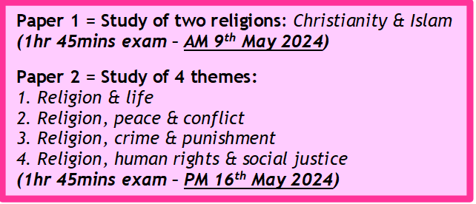
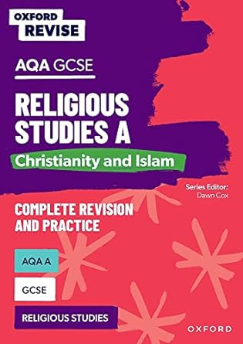
Core Subject Information: Religious Studies
GCSE RS revision
From January 2024 on a Thursday at 3:30
Top tips for success in RS:
Practice timings! Work to approximately a mark per minute
Learn key quotes The strongest arguments have evidence to support them
Ensure you know divergent views within religions e.g. Sunni and Shi'a; Catholic and Anglican
In an RS exam, you MUST refer to religion! 12-mark questions are capped at 6 marks if you do not reference religion
Attempt all the questions, even if you are unsure
Revise the topics you find the most difficult
OUP have recently produced a new revision guide for the GCSE RS course.
If you would like to order one, please do so via your ParentPay account by November 30th and we will order them in bulk, at a discounted price of 5.50

Slide 17


Revision – Adult Perspective
Everyone (parents and carers) in this room shares the same emotions. These are your “little babies” and it is natural and right that you want the best for them.
Some of those worries that are common for all parents and carers:
Am I doing the best job I can to help them?
Am I doing enough to help them?

Slide 18
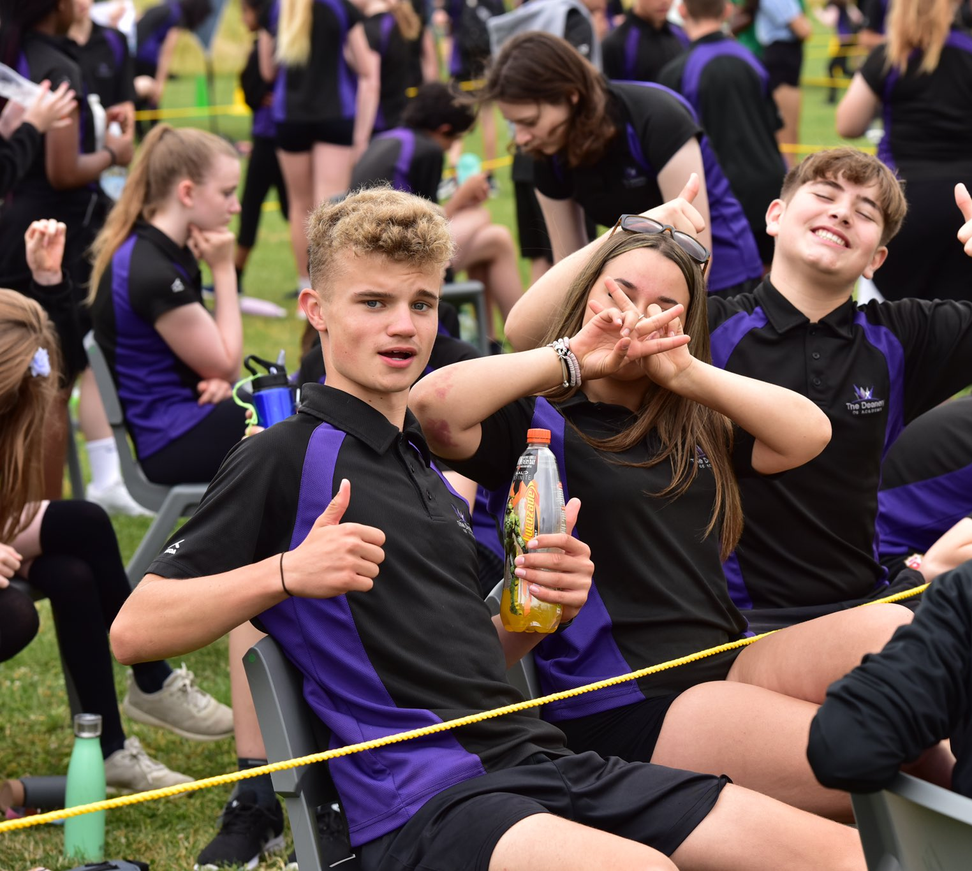
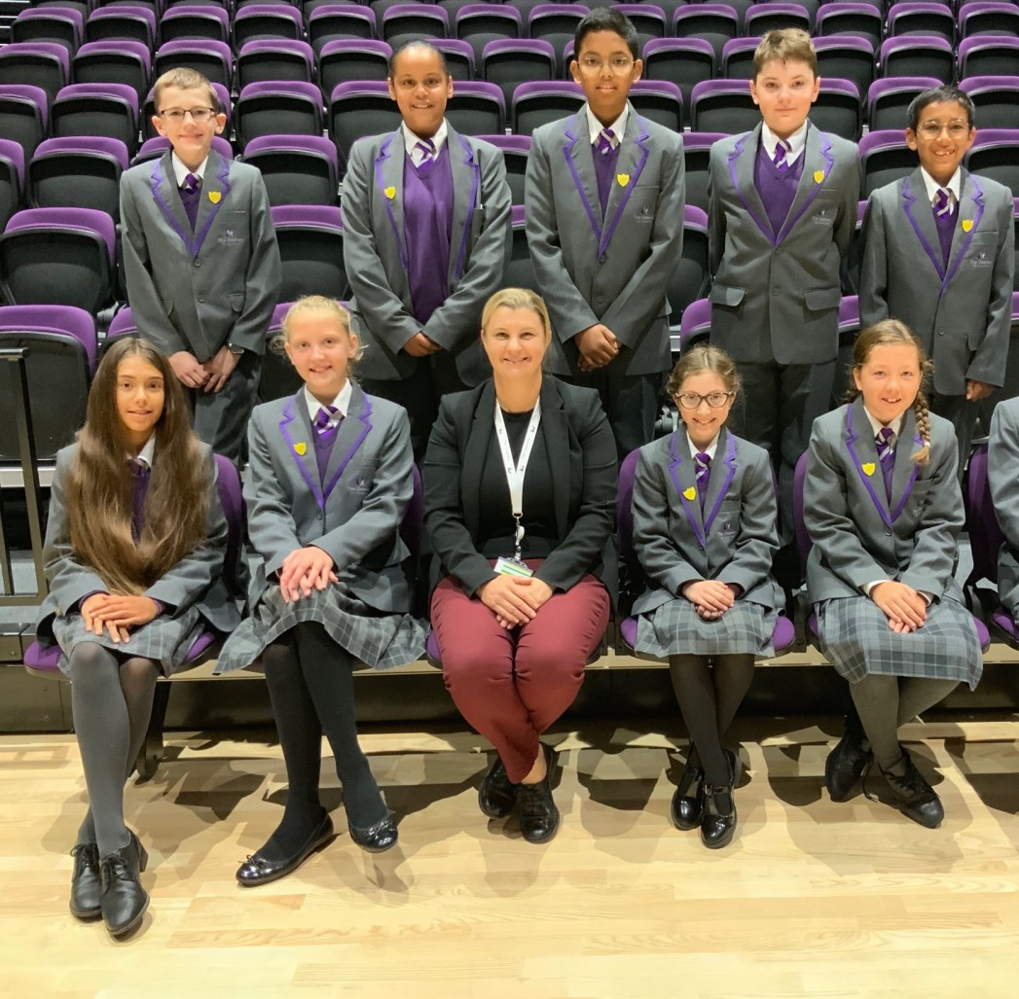

In School Support
Mr Pollock will be running an extra curricular (afterschool) workshop before Christmas on study skills and revision.
There will also be support in tutor time and assemblies to guide and support revision.
This will give students a toolbox of strategies and techniques to use to support them.

Slide 19

What can I do to help my child at home?
If possible, provide a calm, quiet area that is free from distractions.
Help them plan an allocated time to revise – including breaks.
Praise them.
Encourage them.
Take an interest (not an over interest) in what they are doing.
Maybe ask if they want you to quiz them or even revise with them.
Provide revision resources such as revision guides or printed past papers (school can help).
Support them doing what they enjoy in parallel to revision such as clubs and activities.
Ensure stable routines: meal-times and bed-times.

Slide 20
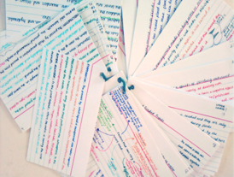
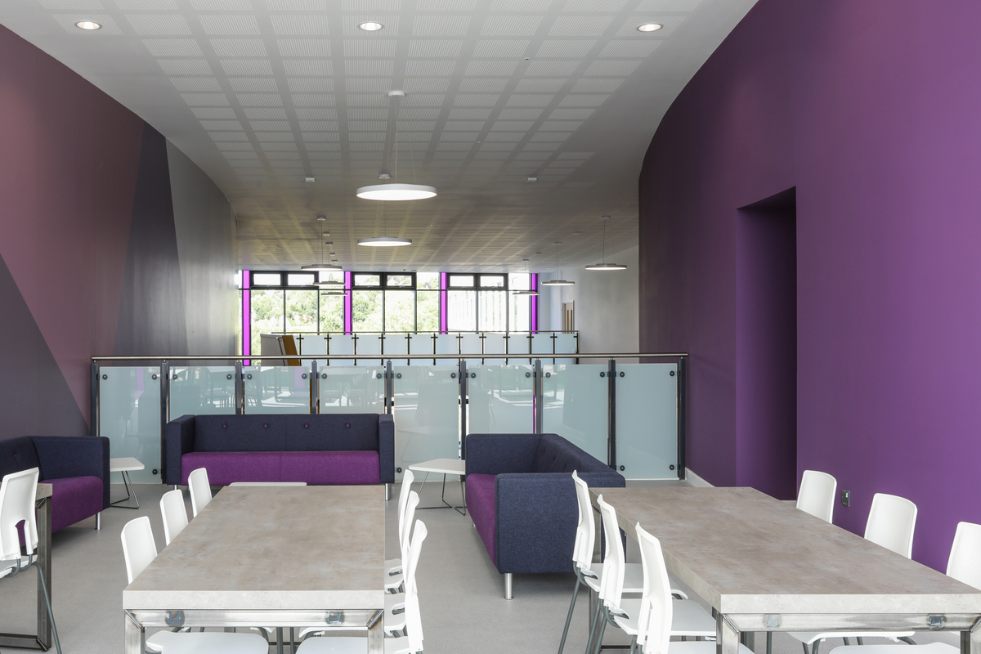

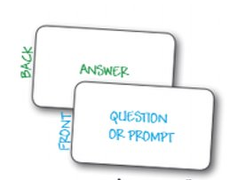
[object File]
Revision Techniques
AO1 – Knowledge recall
1. Creating or using flash-cards
2. Reading knowledge organisers and re-creating them from memory
3. Watching You-Tube clips and making notes
4. Testing yourself with multiple choice quizzes
5. Reading revision guides or textbooks and making notes

Slide 21
Revision Techniques
AO2 – Applying knowledge
1. Try summary questions in revision guides or textbooks
2. Practice some past exam questions and check these with the mark scheme.
3. Try some online quizzes.
4. Ask friends and family to question you on a particular topic using key command works from the exam “describe or explain”.
5. Ask your teacher for subject specific advice.

Slide 22
Revision Techniques
AO3 – Linking your knowledge
1. Try whole past exam papers.
2. Read model examples and check them against your own attempt
3. Use the mark scheme to mark your own paper.
4. Read the mark-scheme and annotate both the past paper and the mark-scheme.
5. Ask your teacher for a past paper question to take home, bring it to them and ask them to go over it with you.

Slide 23
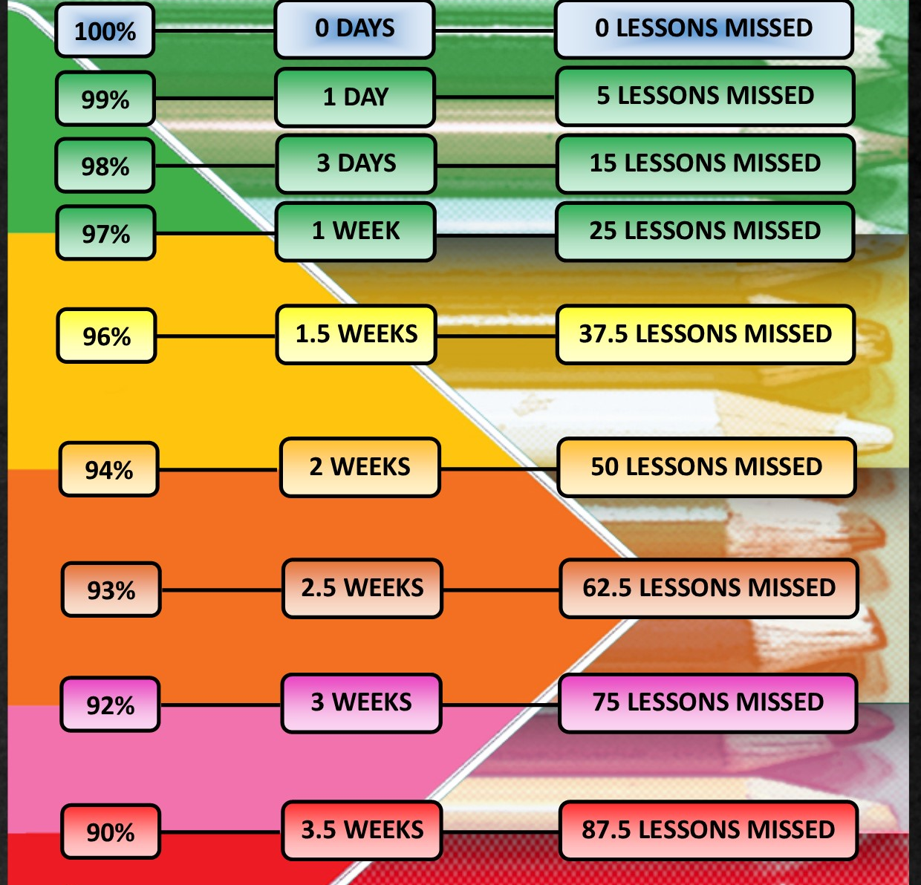
Attendance Matters
Maximise your potential,
attend school every day.
Attendance >95%
On average half a grade better in every subject.
Attendance <90%
On average one a half grades worse in every subject.

Slide 24
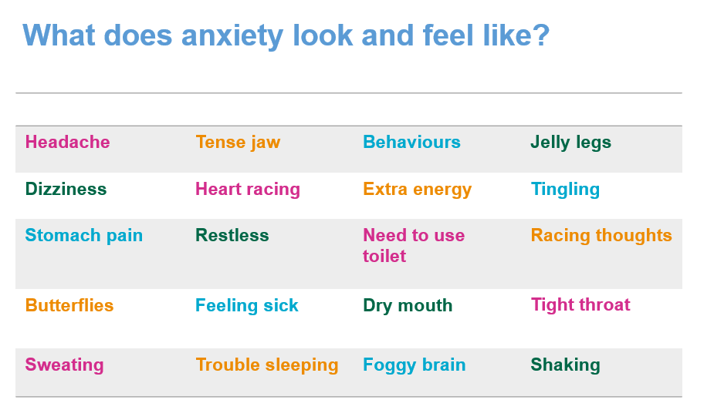
Exam Stress Management
It's OK to feel anxious – it can be a good thing!
Anxiety isn't necessarily a bad thing. It can spur us on, help us stay alert, make us aware of risks and motivate us to solve problems.

Slide 25

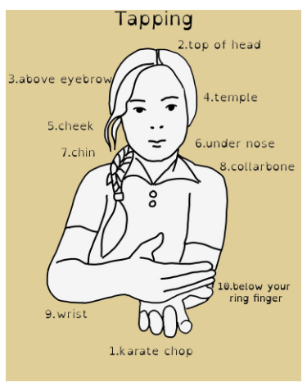
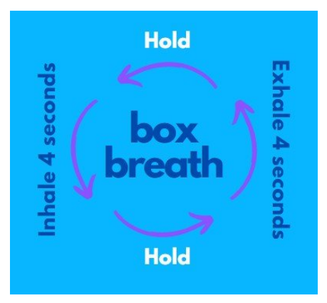

General stress management tips
Be prepared! A lot of the anxiety can be prevented with good preparation – early revision, looking at past papers, schoolwork etc.
Exercise
Eating healthily
Sleep
Limit time of social media/electronics.

Slide 26
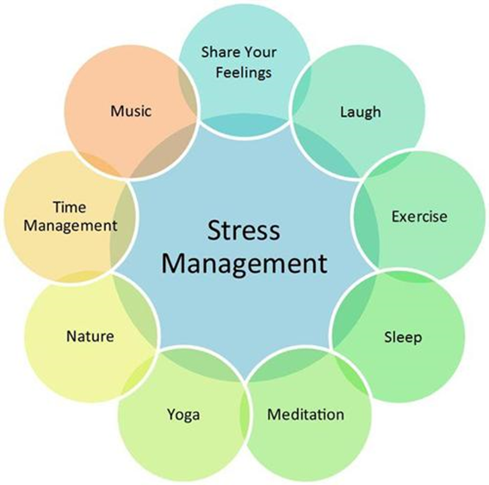
What are we doing in school?
Tutor program now includes revision skills and exam stress management on a weekly basis
More focus on exam techniques in lessons to support students feel prepared.
Careers guidance in school to help with important decisions.
BRIYM counselling – 1:1 but also will be visiting tutor groups to offer support.
https://www.briym.co.uk/parents

Slide 27
THANK YOU!
There is a booklet to take with you covering all the information given this evening. Information will also be shared on the school website.

