Slide 1






Revision Techniques & Strategies
A Practical Workshop
Date: 04/12/23
Delivered by: Matthew Pollock
Wisdom – Hope – Service – Resilience

Slide 2
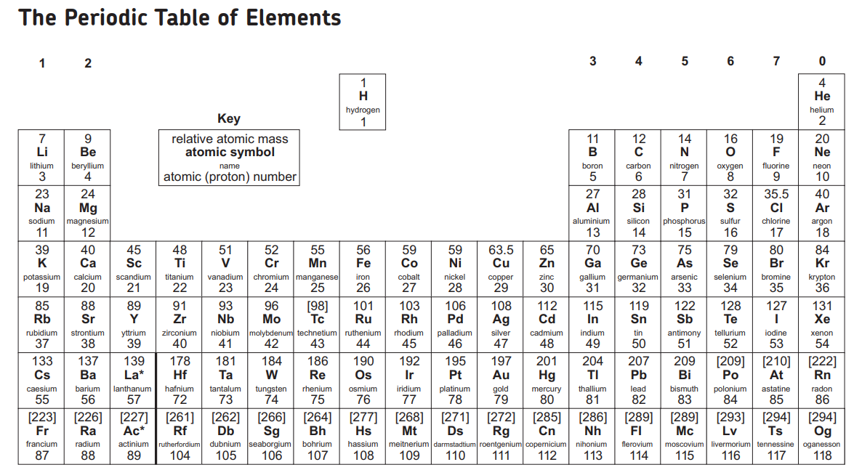

Do Now – Individually colour-in your periodic tables. Use a different colour for each of the following…
The elements you already know or can easily remember.
The elements that you think you could remember with some prompting or you think you could remember after some brief practice.
The elements that are not common and you would struggle to remember.

Slide 3
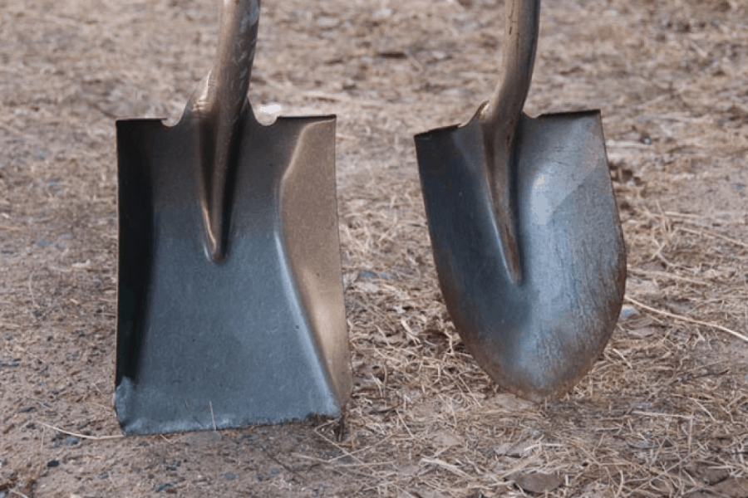
Turn & Talk
How is the picture relevant?

Slide 4

What will success look like to you?

Slide 5
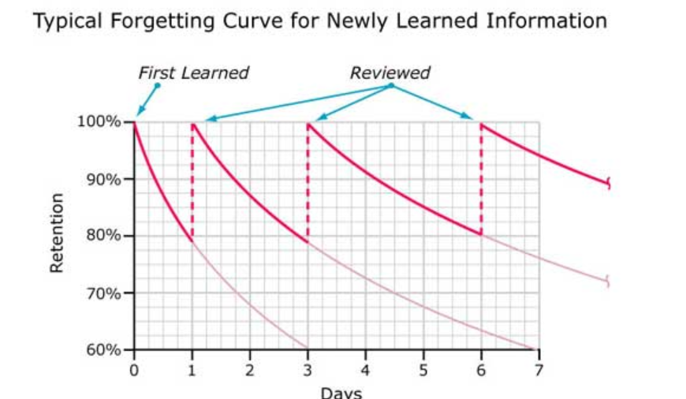
The Forgetting Curve

Slide 6
“Struggle Zone”
Challenge
Zone
Too easy
Too Difficult

Slide 7
Technique 1: Flash Cards
You have been given a double page from a chemistry revision guide. On one side of your flash card you need to summaries the key information. On the reverse (back of the card) you need to write key questions that people could quiz you on to check your knowledge.

Slide 8
Technique 2: Retrieval Games
There are 10 English Literature quotes hidden around the room. You need to find them and write them down on your sheet. They must be written perfectly. You are not allowed to communicate/cheat and you must not take your paper off the table/to the quotes… this is a memory exercise.

Slide 9
Technique 3: Multi-channel
https://www.youtube.com/watch?v=tCHE_7QeRUc
https://www.revisechemistry.uk/GCSE/AQA/RequiredPracticals/practical3.html

Slide 10
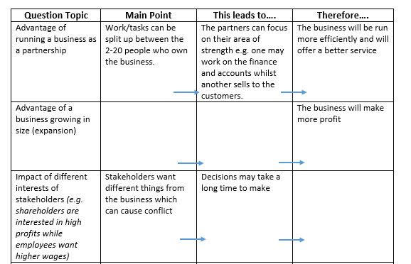
Technique 4: Linking
For an options subject- create/complete the table with 3 question topics.

Slide 11
Technique 5: Critiquing
Use the mark scheme provided to mark each answer. Annotate clearly and justify what you have awarded the number or marks on each. This is a group activity so please feel free to discuss/argue.

Slide 12
Technique 6: Skim & Scan/Translation
You have been given a double page from a biology revision guide. You are only allowed to write down the stuff that you do not know or could not in a “common sense” way apply to a question.

Slide 13
Workshop 2: Spring 2024
Technique 7: Checklists
Technique 8: Practise (Explicit)
Technique 9: Practise (Exam Questions)
Technique 10: Exam Conditions

Slide 14

Be realistic with how much time you are going to spend revising.
Revise for periods of 30 minutes to 1 hour a day, 2 hours as a maximum.
If it helps create a timetable of when you are going to revise and the subjects you want to revise during those times. “Monday 5:30 -6:00 maths, 6:15-6:45 science”.
Ensure your revision doesn’t clash with things you enjoy such as sports and clubs. Make time to enjoy yourself and relax.
Set up a dedicated space that you are going to revise in. It helps if this is in a quiet place and away from where you sleep or watch TV.

Slide 15
Don’t try to do too much too quickly or conversely don’t leave everything until the last minute. Year 11 is a marathon not a sprint.
Don’t spend too much time revising (said no teacher or parent ever), but seriously don’t try and take in too much information at once or you will just forget most of it. It is better to revise “little and often”.
Try not to have any distractions in the background, it is easy to give into temptation.
Try not to revise when you are really hungry or tired, try to make the time you spend revising “high quality” revision time.
Only revise in groups or with friends if you are actually going to revise.

Slide 16
Thankyou
Please take a booklet of useful information on your way out.

