Slide 1
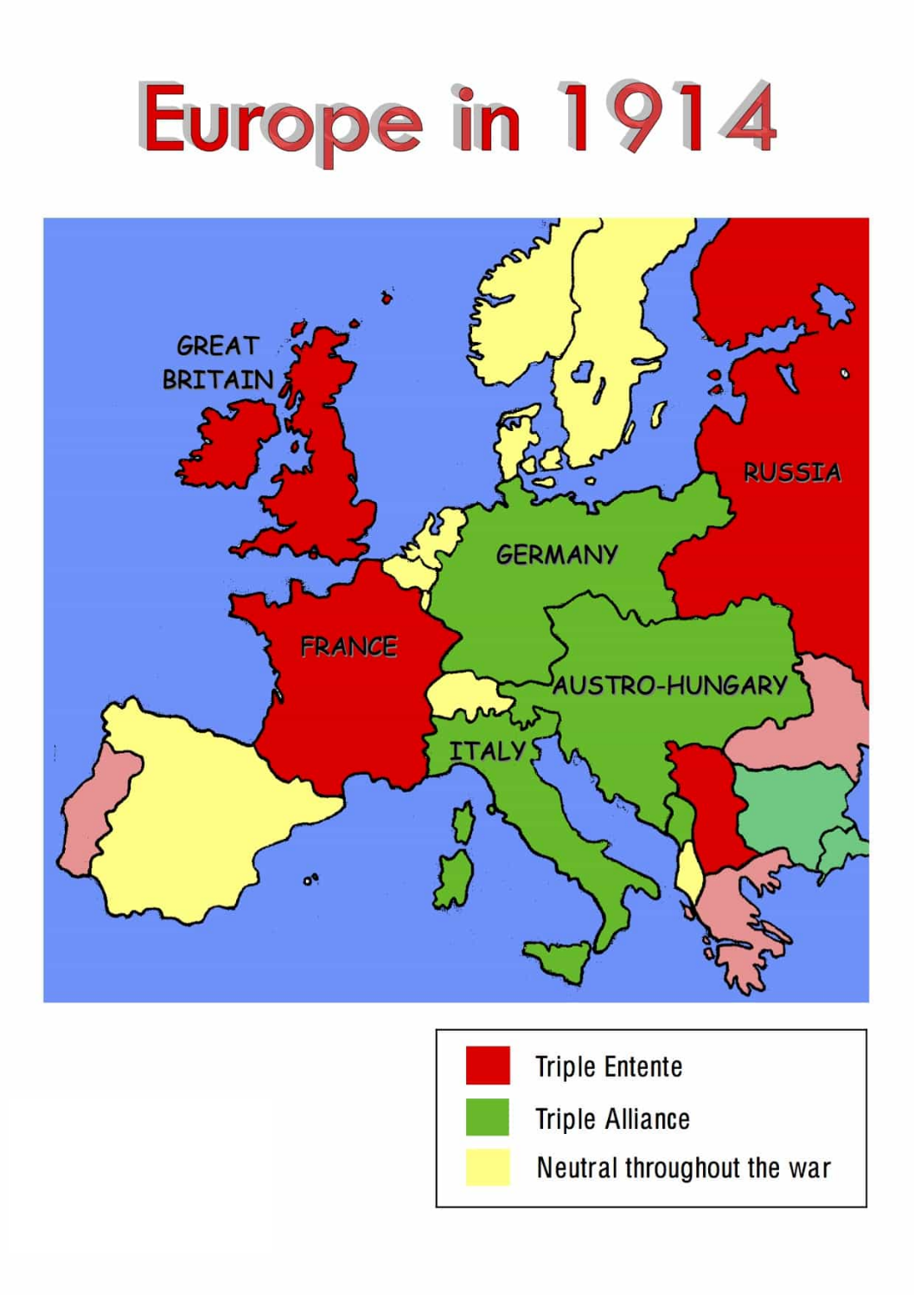
The First World War
Important words | Important words
1 | Alliance | A group of countries, political parties, or people who have agreed to work together because of shared interests or aims.
2 | Imperialism | A system in which a country rules other countries.
3 | Militarism | The belief that it is necessary to have strong armed forces and that they should be used in order to gain advantages.
4 | Conscription | the act or process of forcing people by law to join the armed services:
5 | Trench | A narrow hole that is dug into the ground
6 | Foreign Policy | A government's policy on dealing with other countries.
7 | Splendid Isolationism | Used to emphasize the isolation of a country.
Important people | Important people
1 | Franz Ferdinand | The Archduke of Austria-Hungary.
2 | Wilhelm II | The Kaiser of Germany.
3 | Woodrow Wilson | The President of the United States of America.
4 | Herbert Asquith | The Prime Minister of Great Britain.
5 | Nicholas II | The Tsar of Russia.
Key Events
28th June 1914 Franz Ferdinand is assassinated. | 28th July 1914 Austria-Hungary declares war on Serbia, beginning the First World War. | August 1914 Britain declared war on Germany coming to the defence of Belgium. | 4th August 1914 The Schlieffen Plan began. | 6th April 1917 The United States of America declares war on Germany. | 11th November 1918 Germany signs an armistice to bring to an end the First World War.

