Slide 1
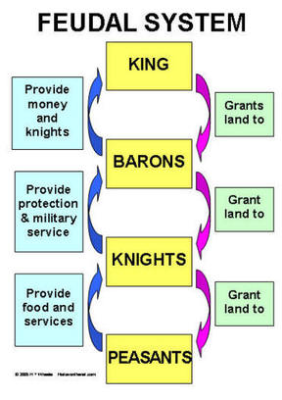
The Norman Conquest, 1066
Important words
Conquest | Take complete control over, usually a country
Rebellion | A violent protest, often with the aim of removing and replacing a country’s leaders
Nobility | The rich landowners such as barons, earls, lords etc
Peasant | A poor person of low social status who works on the land
Domesday Book | A survey carried out between 1085-1086 to help William find out what land and assets people owned across England
Tax | A sum of money paid to the government or king; in medieval times this was used to pay for the monarch’s lifestyle, as well as armies, weapons etc
Loyalty | Staying true to someone, and being honest and helpful to them
Famine | An extreme shortage of food
Siege | A method of attack where an army surrounds a castle, cutting off essential supplies, until the enemy is forced to surrender
Important people
William the Conqueror | By 1071, William had control over England. He could now be called ‘conqueror’.
Important ideas/information | Important ideas/information
1 | Castles | William built motte and bailey castles across England as soon as he had become king, especially in places of strategic importance. These castles were initially built of wood.
2 | Harrying of the North | This was an event that took place in the north of England in 1069. In revenge for an attack on York and the Norman troops there, William decided to teach people in the north a lesson. He burned their crops, slaughtered their animals, destroyed villages and murdered people. His troops poisoned the soil with salt so nothing would grow. As much as 75% of the population in that area died.
3 | Feudal system | This was a social system introduced by the Normans. It was a hierarchy with the king at the top, then earls, barons, lords, bishops, followed by knights and then peasants. Each group was given land by the group above. In return, they performed some type of service e.g. farming or fighting.
 | Timeline
1069 Harrying of the North | 1070 Castles begin to be built from stone | 1071 William controlled all of England. He was now ‘William the Conqueror’. | 1085 William orders a massive survey of England, the people in it and what they own. It is published in 1086.

