Slide 1
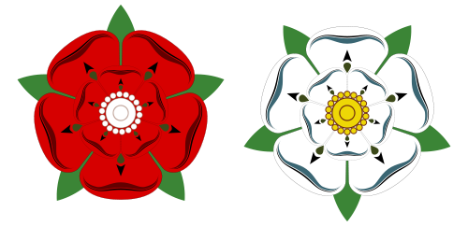
Here comes the Tudors
Important words
Monarchy | Ruler of a country (King or Queen)
Successor | A person who inherits the throne after the death of the previous king or queen
Catholic | The oldest and largest branch of Christianity ruled over by the Pope in Rome.
Protestant | The second largest branch Christianity that became separate from the Catholic church in the 16th century. Protestants don’t have the Pope as their leader
Reformation | A division started by Martin Luther to reform the Catholic Church
Monastery | A building were people lived, worshiped and devoted their time to God. People who lived in a monastery were called monks.
Important people
Henry VII | 1485-1509
Henry VIII | 1509-1547
Edward VI | 1547-1553
Lady Jane Grey | Ruled for only 9 days in 1553
Mary I | 1553-1558
Elizabeth I | 1558-1603
Important ideas/information
Who were the Tudors? | Who were the Tudors? The Tudors were a dynasty of kings and queens who ruled England between 1485 and 1603. The Tudors produced two of England’s most successful and famous monarchs, Henry VIII and Elizabeth I.
How did the Tudors come to power? | From 1154 – 1485, England was ruled by the Plantagenet family. In the 1450s, war broke out between two branches of this family, the House of York and the House of Lancaster. This war was named the Wars of the Roses after the symbols each side used (the white rose of York and the red rose of Lancaster). The war continued until 1485, when Henry Tudor, who was related the House of Lancaster, killed King Richard III, the last Plantagenet king at the Battle of Bosworth Field.
The Reformation | When Henry VII and Henry VIII were King, England was a Roman Catholic country and the head of the Church was The Pope, in Rome. When the Pope refused to grant Henry a divorce from Catherine of Aragon, Henry split the English Church from the Roman Church. This was called The Reformation. At this time most still followed the Catholic religion
The red rose of the House of Lancaster and the white rose of the House of York. The Tudor rose is a mixture of the two.
 | Timeline
1509 Henry VIII becomes King of England aged just 18, he marries his brother’s widow Catherine of Aragon. | 1527 The King’s Great Matter – Henry VIII begins divorce proceedings against Catherine of Aragon to marry Anne Boleyn – this sees England Break with Rome and form the protestant Church of England. | 1534 Henry VIII dissolves the monasteries after breaking with Rome to acquire all their land and money | 1553 Edward VI dies aged just 15, and for the first time in English history, there are only women left to inherit the throne. | 1553 Mary begins the counter-reformation, seeking to turn England back to the Catholic church. She burns almost 300 protestants at the stake.

