Slide 1
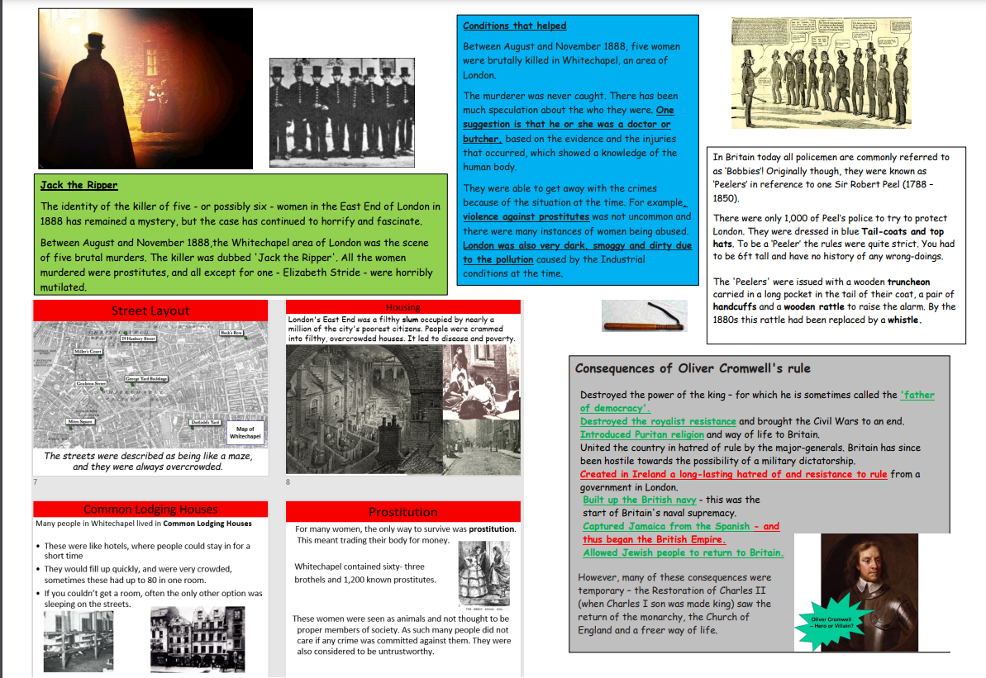

Term 1-
Jack the Ripper

