Slide 1
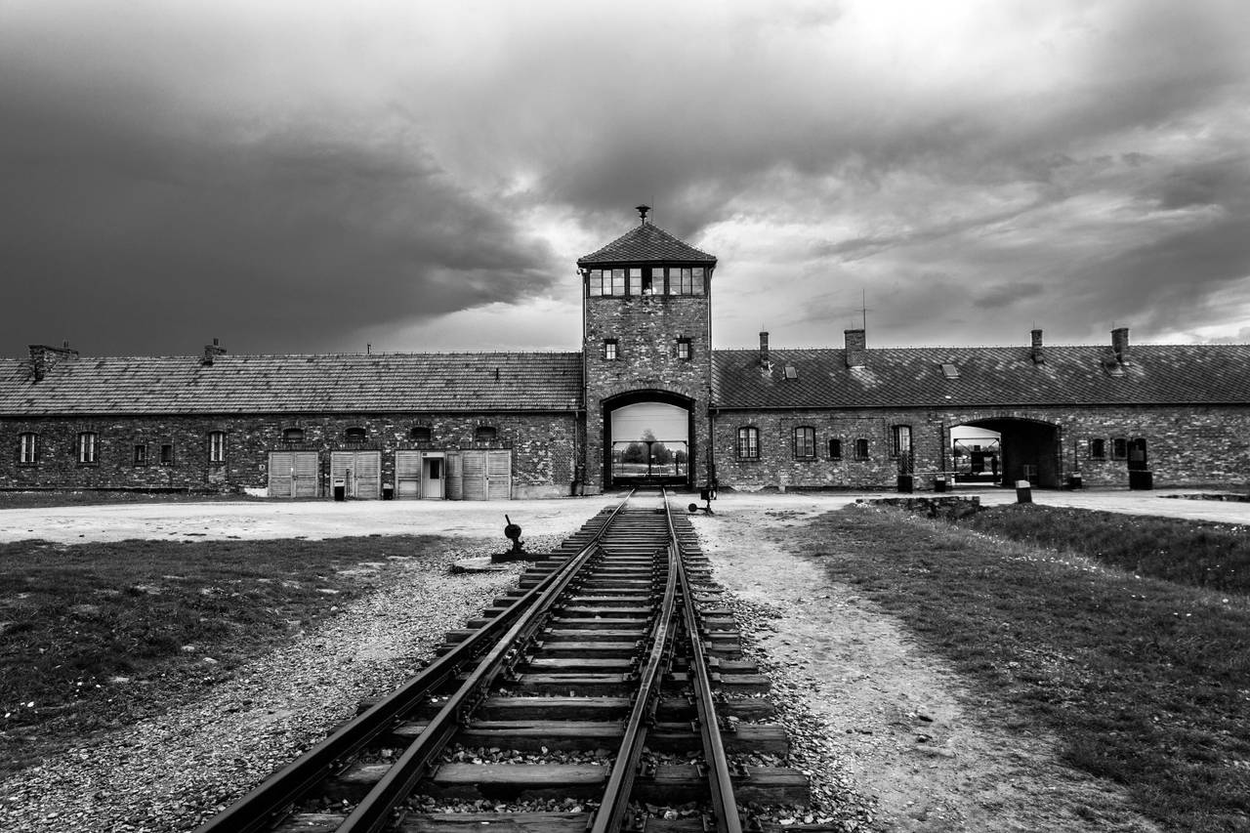
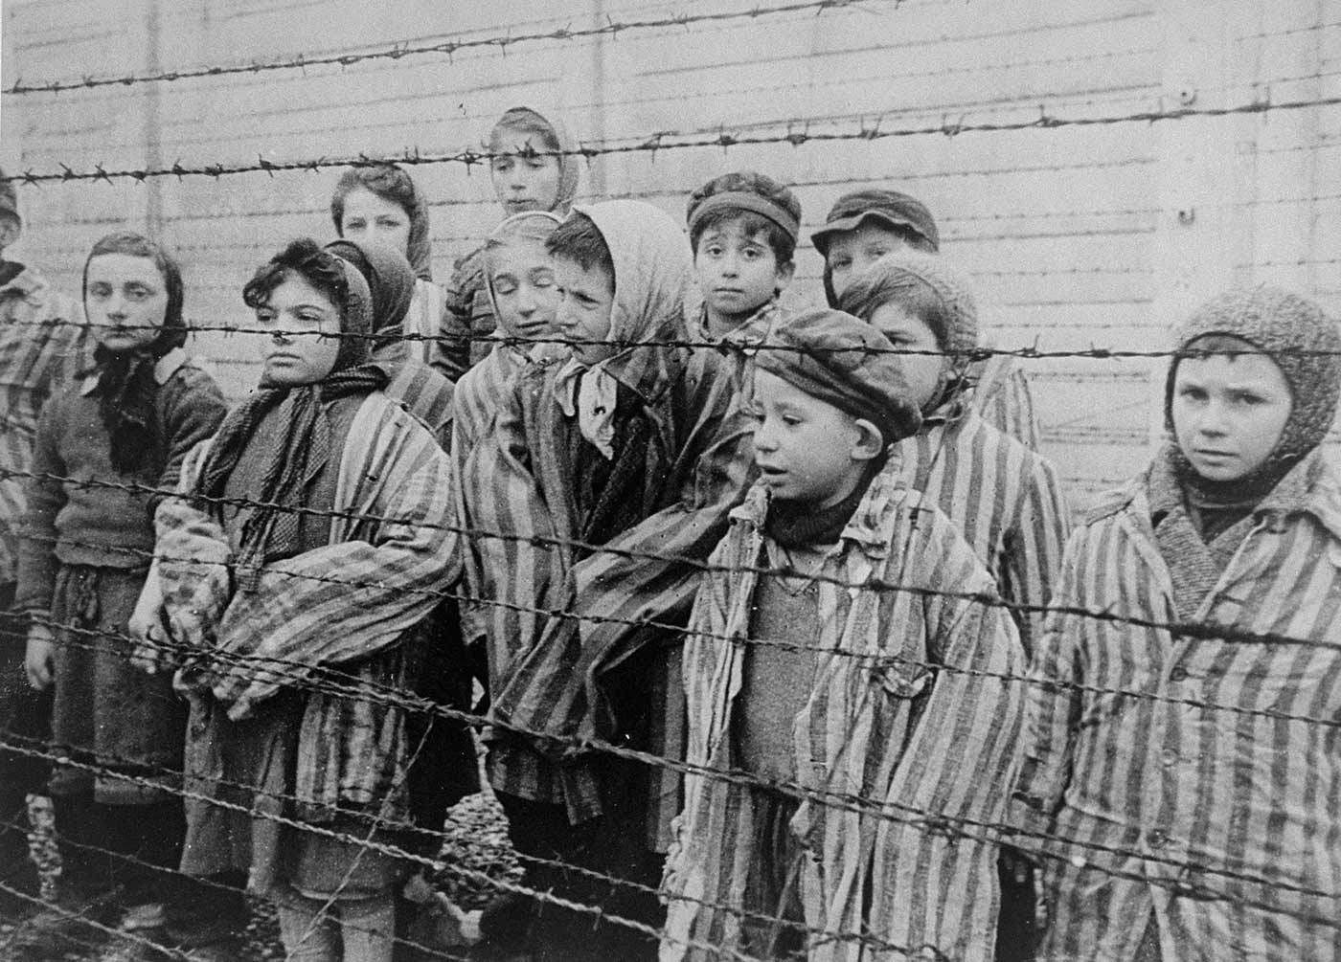
Term 5- The Holocaust
What is the Holocaust?
• The mass murder of Jews under the German Nazi regime during the period 1941–5. More than 6 million European Jews, as well as members of other persecuted groups, were murdered at concentration camps such as Auschwitz.
• Holocaust comes from Hebrew and means destruction or completely burnt. Many Jews use the term Shoah which comes from the Hebrew and means catastrophe.
Historical Reasons for Anti-Semitism:
Jews were blamed for the crucifixion of Christ.
Jews were blamed for the Black Death although many Jews were killed by the disease.
Jews were driven out of many Western European countries in the Middle Ages. They were expelled from England in 1290, from France in 1306 and 1394.
All of these actions made the Jews outliers from the rest of their community and therefore different and victims of prejudice and discriminations
Resistance and Rescuers
Many resistance groups against Nazi Germany were formed.
Resistance took place in many different formats including refusing to follow the Nazi regime.
There were many rescuers of the Holocaust, this includes people who helped Jews escape persecution. We would look at a range of different rescuers.
Hitler’s Persecution of the Jews
Hitler's dislike of the Jews was based on the economy. He blamed them for making Germany weak.
• 1 st April 1933: Hitler’s first action directly against the Jews was a Boycott of all Jewish businesses
• April 11, 1933 - Nazis issue a decree defining a non-Aryan as "anyone descended from non-Aryan, especially Jewish, parents or grandparents.”
• May 10, 1933 - Burning of books in Berlin and throughout Germany.
• In Sept - Nazis establish Reich Chamber of Culture, then exclude Jews from the Arts.
• Summer 1935 Placards saying Jews not wanted displayed in resorts, public buildings, restaurants and cafes .( these were removed during the 1936 Olympic Games).
• A massive, coordinated attack on Jews throughout the German Reich on the night of November 9, 1938 into the next day, has come to be known as Kristallnacht or The Night of Broken Glass.

