Slide 1
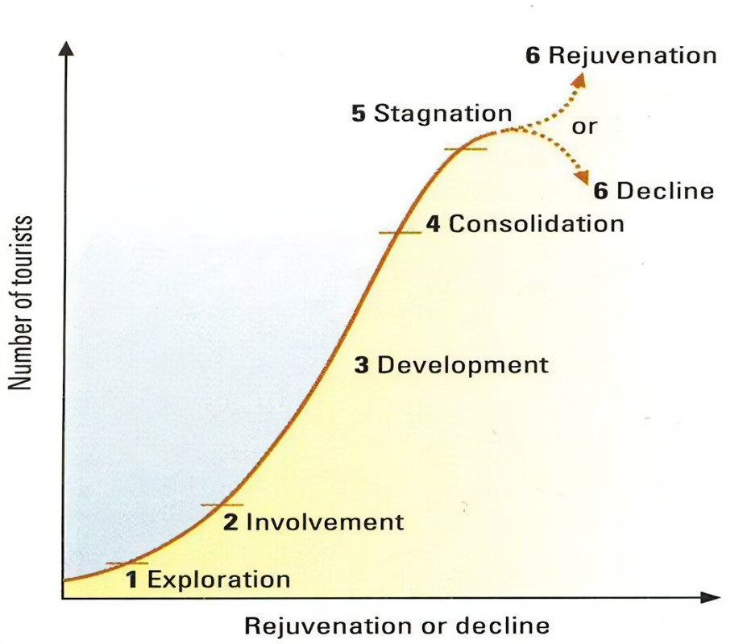
Year 7 Tourism Knowledge Organiser
A tourist is some who travels to a place where they don’t live to enjoy the attractions and/or activities. Tourism in the UK really began during the industrial revolution with factory workers using trains to take day trips to the beach. In the 1950’s holiday resorts like Butlins developed to attract families for a week. The 1970’s saw the start of package holidays to Europe . This started the decline on domestic travel.
Today, many people book their holidays online using websites like Expedia and travel all over the world.
The tourist industry has grown steadily for over one hundred years. Reasons include (1) since the 1950’s, people have become wealthier, (2) families are smaller, (3) people have more leisure time and receive paid holidays and (4) transport has improved. In 2018, $1.45 trillion was spent in the global tourist industry (Figure 1 and 2).
There are many jobs linked to tourism including hotel manager, cleaner, chef, travel representatives and pilots.
Many other jobs are created by tourism, even though they are not known as tourist jobs. This is known as the multiplier effect and includes jobs such as taxi driver, construction worker who is building better roads and farmers who can now sell food to the hotel
Key Terms
Types of Tourism
Beach holidays, eg in Spain and the Maldives. People can relax on the beach or take part in water sports.
Outdoor adventure, eg skiing and walking in the European Alps or the Rocky Mountains of North America.
Cultural/historic, eg people like to visit historic sites, art galleries and museums in cities such as Rome and Paris. In cities like New York and London they can go shopping or see shows.
Ecotourism, eg small numbers of people go trekking in the Amazon rainforest or on whale and dolphin conservation holidays in Scotland. This type of tourism is designed to be sustainable.
Ageing population When the average age of a population is rising.
Conflict A disagreement over something.
Conservation Keeping the environment healthy and productive by careful use of its resources.
disposable income The income available for spending after taxes.
Erosion The wearing away of pieces of rock, soil or other solid materials.
honeypot site A popular visitor attraction or area, where large numbers of people visit.
mass tourism Tourism on a large scale with many people visiting.
National Park An area that is protected by law to ensure its conservation.
quality of life The wellbeing of a person or a group of people.
Quarry An area of land that is used to remove rocks for use in industries.
Sustainable tourism A type of holiday that doesn't cause harm to people or the environment.
Tertiary Providing services - includes retail, tourism, education, health and banking.

