Slide 1
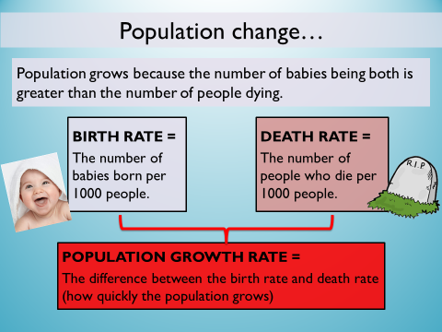
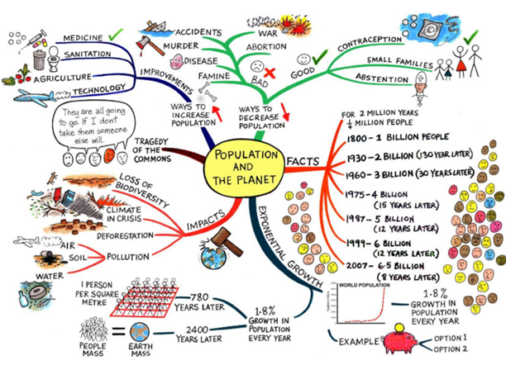
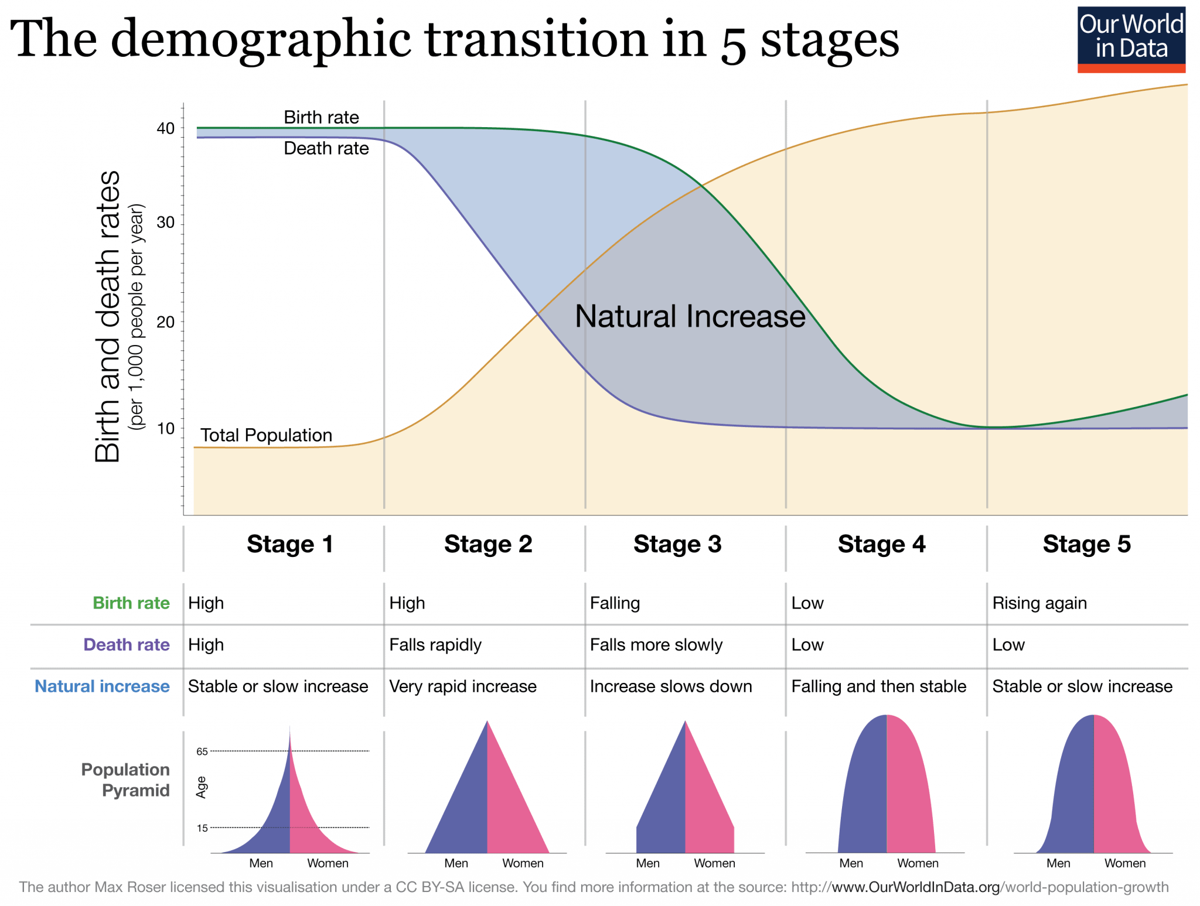
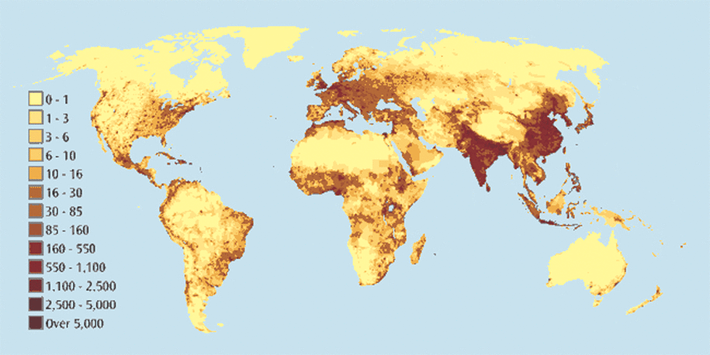
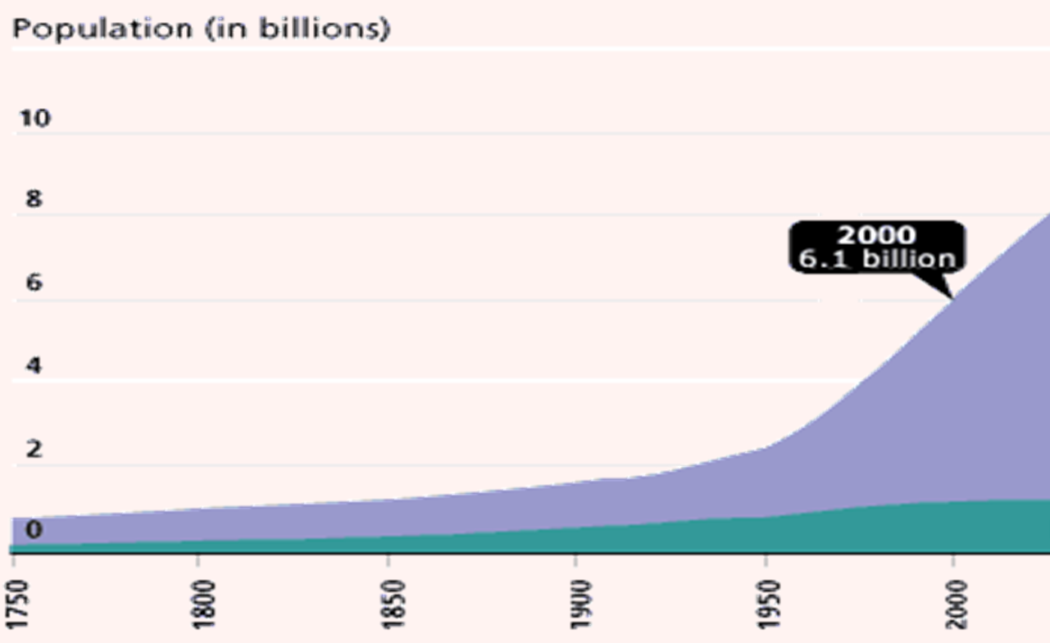
Year 8 Population KO
Population Pyramids
Population structure is the
number of males and females
in different age groups. It’s
often shown as a pyramid with
males and females on each side
and the different ages making
up the different sized layers.
There are two basic population
pyramids shapes:
The World population explosion . The population of the world has grown rapidly since 1950.
Global population Distribution

