Slide 1
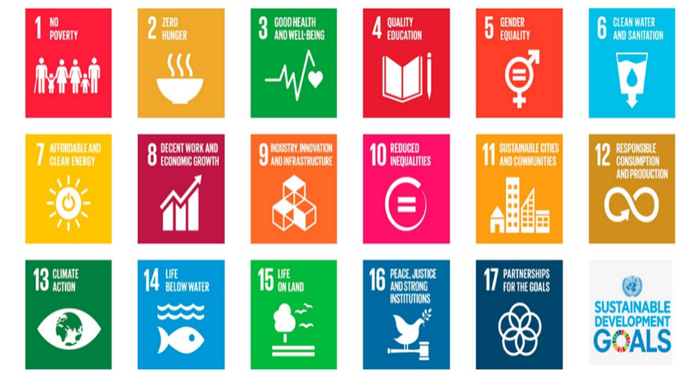
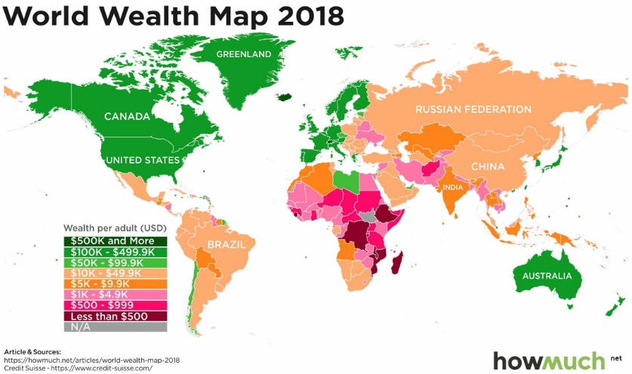
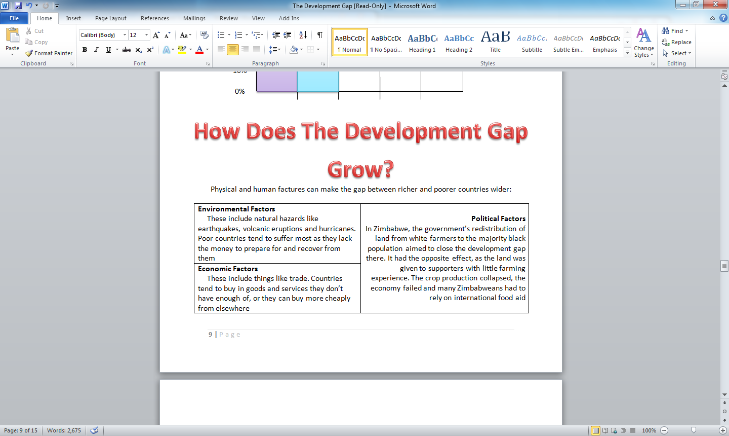
Year 7 Development
Development is any improvement in the standard of living of the people living in a country.
How do we measure development?
By using development indicators.
Economic indicators measure the wealth and industrialisation of a country. An example of a common economic indicator is GNP/capita ($).
Social indicators show how a country uses its wealth to try and improve the quality of life of its people. Social indicators can measure different things like health (doctors /100,000), diet (calories/person/day) and education (% adult literacy).
Developed countries High Income Countries (HIC)
Developing countries Low Income Countries (LIC)
Newly Emerging Economies becoming developed (NEE)
The Development Gap refers to the widening difference in levels of development between the world's richest and poorest countries.
Barriers to Education
Conflict
Early marriage
(as young as 12)
Because they
are girls
Need to work
on farms
Not enough
schools
AIDS and HIV
Cant afford the
school fees
Disability
Lack of school resources

