Slide 1
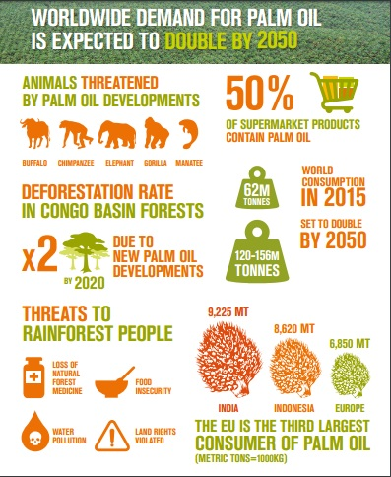
Emergent
Canopy
Understory
Ground/ Undergrowth

