Slide 1

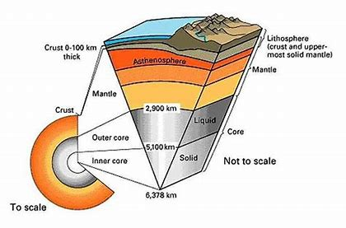
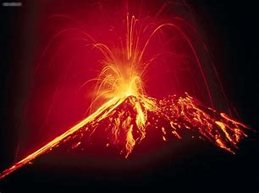
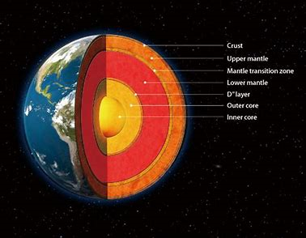
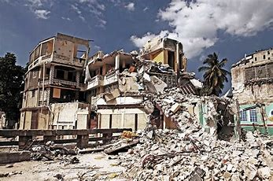
Year 7 Term 2 and 3:The Structure of the Earth
This term we are focusing on how the Earth is structured and the impact that has on the world we live in.
We will learn how the Earth is structured and what the different elements are like. We will also then consider the physical geography of plate tectonics and how they move. This leads on to how humans are affected by volcanoes and earthquakes.
We will also consider the environmental impact of natural disasters
Headings this term
What is the structure of the Earth?
What are Plate Tectonics?
What causes Volcanoes?
What happened at Mountserrat?
Independent Case Study.
What causes Earthquakes?
What happens when an Earthquake occurs?
How can we plan for the future?
What causes a Tsunami?
What happened on December 26th 2004?
Key terms
Earth’s Structure- How the Earth is made up beyond what we see.
Plate Tectonics- Understanding how the Earth’s surface is divided up into sections.
Inner Core- The central part of the Earth; made of solid iron.
Outer Core- Surrounds the inner core of the Earth and has liquid properties.
Mantle- Middle layer of the Earth that is made of rock.
Crust- Outer layer of the Earth and is divided in tectonic plates.
Destructive Plate Boundary A destructive plate boundary is where two plates push against each other causing violent earthquakes, volcanoes and mountain ranges to be formed.
Constructive Plate Boundaries- Two plates move away from each other.
Molten rock (magma) rises from the mantle to fill the gap between the two plates.
Causes volcanoes and earthquakes but also forms mid-ocean ridges that develop into islands.
Conservative Plate Boundary- Two plates slide past each other, without creating or destroying any land. Causes earthquakes, which can be fairly violent and frequent.
Shield volcanoes - gently sloping sides and runny lava that covers a wide area. Gases escape very easily from shield volcanoes.
Composite volcanoes -steep-sided and cone-shaped, made up of layers of ash and lava and containing sticky lava which doesn't flow very far.
Talk like a Geographer
Natural Disaster
Impact
Effect
Dormant
Case Study
Active
Future
Physical
Boundaries
Human
Extinct
Environmental

