Slide 1
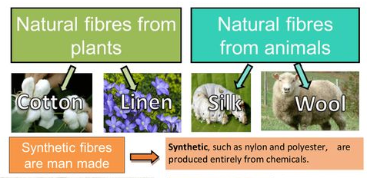
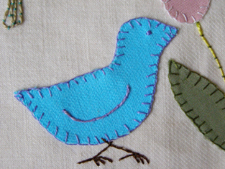
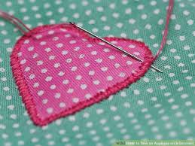
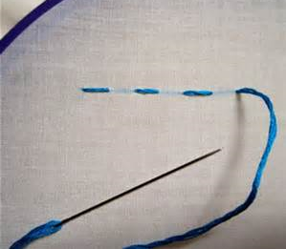
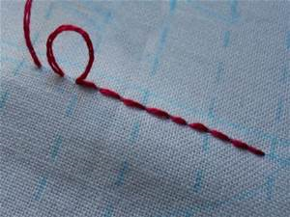
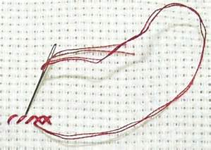
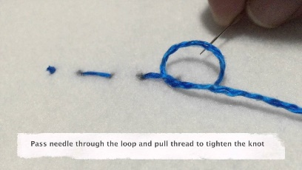
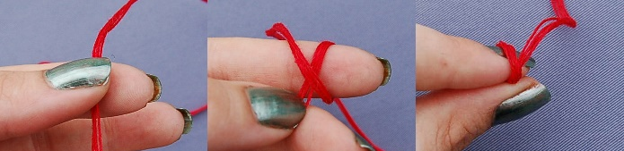
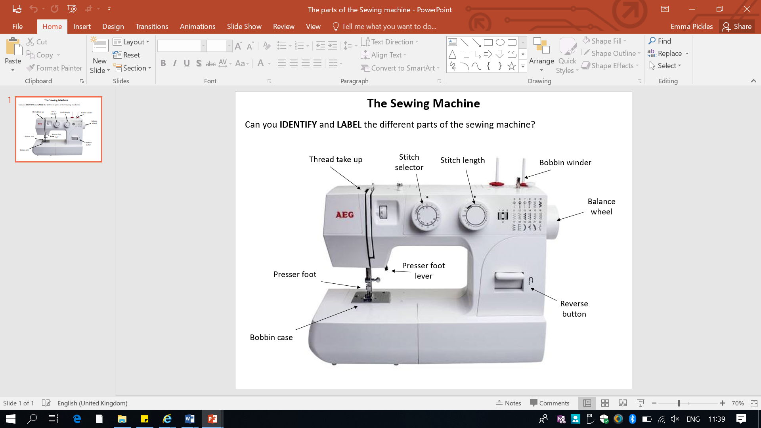
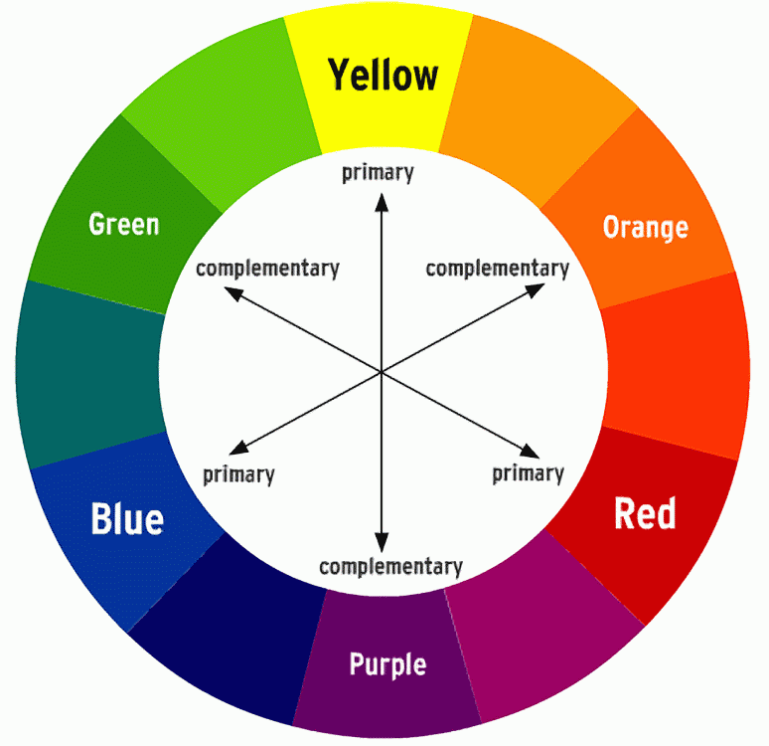
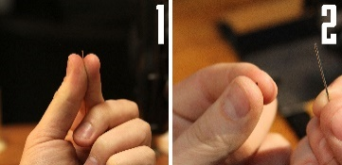

Textiles Knowledge Organiser
Keywords;
Natural
Synthetic
Fibre
Calico
Cotton
Felt
Applique
Hand stitch
Machine stitch
Appliqué
Ornamental needlework in which pieces of fabric are sewn or stuck on to a larger piece to form a picture or pattern.
Types of hand stitch
Tying a knot
Tying off
Running stitch
Back stitch
Cross stitch
Textiles Equipment;
Needle
Thread
Pins
Fabric scissors
Sewing machine
Stitch unpicker
Threading your needle….

