Slide 1
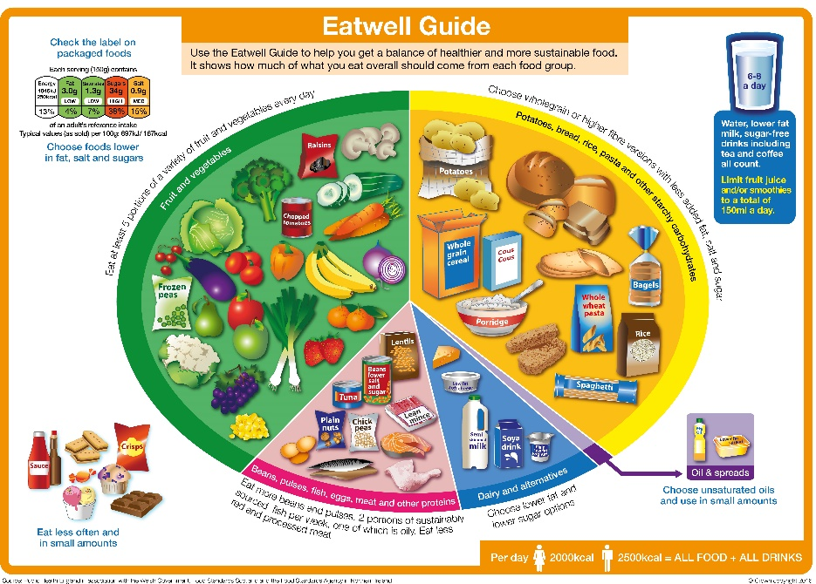
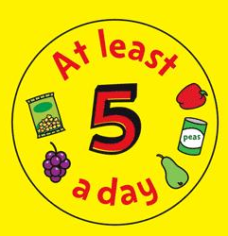
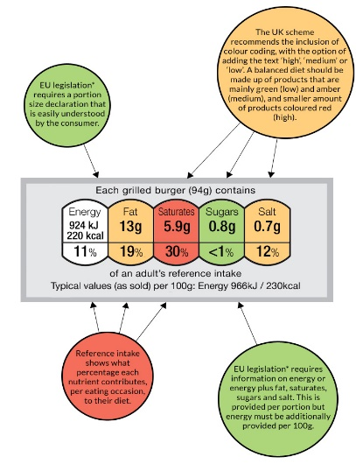
Year 7 Food – Knowledge organiser - Diet and good health
A healthy diet is a balanced diet.
Eat a variety of different foods to provide all of your required nutrients.
Benefits of healthy eating;
Prevents obesity
Prevents illnesses such as CHD and Type 2 diabetes
Increased energy and concentration
Healthy immune system
5-a-day
We should eat 5 or more different fruit and vegetables each day.
Fresh, frozen, juiced and tinned all count.
Choose tinned fruits in juice or water not syrup.
Portion examples;
2 satsumas
Handful of grapes
½ tin of beans
1 apple
7 strawberries
3 tablespoons of peas
8 tips for healthy living;
Base your meals on starchy foods.
Eat lots of fruit and vegetables.
Eat more fish.
Cut down on saturated fats and sugars.
Eat less salt.
Get active and be a healthy weight.
Drink plenty of water.
Don’t skip breakfast.
Food labelling
Labels include information on energy (kJ/kcal), fat, saturates (saturated fat), carbohydrate, sugars, protein and salt.
Weighing and Measuring
Different ages have different nutritional needs
Children – a balanced, varied diet to ensure that they grow and stay healthy.
Adults – should not eat more than they need as they are less active than when they were children.
Pensioners – should limit their food more due to inactivity.
Tsp | Teaspoon
Tbsp. | Tablespoon
Ml | Millilitres
g | Grams
Kg | Kilograms
Oz | Ounces
lb | Pounds

Slide 2
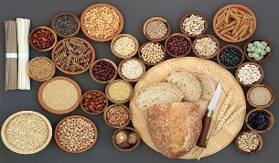
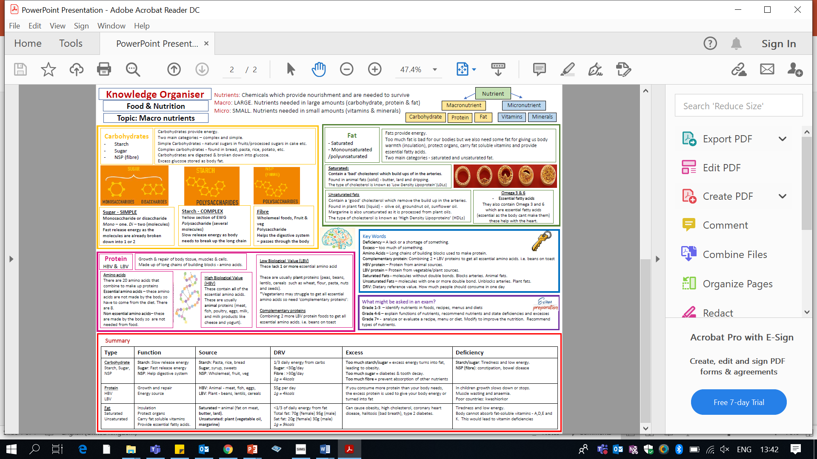
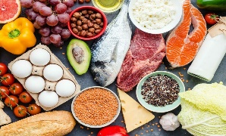
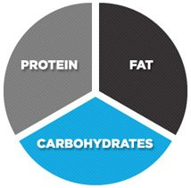
Year 8 Food – Knowledge organiser - Macronutrients
Keywords;
Amino acids – long chain of building blocks used to make protein.
Complementary protein – Combining 2 or more LBV proteins to get all essential amino acids e.g. beans on toast, humus and pitta bread.
HBV – Protein from animals sources.
LBV – protein from plant sources.
Saturated fats – molecules without double bonds. Blocks arteries. Animals fats.
Unsaturated fats – molecules with one or more double bonds. Unblocks arteries. Plant fats.

Slide 3
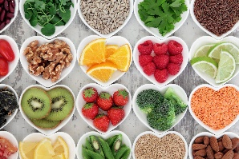

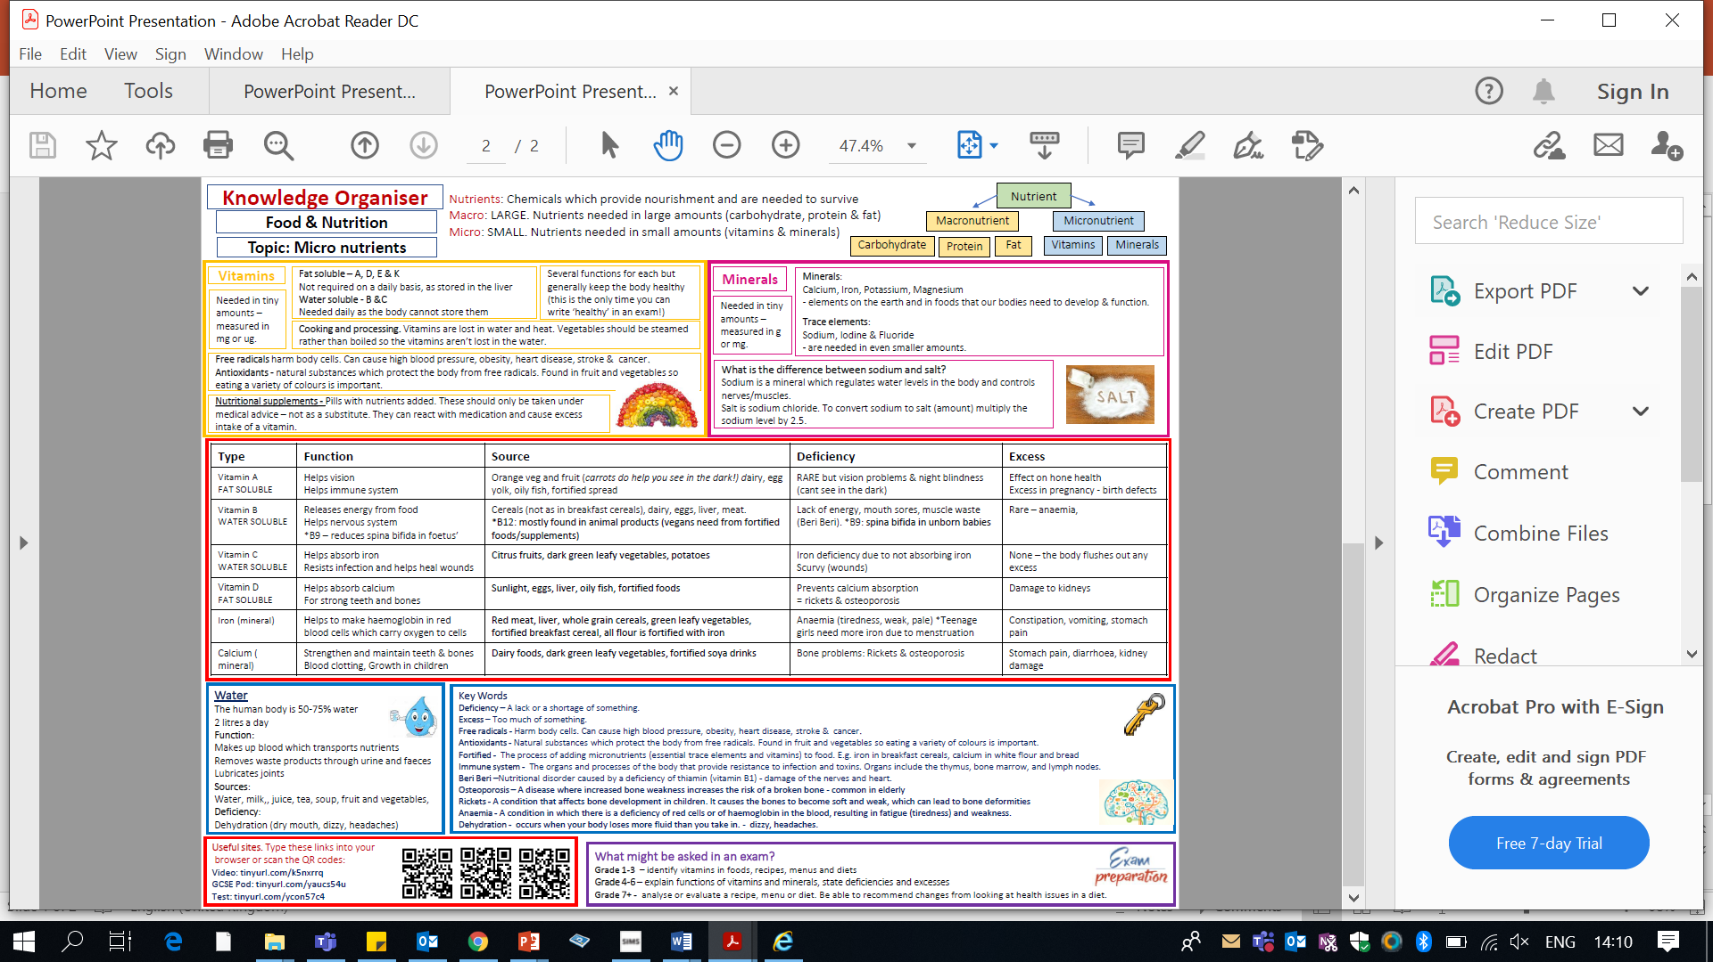
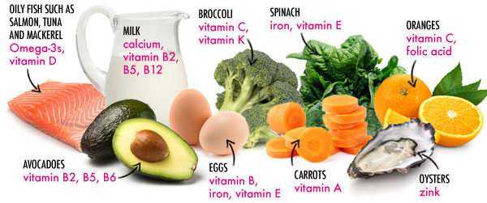
Year 8 Food – Knowledge organiser - Micronutrients
Keywords;
Deficiency – A lack or a shortage of something.
Excess – Too much of something.
Antioxidants – Natural substances which protect the body from free radicals. Found in fruit and vegetables so eating a variety of colours is important.
Free radicals – Harm body cells. Can cause high blood pressure, obesity, strokes, cancer and heart disease.

