Slide 1
RESOURCES REQUIRED
Coloured card
Scissors
Coloured pens (optional)
Students will need subject revision lists/exercise books

Slide 2
HOW TO REVISE FLASH CARDS
TIPS AND TRICKS TO HELP YOU LEARN HOW TO REVISE

Slide 3
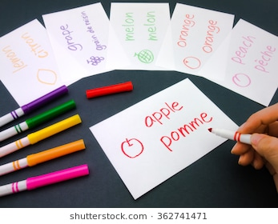
PASSIVE VS ACTIVE
Reading notes and highlighting key information make us FEEL like we’re doing revision BUT it requires very little brain power! We say it is PASSIVE.
In order to remember things long term, we need to DO something more ACTIVE.

Slide 4
EXAMPLES OF ACTIVE REVISION TECHNIQUES
Mind Maps
Flash Cards
Answering Questions and checking your answers
Teaching someone else

Slide 5
THIS LESSON’S FOCUS – FLASH CARDS
How to make them
Step 1 – Pick a topic to revise. Find the Key Words or Key Facts for this topic
Step 2 – Think of colour coding your cards. A different colour for each subject for instance?
Step 3 – On one side of the card write the Key Word, on the other side write the definitions/meanings.
You could also write a question on one side and an answer on the other.

Slide 6
YOUR TURN...
You are going to make a set of Flashcards for
‘Cell biology’
On one side of the card write the part of the topic e.g. animal Cell structure
On the other side of the card write down what ‘c’ means. Include an example if this helps you
Add diagrams or pictures if any come to mind e.g.

Slide 7
Keyword | Example | Description
Carbohydrate | Starch | Needed for energy
2. Protein | Meat, Fish | Growth and repair
3. Lipid | Oils | Store of energy and insulation
4. Enzymes | carbohydrase. | Breaks down large insoluble molecules into smaller soluble molecules.
5. Benedicts | A blue solution | Tests for glucose. Turns brick red if positive.

Slide 8
GREAT EXAMPLES...
The best examples have words and pictures!

Slide 9
WHAT NEXT?
For the rest of this week you will be doing a set of Flash cards in each lesson for a different topic.
Pick the part of the topic you are finding it most difficult to revise for
Find the Revision checklists for those subjects on google classroom or take a paper copy.
Homework – Get a revision folder and complete a set of Flash Cards for the topic we have been working on. I want to see your Revision Folder and will expect to see it bursting with Flash Cards!

Slide 10
Year 8 – Health and Lifestyle
KEY WORDS
1 | Nutrient | Essential substance that your body needs to survive, provided by food.
2 | Carbohydrate | A nutrient that provides energy.
3 | Lipid | A nutrient that provides a store of energy and insulates the body,
4 | Protein | Nutrient used for growth and repair.
5 | Vitamins and minerals | Essential nutrients needed in small amounts for a healthy body.
6 | Fibre | Provides bulk to food which helps to keep it moving through the digestive system.
7 | Starvation | Extreme case of not eating enough food.
8 | Obese | Extremely overweight.
9 | Deficiency | A lack of essential minerals which often leads to health problems.
10 | Digestive system | Group of organs that work together to break down food.
11 | Digestion | Process where large molecules are broken down into small molecules.
12 | Villi | Tiny projections on the wall of the small intestine that increase the surface area for absorption of nutrients.
13 | Catalyst | A substance which speeds up a chemical reaction without being used up itself.
14 | Enzymes | Biological catalysts which can break large molecules down into smaller ones.
15 | Bile | A substance which breaks fat into small droplets.
16 | Drug | Chemical substance which affects the body’s function.
17 | Medicinal drug | A drug that that has a medical benefit to health.
18 | Recreational drug | A drug which is taken for enjoyment.
19 | Ethanol | The drug found in alcoholic drinks.
20 | Depressant | A drug that slows down the bod’s reactions by slowing the nervous system.
21 | Stimulant | A drug that speeds up the body’s reactions by speeding up the nervous system.
22 | Addiction | A need to keep taking a drug in order to feel normal.
23 | Unit of alcohol | Quantity of drink containing the equivalent of 10 ml of pure ethanol.
KEY FACTS
1 | A balanced diet contains the correct quantities of all the nutrients needed to remain healthy.
2 | The seven key nutrients are carbohydrates, lipids, proteins, vitamins, minerals, water and fibre.
3 | Food tests can identify the nutrients in different foods. To prepare a food sample for testing crush the food with a pestle and mortar, add a few drops of distilled water and mix well.
4 | To test for starch add a few drops of orange-yellow iodine solution. The solution will become dark blue-black if starch is present.
5 | To test for sugar add a few drops of blue Benedict’s solution and heat in a water bath. The solution will turn orange-red if sugar is present.
6 | To test for lipids add a few drops of ethanol, shake the test tube and pour the ethanol into a test tube of water. If the solution turns cloudy, the food contains lipids.
7 | To test for protein add a few drops of blue copper sulphate solution followed by a few drops of sodium hydroxide solution. If the solution turns purple, the food contains protein.
8 | Malnourishment can result n health problems resulting from being over or under weight. Being underweight is associated with a poor immune system, lack of energy, tiredness and a lack of vitamins and minerals. Being overweight is associated with heart disease, stroke, diabetes, some cancers.
9 | Different people require different amounts of energy from their diet, depending on age and how active they are.
10 | Enzymes are biological catalysts. Different enzymes break down different nutrient molecules into small molecules which can be absorbed: Carbohydrase – breaks carbohydrates down into sugar molecules. Protease – breaks proteins down into amino acids. Lipase – breaks lipids down into fatty acids and glycerol.
11 | Medicinal drugs may have unwanted side effects as well as medical benefits. Recreational drugs usually have no health benefits and in some cases are harmful. Many recreational drugs are illegal, e.g. cocaine, heroin, cannabis and ecstasy. Some recreational drugs, such as alcohol and tobacco are legal but can still be harmful.

Slide 11
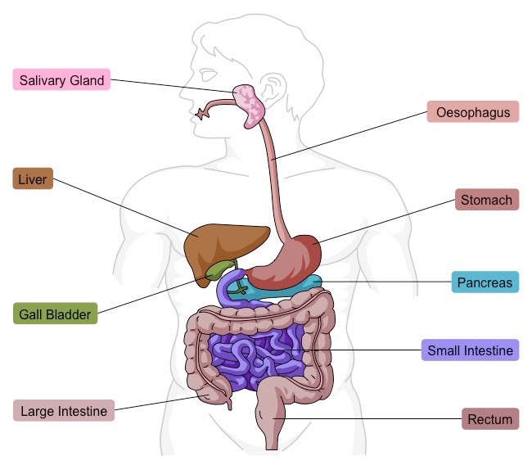
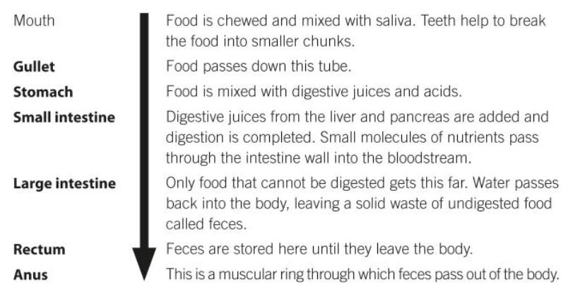
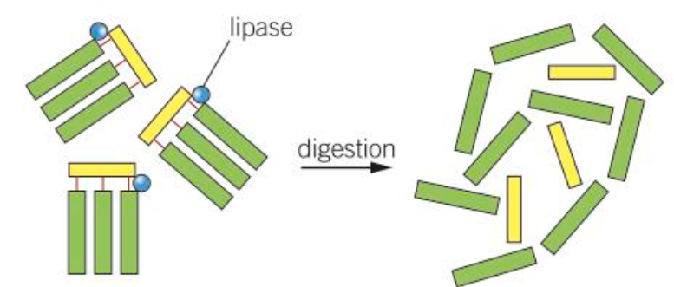
Year 8 – Health and Lifestyle
DIGESTIVE SYSTEM
DIGESTIVE ENZYMES
Carbohydrase breaks carbohydrates down into sugar molecules.
Protease breaks proteins down into amino acid molecules.
Lipase breaks lipids down into glycerol and fatty acid molecules.

Slide 12
HOW TO REVISE FROM FLASH CARDS
Start by reading the definitions/answers and see if you can guess the word/question
If you get them right, put them in a pile on the RIGHT (as in “you got them RIGHT!”)
If you get them wrong, put them in a pile on the LEFT (as in “you still have these LEFT to learn!”)
Go back the pile on the LEFT. Try them again and see if you get them right this time
Extension – start with the word/question and see if you know the definition or answer off by heart!

