Slide 1

How to revise
Mind maps
Tips and tricks to help you learn HOW to revise

Slide 2
Prayer
Dear Lord,
I know you are with me and love me.
Give me peace of mind as I prepare for this time of study.
Help me to focus on my books and notes,
keep me from all distractions so that I will make the best use
of this time that is available to me.
Amen

Slide 3

Notes:
Turn on subtitles if needed

Slide 4




Passive vs Active
Reading notes and highlighting key information make us FEEL like we’re doing revision BUT it requires very little brain power! We say it is PASSIVE.
In order to remember things long term, we need to DO something more ACTIVE.

Slide 5
Examples of Active Revision Techniques
Mind Maps
Flash Cards
Answering Questions and checking your answers
Teaching someone else

Slide 6
This week’s focus – Mind Maps
Step 1 – Pick a topic to revise. Write the topic title in the centre of your page
Step 2 – The main ideas that make up the topic should be represented by thick branches that spread out. Think of these as headings
Step 3 – Create smaller sub-branches which extend out from every branch. Think of these as sub-headings.
Step 4 – At the end of each branch, write out one key word or concept. This will make it easier to remember key concepts during revision.
Step 5 – Find images or draw pictures which illustrate your ideas and pop them onto key areas in your diagram.
Step 6 – Try to find connections between the different branches. If you can find links this is a higher level thinking skill and will help you with more complex questions

Slide 7
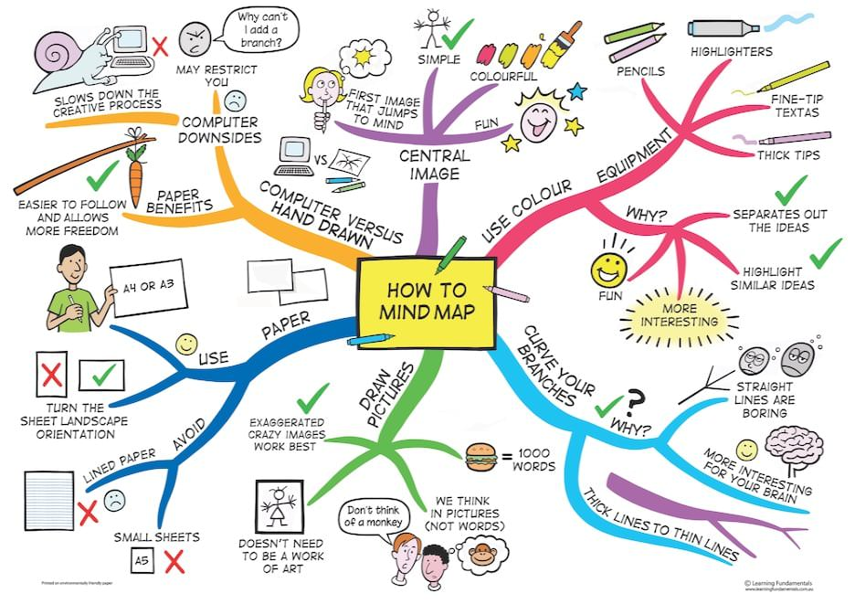

Slide 8

Your turn...
Make a really quick mind map for the subjects
you study (5 mins)
Start with Subject’s at the centre
Do large branches for the main headings e.g. Maths, English, PE, RE, etc
Then think about what you would put on the smaller branches – Teachers? Topics you have learnt?
Can you link any branches?

Slide 9
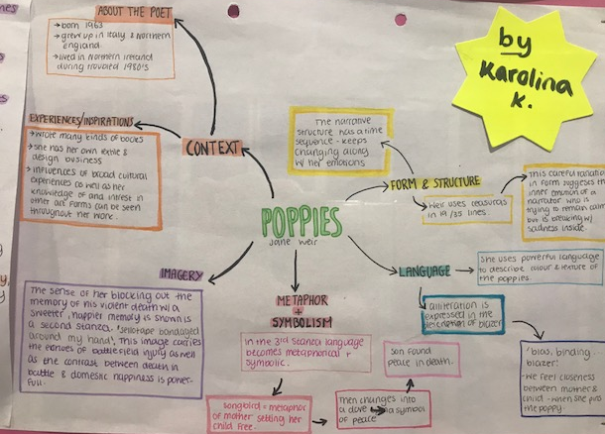
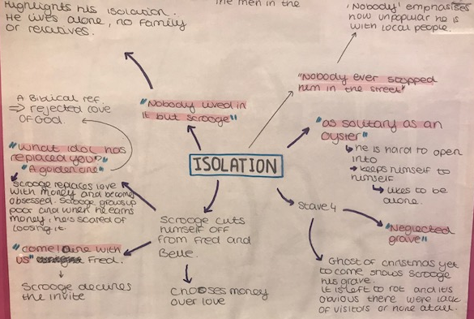
Great Examples...

Slide 10
What next?
For the rest of this week you will be doing 2 mind maps in each review session
Pick the subjects you are finding it most difficult to revise for
Find the Revision Lists for those subjects on My Learning
Homework – complete a Mind Map for each of your subjects and place them in your Revision Folder. Your review tutor will ask to see your Revision Folder and will expect to see it bursting with Mind Maps!

Slide 11

How to revise from a mind map
Read IT
Cover IT
Rewrite IT
How much can you do from MEMORY? This will tell you how much you actually remember
If you don’t remember very much, you will need to do this again in a few days

