Slide 1
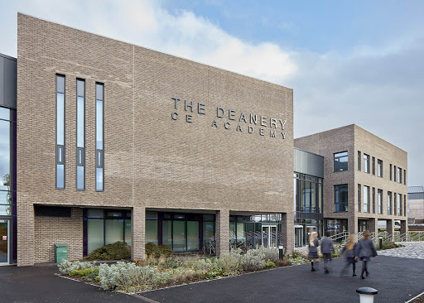
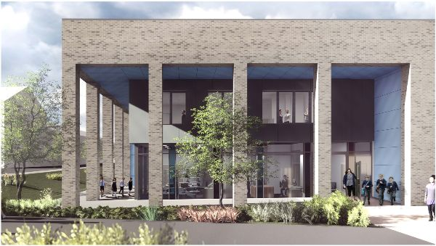
The options process
2024
Mr McDonald – Deputy Headteacher

Slide 2

Options 2024

Slide 3
Timeline
29th January 2024 – Options assemblies.
8th February 2024 – Options evening.
9th February to 8th March – Careers and post 16 appointments
9th February 2024 – Options form shared with pupils.
22nd February 2024 – Year 9 parents evening.
8th March 2024 – Deadline for the options form to be completed.
Term 5 – Options confirmed with pupils.
September 1st 2024 – Students start their KS4 timetables.
September 30th 2024 – Final day for any options changes.
Notes:
Good evening and welcome to our first Options Evening!
It is wonderful to see everyone together again and we are all so delighted to be able to present to you in person, about such an important stage within your child’s education.
Over the past few months, there have been a number of changes and developments across the campus. One of these developments, is our new vision of ‘Discovering and Learning together, so all can Flourish’, which holds so much relevance to tonight’s presentation. Over the past few months, you will have been aware of a number of new staff joining the academy, and I am very proud to have a number of them stand beside me tonight and for them to share their passion, expertise and commitment to enabling your child to flourish.
The options process is exciting, but also can be a bit daunting with a number of questions about the process. I hope that this evening is the starting point of addressing any of these questions and providing you the necessary support to help make the right choices for your child. We believe that every child is unique and has a unique set of skills and attributes, and our goal is to nurture them in order for them to flourish. We want to see every child leave The Deanery, with the necessary skills and knowledge to be successful in life and live life to its full. Tonight is not about your child making a commitment, but instead help us to plan. As you know know, we have started our recruitment early, with the intention of securing the best teachers and expanding our offer. I do not want to make any promises to you our your children, and instead want to live by our vision our doing what ever we can to enable your child to flourish.
As supporters of The Deanery, we appreciate everything you have done to support your child and the academy since we opened in 2019. When you opted for the Deanery, you chose an academy that was committed to getting to know your child and treating them with Christian values that we live by. We wish to continue to build on this work and over the last few months we have begun to develop strong links with other secondary schools, both in the local area and wider a field. These links will enable us to ensure that the provision we offer here at The Deanery continues to be of high quality and enable doors of opportunity to be opened.
Tonight is only one step in the options process and there are commitments to be made. Children and family members will have questions and our intention is to provide further support, via tutor sessions and 1-2-1 meetings. The team is here to support you all.
We want to see every one of you flourish and be proud of everything you achieve here at The Deanery.
Let me finish by saying a short prayer, before passing on to Miss Duncan and the rest of the team
Dear God, I know that You can open doors that no man can ever shut. It’s not always easy for me to see and sense the direction I need to take. And so today, I trust and ask You to lead me to open doors of opportunity that you have prepared for me. Help me make sense of the options that lay before me and help me see and make the right choices today. Amen.

Slide 4
The core curriculum
Subject | English | Maths | Science | RS | PE | ViP
Qualifications | 2 GCSEs | 1 GCSE | 2-3 GCSEs | 1 GCSE | Not accredited | Not accredited
Notes:
Who is studying which science is a decision for the science team and is not part of the options process.
You will need to resit GCSE English and Maths at college if you do not achieve a grade 4 in Year 11.
Discovering and Learning Together, so all can Flourish
“A tree is planted by streams of water, which yields its fruits in season”
Wisdom – Hope – Service – Resilience
Notes:
All learners follow the core curriculum until the end of year 11. These courses and the qualifications which they lead to are shown in the table below. The core curriculum alone gives students the opportunity to achieve up to seven GCSEs.

Slide 5
The English Baccalaureate (Ebacc)
The English Baccalaureate (Ebacc) is a group of qualifications; English, Maths, the Sciences, Geography or History, and a language.
The Ebacc is made up of subjects that are seen as essential to many degrees and opens up a lot of doors.
The Government has a target of 90% of students entering the Ebacc.
The school will recommend some students towards taking the full Ebacc.
Discovering and Learning Together, so all can Flourish
“A tree is planted by streams of water, which yields its fruits in season”
Wisdom – Hope – Service – Resilience
Notes:
The English Baccalaureate (EBacc) is a performance measure in school league tables introduced in 2010. It recognises those learners who achieve a GCSE grade 9-5 or equivalent in English, maths, two sciences (which may include computing GCSE), a modern or ancient foreign language and either geography or history.
The EBacc is not a qualification in itself and is not certificated for learners achieving the EBacc combination of subjects. While the EBacc includes academic subjects highly valued by universities, it is not required for entry to any Russell Group university (though a small number expect a language GCSE for any degree course). The purpose of the EBacc, as stated by the government, is to encourage learners to achieve a broad set of academic GCSEs.
At the Deanery we know that for many, choosing EBacc subjects is a very sensible route at key stage 4. However for other learners a different combination of subjects may be better suited to their strengths and interests and the requirements of their post-16 route.

Slide 6
The options curriculum
You will need to make four choices.
Choice 1 | Choice 2 and 3
Geography | Art – Fine art | History
History | Alternative curriculum | Music
Spanish | Drama | Photography
 | Hospitality and Catering | PE
 | Geography | Spanish
 | Health and Social Care | Sport Studies
 |  | Art - Textiles
You will also need to make a reserve choice – think carefully about it.
Students cannot take both Fine Art and Textiles
PE and sport studies will be recorded as the same option
Discovering and Learning Together, so all can Flourish
“A tree is planted by streams of water, which yields its fruits in season”
Wisdom – Hope – Service – Resilience

Slide 7
Making the right choice of courses at key stage 4 is important because it may affect progression after year 11 and possibly future career opportunities, as well as enjoyment of years 10 and 11.
What am I good at and what courses will I succeed in?
What am I interested in and what do I enjoy?
What type of learner am I?
What qualifications do I need for my next step after year 11 and beyond?
Discovering and Learning Together, so all can Flourish
“A tree is planted by streams of water, which yields its fruits in season”
Wisdom – Hope – Service – Resilience
Notes:
Recent reports and scores in assessments will help you to identify your areas of strength. If you are unsure about your ability to succeed in a particular course, you should ask your subject teacher.
It is important to make sure you choose a course because you find the subject interesting rather than solely because you like the teacher or the group of friends in your current year 9 class. It’s good to be aware that you may not have the same teacher or classmates in a particular subject next year.
All courses are designed to have a variety of activities that appeal to learners with different learning preferences, although some courses may be particularly well suited to certain types of learner. Therefore, you should aim to choose a combination of subjects that contain at least one or two courses that match your learning preferences. This might include more vocational courses, more practical courses or courses with more written content, for example.
One of the most important outcomes of key stage 4 is that learners achieve the qualifications they need for progression to their desired next step after year 11 and their long term aspirations. If you are clear about what career you may wish to pursue you should seek advice about relevant courses. At this stage you may not know exactly what career you want to pursue and should not be overly concerned if you are unsure about what you want to do after year 11, so long as you follow the advice of choosing a balanced curriculum to help keep your post-16 options open.

Slide 8
What is NOT important
How easy a subject is.
Whether your friends are doing the subject.
Which teacher is teaching the subject.
Discovering and Learning Together, so all can Flourish
“A tree is planted by streams of water, which yields its fruits in season”
Wisdom – Hope – Service – Resilience

Slide 9
The options curriculum
You MUST select a reserve subject:
Some courses will be oversubscribed.
Some courses will not have enough students to run.
Some options choices won't work with the school timetable.
Discovering and Learning Together, so all can Flourish
“A tree is planted by streams of water, which yields its fruits in season”
Wisdom – Hope – Service – Resilience

Slide 10
Where to find advice
Where to find advice | Area of advice
Tutor | Overview of a learner’s strengths Knowledge of the options process Careers advice
Head of Faculty/Subject teachers | Further information about a particular course Learner’s likely outcome from a course
Mr Dan (SENDCo) | Advice for learners with SEND
Mr McDonald | Options process Questions about school options policy
College and university websites. | Entry requirements for post-16 courses.
Mr Ouldridge | Careers advice and post-16 choices
Students in Year 10. | What is it really like to be studying the subjects.
The Options Booklet. | The courses on offer, exam boards, content etc.

Slide 11
The Options Form
The Options Form will be electronic. Students will need to be logged into their Office 365 account before they can access it.
The Options Form will be emailed out to all students on Friday 9th February.
There is NO first come first served; take your time. All Options requests will be considered equally at the deadline of 8th March.
Discovering and Learning Together, so all can Flourish
“A tree is planted by streams of water, which yields its fruits in season”
Wisdom – Hope – Service – Resilience

Slide 12
Timeline - reminder
29th January 2024 – Options assemblies.​
8th February 2024 – Options evening.​
9th February to 8th March – Careers and post 16 appointments​
9th February 2024 – Options form shared with pupils.​
22nd February 2024 – Year 9 parents evening.​
8th March 2024 – Deadline for the options form to be completed.​
Term 5 – Options confirmed with pupils.​
September 1st 2024 – Students start their KS4 timetables.​
September 30th 2024 – Final day for any options changes.
Discovering and Learning Together, so all can Flourish
“A tree is planted by streams of water, which yields its fruits in season”
Wisdom – Hope – Service – Resilience
Notes:
Good evening and welcome to our first Options Evening!
It is wonderful to see everyone together again and we are all so delighted to be able to present to you in person, about such an important stage within your child’s education.
Over the past few months, there have been a number of changes and developments across the campus. One of these developments, is our new vision of ‘Discovering and Learning together, so all can Flourish’, which holds so much relevance to tonight’s presentation. Over the past few months, you will have been aware of a number of new staff joining the academy, and I am very proud to have a number of them stand beside me tonight and for them to share their passion, expertise and commitment to enabling your child to flourish.
The options process is exciting, but also can be a bit daunting with a number of questions about the process. I hope that this evening is the starting point of addressing any of these questions and providing you the necessary support to help make the right choices for your child. We believe that every child is unique and has a unique set of skills and attributes, and our goal is to nurture them in order for them to flourish. We want to see every child leave The Deanery, with the necessary skills and knowledge to be successful in life and live life to its full. Tonight is not about your child making a commitment, but instead help us to plan. As you know know, we have started our recruitment early, with the intention of securing the best teachers and expanding our offer. I do not want to make any promises to you our your children, and instead want to live by our vision our doing what ever we can to enable your child to flourish.
As supporters of The Deanery, we appreciate everything you have done to support your child and the academy since we opened in 2019. When you opted for the Deanery, you chose an academy that was committed to getting to know your child and treating them with Christian values that we live by. We wish to continue to build on this work and over the last few months we have begun to develop strong links with other secondary schools, both in the local area and wider a field. These links will enable us to ensure that the provision we offer here at The Deanery continues to be of high quality and enable doors of opportunity to be opened.
Tonight is only one step in the options process and there are commitments to be made. Children and family members will have questions and our intention is to provide further support, via tutor sessions and 1-2-1 meetings. The team is here to support you all.
We want to see every one of you flourish and be proud of everything you achieve here at The Deanery.
Let me finish by saying a short prayer, before passing on to Miss Duncan and the rest of the team
Dear God, I know that You can open doors that no man can ever shut. It’s not always easy for me to see and sense the direction I need to take. And so today, I trust and ask You to lead me to open doors of opportunity that you have prepared for me. Help me make sense of the options that lay before me and help me see and make the right choices today. Amen.

Slide 13
