Slide 1
Welcome to
The Deanery CE Academy
Year 7 2025

Slide 2
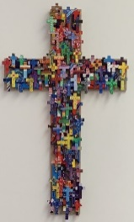


“This is the day the Lord has made…”
We say together:
“…Let us rejoice and be glad in it!”
Psalm 118:24
Notes:
Teacher to light the tutor worship candle and say “This is the day the Lord has made…”, to which students respond “Let us rejoice and be glad in it”
This is our invite to all to join together and be welcomed into our worship this morning

Slide 3


Thinking ahead
Friendship choices
Fresh start?
What are you looking forward to about secondary school?
Set yourself one goal that you can achieve by the end of the first term and one goal to achieve by the end of Year 7. Think SMART.
Notes:
Introduce yourself and get them all to introduce themselves. Discuss their summer. Get them to write down two goals.

Slide 4
Behaviour expectations
To aim to improve.
To work and co-operate with all staff.
To come correctly equipped for all lessons.
To complete homework and hand it in on time.
To attend all lessons on time.
To talk to staff about problems and difficulties.
To respect all people and not physically or verbally abuse them.
To support fellow pupils by not accepting and reporting the abuse or bullying of others.
To respect all School property and property of any other pupil.
To attend School dressed in accordance with the School dress code.
Adopt the ethos of Deanery Proud

Slide 5
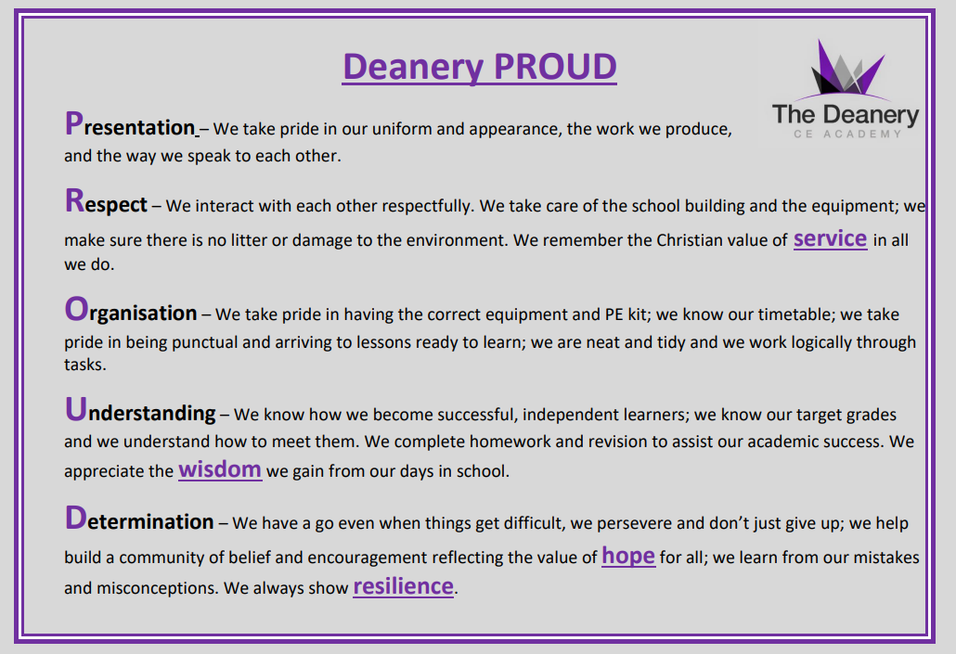

Slide 6
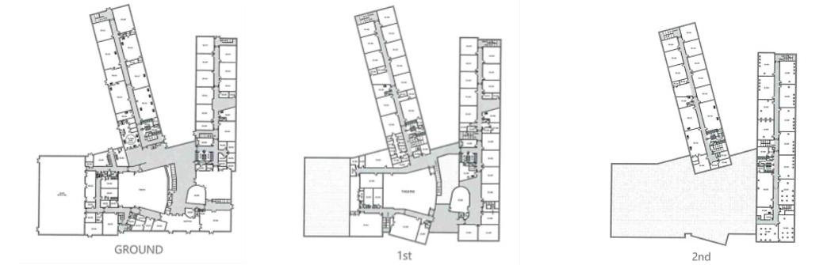
Moving around the school
Calm and purposeful movement around the school.
Be respectful of other people.
Walk on the left

Slide 7
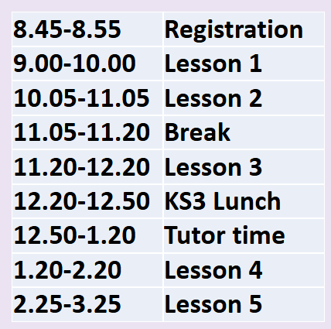
Shape of the day

Slide 8

Assembly
Go to tutor bases and register quickly.
Enter the hall in silence.
Sit in your tutor group in alphabetical order .
Sit in silence and actively listen.
Give a round of applause to guest speakers.
Leave the hall in silence.

Slide 9
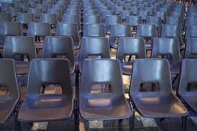
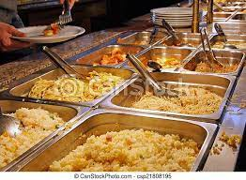
Queuing in the canteen:
Sit on a chair, calmly and sensibly
Move along when asked
No pushing in
For the transition days you need to have a packed lunch with you. In September you will have log ins for parent pay and do your fingerprint for the canteen.

Slide 10
Social times
Toilets – During social times your toilets will be downstairs in the DT corridor and the Maths corridor
Eating food – you can eat in the agora, the cornerstone, Kingfisher view and outside.
Please make sure you use the bins around you to tidy up after yourselves.
Break times – the whole school will be out together.
Lunch times will be Yr7 – 9 and Yr10 – 11.
No mobile phones

Slide 11

Where to get help
If you are worried about a lesson – talk to your class teacher.
Day to day issues – see your tutor, Mrs Coe (AHOY) or Mr Cameron-Larelle (HOY)
Safeguarding worries – Ms Luckman, Mrs Matthews, Ms Parry, Mrs Woodfield, Mrs Buckley or Mr McDonald.
This week you can also get help from our Peer mentors

Slide 12
Teaching and Learning at the Deanery
Mr McDonald
Understand what a lesson at the Deanery looks like.
Recognise techniques and language to support you in all your lessons.

Slide 13
Why?
Creating a Safe Space: Having routines, rules, and clear expectations helps make classrooms feel safe and comfortable. When students know what to do and what to expect, they can focus on learning instead of worrying about what's going to happen next.
Consistent Routines: Doing the same things in different classrooms, like how to get everyone's attention or start a discussion, helps students learn these routines quickly. This also makes it easier for new teachers to manage their classes.
Freeing Up Brain Power: When routines and expectations become second nature, students can use their brain power to concentrate on the lesson instead of figuring out what they should be doing.
Understand what a lesson at the Deanery looks like.
Recognise techniques and language to support you in all your lessons.

Slide 14
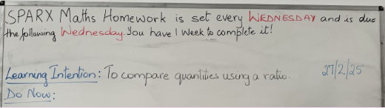
At the start of each lesson your teacher will:
Greet you at the Threshold and welcome you into the classroom.
Do Now will be ready for you to start straight away.
Check you remember what you have already learnt through Retrieval Practice.
Share the Learning Intentions with you.
Understand what a lesson at the Deanery looks like.
Recognise techniques and language to support you in all your lessons.

Slide 15
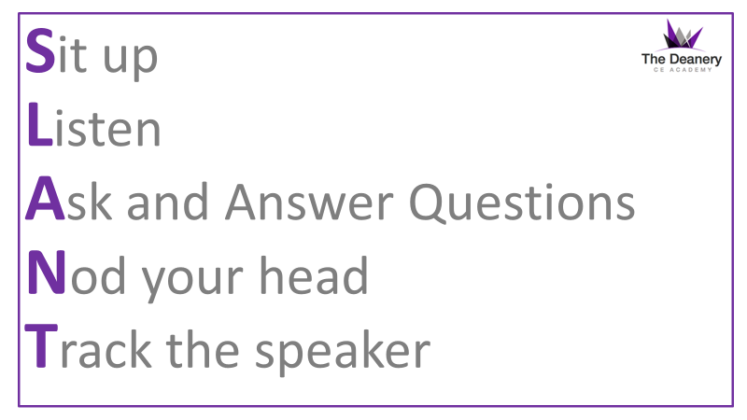
Understand what a lesson at the Deanery looks like.
Recognise techniques and language to support you in all your lessons.

Slide 16
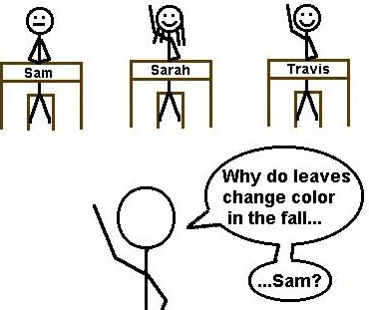

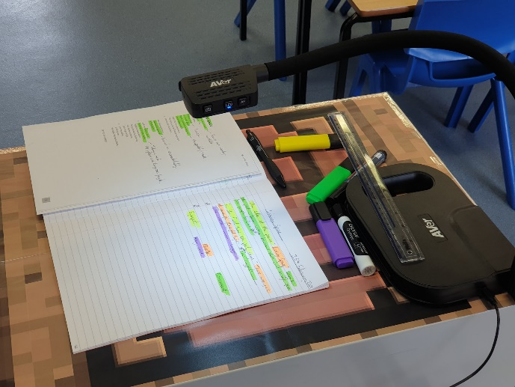
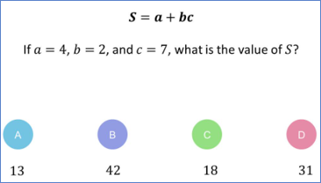

During each lesson your teacher will use:
Cold call
Mini-whiteboards
Show call
Silent Solo
Understand what a lesson at the Deanery looks like.
Recognise techniques and language to support you in all your lessons.

Slide 17
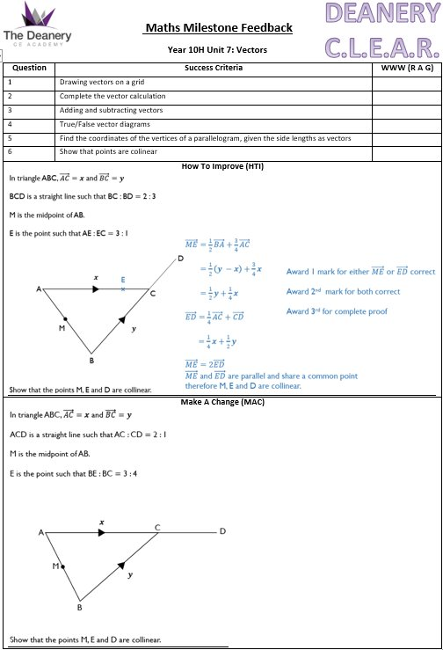
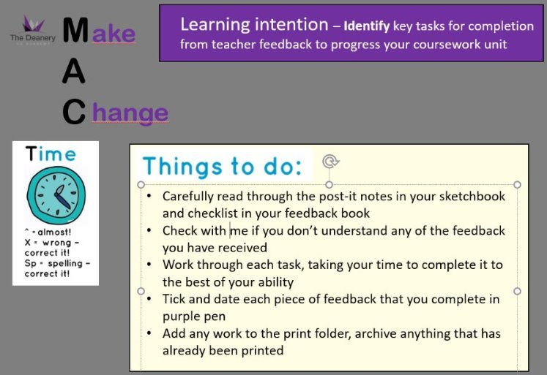
Your teacher will give you Feedback:
Assessments or certain pieces of work will be marked with …
  WWW – What Went Well
  HTI – How To Improve
  MAC – Make A Change
    Purple pen
Understand what a lesson at the Deanery looks like.
Recognise techniques and language to support you in all your lessons.

Slide 18
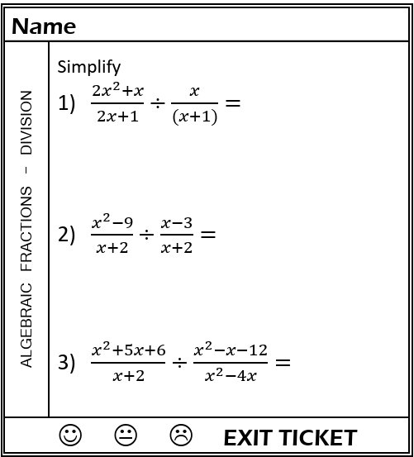
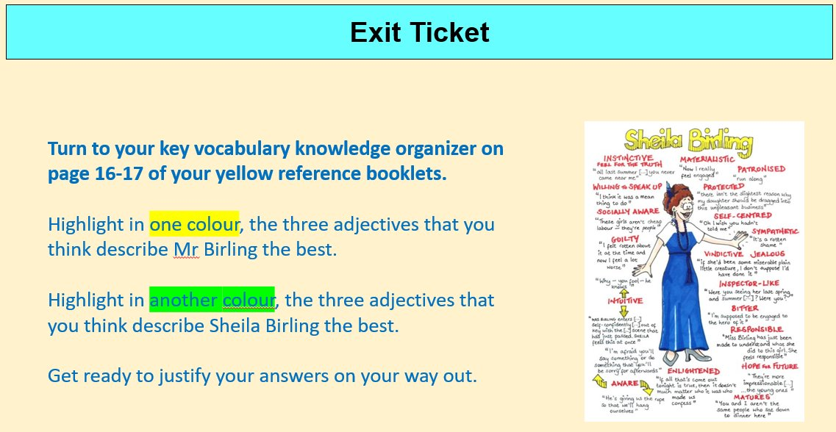
At the end of each lesson your teacher will:
Check what you have learnt through an Exit Ticket.
Understand what a lesson at the Deanery looks like.
Recognise techniques and language to support you in all your lessons.

Slide 19
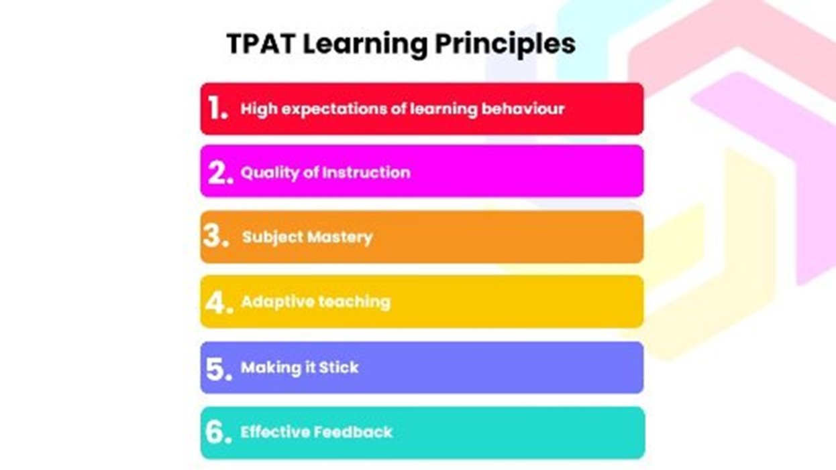
Understand what a lesson at the Deanery looks like.
Recognise techniques and language to support you in all your lessons.

Slide 20

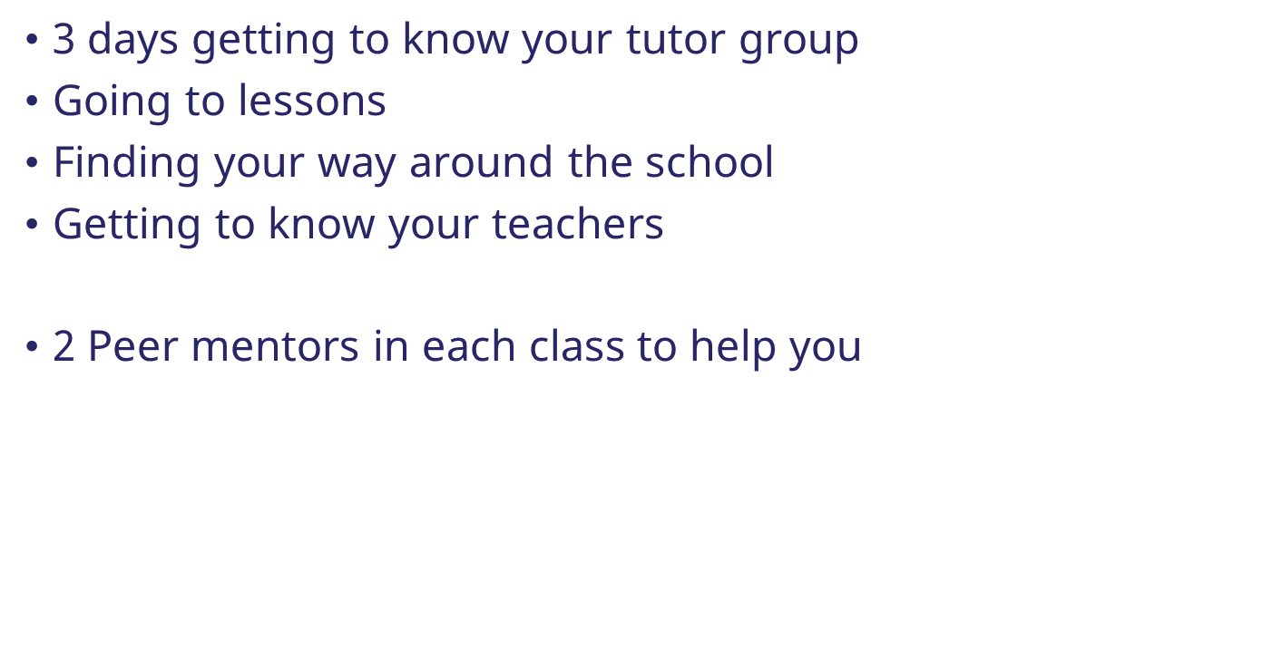

Slide 21
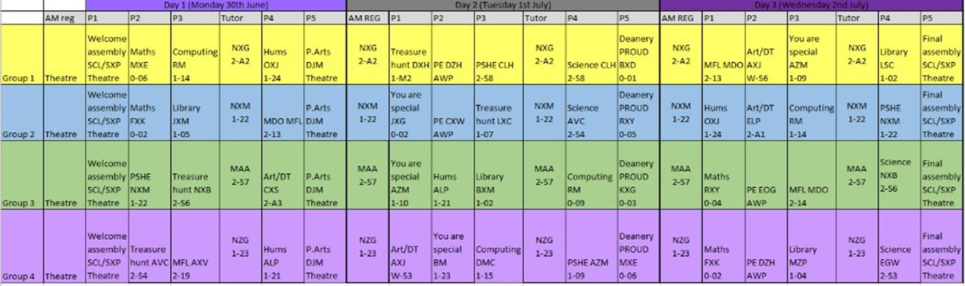
Transition days
The groups you are in for these 3 days are not your tutor groups. These will be shared with you in September.
The groups you are in reflect the houses you will be in.
You will have a PE lesson either tomorrow or Wednesday. On that day you should come to school in your school PE kit.

Slide 22
A moment of reflection
Dear God,
Thank You for being with us today as we begin this new journey.
We may feel excited, nervous, or unsure,
But we trust that You are walking beside us.
Help us to be brave, kind, and open to new friendships.
Give us confidence as we explore new places and meet new teachers.
Guide us to make good choices, to be respectful, and to always try our best.
Bless our families, friends, and all those who support us.
And help us remember that, wherever we go, You are always with us.
Amen.

Slide 23


“Therefore go and make disciples of all nations, baptising them in the name of the Father and of the Son and of the Holy Spirit, ²⁰ and teaching them to obey everything I have commanded you. And surely I am with you always, to the very end of the age.”
Matthew 28:19-20
“Go in peace to love and serve the Lord”
We say together:
“Amen”
Notes:
Teacher to say “Go in peace to love and serve the Lord”, to which students respond “Amen”
This is our ‘sending out’. Students are sent out into the world to put their faith into action, based on the great commission in the gospel of Matthew
Blow out the tutor candle to signal the end of our worship today

